Slide 1
Material for Meeting
7th January 2019
Special Edition

Slide 2
Summary
Housekeeping
New data
Improving efficiency
Accuracy
Uncertainty
Collaboration
Questions for RAL
Future directions

Slide 3
1. Housekeeping
We’ve made our standardised our code to PEP8 and commented it for tomorrows visit.
We are free next term:
Monday morning (except 10 to 11)
Tuesday between 2 and 5pm
Wednesday (all day except 11 to 12 pm)
Thursday after 2pm
Friday morning

Slide 4
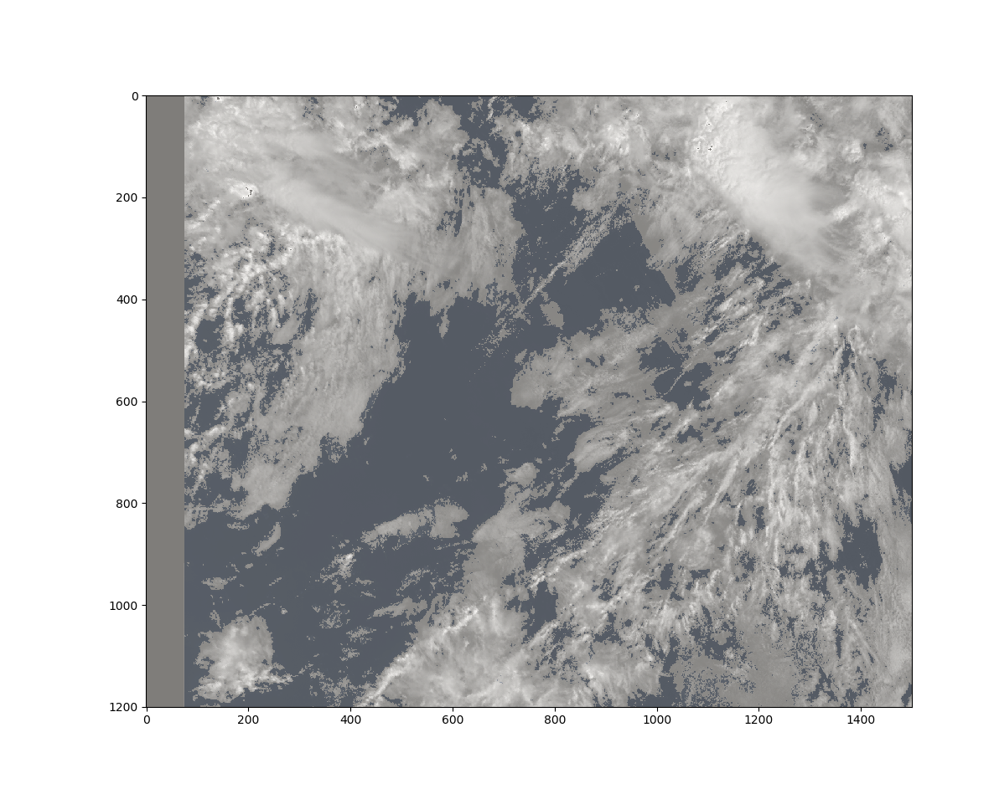
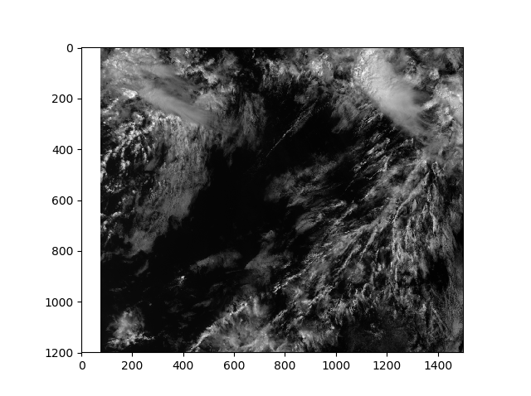
Example plot
Left: Generated mask
Right: S1_an channel data

Slide 5
2. New data
Improved data collection by using interpolation between adjacent agreeing CALIOP measurements
Improved CALIOP 2018 data with surface data
https://docs.google.com/spreadsheets/d/1W3gyqzpbKeNRWvtOrYsDbg2UzzVLfw-t74esUQ_12GU/edit#gid=0
Data for > 2.2 million pixels from Jan18 to Aug18 for CALIOP matches
Data for ~ 42,000 pixels for CATS matches from Aug17
Unable to gather more SLSTR data from 2017
See error on Jul18

Slide 6
3. Improving efficiency

Slide 7
4. Accuracy
Hyperparameters
Model accuracy testing, testing as a function of times slices, satellite zenith angle and surface type.
=> Highlights the need to generate an uncertainty on for the model results

Slide 9
5. Uncertainty
We can use ensembles to estimate the uncertainty of our model. Following the paper from Lakshminarayanan et al. (Deep Mind):
Gaussian approximation, mean and variance are taken as value and error respectively
Overcomes the challenge of assigning larger uncertainty for unseen data
Easy to implement (as opposed to creating a Bayesian neural network)

Slide 10
6. Collaboration
We will now be working with Dan and Barney once a week (on Wednesdays at 11am)

Slide 11
7. Questions for RAL
How can we get the 2017 data for SLSTR (currently on remote tape drives)?
What is the difference between ‘confidence_an’ and ‘confidence_in’?
What is the best way to test hyperparameters for the neural network?
What is the best way to generate uncertainty?

Slide 12
8. Future directions
Match and download the rest of the CATS data
Create adversarial data
Create ensemble of neural networks
Train networks using different proper scoring functions

