Slide 1
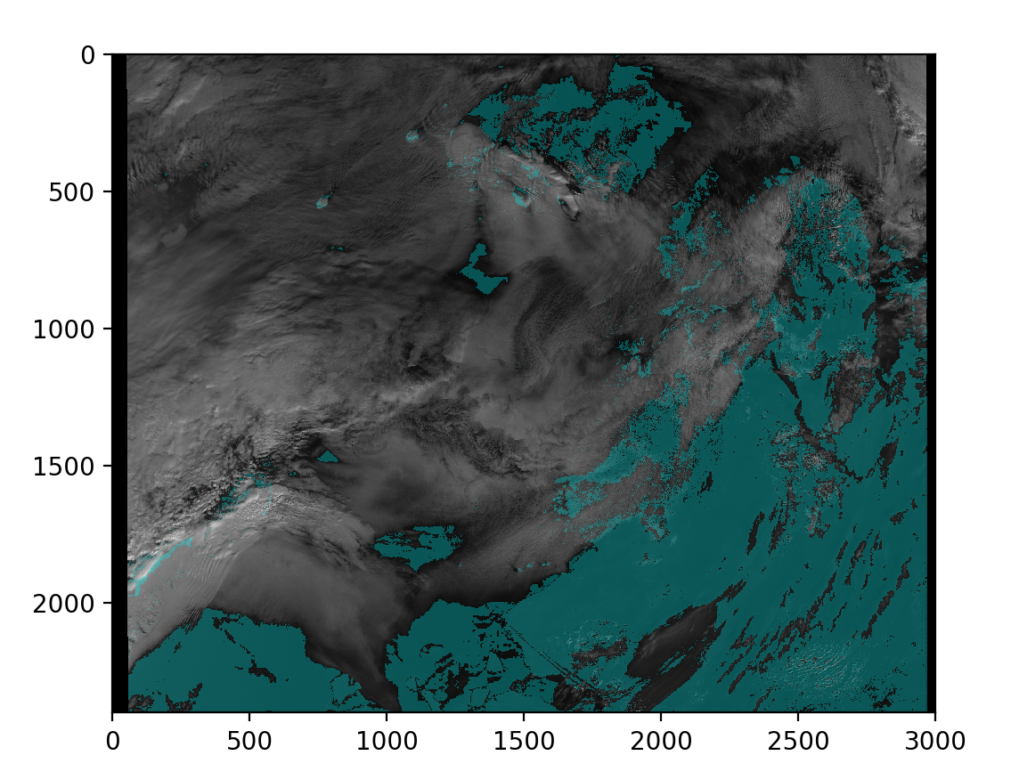
Material for Meeting
7th January 2019
Special Edition

Slide 2
Summary
Housekeeping
New data
Improving efficiency
Accuracy
Uncertainty
Collaboration
Questions for RAL
Future directions

Slide 3
1. Housekeeping
We’ve made our standardised our code to PEP8 and commented it for tomorrows visit.
We are free next term:
Monday morning
Tuesday between 2 and 5pm
Wednesday (all day except 11 to 12 pm)
Thursday after 2pm
Friday morning
The NN model and datasets can now be saved and loaded.

Slide 4
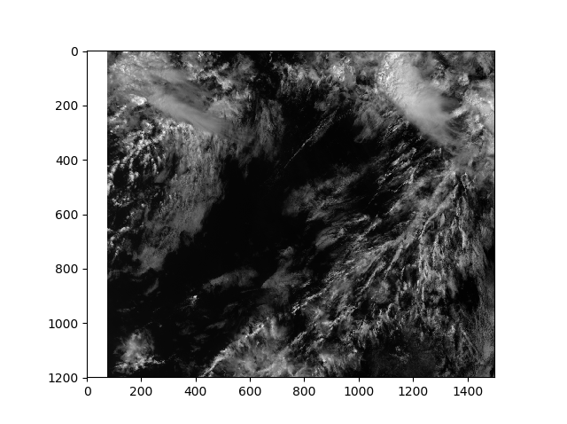
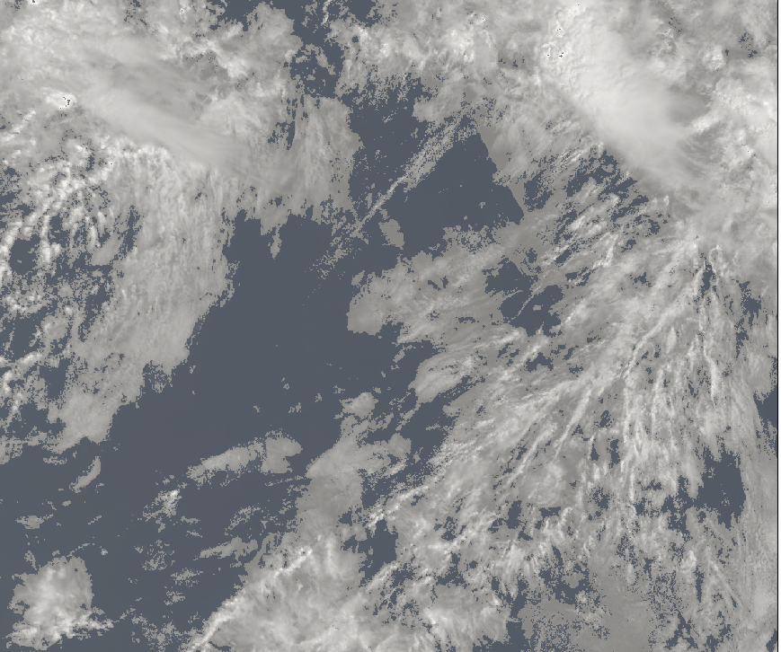
Example plots
Left: Generated mask
Right: S1_an channel data

Slide 5
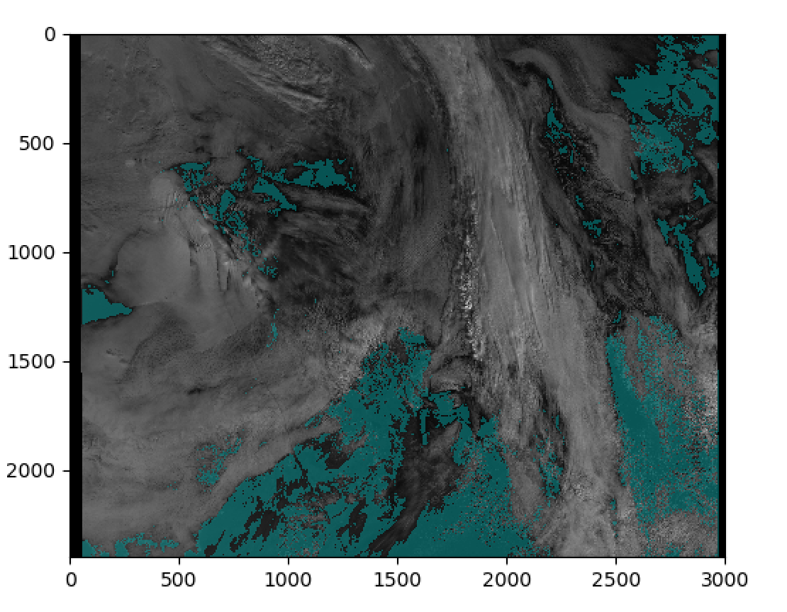

Slide 6
2. New data
Improved CALIOP 2018 data with surface data, the model now take 14 parameters (excluding the truth data and time difference)
Some matched CATS 2017 data
https://docs.google.com/spreadsheets/d/1W3gyqzpbKeNRWvtOrYsDbg2UzzVLfw-t74esUQ_12GU/edit#gid=0
Data for > 2.2 million pixels from Jan18 to Aug18 for CALIOP matches
Data for ~ 42,000 pixels for CATS matches from Aug17
Unable to gather more SLSTR data from 2017
See error on Jul18
Adversarial data (pending)

Slide 7
3. Improving efficiency
Efficiency was improved by 7850%, it now takes Kenza approx. 2 min to load one mask, Tom 30s and the HEP server 1 minute.

Slide 8
4. Accuracy
Hyperparameters
We have found that layers with the same number units (32) work best
Number of layers above 5 make little difference
Dropout of 0.8 gives the best accuracy
The in-built ADAM minimiser also works best (this one is also used at DeepMind)
Model accuracy testing, testing as a function of times slices, satellite zenith angle and surface type (see next slide)
Minimise model using proper scoring rules as discussed in the the paper from Lakshminarayanan et al. (Deep Mind)
=> Highlights the need to generate an uncertainty on for the model results (see Section 5)

Slide 9
5. Uncertainty
We can use ensembles to estimate the uncertainty of our model. Following the paper from Lakshminarayanan et al. (Deep Mind):
Gaussian approximation, mean and variance are taken as value and error respectively
Overcomes the challenge of assigning larger uncertainty for unseen data
Easy to implement (as opposed to creating a Bayesian neural network)

Slide 10
6. Collaboration
We will now be working with Dan and Barney once a week (on Wednesdays at 11am)

Slide 11
7. Questions for RAL
How can we get the 2017 data for SLSTR (currently on remote tape drives)?
What is the difference between ‘confidence_an’ and ‘confidence_in’?
What is the best way to test hyperparameters for the neural network?
What is the best way to generate uncertainty?
We want to use the time difference between the CALIOP/CATS and SLSTR data as a model input, but what do we use as a input on test data?

Slide 12
8. Future directions
Match and download the rest of the CATS data and CALIOP July 2018
Create adversarial data
Create ensemble of neural networks
Train networks using different proper scoring functions

