Slide 1
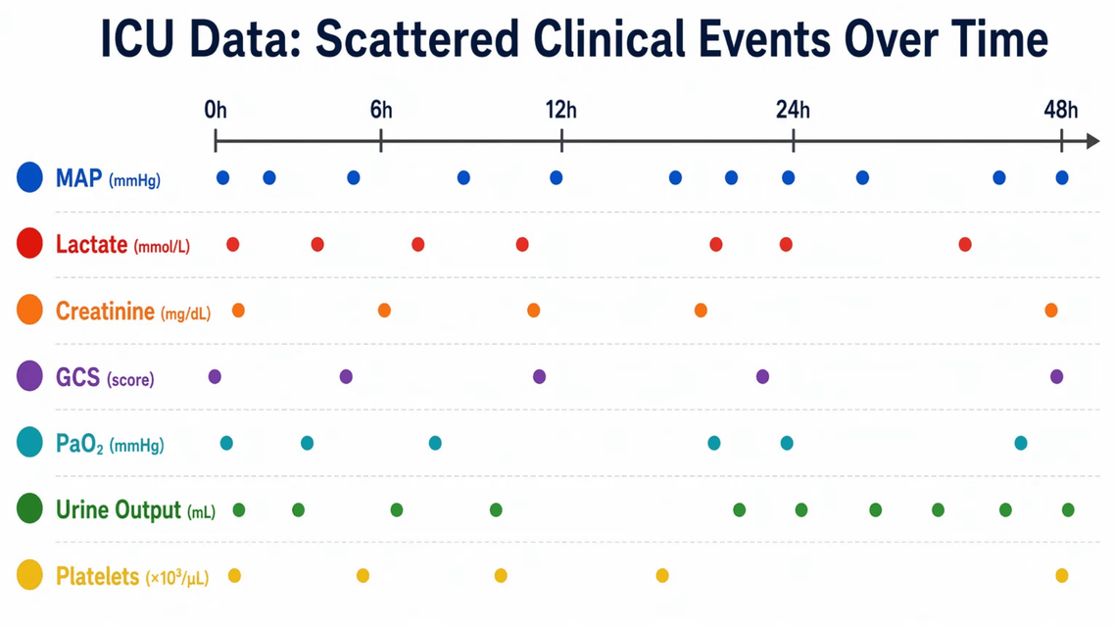
CliniCause:
FROM IRREGULAR ICU
TIME-SERIES TO
CAUSAL LATENT-STATE
ANALYSIS
Raw ICU events
Latent
states
Causal
analysis
M.Sc. thesis seminar: Communication Systems Engineering
Kobi Kenzi | Ben-Gurion University of the Negev
Advisor: Dr. Dan Vilenchik | June 2026
M.Sc. thesis seminar | CATE estimates are model-based risk differences under assumptions
1
M.Sc. thesis seminar | CATE estimates are model-based risk differences under assumptions
1
Notes:
Open by framing this as an engineering seminar. The thesis is a pipeline: raw irregular ICU events, latent clinical states, model voters, DAG-guided adjustment, CATE estimation, and robustness checks. Emphasize that these are model-based risk differences under assumptions, not clinical claims.

Slide 2
ROADMAP
Seminar roadmap: from irregular non-causal raw data to a validated causal estimation pipeline
1
Introduction to Causal Inference — Problem definition; Prediction vs. Causal effect; ATE/CATE.
2
The causal data gap — Real causal data scarcity; Proxy-variable gap; Synthetic benchmark dependence.
3
Engineering contract — Datasets, latent clinical states, reviewable DAGs and rule specifications.
4
Label construction & model voters — Decision trees plus STraTS, TCN, GRU and GRU-D majority vote.
5
Evidence & wrap-up — CATE rankings, robustness, permutation, sensitivity and clinical sanity checks.
Main thread: recover a causal representation before estimating effects.
M.Sc. thesis seminar | CATE estimates are model-based risk differences under assumptions
2
Notes:
This slide tells the audience how the talk is organized. The key design change is stronger section framing, not a more formal doctoral structure.

Slide 3
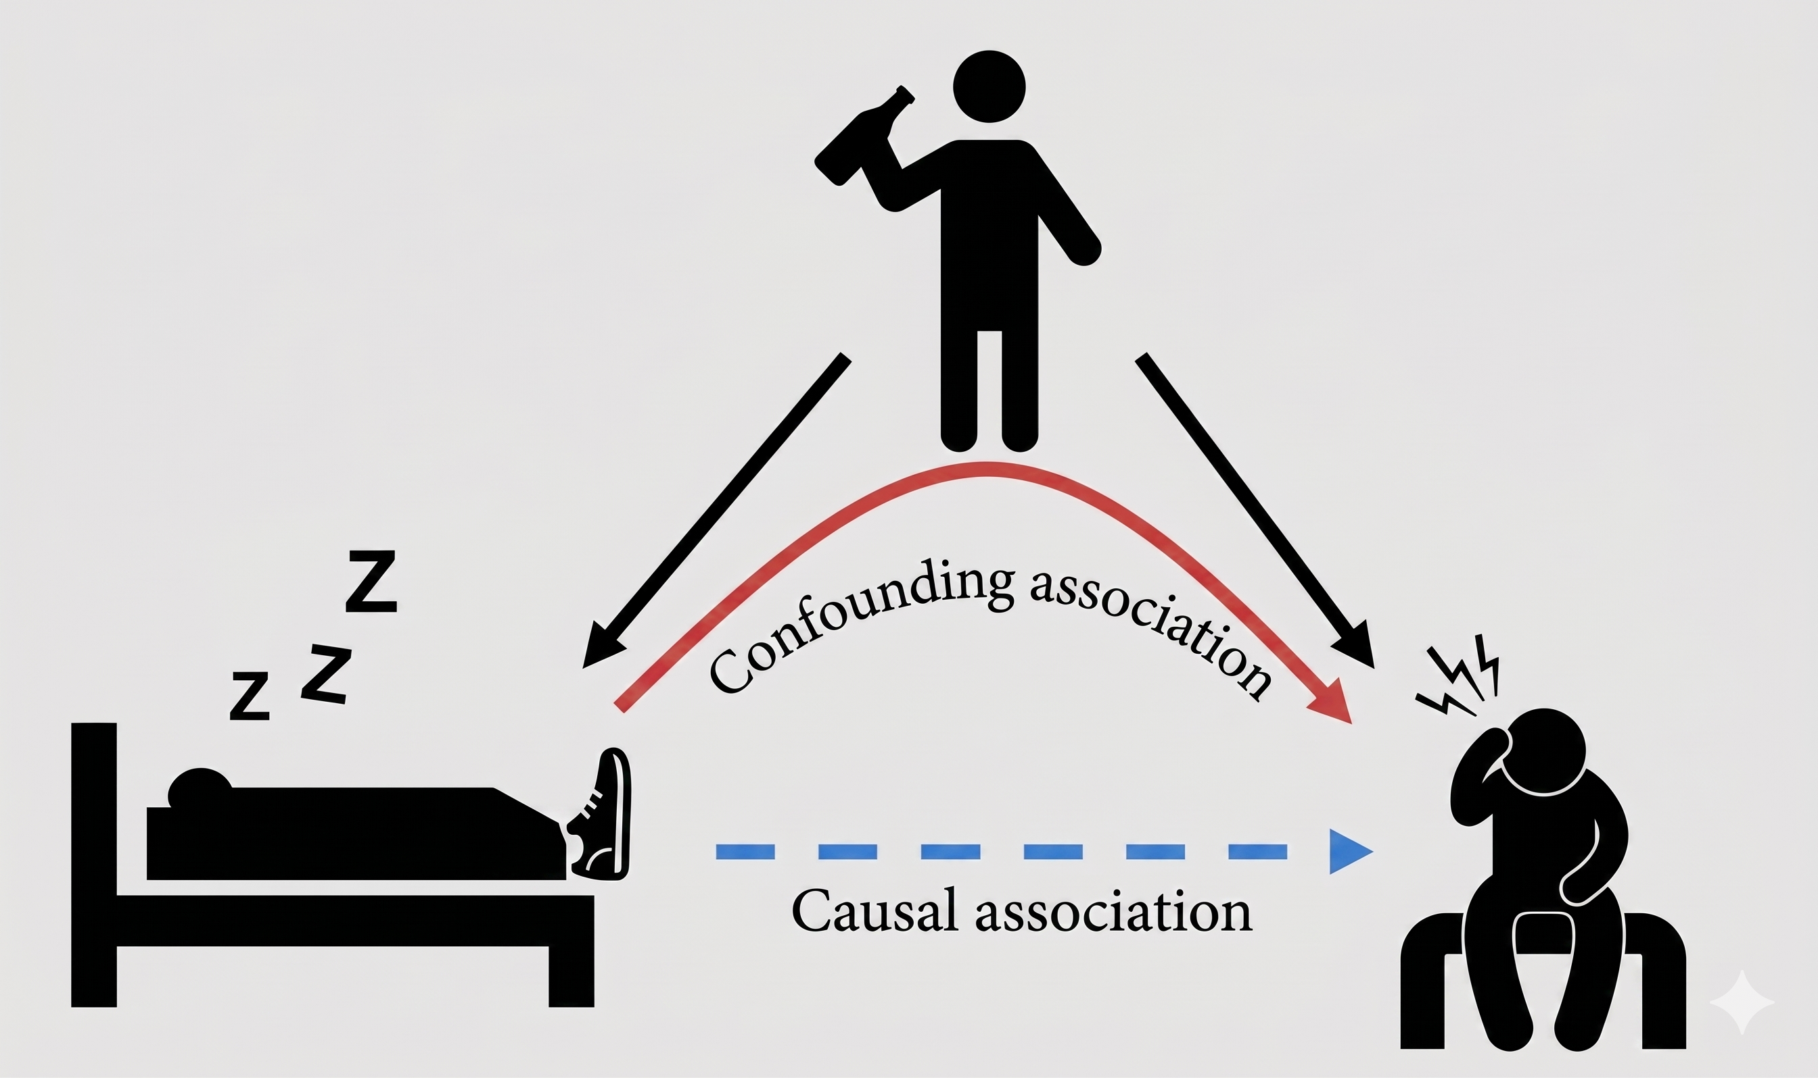
PROBLEM DEFINITION
Causal inference asks a different question than prediction
Prediction
Given x, estimate Y.
Useful question:
“Which patients have elevated mortality risk?”
Causation
For the same patient profile x, compare Y(1) and Y(0).
Useful question:
“What would change if state T were absent/present?”
Core notation
T: Treatment
Y: Outcome
W: Confounders
X: Context
CATE(x): estimated outcome difference between T=1 and T=0 after confounder adjustment
M.Sc. thesis seminar | CATE estimates are model-based risk differences under assumptions
3
Notes:
Give only the minimal causal vocabulary. Prediction estimates risk. Causal inference asks a counterfactual question: what would happen to the same patient profile if the treatment or latent state were different?

Slide 4
PROBLEM DEFINITION
Real causal datasets are scarce across domains
Raw real-world data
Gap
Common shortcut
Missing resource
Logs, measurements, actions, states, timestamps and outcomes collected for operational—not causal—purposes.
Counterfactuals are not observed; causal variables are not given by the columns.
Use synthetic DAGs, simulated treatments or semi-synthetic benchmark labels.
Real, reusable causal-style datasets with explicit variable definitions, assumptions and validation artifacts.
clinical time series
network telemetry
economics / policy
recommendation logs
games / simulators
industrial systems
Why this matters
Why real data is harder
Therefore
Benchmarks can be easy to evaluate when causal truth is created by construction, but that does not solve the real-data problem.
Observed variables are often proxies, symptoms, mediators, decisions or measurements of hidden mechanisms.
Before estimating effects, a dataset needs causal objects that are defined, documented and reviewable.
Core problem: causal inference lacks real causal datasets, which derived from real world measurements
M.Sc. thesis seminar | CATE estimates are model-based risk differences under assumptions
6

Slide 5
THESIS CONTRIBUTION
A pipeline for building causal-style datasets from non-causal variables
1. Raw-data contract
Pipeline artifact
What becomes reusable beyond one domain
Start from ordinary domain data: events, measurements, decisions, timestamps and outcomes.
Causal variables
Latent or derived variables whose meaning is explicit, auditable and tied to evidence.
Provenance
For each label: source variables, rule/model evidence and confidence or voter agreement.
2. Causal abstraction layer
Translate non-causal columns into treatment-like latent states or variables using domain expertise.
Causal metadata
Treatment, outcome, context and confounder definitions separated from model fitting.
3. Assumption layer
Validation suite
Prediction, robustness, permutation, sensitivity and domain sanity checks.
Attach DAGs, confounder sets, evidence rules and estimator-ready definitions of T, Y, W and X.
Benchmark protocol
A repeatable way to compare estimators under the same assumptions and labels.
4. Release layer
Dataset package
Documentation that states assumptions, proxy limitations and what is not claimed.
Publish tables, labels, rules, metadata, validation outputs and limitations for reuse.
CliniCause is a validated software pipeline that translates non-causal time-series measurements into a causal representation dataset.
M.Sc. thesis seminar | CATE estimates are model-based risk differences under assumptions
7

Slide 6
ICU IRREGULARITY + CAUSAL GAP
Introducing ICU data: irregular multivariate measurements, not causal variables
Patient-event contract
patient_id
time
variable
value
outcome
Sparse table
per patient
Irregular sampling
Each variable is measured at different times and frequencies.
Informative missingness
Missing values can reflect stability, measurement policy, or clinical choice.
Fragile aggregation
Hourly grids and summaries can hide timing and measurement decisions.
Raw ICU signals reflect measurement processes; they do not yet define causal variables or causal relationships
M.Sc. thesis seminar | CATE estimates are model-based risk differences under assumptions
7
Notes:
Describe the scattered-event format: variables are observed at different times; absence of a lab is not neutral; aggregation can make the dataset easier but can erase important timing and missingness signals.

Slide 7
ICU IRREGULARITY + CAUSAL GAP
Most raw clinical variables are symptoms or proxies, not causal variables
Underlying condition
diabetes / shock / organ failure
Observed measurements
glucose, MAP, lactate, creatinine...
observed association
not necessarily causation
Outcome
mortality
Clinical example: diabetes or illness severity can drive both glucose patterns and mortality; glucose itself is a proxy, not the causal target.
Proxy risk
Treating measurements as treatments can confuse symptoms, mediators and confounders.
Timing risk
A variable may become abnormal after the latent illness process has already started.
Definition risk
The causal target is unclear unless we first define clinically meaningful states.
Key move: define latent clinical states as causal variables, then estimate their effects on mortality.
M.Sc. thesis seminar | CATE estimates are model-based risk differences under assumptions
8

Slide 8
ENGINEERING CONTRACT
Two ICU datasets, one shared patient-event contract
Aspect
PhysioNet 2012
MIMIC-III
Source / type
PhysioNet / Computing in Cardiology ICU challenge dataset
Large single-center critical-care database
Time-series window
First 48 hours of ICU stay
ICU vitals, labs, interventions and clinical records
Outcome
In-hospital mortality
In-hospital mortality
Project cohort
n = 7,993 after project filtering
n = 26,845 in the project cohort
Available signal
Vitals and labs; compact benchmark-like structure
Vitals, labs, interventions and richer clinical context
Role in thesis
Compact external-style benchmark for pipeline validation
Richer cohort for scale, robustness and clinical variation
Shared patient-event contract
patient id
time
variable
value
outcome
Both datasets are normalized into the same downstream interface before latent-state labeling and causal analysis.
M.Sc. thesis seminar | CATE estimates are model-based risk differences under assumptions
9

Slide 9
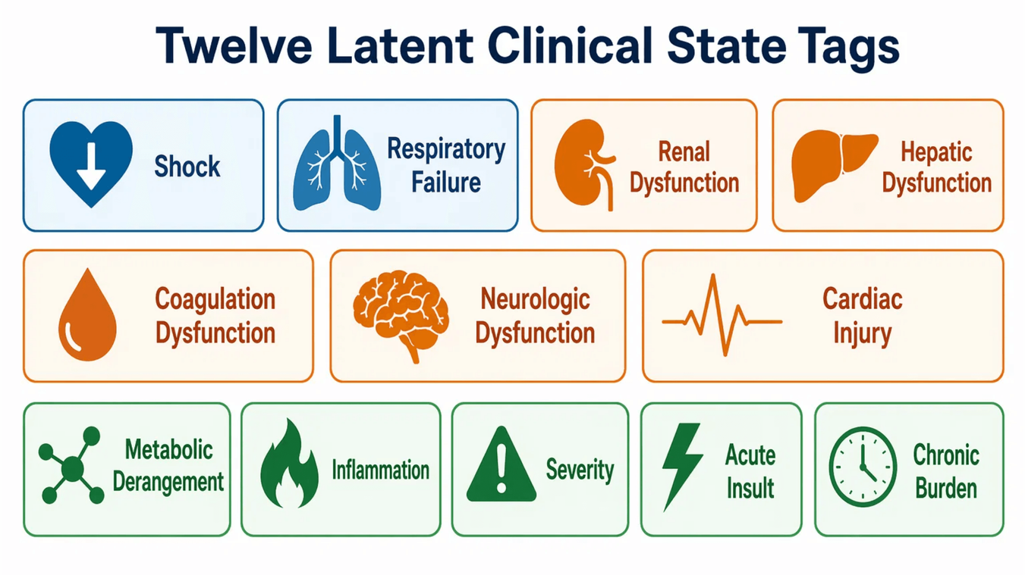
ENGINEERING CONTRACT
Latent variables are the causal bridge layer
Not original columns
They are not MAP, creatinine, glucose or platelet values.
Causal abstractions
They represent clinically meaningful illness states correlated with many measurements.
Estimator interface
They create a binary treatment-like variable T for DAG adjustment and CATE estimation.
Latent states define what causality means in this environment
M.Sc. thesis seminar | CATE estimates are model-based risk differences under assumptions
10
Notes:
Explain why binary latent states are useful: they are simpler and auditable, and they give the causal estimator a clear treatment variable. But they are proxies and lose within-state severity.

Slide 10
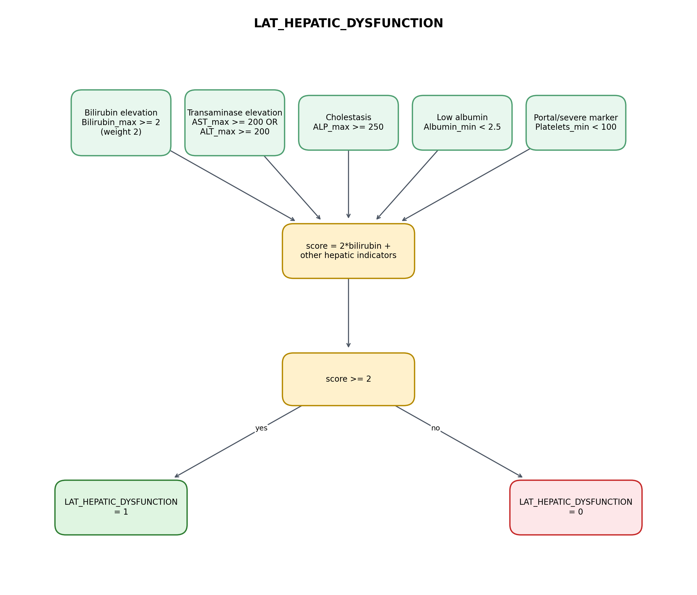
LABELS BUILT AND REFINED
Decision trees translate raw proxies into causal latent variables
Raw measurements
MAP, lactate, creatinine, urine output, SpO₂, bilirubin...
Rule logic
Thresholds, timing, combinations and minimum evidence requirements.
Latent tag
Binary proxy state such as shock, renal dysfunction or respiratory failure.
Rules make the first labels inspectable: each positive tag can be traced back to evidence
M.Sc. thesis seminar | CATE estimates are model-based risk differences under assumptions
11
Notes:
Show the rule-layer concept: deterministic trees translate non-causal measurements into causal latent proxies. This is a bridge, not a clinical diagnosis.

Slide 11
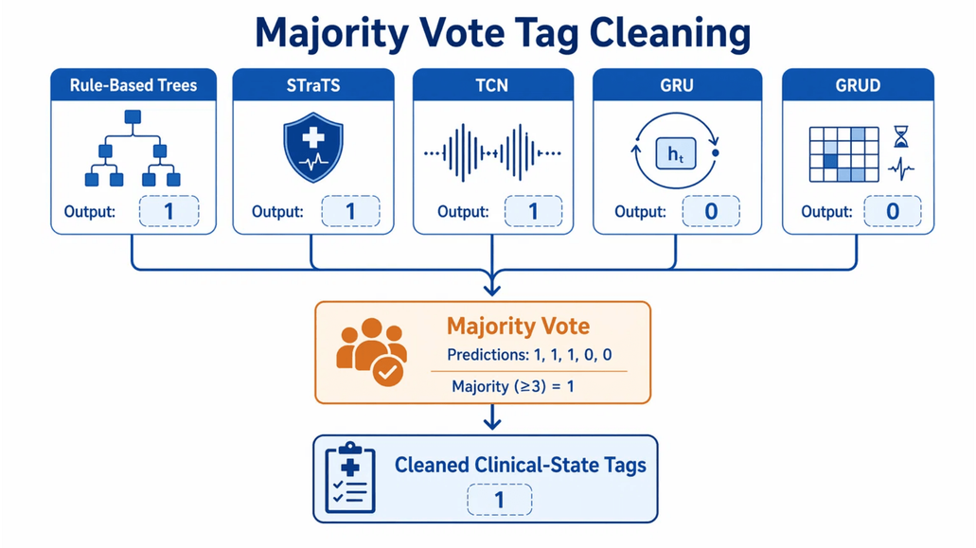
LABELS BUILT AND REFINED
Majority vote improves robustness without replacing auditability
Why not one approach?
Rules are transparent but brittle.
Models can learn context but inherit label noise.
Each architecture sees the sequence differently.
What each voter contributes
Rules: transparent clinical anchor for auditable proxy labels.
STraTS: raw-event context without forcing a dense grid.
TCN: wide temporal patterns from convolutional memory.
GRU: sequential baseline for patient-history consistency.
GRU-D: missingness and elapsed-time signal.
The ensemble reduces dependence on a single weak proxy, while the rule layer keeps labels auditable
M.Sc. thesis seminar | CATE estimates are model-based risk differences under assumptions
12
Notes:
Explain that majority vote is not a clinical override. It is a label robustness mechanism. It combines rule-based trees with STraTS, TCN, GRU and GRU-D voters.

Slide 12
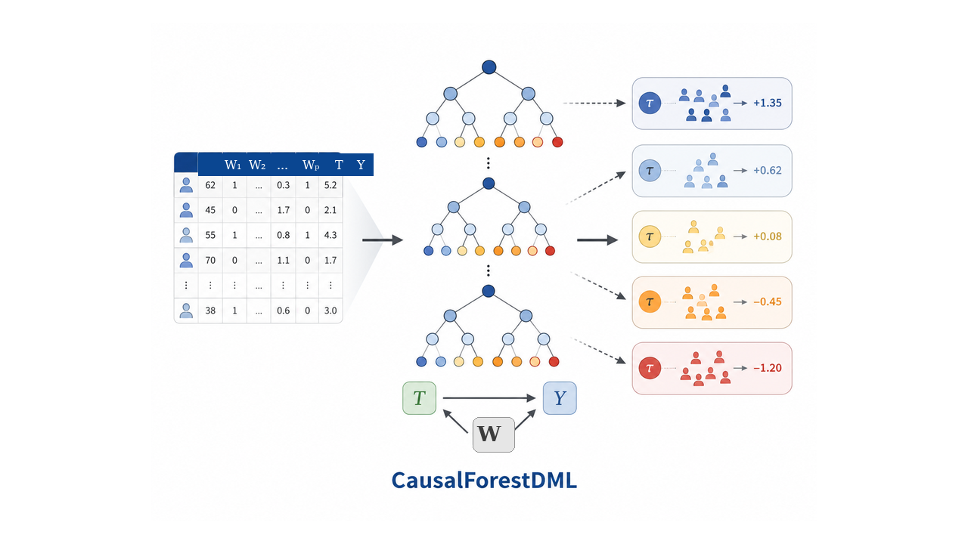
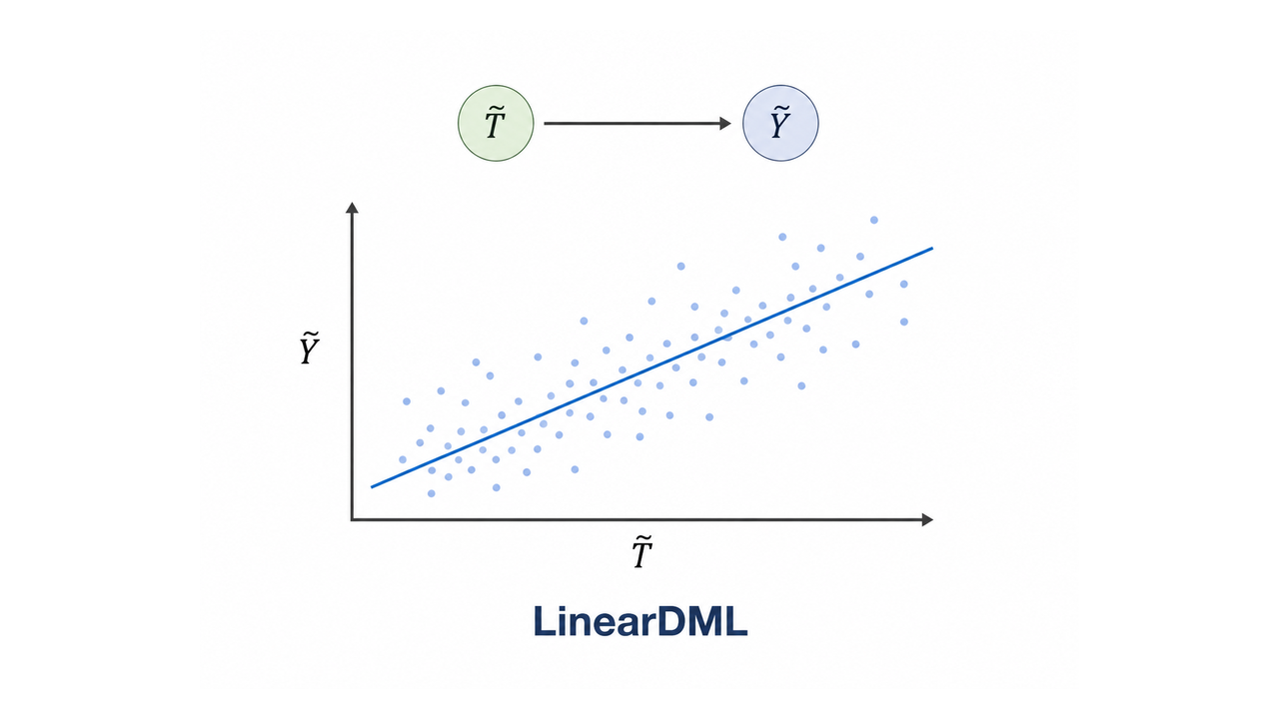
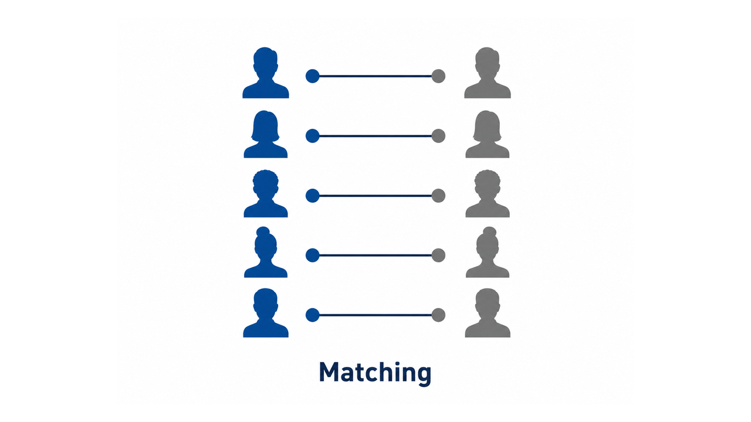
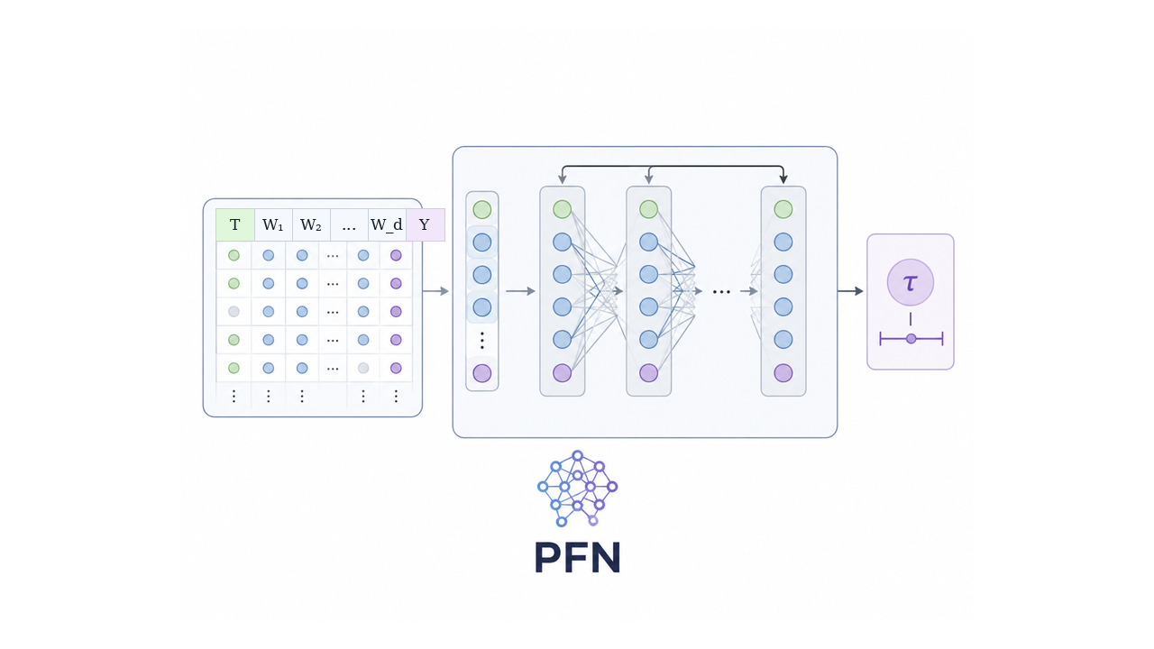
CATE ESTIMATION
Four causal estimators stress-test the same DAG-adjusted latent table
CausalForestDML: Nonlinear heterogeneous effects
LinearDML: Simple orthogonalized effect surface
Matching: Transparent matched-pair baseline
PFN: External neural/foundation-style stress test
Each estimator uses T, Y and the same DAG-adjusted confounder set W; differences reflect modeling assumptions.
M.Sc. thesis seminar | CATE estimates are model-based risk differences under assumptions
13
Notes:
This slide explains the interface. Once we have latent states, outcome and DAG-selected covariates, the problem becomes a tabular causal estimation problem.

Slide 13
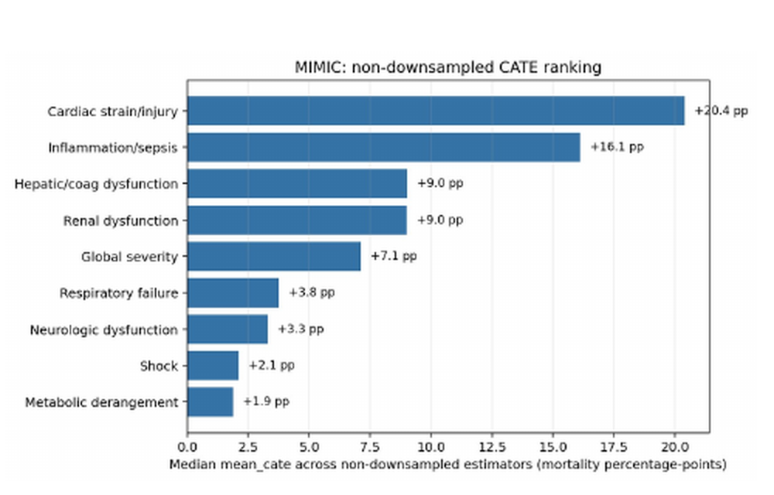
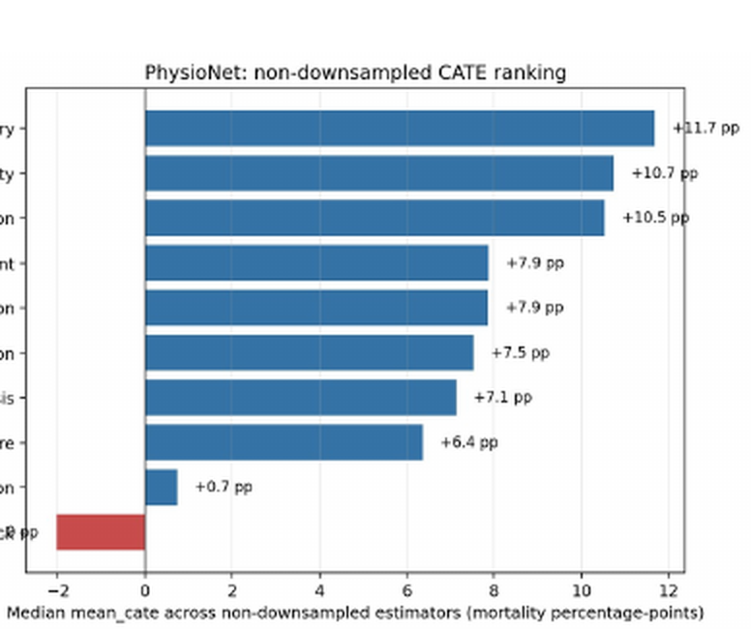
EVIDENCE
Results: full-cohort CATE rankings
MIMIC-III full-cohort CATE ranking
PhysioNet full-cohort CATE ranking
Read CATE bars as percentage-point mortality risk differences under the DAG, latent-label, and estimator assumptions.
M.Sc. thesis seminar | CATE estimates are model-based risk differences under assumptions
15

Slide 14
EVIDENCE
What evidence supports the pipeline?
Results
CATE rankings + mortality signal
Robustness
Agreement across causal estimators
Permutation
Effects collapse when labels/outcomes are shuffled
Sensitivity
Hidden-bias stress test
Clinical evidence
Plausibility and contradiction checks
Limitations
Assumptions remain explicit
The thesis claim is reproducibility under explicit assumptions, supported by multiple validation checks
M.Sc. thesis seminar | CATE estimates are model-based risk differences under assumptions
14
Notes:
Use this as a transition into evidence. The support is cumulative: results, predictive signal, cross-estimator robustness, permutation tests, sensitivity analysis, clinical plausibility and limitations.

Slide 15
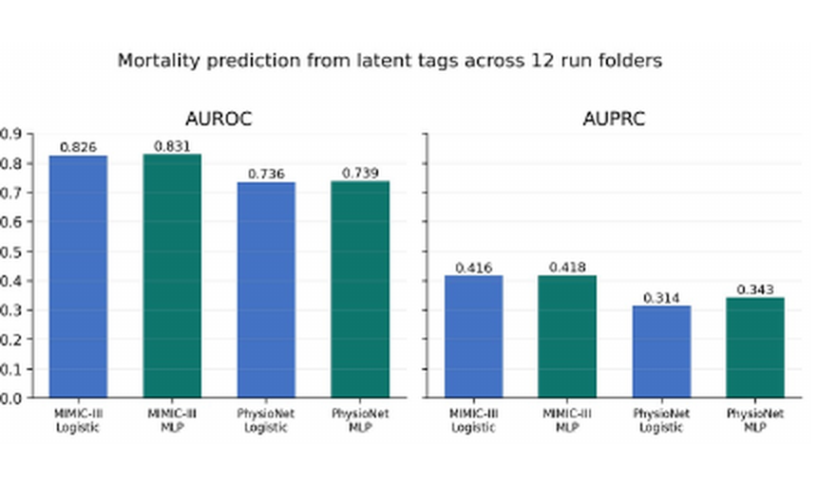
EVIDENCE
Outcome check: latent tags retain mortality signal
Parsed source: 12 saved output folders; test metrics only.
MIMIC-III signal: AUROC ≈ 0.83 and AUPRC ≈ 0.42 across logistic and MLP checks.
PhysioNet signal: AUROC ≈ 0.74 and AUPRC ≈ 0.31–0.34; weaker but still informative.
Interpretation: This supports the latent representation as a predictive patient-state summary; it is not causal proof.
Mortality prediction checks whether the engineered latent states preserve outcome-relevant signal.
M.Sc. thesis seminar | CATE estimates are model-based risk differences under assumptions
16

Slide 16
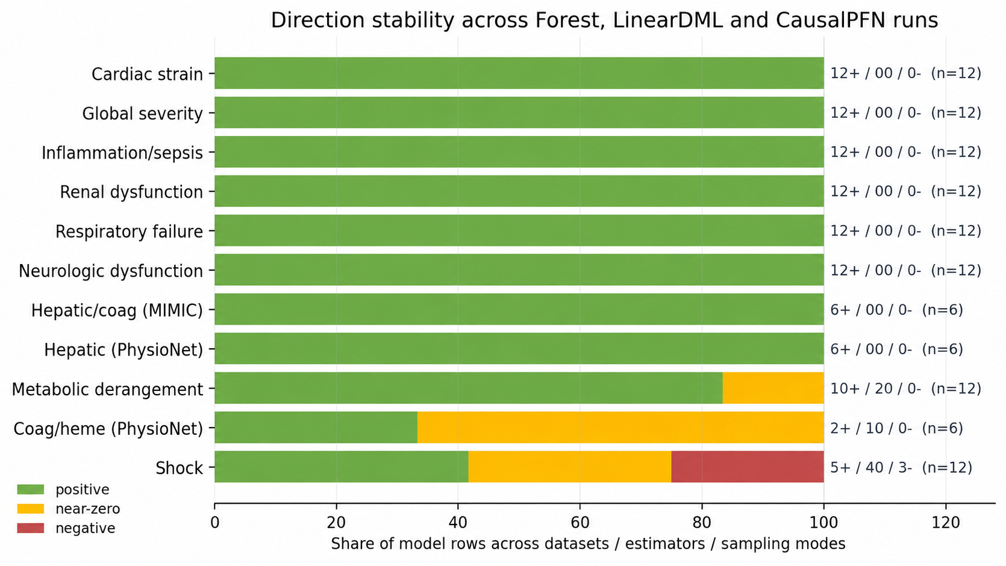
EVIDENCE
Cross-model direction stability
Direction stability is stronger evidence than exact numerical agreement.
M.Sc. thesis seminar | CATE estimates are model-based risk differences under assumptions
17

Slide 17
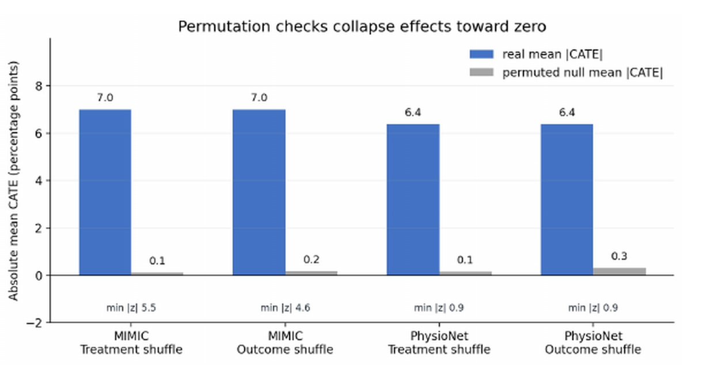
EVIDENCE
Validation: permutation checks
What is shuffled?
Treatment shuffle breaks state assignment; outcome shuffle breaks the mortality relationship while preserving marginal structure.
Expected behavior
Estimated effects should collapse toward the null if the pipeline is detecting real structure rather than arbitrary labels.
Permutation tests proves that the causal models did not hallucinate CATE values
M.Sc. thesis seminar | CATE estimates are model-based risk differences under assumptions
19

Slide 18
EVIDENCE
Medical literature supports most positive CATE directions — and flags two limitations
The report compares estimated CATE patterns against clinical mortality gradients. These are sanity checks, not proof of causal magnitude.
Evidence supporting key positive signals
Evidence-based red flags
Renal / AKI
KDIGO defines AKI by creatinine / urine output; AKI-EPI shows mortality odds rising by stage, with stage 3 OR 6.884. In septic ICU patients, stage 3 AKI contributed ≈16.8 pp 30-day mortality. [S04–S06]
⚠ Shock
Sepsis-3 septic shock requires vasopressors + lactate >2 mmol/L and reports hospital mortality >40%. But shock CATE is low in MIMIC and negative in PhysioNet → proxy / mediator audit needed. [S01,S02]
Hepatic / bilirubin
ICU bilirubin studies show clear mortality gradients: bilirubin >1 mg/dL had 30% vs 21% mortality; bilirubin ≥2 mg/dL had 31.9% vs 17.0% mortality in MIMIC-III. [S08–S09]
Cardiac strain / injury
Elevated ICU troponin is common and prognostic: median 43% prevalence in ICU studies, adjusted mortality OR 2.5; in sepsis, elevated troponin HR 1.57. [S18–S19]
⚠ PhysioNet heme/coag
PLOT-ICU: thrombocytopenia mortality 34.6% vs 19.3%; severe cases ≈51–52%. Near-zero / negative PhysioNet heme CATE is not validated until the label is audited. [S12,S13]
Sepsis / global severity
Sepsis-3 links organ dysfunction to >10% in-hospital mortality; SOFA was designed to describe organ dysfunction/failure and component failures are mortality-associated. [S01,S03,S15]
Takeaway: The results are clinically meaningful, but some signals still require expert validation
20
M.Sc. thesis seminar | CATE estimates are model-based risk differences under assumptions
20
M.Sc. thesis seminar | CATE estimates are model-based risk differences under assumptions

Slide 19
WRAPPING IT TOGETHER
Thesis contribution: causal representation for irregular ICU data
What the thesis contributes
What it does not assume or claim
Shared patient-event contract: PhysioNet and MIMIC-III are normalized into a common irregular-event representation.
Raw variables are causal: Vitals and labs are treated as measurements and proxies, not as causal objects by default.
Latent causal bridge: Raw measurements are translated into auditable latent illness-state proxies.
Latent labels are clinical truth: They are engineered proxies that require audit and refinement.
DAG-guided estimation: Confounder adjustment is explicit, reviewable, and separated from model fitting.
The DAG is guaranteed correct: Graph assumptions are transparent and contestable, not learned ground truth.
Validation layer: Robustness, permutation, sensitivity, and clinical evidence checks expose both support and failure modes.
Observational CATE proves treatment effect: Estimates are hypothesis-generating summaries, not bedside decisions or clinical proof.
Main message: recover the problem’s causal structure from observational data.
M.Sc. thesis seminar | CATE estimates are model-based risk differences under assumptions
21

Slide 20
FUTURE RESEARCH
Three directions that naturally extend the thesis
Non-binary latent variables
Extend binary tags to severity, duration, and trajectories.
Domain extension
Evaluate the representation → DAG → effect pipeline in games, networking, and other engineered systems.
Foundation-model causal reasoning
Compare model-proposed latent variables, DAGs, and rules against expert-validated baselines.
Future work can focus on richer state representations, cross-domain validation, and safer expert-model collaboration
M.Sc. thesis seminar | CATE estimates are model-based risk differences under assumptions
22
Notes:
Future research: non-binary states, extension beyond ICU to domains such as games or networking, and systematic evaluation of foundation models as causal-reasoning assistants.

Slide 21
CONCLUSION
CliniCause turns non-causal measurements into auditable causal datasets
Representation first
Raw measurements are proxies; causal variables must be constructed before estimating effects.
Translation pipeline
CliniCause converts irregular time-series variables into an auditable causal representation table.
Validation over certainty
Rules, voters, DAGs, permutation, sensitivity and evidence checks expose assumptions and failures.
Dataset contribution
The output is a reusable causal-representation dataset for benchmarking and hypothesis generation.
Main message (again): recover the problem’s causal structure from your observational data
M.Sc. thesis seminar | CATE estimates are model-based risk differences under assumptions
23
Notes:
Conclude with the main thesis contribution. The emphasis is representation, auditability and validation, not a single estimator.

Slide 22
Thank you
Kobi Kenzi
Advisor: Dr. Dan Vilenchik
Ben-Gurion University of the Negev
Department of Communication Systems Engineering
Questions?
From irregular ICU events to auditable causal latent-state analysis
M.Sc. thesis seminar | CATE estimates are model-based risk differences under assumptions
24
Notes:
Invite questions. Be ready to go deeper on the latent-variable definitions, DAG assumptions, CATE estimators or robustness checks.

