Slide 1
Balls into Bins: Load Balancing Under Cost Constraints
Randomized choices, stateful policies, and cost-quality tradeoffs
10,000 balls
16 and 32 bins
10 trials per scenario
Main message
How much load-balance quality does each policy buy for its decision cost?

Slide 2
Problem Statement
Allocate each arriving ball immediately.
Goal: reduce max load and imbalance.
Systems analogy: assign tasks, flows, or jobs to resources.
Question: how much state or load information should the allocator use?
Workload | Initial bins
unweighted | empty
weighted | empty
unweighted | randomly initialized
weighted | randomly initialized
The experiments compare online allocation policies across clean and realistic starting conditions.

Slide 3
Algorithms Compared
Family | Policy | What it knows | Main cost
Stateless | Random | one random bin | very low
Stateless | Power-k | k sampled bin loads | grows with k
Stateless | Absolute minimum | all bin loads | high scan cost
Stateful | Round-robin | next-bin pointer | very low state
Stateful | Heap size s | partial/global heap state | state + heap updates
The core comparison is stateless sampling versus maintained state versus full global knowledge.

Slide 4
Theory Anchor: Why Power-2 Matters
Random allocation has a large maximum-load tail.
Power of Two Choices gives a dramatic theoretical improvement.
Additional choices help, but with diminishing returns.
The simulation checks whether this holds with cost, weights, and initialization.
Hypothesis
Small local information captures most of the benefit.
Theory motivates Power-2 as the practical randomized baseline.

Slide 5
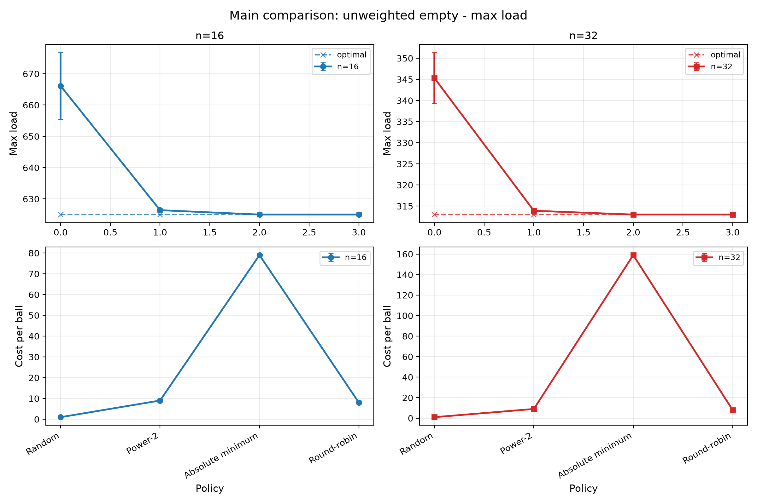
Clean Baseline: Power-2 Captures Most of the Gain
Max load
n=16: Random 666.1 -> Power-2 626.4
n=32: Random 345.3 -> Power-2 313.9
Beyond Power-2
Absolute minimum adds only a small improvement.
Power-2 nearly closes the gap to the ideal policy in the clean unweighted case.

Slide 6
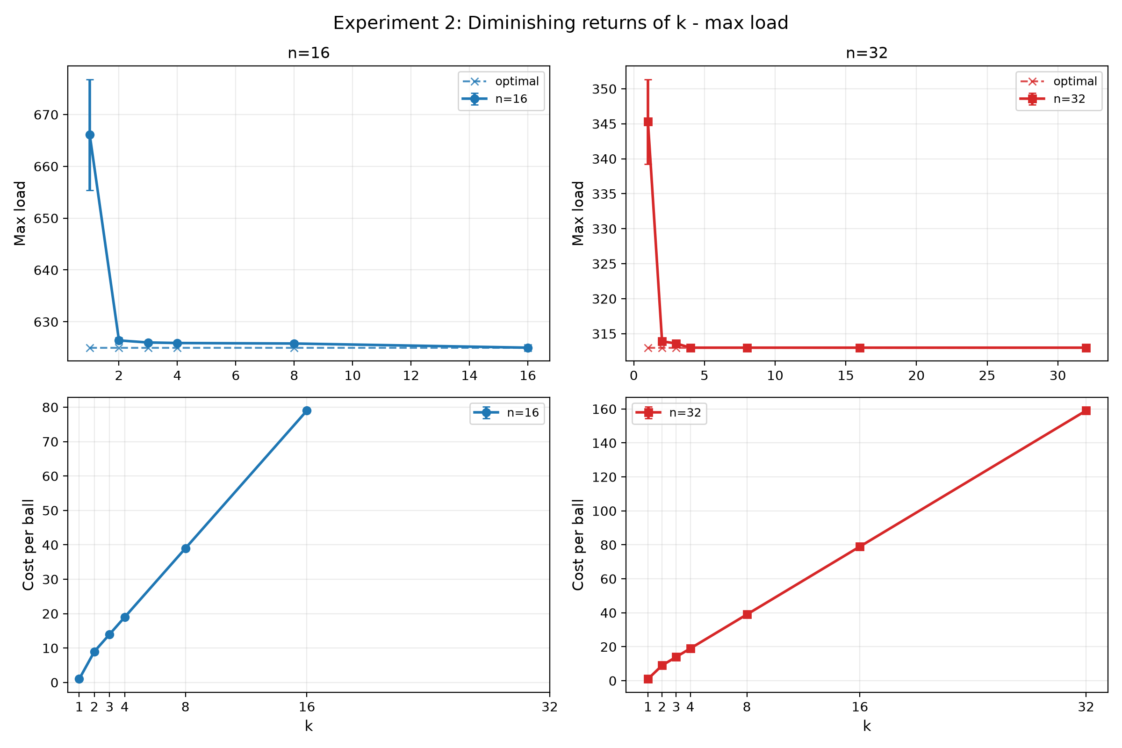
Diminishing Returns of k
n=16
Power-2/3/4 max load: 626.4 / 626.0 / 625.9
Cost per ball: 9 / 14 / 19
n=32
Power-2/3/4: 313.9 / 313.6 / 313.0
The big improvement is k=1 to k=2. Larger k mostly increases cost.

Slide 7
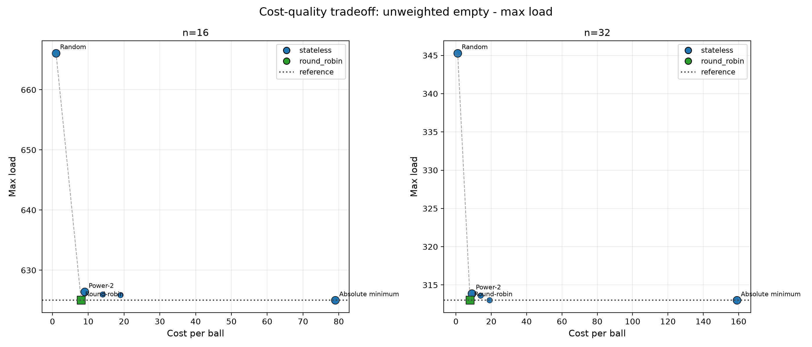
Cost-Quality Tradeoff
Lower max load is better.
Lower cost per ball is better.
Absolute minimum is close to optimal but expensive.
Round-robin looks excellent here, but that success is fragile.
Power-2 is the knee of the curve: most of the quality for a small cost.

Slide 8
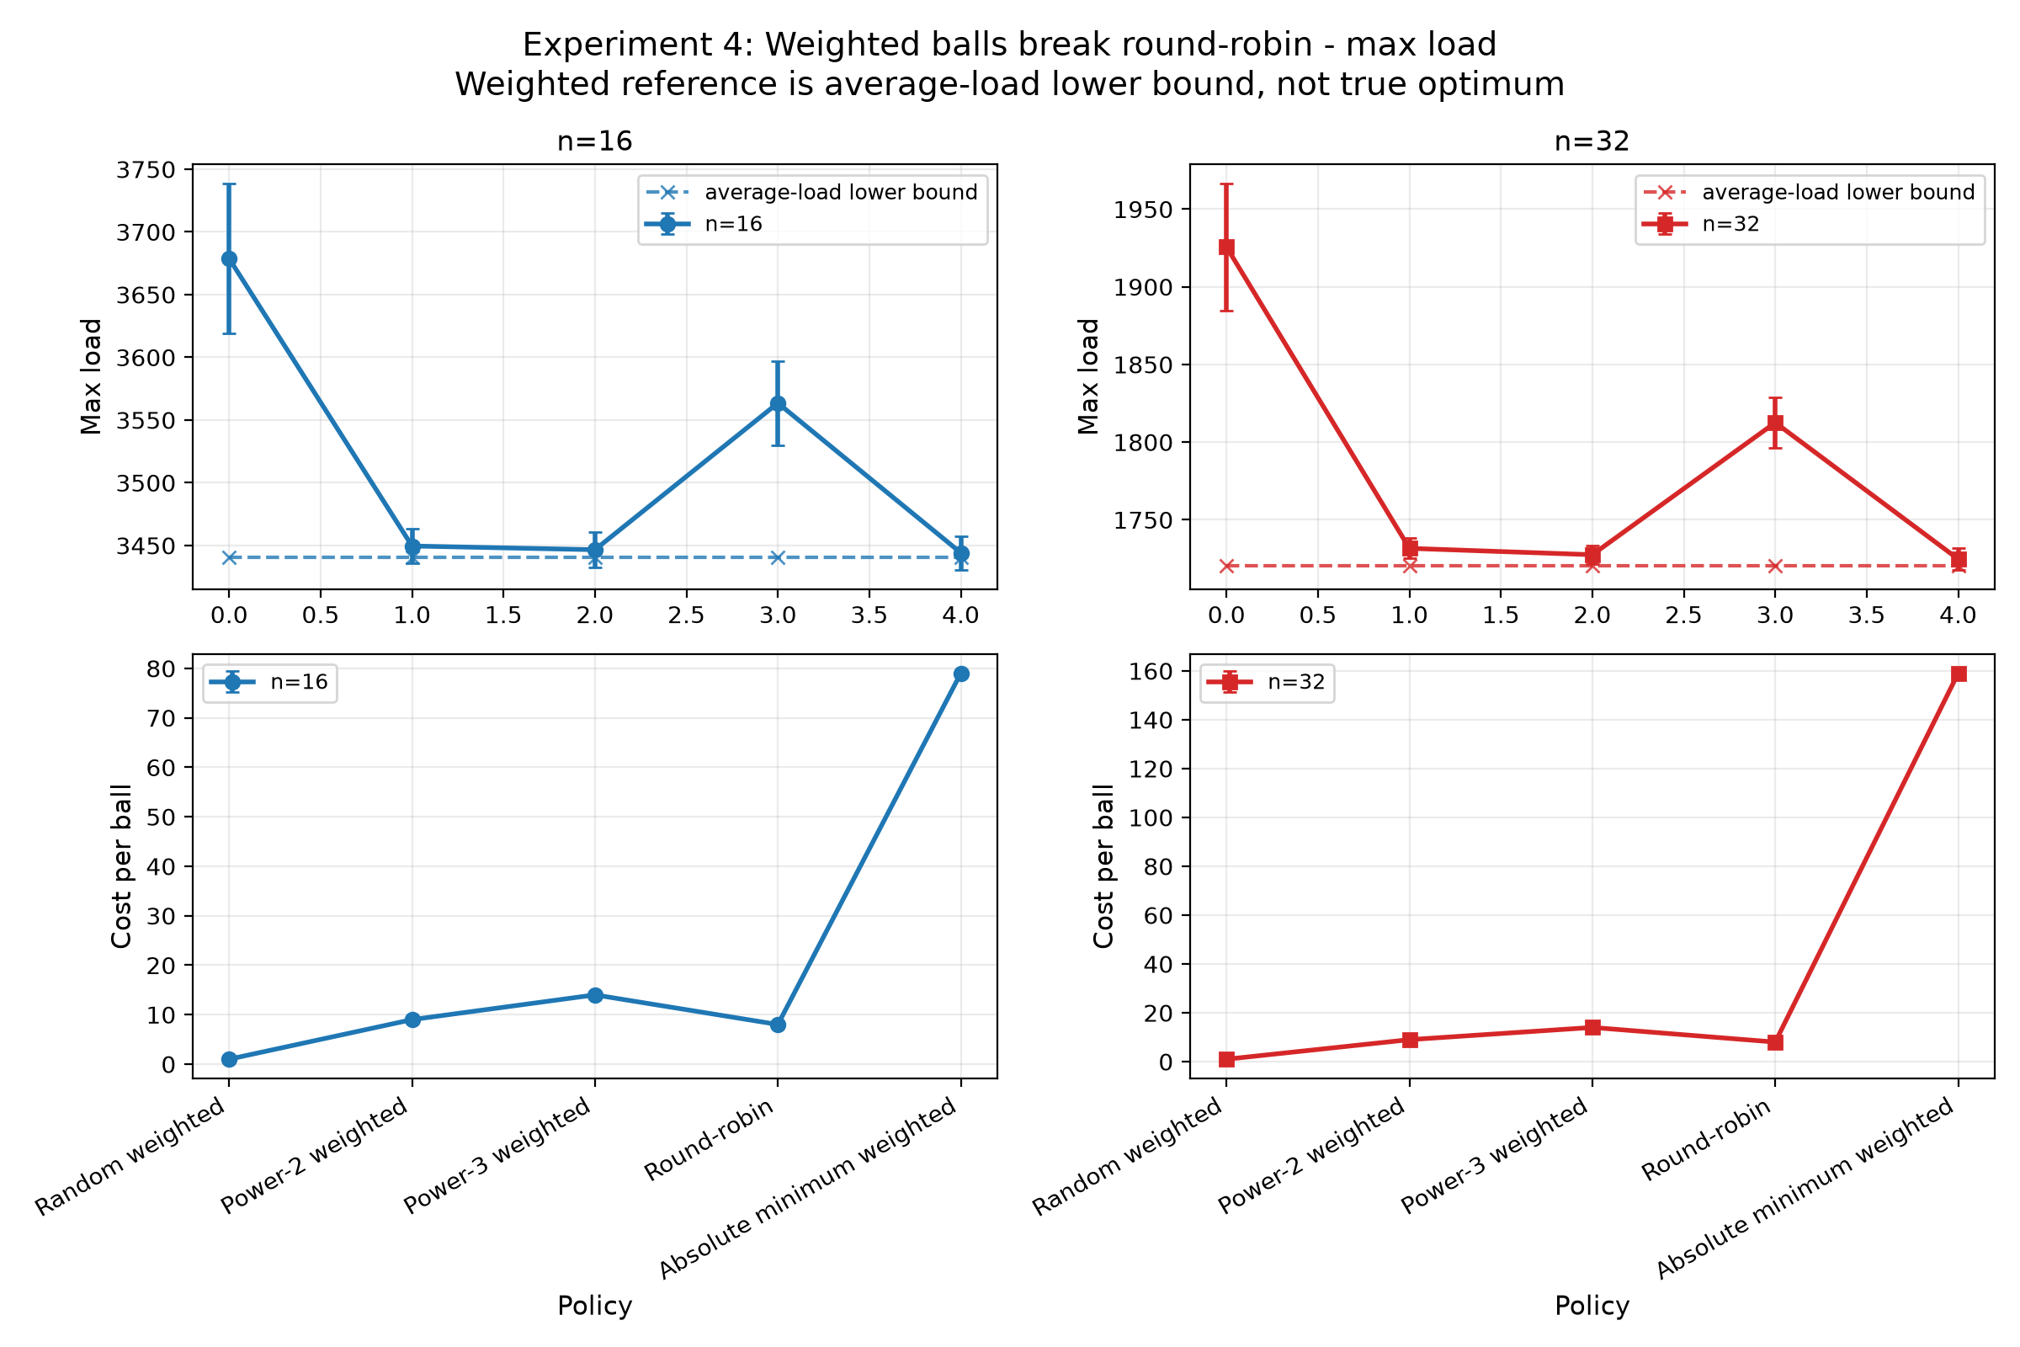
Weighted Balls Break Count Fairness
Weighted-empty n=32
Round-robin 1812.6
Power-2 1731.6
Fair by count can still be bad by load.
Power-2 reads current load and adapts.
Round-robin balances counts, not load. Weighted balls expose that weakness.

Slide 9
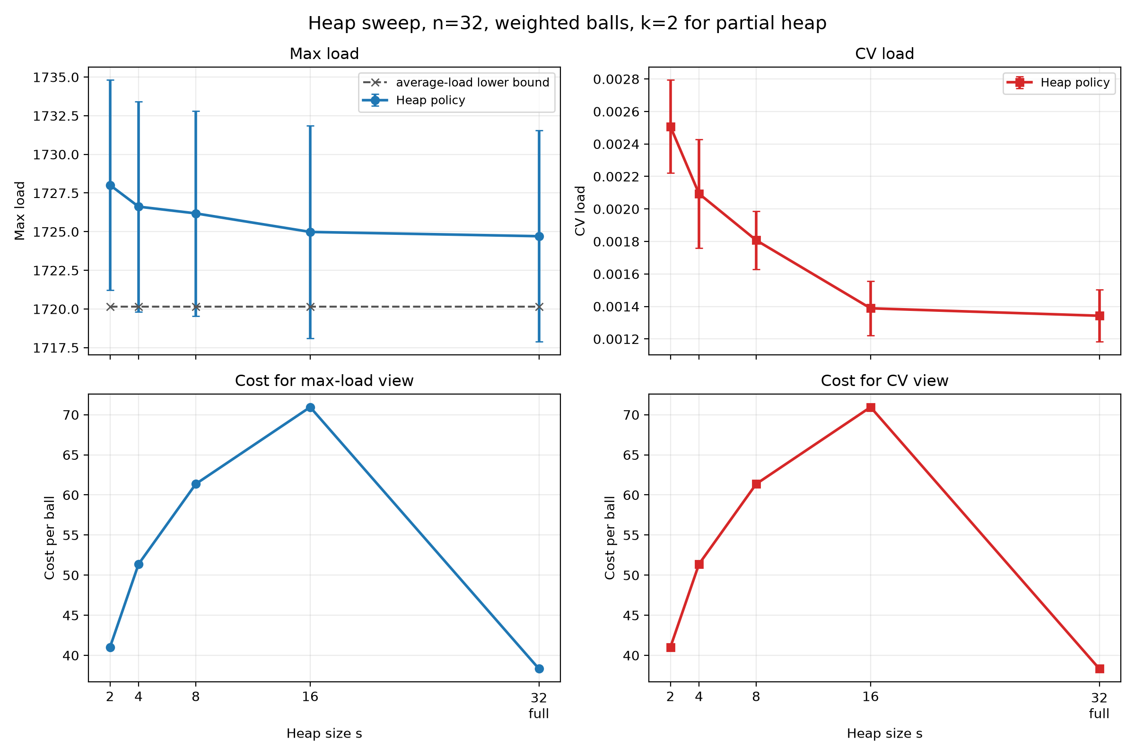
Stateful Heap: When Maintained State Helps
Full heap
Matches absolute-min quality around 1724.7
Cost around 38.32 instead of 159
Partial heap tracks s bins.
Full heap tracks all bins.
More state improves quality and update cost.
A maintained heap can approach global-min quality without scanning all bins.

Slide 10
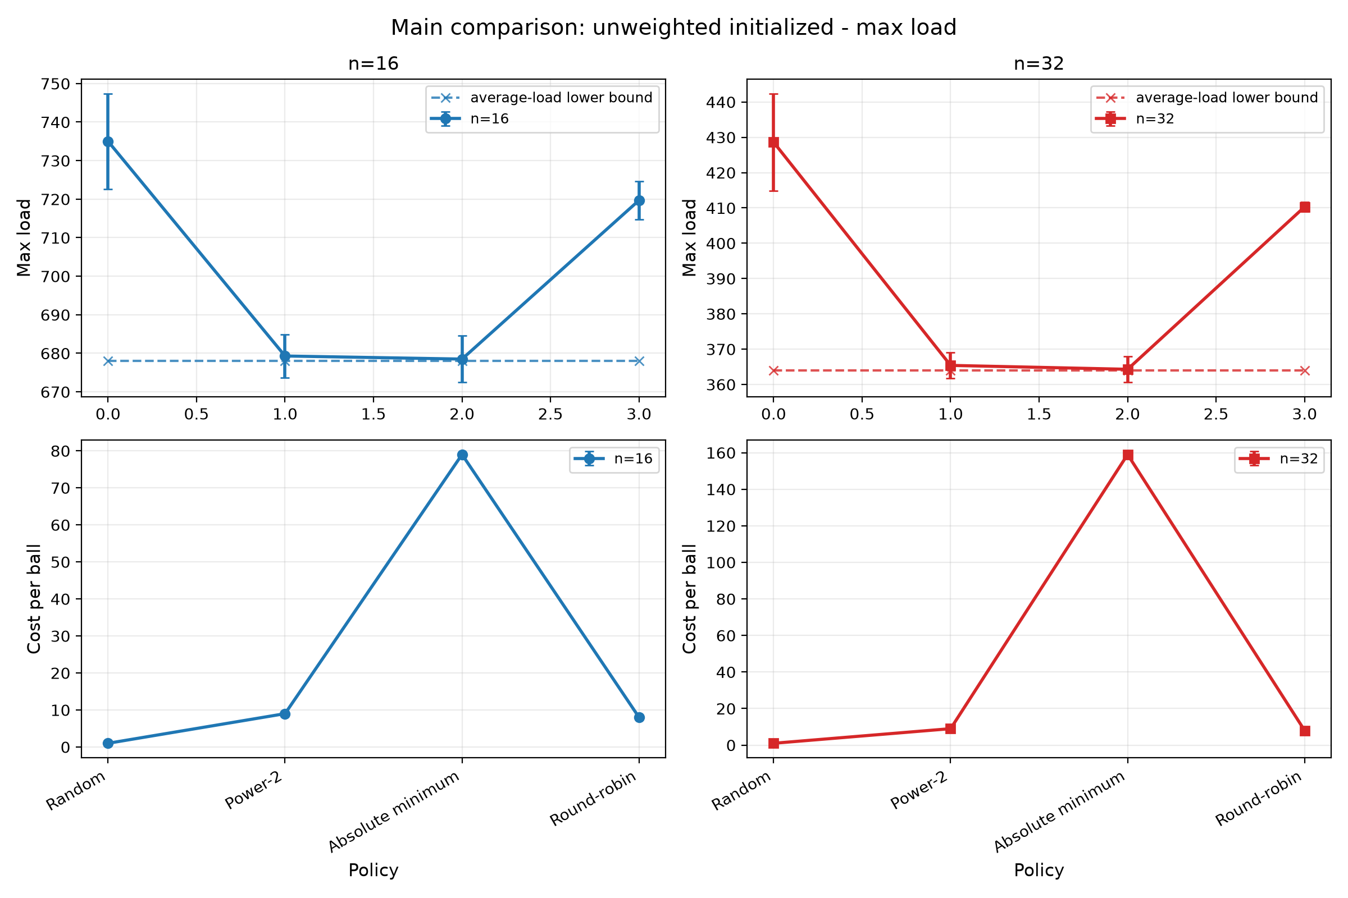
Initialization Tests Robustness
Near reference
n=16: Power-2 679.3 vs ref 678.0
n=32: Power-2 365.4 vs ref 364.0
Real systems rarely start from zero.
Round-robin can preserve initial imbalance.
Starting from non-empty bins exposes whether a policy corrects imbalance.

Slide 11
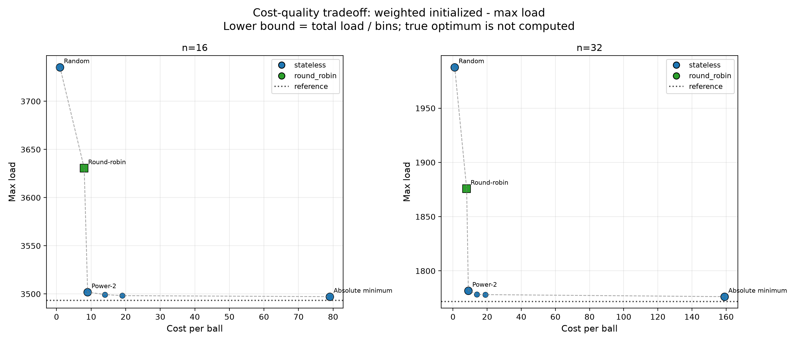
Final Realistic Tradeoff
Random is too weak.
Absolute minimum is expensive.
Round-robin is fragile.
Power-2 is simple, stateless, and robust.
Heap/full heap can improve quality when state cost is justified.
Under weighted + initialized conditions, Power-2 is the strongest simple default.

Slide 12
C++ Implementation Overview
src/main.cpp builds scenarios, runs them, and exports results/simulation_results.csv.
ExperimentRunner creates all experiment scenarios.
Scenarios
Simulators
Metrics CSV
Plots
Conclusions
->
->
->
->
PowerKSimulator: Random, Power-k, Absolute minimum.
StatefulRoundRobinSimulator: round-robin.
HeapSizeSPowerOfKSimulator: heap size s / full heap.
scripts/plot_results.py reads the CSV and creates the plots.
The deck uses repository outputs only.
The project is structured as a repeatable performance evaluation pipeline.

Slide 13
Final Takeaway
Two choices are the best default.
Most of the balance benefit with little decision cost.
Good robustness across weights and initialized bins.
Full global knowledge is rarely worth the price.
Stateful heap designs can improve quality further when memory/update cost is justified.
Engineering decision: optimize load-balance quality per unit of decision and state cost.

