Slide 1

Load Balancing Under Cost Constraints
A Systems Perspective on the Power of Two Choices
Cisco Systems Performance Evaluation Balls-into-Bins Simulation Study
Notes:
Today, we're diving into load balancing, specifically how we manage cost constraints. We'll explore the 'Power of Two Choices' from a systems perspective. This isn't just theory; we're looking at real engineering trade-offs. We'll analyze various algorithms to find the most efficient strategies for system design. Our goal is to move beyond abstract math and focus on practical implications.

Slide 2

The Core Engineering Trade-off
How much global information is worth the cost?
In any distributed system, the primary objective is to minimize maximum load and imbalance across available resources. However, every bit of information—whether obtained through active sampling or maintained as internal state—incurs a non-trivial performance cost.
TAKEAWAY
Small local information often captures the vast majority of load-balancing benefits.
Notes:
This slide frames our core engineering challenge: how much global information is truly worth its cost? In distributed systems, we always want to minimize load and imbalance. But every piece of information, whether sampled or maintained, adds cost. We're asking if minimal local information can achieve near-optimal balance. We want to find that 'knee of the curve' where quality is high and cost is manageable. This sets the stage for our experimental setup.

Slide 3

Experimental Setup
Stress-testing policies across realistic scenarios
The simulation framework is designed to evaluate policies under both clean and adversarial conditions, ensuring findings are comparable across algorithm families.
PARAMETER
SIMULATION VALUE
Total Balls
10,000
Bin Counts
16 and 32
Trial Count
10 per scenario
Workload Modes
Unweighted/Weighted × Empty/Initialized
Primary Metrics
Maximum Load, Decision Cost per Ball
OBJECTIVE
Quantify the load-balance quality bought for each unit of decision cost.
Notes:
To answer that, we built a robust experimental setup. We stress-tested policies under both ideal and adversarial conditions. Our consistent parameters ensure fair comparisons across all algorithms. We're tracking maximum load and decision cost per ball. This allows us to quantify the load-balance quality we get for every unit of decision cost. Now, let's look at the algorithms we tested.

Slide 4

Algorithms: From Random to Global
Three families of allocation policies
We categorize the compared algorithms into distinct families based on their information requirements and state management overhead.
FAMILY
POLICY
MECHANISM
COST PROFILE
Stateless
Random
Selects exactly one bin at random
Very Low
Stateless
Power-k
Samples k bins, picks least loaded
Linear w/ k
Stateless
Absolute Min
Scans all bins for global minimum
High Scan
Stateful
Round-robin
Uses a pointer to the next bin
Low State
Stateful
Heap (s)
Maintains top-s least loaded bins
State + Update
COMPARISON
The core trade-off is between stateless sampling, maintained state, and full global knowledge.
Notes:
We categorized our algorithms into three families: stateless, stateful, and those with global knowledge. Each family has different information requirements and state management overhead. For example, 'Random' is very low cost, while 'Absolute Minimum' has a high scan cost. This comparison highlights the fundamental trade-off we're exploring. Next, we'll dive into the 'Power of Two Choices' as our baseline.

Slide 5

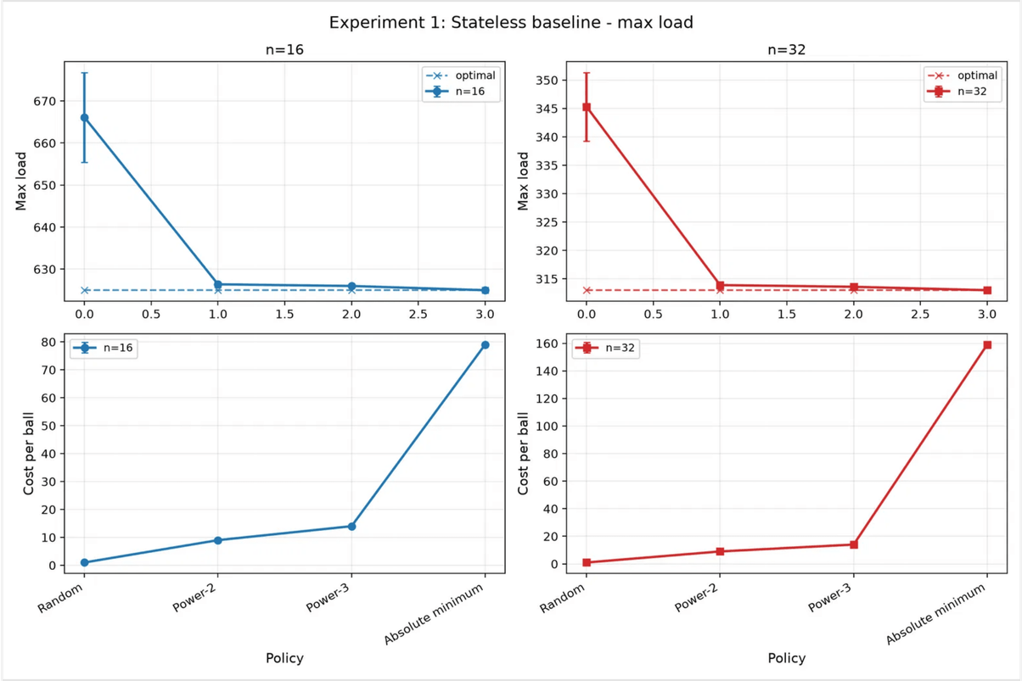
The "Power of Two Choices" Baseline
The theoretical "Power of Two Choices" suggests that even a tiny amount of choice dramatically improves load distribution.
Our simulation confirms this: moving from Random (k=1) to Power-2 (k=2) results in a sharp reduction in maximum load, nearly closing the gap to the ideal global policy.
TAKEAWAY
Power-2 captures most of the load-balancing benefit with minimal decision cost.
Notes:
The 'Power of Two Choices' is a critical baseline. It shows that even a small amount of choice dramatically improves load distribution. Our simulation confirms this: moving from Random, which is k=1, to Power-2, which is k=2, sharply reduces maximum load. Power-2 nearly matches the ideal global policy in clean scenarios, but at a much lower cost. This means Power-2 captures most of the load-balancing benefit with minimal decision cost. But what happens if we increase 'k' even further?

Slide 6
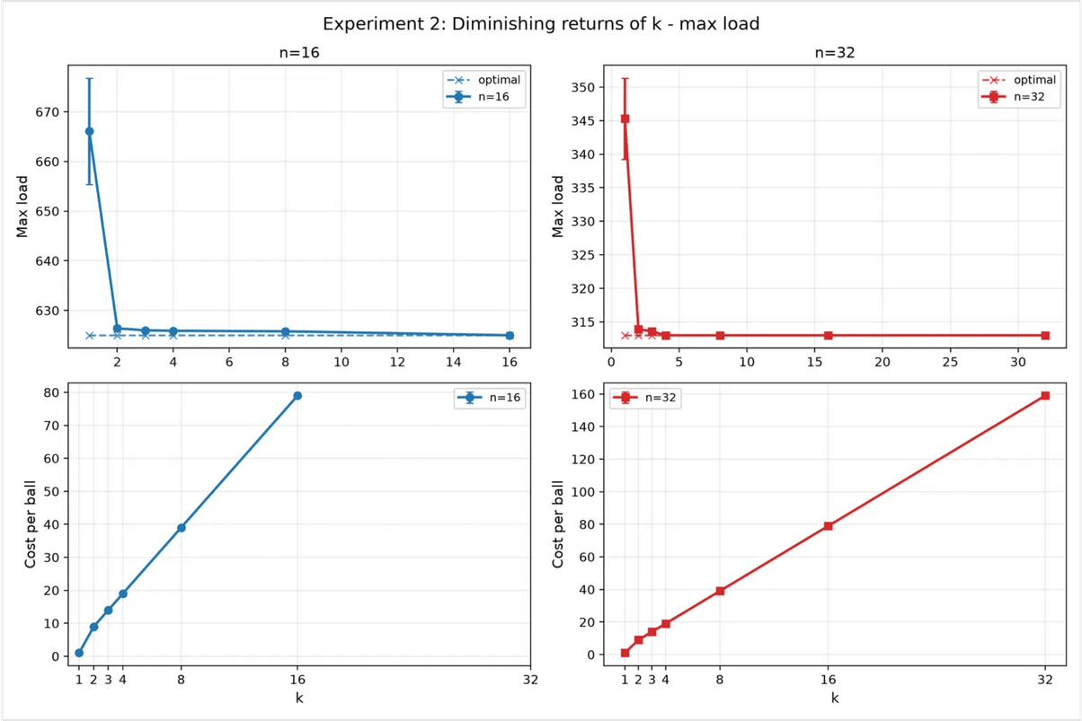
Diminishing Returns of k
Sampling more than two bins is rarely justified
While increasing the number of samples (k) continues to improve the load balance, the returns diminish rapidly after k=2.
The data shows that the improvement from k=2 to k=4 is marginal compared to the linear increase in decision cost per ball.
TAKEAWAY
For most stateless applications, k=2 represents the optimal balance between performance and overhead.
Notes:
While the Power of Two Choices gives us a huge win, we quickly hit diminishing returns. Sampling more than two bins rarely justifies the increased cost. We see here that the improvement from k=2 to k=4 is marginal. But the decision cost increases linearly with k. For most stateless applications, k=2 offers the optimal balance between performance and overhead. So, we get most of the benefit without the extra work. Now, let's look at how simple stateful policies fare.

Slide 7
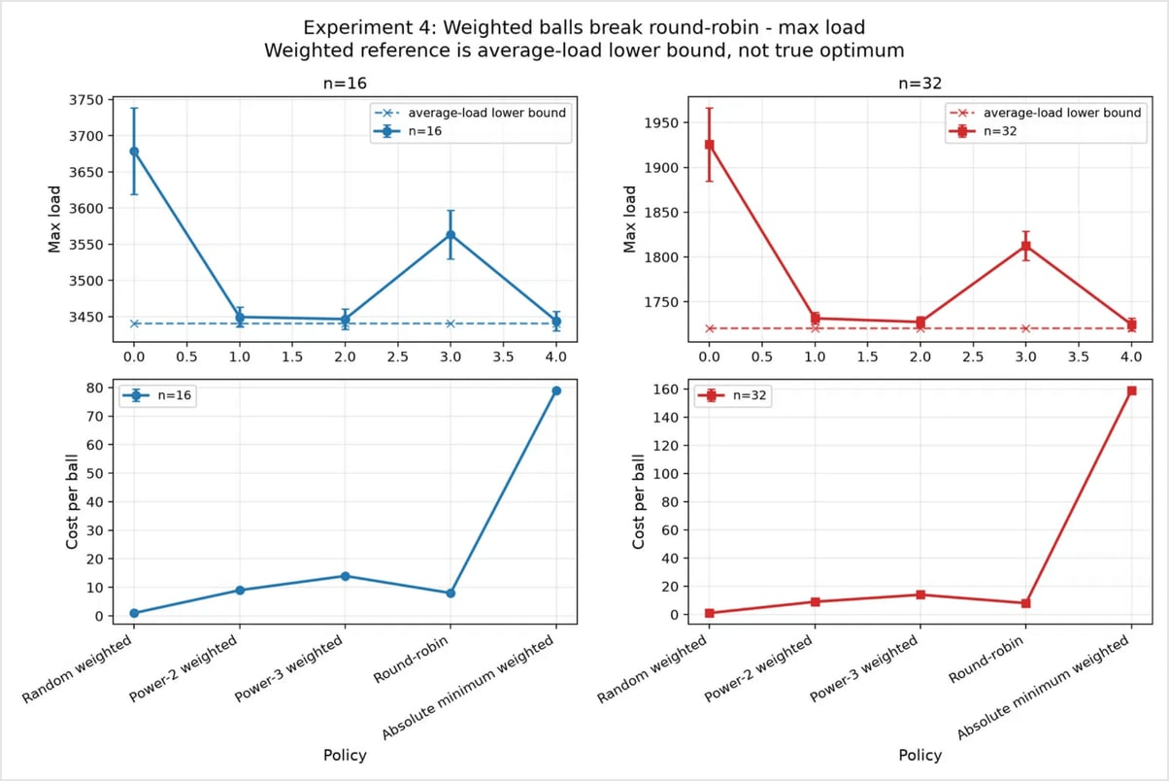
Round-Robin: The Fragility of Simple State
Balances counts, not actual load
Round-robin is often favored for its simplicity and low state requirements. However, it is fundamentally a "blind" policy that assumes all balls are equal.
TAKEAWAY
Stateful policies must be load-aware to remain robust under variable workloads; simple sequencing is insufficient.
Notes:
Moving from stateless to simple state, Round-robin is often praised for its simplicity. But this simplicity comes with a critical flaw: it balances counts, not actual load. Round-robin is a blind policy; it assumes all balls are equal. When ball weights vary, Round-robin completely fails to account for actual load. This leads to significant imbalances. Stateful policies must be load-aware to be robust under variable workloads. Simple sequencing just isn't enough. So, how can we use state more effectively?

Slide 8

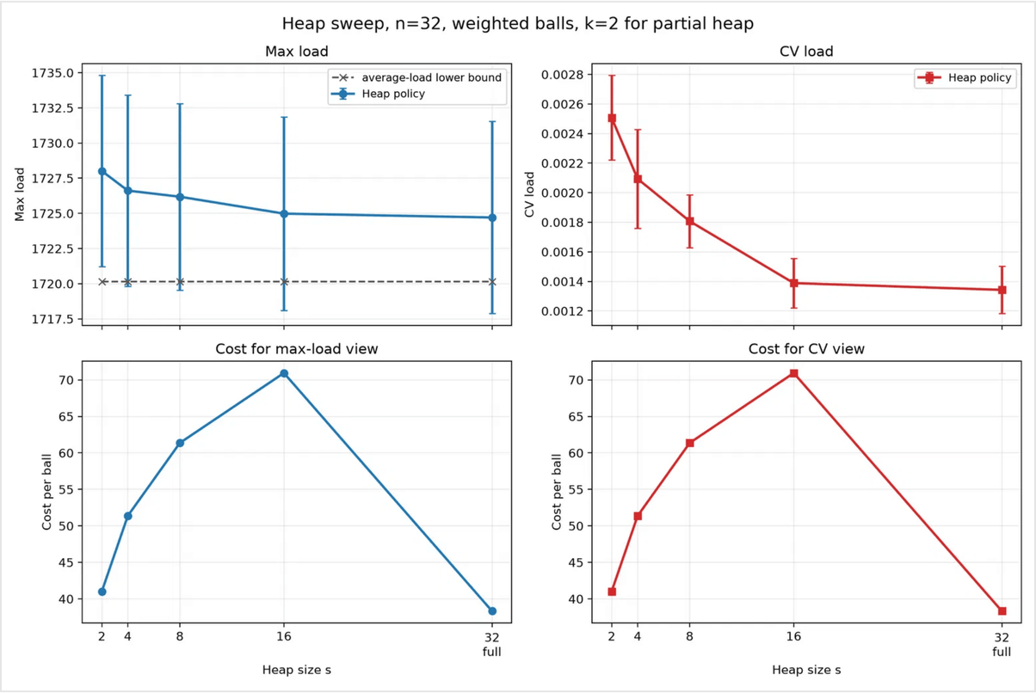
Heap: Approaching Global Quality
Maintained state replaces expensive scanning
By maintaining a heap of bin loads, we can achieve near-global allocation quality without the high cost of scanning every bin for every ball.
A full heap management strategy matches the quality of the "Absolute Minimum" policy but at a fraction of the per-ball decision cost.
TAKEAWAY
Heap-based designs are the superior choice when the system can afford the memory and update overhead of maintaining state.
Notes:
This is where a Heap-based approach shines, approaching global quality with state. By maintaining a heap of bin loads, we achieve near-global allocation quality. We do this without the high cost of scanning every bin for every ball. A full heap strategy matches the quality of the 'Absolute Minimum' policy. But it does so at a fraction of the per-ball decision cost. Heap-based designs are the superior choice when your system can afford the memory and update overhead of maintaining state. Next, we'll see how these policies handle initial imbalances.

Slide 9
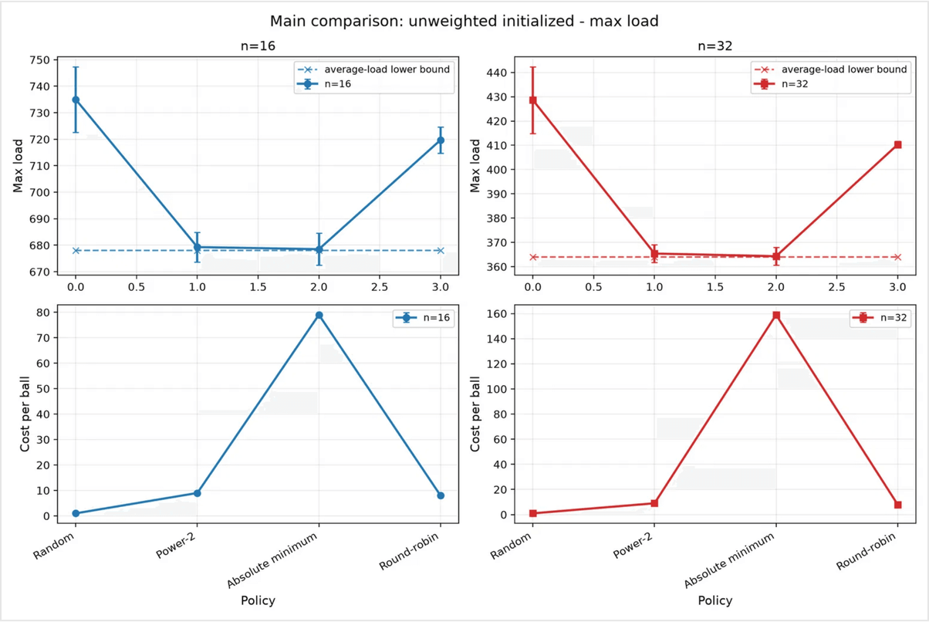
Robustness to Initial Imbalance
Systems in production rarely start from zero
Real-world load balancers must handle bins that are already partially filled. Randomized sampling policies like Power-2 are inherently self-correcting.
They naturally gravitate toward under-loaded bins, whereas sequence-based policies like Round-robin can preserve or even exacerbate initial imbalances.
TAKEAWAY
Randomized sampling provides a level of robustness and self-healing critical for dynamic environments.
Notes:
Production systems rarely start from a clean slate; they often have existing loads. This slide highlights how different policies handle initial imbalances. Randomized sampling, like Power-2, naturally self-corrects by favoring under-loaded bins. This is a critical advantage in dynamic environments. In contrast, simple sequence-based policies, such as Round-robin, can actually perpetuate or worsen existing imbalances. This self-healing property of randomized sampling is crucial for system stability. Next, we'll bring all these insights together to define the final performance trade-offs.

Slide 10
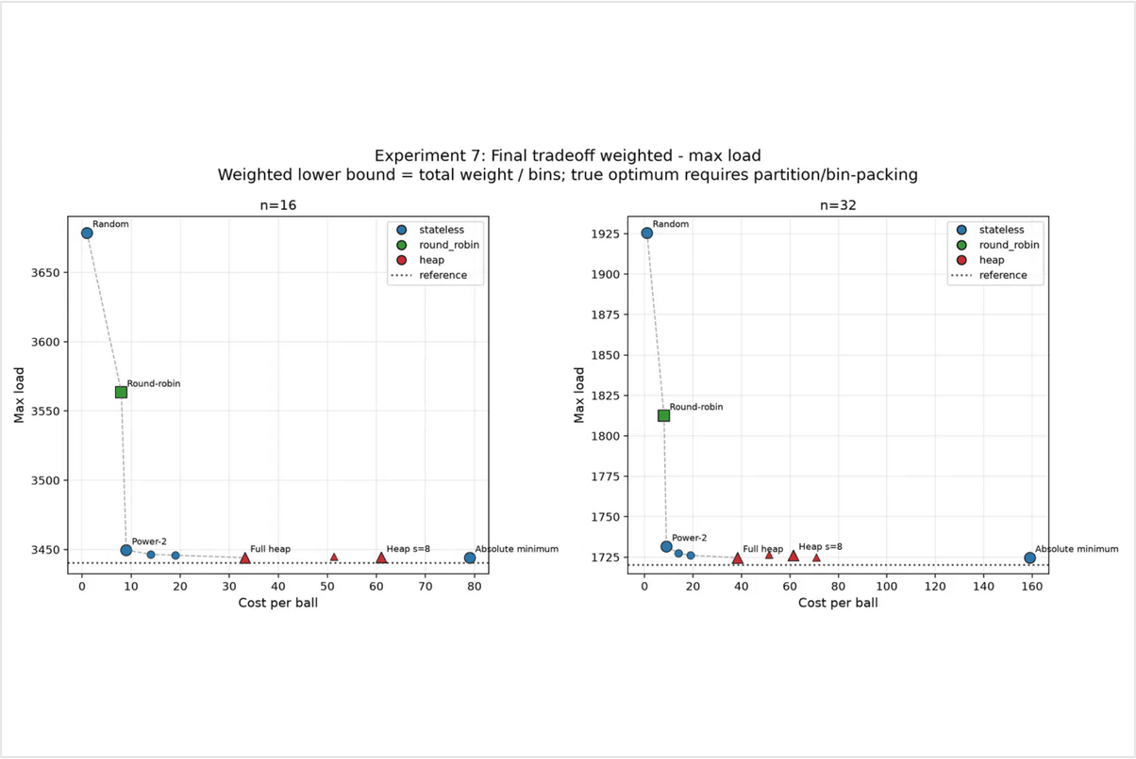
Final Performance Trade-off
Choosing the right strategy for complex environments
When evaluating all policies under the most realistic conditions—weighted balls and initialized bins—a clear hierarchy emerges.
Power-2 remains the strongest simple default, while Heap-based methods provide the highest quality for those who can manage the state.
TAKEAWAY
In complex environments, Power-2 is the most reliable stateless choice, whereas a Heap is the optimal stateful choice.
Notes:
Now, let's look at the complete picture, considering the most realistic conditions: weighted balls and pre-initialized bins. This slide presents the final performance hierarchy. Power-2 consistently emerges as the strongest default, offering excellent performance without state. For those needing the absolute highest quality, Heap-based methods are optimal, provided you can manage the state overhead. This analysis helps us choose the right strategy based on specific system constraints. We'll now summarize these findings into actionable engineering decisions.

Slide 11

Summary & Engineering Decisions
Two choices are usually enough
01. BEST DEFAULT
Power-2 provides high robustness and low cost without requiring any maintained state. It is the most reliable choice for high-throughput stateless systems.
02. BEST FOR QUALITY
Heap-based designs should be used only when the additional memory and update costs are justified by the requirement for near-perfect load balance.
03. DIMINISHING RETURNS
Global knowledge is rarely worth the price. The cost of full scanning is almost never justified by the marginal gains over Power-2 or Heap-based methods.
FINAL TAKEAWAY
Optimize load-balance quality per unit of decision and state cost. In most systems, the power of two choices is all you need.
Notes:
To summarize our findings, we have three key engineering recommendations. First, Power-2 is your best default; it's robust, low-cost, and stateless. Second, use Heap-based designs only when near-perfect balance justifies the added memory and update costs. Finally, remember that global knowledge is rarely worth the expense; the marginal gains over Power-2 or Heap are minimal. Ultimately, always optimize for load-balance quality per unit of decision and state cost. For most systems, the power of two choices is truly all you need.

