Slide 1
PERFORMANCE & ARCHITECTURE · TECHNICAL INTERVIEW
Balls into Bins
Load Balancing Under Cost Constraints
Randomized choices, stateful policies, and cost–quality tradeoffs
MAIN MESSAGE
How much load-balance quality does each policy buy for its decision cost?
10,000
16 & 32
10
BALLS
BINS
TRIALS PER SCENARIO
Kobi Kenzi

Slide 2
Problem Statement
Each arriving ball must be assigned to a bin immediately — no batching, no undo.
Objective: minimize the maximum load and the imbalance across bins.
Systems analogy: assigning jobs, network flows, or tasks to servers, links, or queues.
Central question: how much state or load information should the allocator use?
ONLINE ALLOCATION, ONE BALL AT A TIME
bins start at different loads
This models any system that must commit a resource assignment immediately, with only partial knowledge of global state.
2

Slide 3
Simulation Setup
10,000
16 & 32
10
4
BALLS PER RUN
BIN COUNTS TESTED
TRIALS PER SCENARIO
METRICS TRACKED
FOUR WORKLOAD / SETUP MODES
Mode 1
Mode 2
Unweighted balls
Empty initial bins
Weighted balls
Empty initial bins
Mode 3
Mode 4
Unweighted balls
Randomly initialized bins
Weighted balls
Randomly initialized bins
METRICS
Max load · Max–min gap · CV / load imbalance · Cost per ball
Every policy is evaluated across all four conditions — clean and adversarial alike.
3

Slide 4
Algorithms Compared
Stateless
Round-robin
Heap
Family | Policy | What it knows | Main cost
Stateless | Random | One random bin | Very low
Stateless | Power-k | k sampled bin loads | Grows with k
Stateless | Absolute minimum | All bin loads | High scan cost
Stateful | Round-robin | Next-bin pointer | Very low (state)
Stateful | Heap size s | Partial / global heap state | State + heap updates
The core comparison is stateless sampling vs. maintained state vs. full global knowledge.
4

Slide 5
Simulation Structure: Objects and Flow
Scenario
Simulator
policy
Bin loads +
cost model
Aggregated
metrics
CSV
Plots
SCENARIO
SIMULATORS
METRICS & OUTPUT
10,000 balls · 16 or 32 bins · 10 trials
Weighted or unweighted balls
Empty or randomly initialized bins
Selected policy + parameters (k, heap size s)
Seeds and cost weights
SimulationBase ‹abstract›
Max load, min load, max–min gap, CV / imbalance
Cost per ball and total cost
Aggregated across all 10 trials
Written to a results CSV
Plotting script turns the CSV into the deck's plots
Owns the load array, ball arrival, and cost accumulation.
Subclasses implement only: select bin.
↳ PowerKSimulator
Random, Power-k, Absolute minimum
↳ StatefulRoundRobinSimulator
Round-robin pointer state
↳ HeapSizeSPowerOfKSimulator
Partial heap / full heap state
All three simulators inherit from a shared SimulationBase — they differ only in how each selects a bin.
5

Slide 6
Theory Anchor: Why Power-2 Matters
One random choice leaves a small set of bins overloaded — the classic balls-in-bins bottleneck.
Sampling just two bins and keeping the less-loaded one cuts that bottleneck exponentially, not just by a constant factor.
This is the power-of-two-choices result (Mitzenmacher, 2001): a couple bits of local information go a very long way.
Beyond two choices, more sampling keeps helping, but only by changing the base of an already-tiny logarithm — diminishing returns, fast.
MAX LOAD, n BALLS INTO n BINS (WHP)
1 random choice
Θ( log n / log log n )
Propositions 2 & 5
2 choices — Power-2
log₂(log n) + O(1)
Theorem 2 (Mitzenmacher, 2001)
d choices
log_{d}(log n) + O(1)
Theorem 3
These bounds assume n balls into n bins. Our simulation runs heavily loaded — 10,000 balls into 16–32 bins — a different regime, but the same qualitative gap motivates Power-2.
Hypothesis: small local information captures most of the benefit. No proof here — the rest of this deck tests it empirically.
Theory motivates Power-2 as the practical randomized baseline — the rest of the deck checks it against real cost.
6

Slide 7
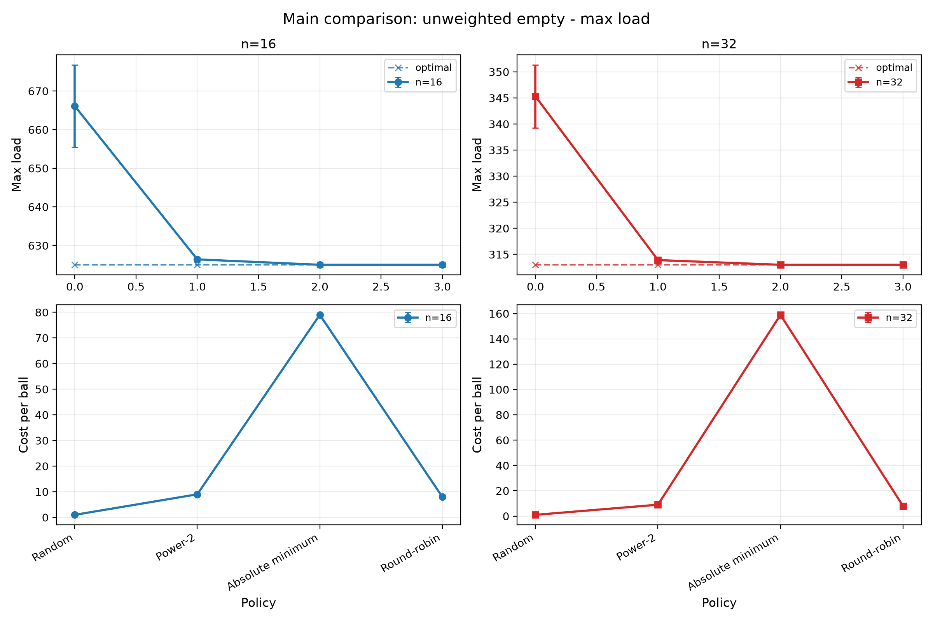
Clean Baseline: Power-2 Captures Most of the Gain
666.1 → 626.4
MAX LOAD, n=16 (RANDOM → POWER-2)
345.3 → 313.9
MAX LOAD, n=32 (RANDOM → POWER-2)
Absolute minimum adds only a small improvement beyond Power-2 — at much higher cost.
Power-2 nearly closes the gap to the ideal policy in the clean, unweighted case.
7

Slide 8
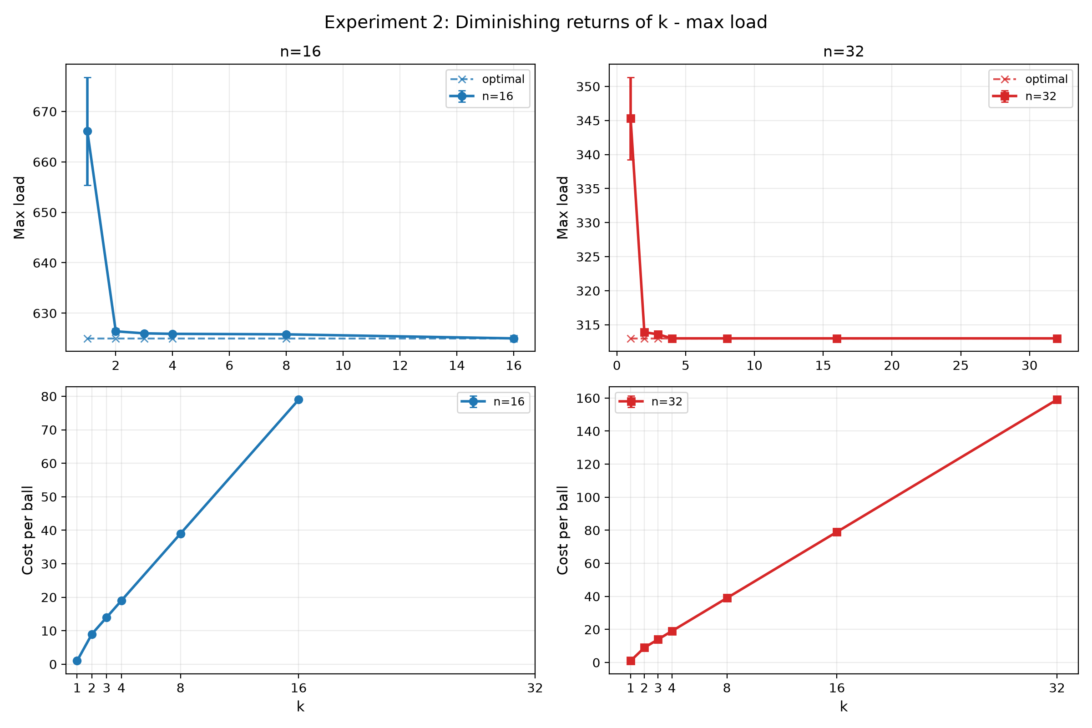
Diminishing Returns of k
626.4 / 626.0 / 625.9
MAX LOAD, n=16 — POWER 2 / 3 / 4
Cost per ball: 9 / 14 / 19
313.9 / 313.6 / 313.0
MAX LOAD, n=32 — POWER 2 / 3 / 4
Cost per ball: 9 / 14 / 19
Cost grows roughly linearly with k — quality gain does not.
The big improvement is k=1 → k=2. Larger k mostly increases cost.
8

Slide 9
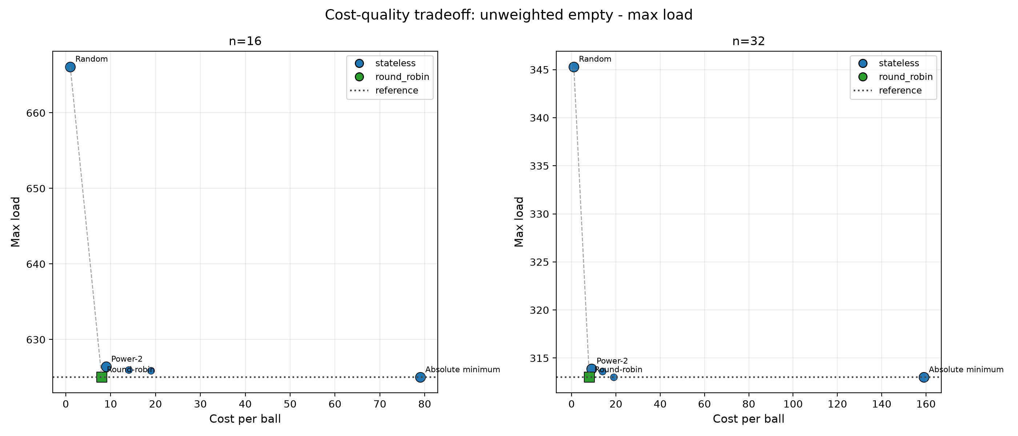
Cost–Quality Tradeoff
Absolute minimum Near-optimal — but expensive
Round-robin Looks excellent here — but fragile
Power-2 The knee of the curve
Power-2 delivers most of the achievable quality for a small, flat cost — the knee of the curve.
9

Slide 10
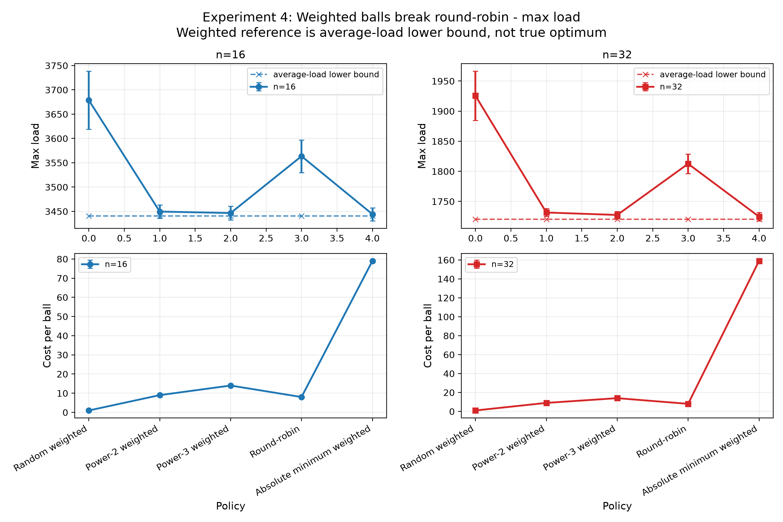
Weighted Balls Break Count Fairness
1812.6 vs 1731.6
MAX LOAD, WEIGHTED n=32 — ROUND-ROBIN vs POWER-2
Fair by count can still be bad by load. Power-2 reads current load and adapts; round-robin does not.
The same pattern appears at n=16: round-robin's clean-case advantage disappears once balls carry weight.
Round-robin balances counts, not load — weighted balls expose that weakness.
10

Slide 11
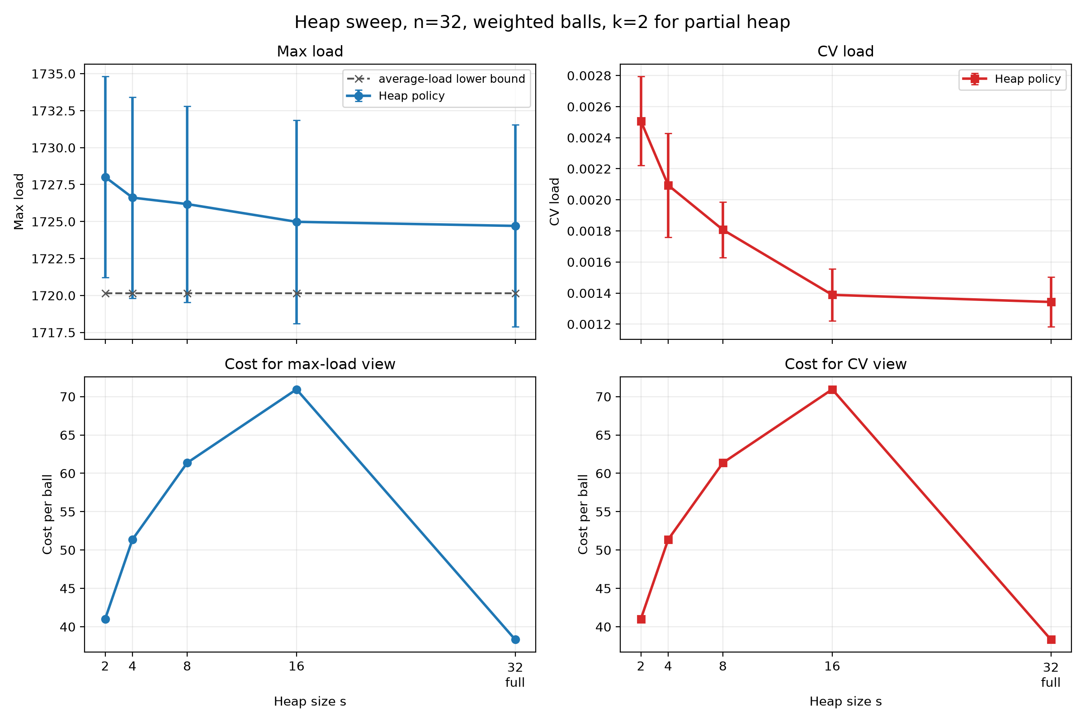
Stateful Heap: When Maintained State Helps
≈ 38.3 vs ≈ 159
COST PER BALL — FULL HEAP vs ABSOLUTE MINIMUM
Full heap matches absolute-minimum quality (max load ≈ 1724.7) at a fraction of the cost.
Partial heap tracks s bins; full heap tracks all bins. More state steadily improves quality, at rising update cost.
A maintained heap can approach global-min quality without scanning all bins every time.
11

Slide 12
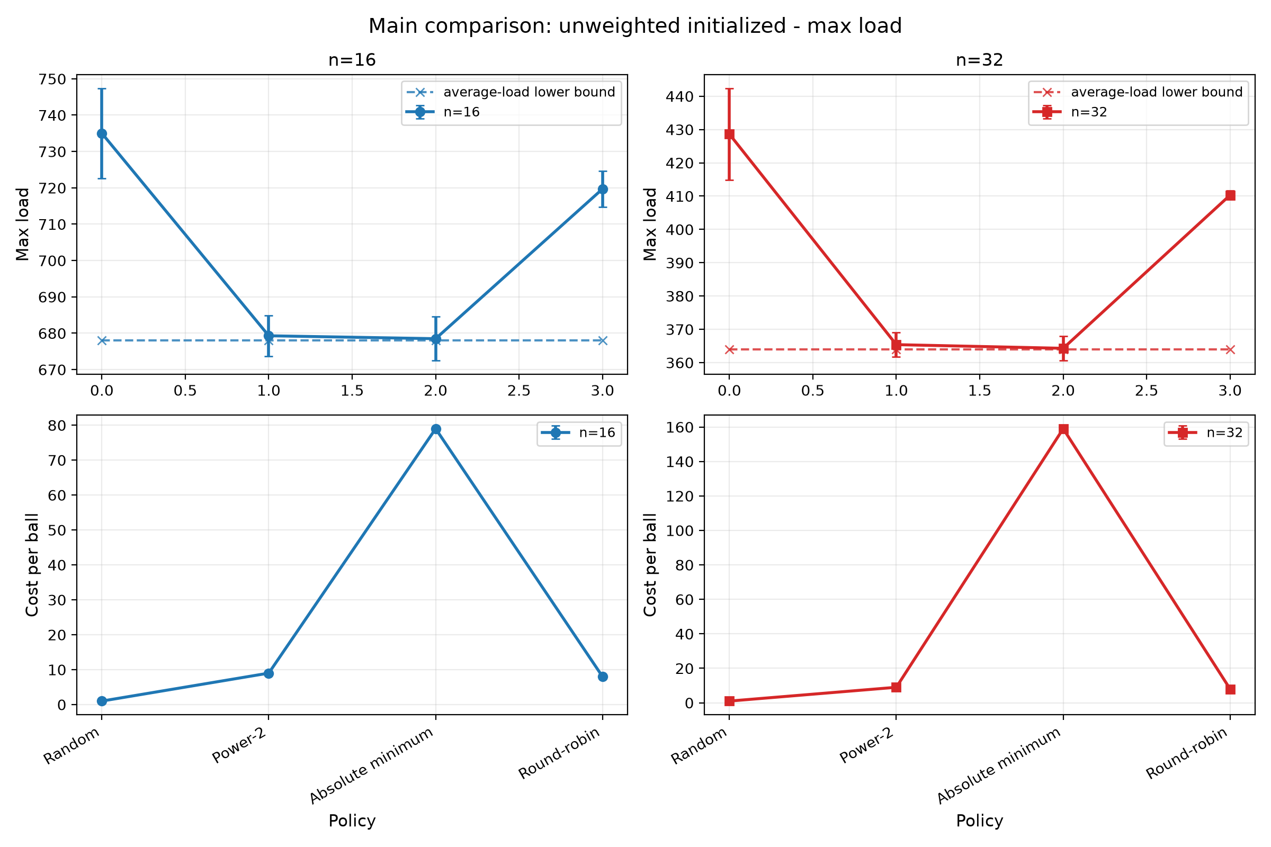
Initialization Tests Robustness
679.3 vs 678.0
MAX LOAD, n=16 — POWER-2 vs REFERENCE
365.4 vs 364.0
MAX LOAD, n=32 — POWER-2 vs REFERENCE
Real systems rarely start from zero. Round-robin can preserve — rather than correct — initial imbalance.
Starting from non-empty bins exposes whether a policy corrects imbalance or just preserves it.
12

Slide 13
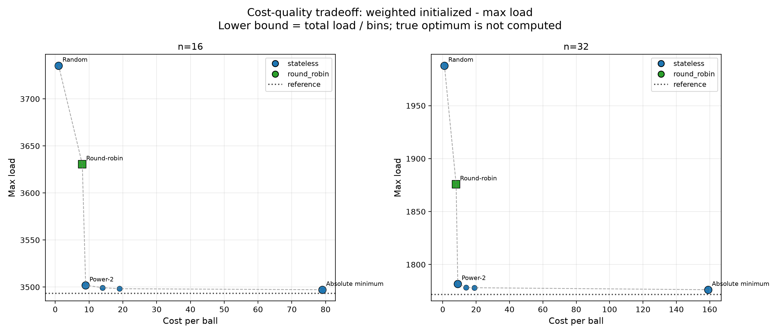
Final Realistic Tradeoff: Weighted + Initialized
Random
Too weak
Absolute minimum
Expensive
Round-robin
Fragile
Power-2
Simple, stateless, robust
Under weighted, initialized conditions, Power-2 is the strongest simple default.
13

Slide 14
C++ Implementation Overview
Scenarios
Simulators
Metrics CSV
Plots
Conclusions
src/main.cpp builds scenarios, runs them, and exports results/simulation_results.csv.
ExperimentRunner creates all experiment scenarios.
PowerKSimulator
StatefulRoundRobinSimulator
HeapSizeSPowerOfKSimulator
Random, Power-k, Absolute minimum
Round-robin
Heap size s / full heap
scripts/plot_results.py reads the CSV and creates the plots. The deck uses repository outputs only.
The project is structured as a repeatable performance-evaluation pipeline, not a one-off script.
14

Slide 15
ENGINEERING CONCLUSION
Two choices is the best default.
Most of the balance benefit, with little decision cost.
Good robustness across weighted balls and initialized bins.
Full global knowledge is rarely worth the price.
Stateful heap designs can improve quality further — when memory/update cost is justified.
ENGINEERING DECISION
Optimize load-balance quality per unit of decision and state cost.
15

