Slide 1
MLDP Project Presentation
TELECOM CUSTOMER CHURN
By: Kenzie Tan Si En

Slide 2
TABLE OF CONTENTS
01
02
03
BUSINESS UNDERSTANDING
PREDICTIVE MODELLING
DATA CLEANING & INSIGHTS
Using algorithms to predict customer churn
Understanding the business aspect & its solution
Insights gathered from EDA

Slide 3
MARKET RESEARCH
WHY IS IT IMPORTANT TO RETAIN CUSTOMERS
ABOUT THE DATASET/COMPANY
Retaining customers continuously bring in profit
Costs 5x as much to acquire a new customer than keep one (Forrester, 2019)
Source of dataset: Kaggle
It is a subset of the data taken from IBM
It is a telecom company
Company kept anonymous – alias telecom X
SOLUTION
Accurate prediction to classify customer churn
Notes:
retaining customers continuously bring in profit from re-subscribing to telecom X’s contracts. Although it may sound trivial, according to research from Forrester (2009), it costs 5 times as much to acquire a new customer than to keep one.

Slide 4
DATA CLEANING & INSIGHTS

Slide 5
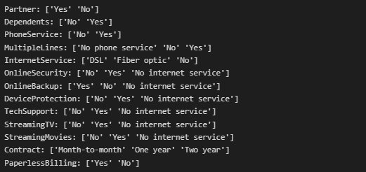
DATA CLEANING
MISSING VALUES
DATA TRANSFORMATION
11 rows in TotalCharges with missing values
They were missing completely at random
Actions: removed these rows
Changed “No internet service” to “No” as they imply the same meaning
Notes:
After checking for anomalous values, I discovered that there were 11 rows in TotalCharges with values of “ “. From my observations, as there are no other columns with missing values, and I am unable to think of any relation on why these values are missing, I shall classify them as missing completely at random. I have decided for these rows, I would be dropping them. Only 11 of the 7043 rows has missing values, almost no effect in data loss, 11 rows would unlikely affect EDA and predictive modelling much.

Slide 6
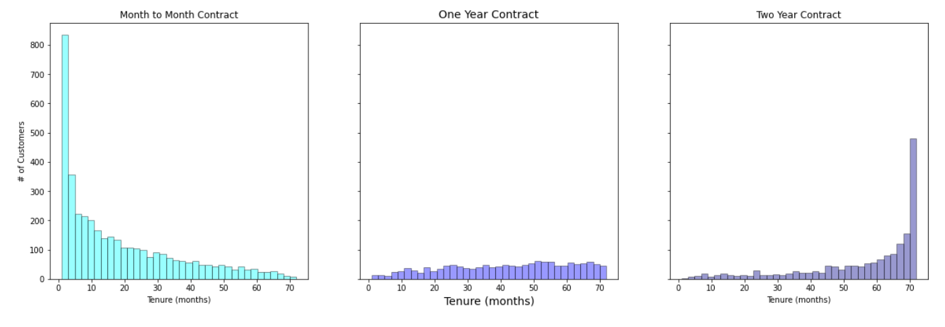
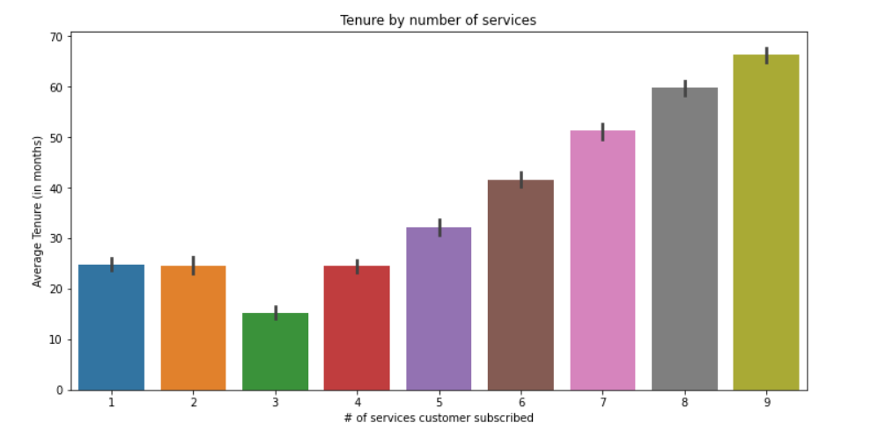
TENURE & CONTRACT
CUSTOMERS BY TENURE, AMONG CONTRACTS
TENURE AND NUMBER OF SERVICES
Every customer has at least 1 service subscribed
General trend: more services, longer tenure, for > 4 services
Most customers signed up for month-to-month contract, and stayed with the company for 1-3 months
Customers with 2 year contracts tend to last for > 65 to 70 months
Notes:
Distribution of customers among contracts:
Most customers opted for the month-to-month contract
The one year and two year contract have around the same number of people opted Majority of customers who signed up for month-to-month contract stayed with the company for 1-3 months, while most of the customers with 2 year contracts tend to last for more than about 65 to 70 months, even though 2 year contracts are only 24 months long, which implies that customers are more likely to recontract with telecom X, compared to one year contract and month-to-month contract.

Slide 7
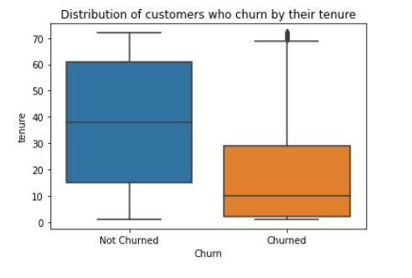
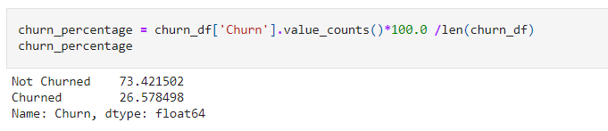
CHURN WITH OTHER FEATURES
RELATIONSHIP BETWEEN CHURN & TENURE
FINDING OUT CUSTOMER CHURN RATE
~26.5% customer churn
Realistically too high, data could be skewed towards a higher churn rate
Important to note:
- Data modelling on a skewed dataset could lead to more false negatives
Customers who did not churn generally stays with telecom X longer
Anomalies: customers with high tenure also did churn
Notes:
Gender distribution in customers is almost the same (~ 50% for both male and female) Noticibly, both the distribution for senior citizens are also about evenly distributed among both genders Most of our customers are younger people

Slide 8
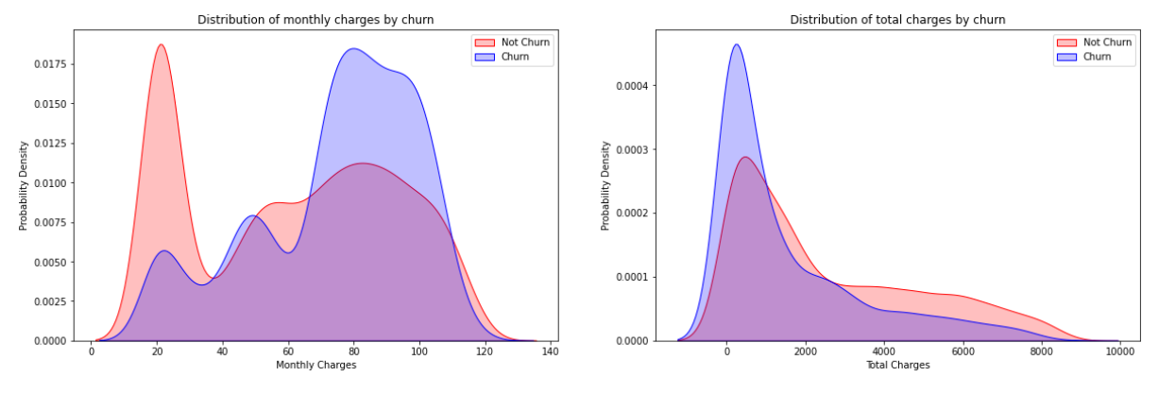
CHURN WITH OTHER FEATURES
COMPARING CHURN BETWEEN MONTHLY & TOTAL CHARGES
FINDINGS
MonthlyCharges:
customers who pay > 70 are more likely to churn
TotalCharges:
customers who pay < 1700 are more likely to churn, overall not much difference
Notes:
Generally, for monthly charges, customers who pay a lower monthly charge are more likely to not churn, compared to customers who pay > 70 are more likely to churn For total charges, there is not much difference between whether customers will churn or not, however, it is notable that customers who paid < 1700 are more likely to churn, those who did not churn are a little more skewed towards higher total charges compared to those who churned

Slide 9
PREDICTIVE MODELLING

Slide 10
DATA PREPARATION
CATEGORICAL DATA ENCODING
Shortcomings & Assumptions
Label encoding - binary categorical data
One-hot encoding – categorical data > 2 unique values
1. We are assuming that all features are independent (unlikely)
2. Data imbalance – higher weight to majority class
Notes:
We do not know what the company is, this means that we are unsure how the different contracts may affect the number of services subscribed (usually not the case in real life). Now we are assuming that all these different features are independent and mutually exclusive from each other, which may have affected the accuracy of the model.

Slide 11
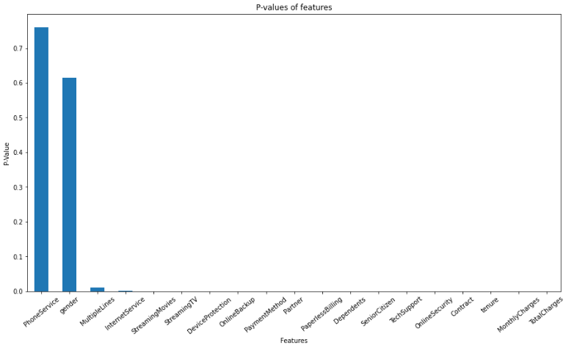
Data Preparation
Features Scaling
0-1 normalization for numerical features - specifically for K-Nearest Neighbours
Kept original for models which do not need features scaling
Features Selection
Chi-Squared Test
- Remove features not statistically significant
- P-value threshold set to 0.05
Features removed: PhoneService & Gender
Notes:
the purpose of this chi-squared test is to test for a feature’s independence using p-values. As for me I set the threshold p-value of accepting the null hypothesis – that a feature is not significant, for features whose values are > 0.05

Slide 12
MODEL SELECTION
Algorithms Used
Metrics Selction
goal for prediction: prevent customer churn before they do happen
Precision is the % of all churns that the model correctly identifies
Recall is the % of identified churn that ends up churning
F1-score: harmonic mean of precision & recall
K-Nearest Neighbours, Naïve Bayes, Random Forest, AdaBoost
Handle data imbalance:
- Random Forest (bagging), AdaBoost (Boosting)
Notes:
We do not know what the company is, this means that we are unsure how the different contracts may affect the number of services subscribed (usually not the case in real life). Now we are assuming that all these different features are independent and mutually exclusive from each other, which may have affected the accuracy of the model.

Slide 13
HYPERPARAMETER OPTIMIZATION
Algorithms Used
Stratified Kfold Cross Validation
Replaces normal train_test_split
Reduces bias – most data used for fitting
Reduces variance – most data used for testing
Stratified version cross validation:
ensure data imbalances are accounted for and well represented in both training and testing data
K-Nearest Neighbours, Bernoulli Naïve Bayes, Random Forest, AdaBoost
Handle data imbalance:
- Random Forest (bagging), AdaBoost (Boosting)
Notes:
We do not know what the company is, this means that we are unsure how the different contracts may affect the number of services subscribed (usually not the case in real life). Now we are assuming that all these different features are independent and mutually exclusive from each other, which may have affected the accuracy of the model.

Slide 14
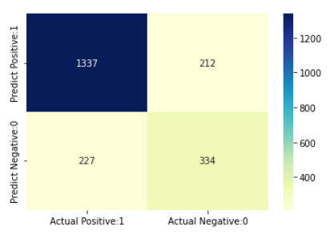
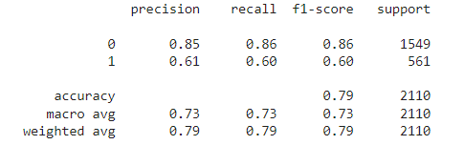
MODEL PERFORMANCE
Best performing model: K-Nearest Neighbours

Slide 15
THANK YOU

Slide 16
REFERENCES
Forrester. (2009, April 1). Listen to the Voice of the Customer. CRM Magazine. https://www.destinationcrm.com/Articles/Web-Exclusives/Viewpoints/Listen-to-the-Voice-of-the-Customer-53239.aspx

