Slide 1
Citrus Toolbox
Moving towards a better Renderer

Slide 2
Inspired By
https://advances.realtimerendering.com/s2020/RenderingDoomEternal.pdf
https://advances.realtimerendering.com/other/2016/naughty_dog/
https://vkguide.dev/docs/gpudriven
https://roar11.com/2019/06/vulkan-textures-unbound/
https://gpuopen.com/performance/
https://ourmachinery.com/post/moving-the-machinery-to-bindless/

Slide 3
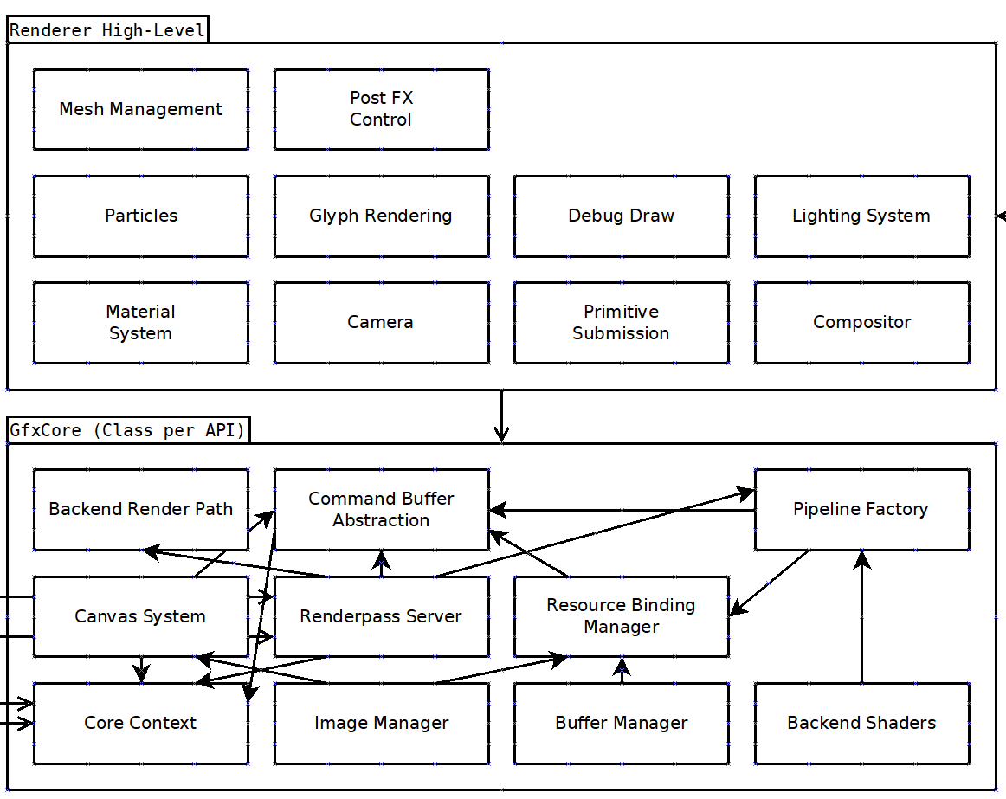
The Current Abstract Approach
Core/High Level
High Level Renderer
  Uploads Data to Buffers/Images
  Writes Command Buffers
  Runs only CPU side code :(
GfxCore
  Talks to GPU API
  Manages device and resources
  Also implements some more high level features :(

Slide 4
Benefits of Abstraction
Under this approach creating new parts of the rendering system is simple as long as:
  They only work with the existing buffer/texture/cmd API.
  The simplest approach is taken and performance isn’t too heavily scrutinized or a low level optimization is required.
  Pretty much no rendering infrastructure approach past 2009 is used...

Slide 5
Shortcomings of Abstraction
All of the previously mentioned caveats...

Slide 6
What didn’t it address?
Unfortunately the old design ignored how the scene would be rendered/culled and displayed from different perspectives and assumed that would be implemented in the component system. While this is more modular and can play well with CPU driven rendering, a lot more could be done if the complete state of the scene was known by the renderer.

Slide 7
Breaking the Abstraction
Unify the GfxCore and the Renderer
Ditch multi-API per-platform support!
One Renderer per API! Write the Renderer to always be in close contact with the low-level graphics API!
The Renderer should still communicate with the scene/component system via a slim interface without the graphics API leaking into other parts of the engine.

Slide 8
Arguments for a “Black Box”
General purpose abstraction layers are unwieldy to maintain, a small one designed for a specific use will still often come as an obstruction to many real world tasks.
Having access to the raw low-level graphics API allows for deep optimizations at every stage without having to worry about how the optimization bubbles it’s way through the abstraction layers.
Citrus only targets PC using Vulkan with no intentions to make mobile/web games, nor will it likely produce any console games.
Come that day porting the Vk to DX12/GNM should still be easy.

Slide 9
Envision a Game
Genre: Racing
Inspiration: F-Zero/Wipeout
Rendering Requirements: Maintain solid 60FPS!!! Style: retro callback to PS2/GC era photo-textured visuals with higher polycount/texel density. Scene can be partitioned into checkpoints. Vertex lit. Effects such as glow/bloom, dynamic reflection-mapping, and distortion for water/heat. Bombastic environment animation for liveliness.

Slide 10
Design for what you need!
Static/Skinned Meshes
Simple Particles
Vertex lighting (offline/realtime)
Dynamic Cubemapping
Bloom/Material Glow
Water Pass
Distortion Pass
Debug Draw/ImGUI
Multi-Window Rendering (Best practice for editor)

Slide 11
Abstraction Reducing Code Paths
What is the Renderer’s Responsibility?
We only care that it can talk to the GPU and while it is doing so we can:
  Load geometry and textures from disk.
  Update contents of transforms/bones/particles/glyphs/materials.
  Tell it that geometry should be instanced somewhere with a material.
  Setup the lighting conditions of the scene.
  Setup the virtual camera(s).
  Render the scene from a camera onto a region in a window/snapshot.
Anything else can come later, we don’t need to design for the kitchen sink.

Slide 12
Addressing the Issue: Code Duplication
Instead of abstracting the API to reduce code duplication consider writing helper functions like:
  Creating an image an image view together.
  Doing setup for a command buffer of a renderpass.
  Uploading data from a staging buffer.
  And so on…
Use API constructs as function inputs rather than assuming fixed use case (ex: VkImageView, VkBuffer)

Slide 13
Let’s Build a new Renderer!

Slide 14
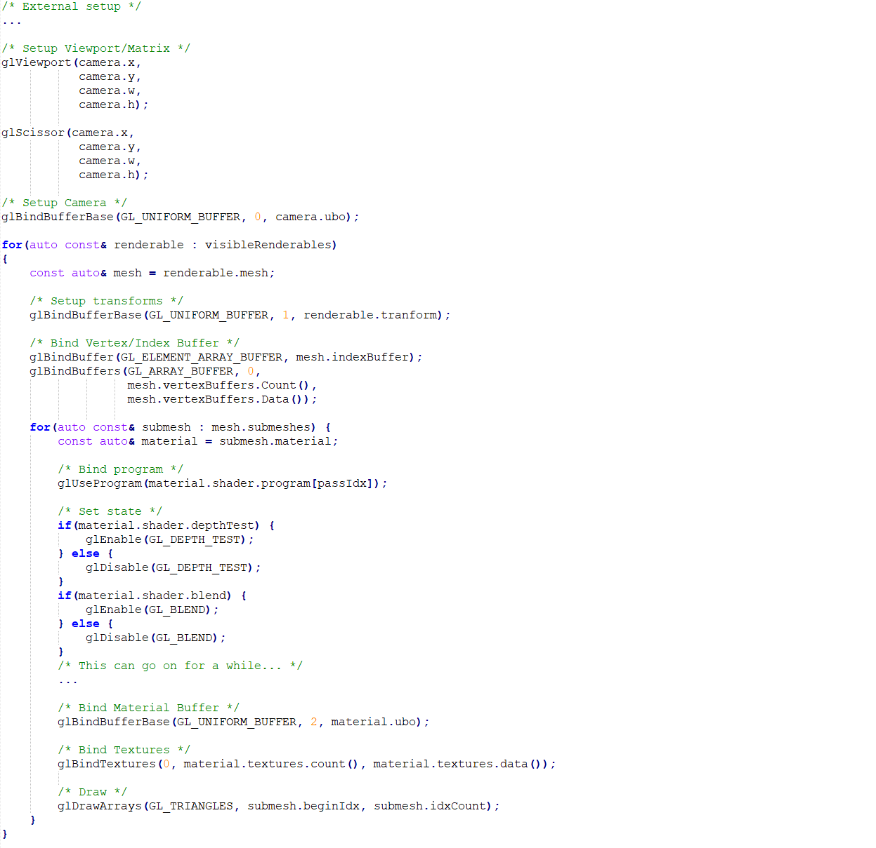
Rendering a Scene (GL Style)
Immediate mode modernized with buffers.
Lots of diving through data structures per-call (could be improved with caching)
Gets messy with driver state management behind the scenes patching shaders.
We know what needs to be drawn up-front... so much busywork!!!
Outside of scene graphs this API style barely makes any practical sense.
*This was written as an example, not compiled

Slide 15
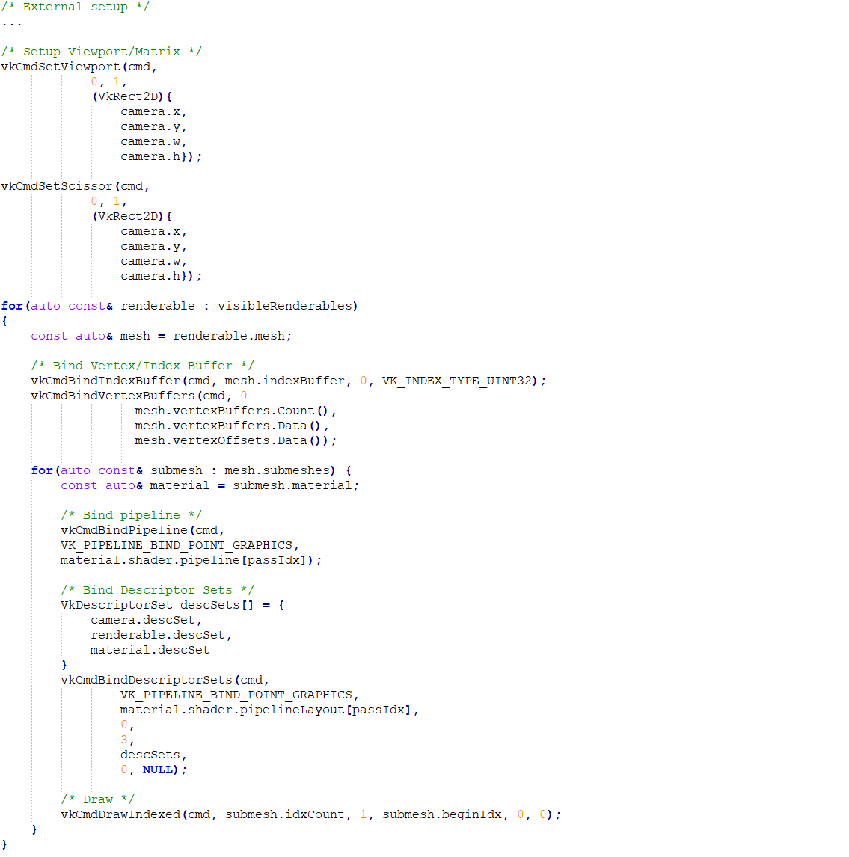
Basic approach: Replicate in Vulkan
Um… Better?… We don’t have that driver state nonsense but we are still iterating through the same stuff to render a scene… But we can multi-thread the passes… So that’s… Good? Hardly revolutionary though...

Slide 16
What can be improved?
We can avoid the GPU relying on the CPU to feed it draw commands as much as possible by pushing the scene state in it’s entirety to the GPU and update what changed each frame.
Once all of the scene info is accessible via the GPU we should be able to not only cull them, but merge all draw-calls using the same pipeline.
We only need to bucket by vkCmdBindPipeline()!!!

Slide 17
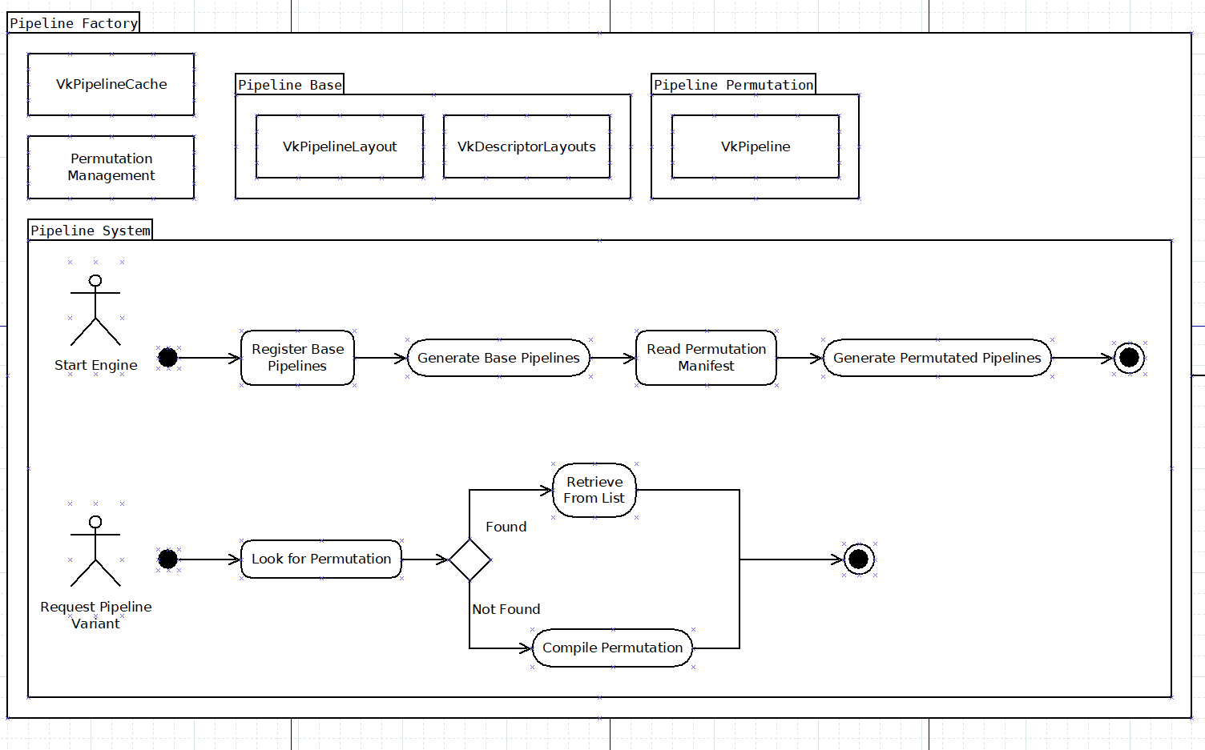
Dealing with Pipelines
Pipelines should be compiled at application start and cached for reuse on multiple runs.
Pipelines can be retrieved once at material fetch based on a bit-flag of a permutation shader/quality/feature set.
Using Ubershaders we can compile the base pipeline and use it to speed up permutation pipeline compilation.
By running static analysis on the asset system and a runtime manifest only relevant permutations need to be compiled instead of every possible bit.

Slide 18
Pipeline Permutations
In Theory…
  Billions of possible combinations that need to be compiled for hours or else the frame-rate enters a death-spiral
  Seems many commercial engines just hit this and compile tens of thousands of PSOs...
In Practice (hopefully)…
  A couple of pipelines for common use cases. (eg: blended terrain, screens, glass, particles, animated meshes, water, etc.)
  Can be culled further by trimming irrelevant combos.

Slide 19
Shader Option Handling
Material Options Fields
  Shader Type
  Feature True/False (ex:)
    Use Base Texture
    Use Glow Texture
    Use Reflectivity
    Is Lit
    Is Cutout
    Etc...
Feature Culling Indices
  Disables feature bits to trim permutations
  Per-Shader Type
    Uint8 FeatureReq[48]
      DependsOtherFeatureIdx[6]
      DependsOnFeatureOff[1]
      AffectsDepth[1]
Final Pipeline Key(s) (Uint64)
  Shader Type : 8
  Pass : 3
  Quality : 2
  Geometry Type : 3
  Features : 48

Slide 20
Building Shaders
In the build system call glslc and output a SPIR-V file in the generated directory, use File2Header to include in project build...

Slide 21
Going Bindless
One global descriptor set with buckets of descriptors for each texture/data stream type.
Access to every texture and buffer in memory from every draw call. Greatly simplifies material system.
Can potentially render every single triangle in a single draw call (if we ignore multiple pipelines)
Reduces API complexity since the CPU doesn’t need to know what resources are used for what draw call.

Slide 22
Bypass the Input Assembler
Skips calls to vkCmdBindIndexBuffer() and vkCmdBindVertexBuffers
Use storage buffers for vertex/index buffers
Implement geometry reading from the shader (nowadays the driver does this at PSO compile so shouldn’t any real cost. AMD recommends this, new cards don’t do fixed function)
Makes moving to meshlets/mesh shaders easier (will still use vertex shaders mixed with compute for culling/processing)

Slide 23
Scratch Data
Upload scratch temporary data such as resources for a compute shader into push constants, this limits to 128 bytes but this should more than suffice for feeding resource handles and parameters for simple tasks… Passing data to draws via push constants is no longer a viable option.

Slide 24
CPU→GPU Uploads
Multi-buffer frames to allow the CPU to work ahead.
Prefer uploading new data to multi-buffered staging resources not accessible via the bindless system.
Create an order queue of resource updates.
  Minimize multi frame state duplication
  Allow partial resource uploads rather than swapping
  Only cannon representation of resources is on GPU

Slide 25
Global Descriptor Set
Use global descriptor set(s) as we are using a bindless indexing system and binding cost is irrelevant.
The descriptor set will need to be updated with new textures/buffers, this requires a swap to an unused set.
The global resource descriptor sets will need to be frame buffered alongside their update history to be kept up to date when a descriptor set returns from it’s flight.
https://gpuopen.com/performance/#descriptors

Slide 26
DDS/KTX/GBIN Files
Load DDS/KTX (Images)
  headers with Tiny_DDS and Tiny_KTX
  If compatible use direct GPU load from storage
  If not available async copy contents over via the CPU using a fixed staging buffer/set of commands each frame.
Load GBIN (Buffers)
  Upload the entire file to a GPU Buffer with async staging

Slide 27
Death to Draw Calls: Indirect Drawing
(Sort of) We still need a few draw calls as we cannot bind new pipelines on the GPU yet :(
Bucket and store DrawIndexedIndirectCommands in continuous buffers per-pipeline and draw them.
We could implement further GPU culling by feeding back successful culls into buffers for indirect count.
We would only have as many draw calls as on-screen pipeline permutations (we can cull that down on the CPU)

Slide 28
GPU Culling
Run culling via compute shader to test against bounds.
We can investigate occlusion culling later in the project’s life should that be a good optimization for our game. (it might not be that helpful depending on track design)
  We can either generalize with depth pyramids or design the track with hand authored occlusion geometry.
https://vkguide.dev/docs/gpudriven/compute_culling/

Slide 29
Transparent Sorting
(Maybe Necessary)
http://www.heterogeneouscompute.org/wordpress/wp-content/uploads/2011/06/RadixSort.pdf

Slide 30
Empty Draw Call Culling
GPU will idle. We should ideally tell the CPU to skip empty draw calls.
Read back buffer information. Would mean we can skip the requirement for draw indirect count. Would require a small GPU→CPU read-back each frame.
Test for whether or not to do draws on CPU (not ideal)
“VK_EXT_conditional_rendering” TO THE RESCUE!!! (Optional, if driver doesn’t support it accept the loss)

Slide 31
Fetching Instance Data: Scene on GPU
Indirect Commands (Bucketed by Pipeline)
  Instance Base (index into render-able data)
Renderable Data Streams (SOA on GPU)
  Material Index
  Geometry Data Streams Indices/Offsets
  Transform
Sanitize creation to ensure that all streams have been populated, geometry and materials MUST be updated together, while transforms can be arbitrarily updated.

Slide 32
Material Structure
Shader Feature Flags (used to select pipelines)
One size fits all buffers for all rendered surfaces to avoid fragmentation and simplify lookup.
Post-fx shaders will not use the material structure and will work using camera settings or permutations for quality levels.

Slide 33
Cameras
CPU Data
  GUI Canvas
GPU Data:
  Post FX Settings
ISSUE!!! Can lights be cameras? Solution: split viewports up into it’s own stream and have lights and use them for rendering the Point of View/Perspective/Settings

Slide 34
Level of Detail
Store multiple indirect commands per-level-of detail in scene description and promote to final draws in the culling stage based on screen percentage.

Slide 35
Particles
Can be animated with offline generated VATs
Can be simulated (ISPC?)
Support Motion vector flipbooks
Vertex lit

Slide 36
Glyph Rendering
Render fonts atlas with “stb_truetype”
Render text by uploading rect data into glyph streams.
Use an SDF shader to improve text scalability.

Slide 37
Material Properties
Is Distortion
Diffuse Color
Spec Color
Spec Power
Glow Strength (Add to buffer Alpha)
Use Dynamic Lighting
Use Vertex Baked Lighting
Transparency: Blend/Add/Clip
Use Alpha as Reflection Mask
Base Texture
Reflection Texture

Slide 38
Sun Lighting

Slide 39
Indirect Lighting
Keep it painfully simple!!!
  Load Cube-map processed with Knald’s Lys.
  https://docs.knaldtech.com/doku.php?id=specular_lys
  Ambient Occlusion can be baked into vertex/texture.
  Sky Occlusion decals for tunnels.
We just need to get a game running and looking acceptable, use existing tools wherever possible. We can improve later.
Speed > Quality

Slide 40
Clustered Lighting
TBD

Slide 41
Physically Based Rendering
Metal/Roughness workflow
Follow GLTF guidelines
Keep a lightweight implementation
https://google.github.io/filament/Filament.md.html
https://github.com/SaschaWillems/Vulkan-glTF-PBR

Slide 42
NOT making a bloated Render Graph...
In other words: don’t optimize for everything and end up with nothing!
The goal here is to make a small but manageable renderer, not an abstraction playground. Render graphs are the ultimate in the latter.
More time up-front, less time debugging a mess.
Either way we will be battling sync through production.
Keep it simple stupid!!! Plan ahead!!!

Slide 43
Water/Glass/Particle Ordering
For Each Split:
  Render Solid Depth Pre-pass
  Render Glass/Water GBuffer
  Render Main Solid Geometry Pass
  Render Thick Glass/Water Absorption (Multiply)
  Render Thick Glass/Water Composite (Refract/Reflect)
  Render Thin Glass (Multiply/Add)
  Render Blend Particles (Alpha Blend)
  Render Add Particles (Alpha Add)
  Render Distort Particles (Add Distort Buffer)
  Post Processing
Composite Splits
Render GUI (No Sorting, Immediate FIFO)

Slide 44
Post FX: Bloom

Slide 45
Post FX: Color Grade
http://paulbourke.net/dataformats/cube/
Load as an HDR volume texture
Simple volumetric lookup
Grade in image manipulation software

Slide 46
Split-screen
TBD

Slide 47
GPU Frame History
Keep per split
  Pre-GUI
  Depth Pyramid
Per Window
  Frame on pause

Slide 48
GUI: A layering issue
We need the flexibility of being able to sort and draw arbitrary layers of blended transparency, this includes arbitrary pipeline binding. It would be best to use CPU driven rendering with direct draw calls as this complicates the pipeline significantly to deal with such complexity on the GPU.

Slide 49
Pause Mode
Keep final composite to conserve power
Keep rendering GUI to provide a pause menu
For Each Split:
  Render Solid Depth Pre-pass
  Render Shadow and Occlusion Decals
  Render Glass/Water GBuffer
  Render Main Solid Geometry Pass
  Render Glass/Water Absorption
  Render Glass/Water Composite
  Render Thin Glass
  Render Blend Particles
  Render Add Particles
  Render Distort Particles
  Post Processing
Composite Splits Grab Pause Frame
Render GUI (No Sorting, Immediate FIFO)

Slide 50
Multi-Window Rendering
Doesn’t need to be super optimized, editor only.
Share the same internal render target images (max size of all windows) for the renderer.

Slide 51
Snapshot
Cubemap/Screenshot for LUT Grading
Render additional views to off-screen target(s) (similar to multi-window render)
Save to file with “stbi_write_hdr()”

Slide 52
What we Lose
Ease of prototyping
Beginner friendly code
Probably a snowball of tech debt… (Good)

Slide 53
What we Gain
Closer to the metal
Easier to target for specific goals
Easier to debug
Easier frame time decouple
Batching by default
A more consistent vision

Slide 54
Action Plan
Vulkan setup
Bindless System
DearImGUI
Im3D
Indirect Drawing
Ubershader
Lighting

