Slide 1
Building Voice Agent at Scale
AWS Workshop | June 26, 2026
Trung Vu - Nghi Danh – Kiet Tran
From real-time audio to production agent runtime

Slide 2
Workshop Outcomes
By the end, participants can explain the moving parts of a production voice agent and choose a deployment path on AWS.
1. Choose the architecture
2. Scale the agent brain
3. Ship the runtime
Compare speech-to-speech vs cascaded STT - LLM - TTS pipelines, and know where latency enters.
Use tools, sub-agents, and session segmentation without turning one prompt into the whole system.
Map WebSocket, WebRTC, telephony, AgentCore Runtime, and observability to a realistic delivery path.

Slide 3
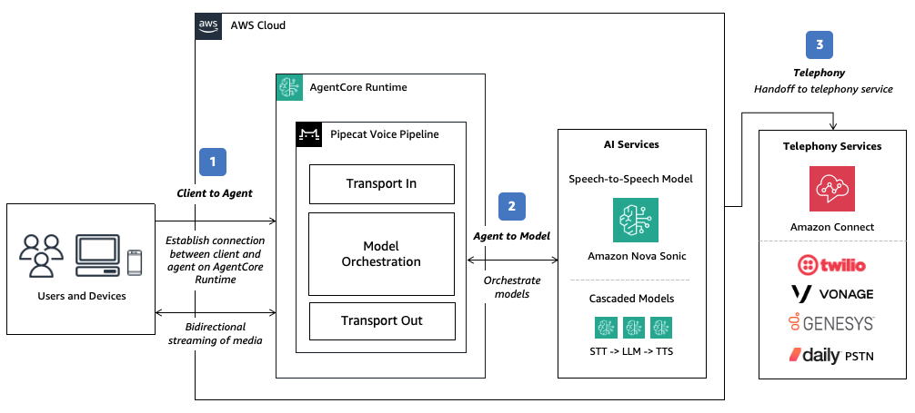
Voice Agents Are Streaming Systems
Natural conversation needs simultaneous streams, not request/response turns.
- Client to agent: browser, mobile, edge, phone
- Agent to model: bidirectional audio + tool events
- Telephony: SIP/voice-provider handoff for calls
Target
Risk
Fix
Sub-second feel
Jitter + stalls
Stream each hop

Slide 4
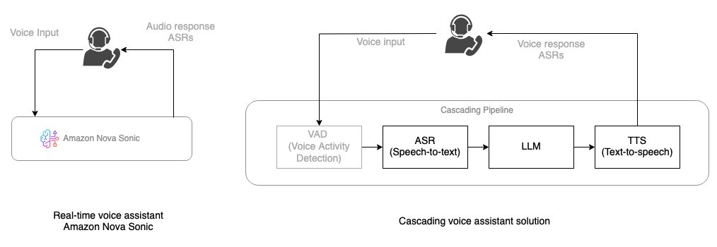
Speech-to-speech
Cascaded pipeline
Decision frame
Lowest moving-parts count; built-in streaming, turn-taking, voices, and tool use.
More control over STT, LLM, TTS, language coverage, and specialized components.
Optimize for natural flow first; choose modularity only where it buys real capability.

Slide 5
Transport Choices
Select the network path by channel, latency budget, reliability, and operating model.
WebSocket
WebRTC + TURN
Managed WebRTC
Simple full-duplex path for web/mobile prototypes and direct audio streaming.
UDP-first media path for lower latency and resilience across networks.
Offload SFU, relays, reconnection, and client SDKs to a managed RTC provider.
Telephony
KVS TURN
SageMaker + vLLM STT
For inbound/outbound calls through contact center or voice provider integrations.
AWS-native temporary TURN credentials for WebRTC NAT traversal.
Bring open real-time ASR models behind managed bidirectional streaming.

Slide 6
Latency Is the Product.
Time to first audio
Measure the silence after the user stops speaking.
Barge-in
Let users interrupt, clarify, and redirect mid-response.
Network recovery
Users judge intelligence by timing before they judge model quality.
Treat reconnects and jitter as first-class UX paths.
Workshop takeaway from AWS Nova Sonic, Pipecat, WebRTC, and AgentCore streaming guidance

Slide 7
Build Path Prototype to Production
Four decisions turn a voice demo into a production workshop architecture.
01 Model
02 Transport
03 Runtime
04 Operations
Nova Sonic or cascaded
WebSocket, WebRTC, telephony
AgentCore, Fargate, SageMaker
Evals, policy, cost, handoff

Slide 8
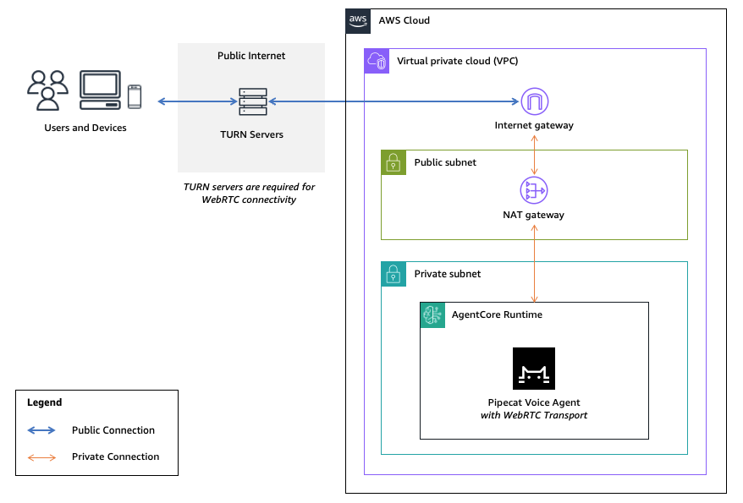
Reference path for production voice agents:
AgentCore Runtime Deployment Pattern
- Package the agent pipeline as a container
- Expose /ws or WebRTC entrypoints
- Isolate each session in AgentCore Runtime
- Use TURN/VPC design when WebRTC is required
- Trace audio, reasoning, and tool calls
Container
Session
ARM64 / Graviton image
MicroVM isolation

Slide 9
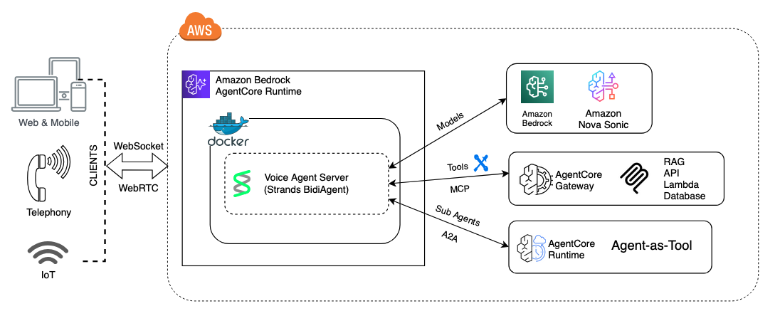
Keep the real-time voice loop focused. Move complexity into tools, sub-agents, and scoped sessions.
Scaling the Agent Brain
Tool calling
Nova Sonic invokes MCP tools through AgentCore Gateway for low-latency actions.
Agent-as-tool
Delegate complex reasoning to specialized agents with their own prompts and tools.
Session segmentation
Split authentication, inquiry, and fulfillment into focused voice sessions.

Slide 10
Anchor the workshop in patterns that already map to real AWS examples.
Use Cases Worth Stealing
Workshop design principle
Use cases are not just demos.
They define the transport, latency target, memory boundary, tool surface, and human fallback path.
Healthcare contact center
Media assistant
Clarus Care: multi-intent voicebot, urgent routing, analytics.
Movie recommendations and scene Q&A with AgentCore Gateway + RAG.
Podcast generator
Smart devices / vehicles
Nova 2 Sonic for two-host conversational audio generation.
Nova Sonic + WebRTC for low-latency voice on edge clients.
High-volume support
Speech-to-speech agents resolve repetitive requests and hand off with structured context.

Slide 11
Before going live, test the voice system as a distributed streaming product - not just a chatbot with a microphone.
Production Readiness Checklist
Latency + audio
Reliability
TTFA, jitter, chunk size, sample-rate conversion, turn detection.
Reconnects, session timeout, retries, circuit breakers, fallback channels.
Exit criteria
- p50/p95 time-to-first-audio tracked
- Barge-in and VAD tested
- Tool failures degrade gracefully
- Human handoff has context
Trust + access
Cost + operations
SigV4/OAuth, policy controls, guardrails, PII boundaries, audit traces.
Session cleanup, model mix, observability, evals, dashboard ownership.

Slide 12
What is Hera?
Voice-first assistant for Apple Store, running on AWS
Users interact via browser microphone; the agent responds in a natural voice, leveraging RAG to retrieve Apple product specs / pricing / inventory from a lightweight S3 Vectors knowledge base.
Key Features
• Speech-to-speech with Nova 2 Sonic
• RAG voice tool calling (lookup_product)
• Browser-only — only browser microphone required

Slide 13
Use case — Apple Store assistant
Demo voice agent + 3-SKU knowledge base
Real conversation sample
User — Do you have MacBook Pro M4 in stock?
Agent — Yes, we have the 14-inch M4 Pro in Silver and Space Black. The 14-inch starts at $1,999. Anything else?
User — What about iPhone 13 Pro Max?
Agent — iPhone 13 Pro Max is currently out of stock. Would you like an alternative?
KNOWLEDGE BASE
Apple Watch Series 11 — $399 · in stock
iPhone 13 Pro Max — $1,099 · out of stock
MacBook Pro M4 (14-inch) — $1,999 · in stock

Slide 14
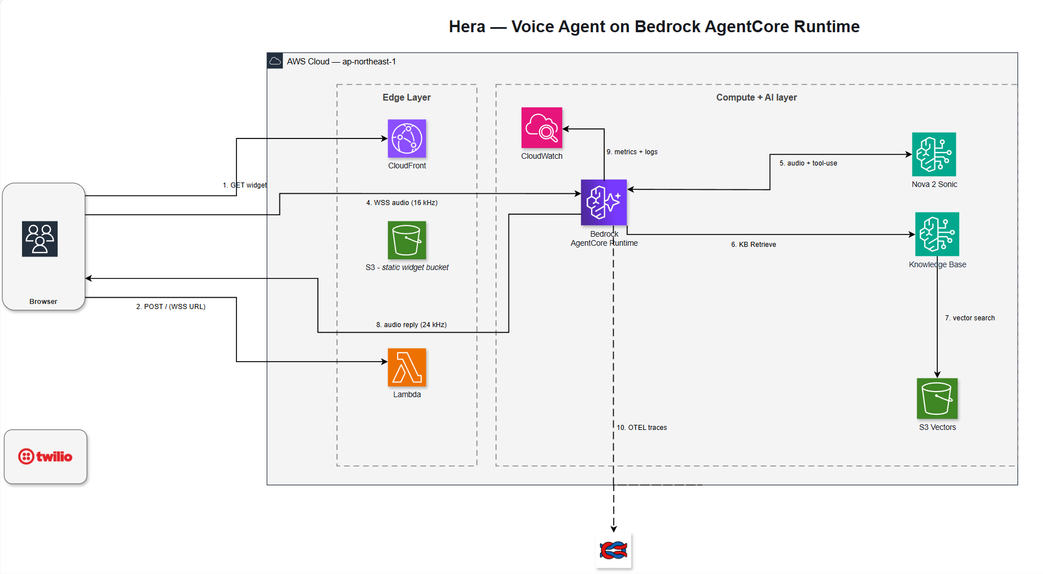
Overall Architecture
Edge layer + Compute/AI layer · fully managed

Slide 15
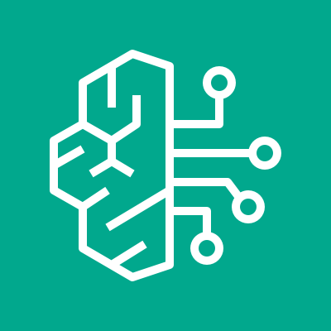
Amazon Bedrock + Nova 2 Sonic
Speech-to-speech foundation model
ASR + LLM + TTS in a single stream
• Bidirectional WebSocket — two-way simultaneous audio
• Built-in tool calling — model directly invokes lookup_product
Why use it
• Natural barge-in — responds to user interruption instantly
• Async tool calling — agent keeps speaking while tool executes in the background
Latency <2s · natural barge-in · no need to glue 3 vendors

Slide 16
Bedrock Knowledge Base + S3 Vectors
RAG layer for voice agent – serverless storage and retrieval
Ingestion Pipeline
catalog/*.md → S3 source → Bedrock ingestion job → Titan v2 embed → S3 Vectors
Retrieval Pipeline (single tool call)
lookup_product(query) → Retrieve API → S3 Vectors search → top-3 chunks → Sonic reply
S3 Vectors vs OpenSearch Serverless
• Truly serverless — pay-per-use, no OCU floor
• Native integration with Bedrock KB
• Perfect for spiky, read-light workloads, scales with data size

Slide 17
How does a voice turn flow?
5 steps / 1 turn — end-to-end < 3s p95
01 · Browser requests presigned WSS URL
Lambda presigner signs SigV4 URL, 5-minute TTL
02 · Browser opens WebSocket → AgentCore
No SDK required, vanilla JS
03 · Pipecat receives PCM mic input
16 kHz mono Int16 via WebSocket
04 · Sonic calls lookup_product
Bedrock KB Retrieve → S3 Vectors → top-3
05 · Sonic outputs 24 kHz audio
Browser plays back via audio worklet

Slide 18
Real Metrics
Cost · latency · pricing
<$1
/h burst test
Voice + KB + dashboard
~$0
idle overnight
AgentCore $0, S3V $0
0.86
KB top score
iPhone 13 stock query
<3s
p95 latency
end-of-utt → audio
$0.017
/min conversation
Nova 2 Sonic pricing

Slide 19
Recap
Building Voice Agents: 1 Speech-to-Speech Model + Tool Calling + RAG on Managed Infrastructure
VOICE AGENT FORMULA
Speech-to-speech: Nova 2 Sonic — 1 model
Tool calling + RAG: Sonic calls lookup_product → KB → S3 Vectors
Pipecat: Manages audio frames, barge-in, stream rotation – 1 day to run
CHEAP · LEAN · OBSERVABLE
Managed/serverless: AgentCore scale-to-zero, $0 when idle
Observable: Langfuse trace for every conversation
NO self-managed ECS/EC2/VPC — idle ~$0, demo < $1/h

Slide 20


Thank you!
Questions & Discussion
Builder · AWS Student Builder Group HUFLIT
https://www.meetup.com/aws-sbg-at-huflit/events/315340642/

