Slide 1
Hera
Voice Agent on AWS — Amazon Bedrock Nova 2 Sonic + AgentCore
Kiet Tran · Builder,
AWS Student Builder Group HUFLIT
30-05-2026 ·
Ho Chi Minh City

Slide 2
Agenda
01 Overview
What is Hera, architecture, voice turn
02 Theory
Cascade vs S2S, AWS services
03 Demo
Voice loop live, cost, latency
04 Recap
Key takeaways and next steps

Slide 3
What is Hera?
Voice-first assistant for Apple Store, running on AWS
Users interact via browser microphone; the agent responds in a natural voice, leveraging RAG to retrieve Apple product specs / pricing / inventory from a lightweight S3 Vectors knowledge base.
Key Features
• Speech-to-speech with Nova 2 Sonic
• RAG voice tool calling (lookup_product)
• Browser-only — only browser microphone required

Slide 4
Use case — Apple Store assistant
Demo voice agent + 3-SKU knowledge base
Real conversation sample
User — Do you have MacBook Pro M4 in stock?
Agent — Yes, we have the 14-inch M4 Pro in Silver and Space Black. The 14-inch starts at $1,999. Anything else?
User — What about iPhone 13 Pro Max?
Agent — iPhone 13 Pro Max is currently out of stock. Would you like an alternative?
KNOWLEDGE BASE
Apple Watch Series 11 — $399 · in stock
iPhone 13 Pro Max — $1,099 · out of stock
MacBook Pro M4 (14-inch) — $1,999 · in stock

Slide 5
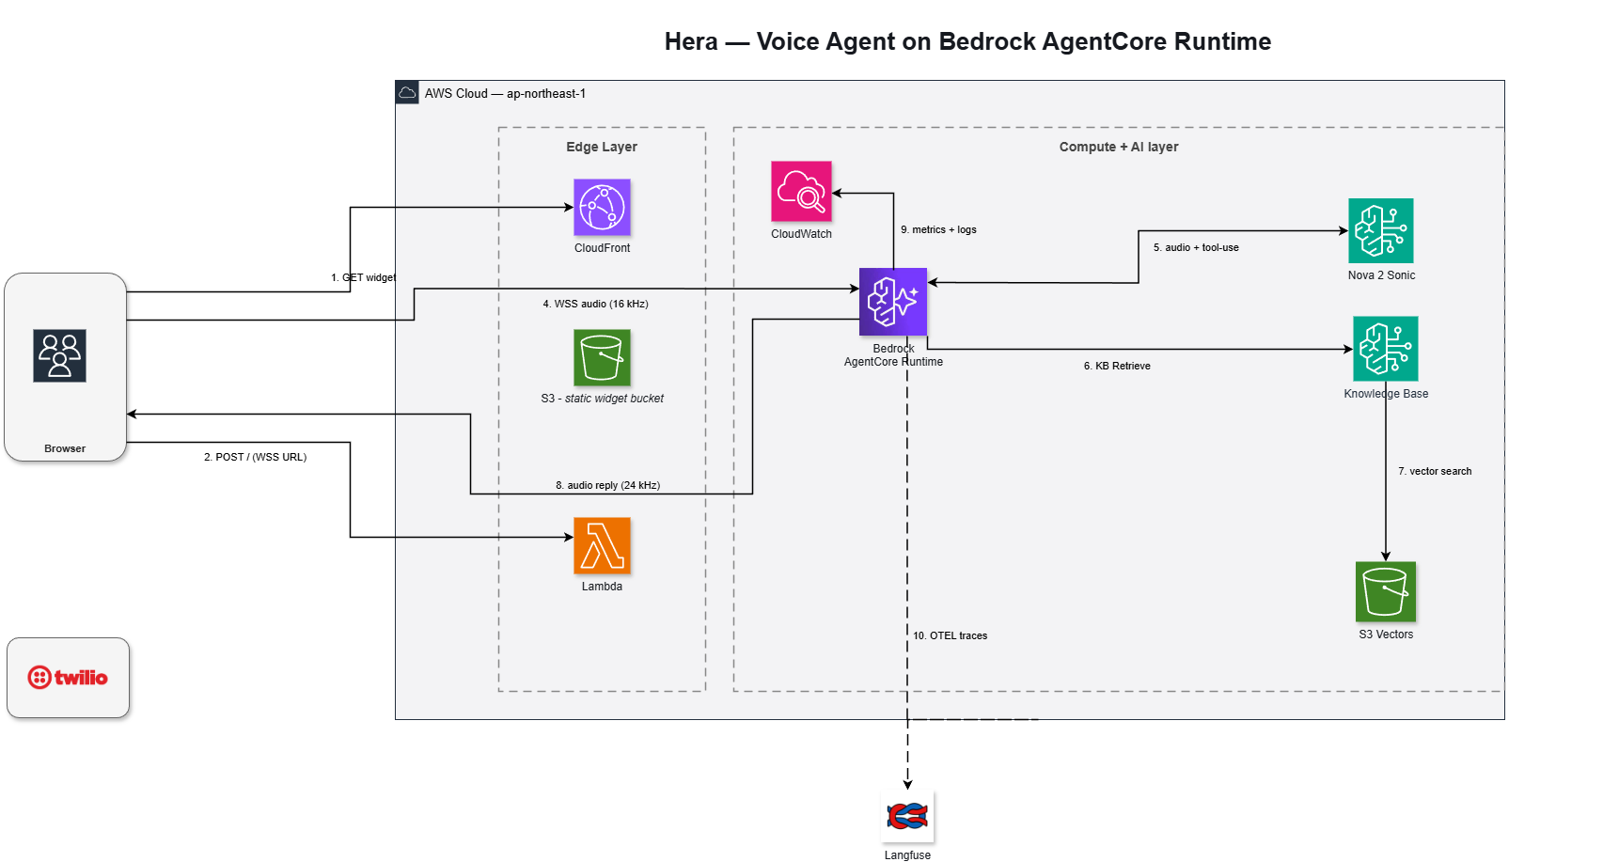
Overall Architecture
Edge layer + Compute/AI layer · fully managed

Slide 6
01
Theory
Why each service was selected

Slide 7
The Problem: Shifting voice AI from Cascade to Speech-to-Speech
Traditional Approach (~2023-2024)
• 3 sequential services: STT → LLM → TTS
• Cumulative latency of 4-6s per turn
• No barge-in (cannot interrupt agent)
• Complex glue code across 3 vendors
Modern Approach (2025-2026)
• A single foundation model replacing all three
• Bidirectional streaming, latency <2s
• Natural barge-in support
• Direct tool calling from model → RAG

Slide 8





AWS services
Core: Bedrock · AgentCore · KB + S3 Vectors · serverless
Bedrock
Nova 2 Sonic
Bedrock KB
+ S3 Vectors
AgentCore
Runtime
S3
Widget + KB src
CloudFront
HTTPS edge + OAC
Lambda
SigV4 presigner

Slide 9
Amazon Bedrock + Nova 2 Sonic
Speech-to-speech foundation model
ASR + LLM + TTS in a single stream
• Bidirectional WebSocket — two-way simultaneous audio
• Built-in tool calling — model directly invokes lookup_product
Why use it
• Natural barge-in — responds to user interruption instantly
• Async tool calling — agent keeps speaking while tool executes in the background
Latency <2s · natural barge-in · no need to glue 3 vendors

Slide 10
Bedrock Knowledge Base + S3 Vectors
RAG layer for voice agent – serverless storage and retrieval
Ingestion Pipeline
catalog/*.md → S3 source → Bedrock ingestion job → Titan v2 embed → S3 Vectors
Retrieval Pipeline (single tool call)
lookup_product(query) → Retrieve API → S3 Vectors search → top-3 chunks → Sonic reply
S3 Vectors vs OpenSearch Serverless
• Truly serverless — pay-per-use, no OCU floor
• Native integration with Bedrock KB
• Perfect for spiky, read-light workloads, scales with data size

Slide 11
Amazon Bedrock AgentCore Runtime
Managed serverless agent runtime — first-party voice + Pipecat pattern
• Managed serverless — no VPC, ECS, or NAT gateway required
• One microVM session-level isolation
• $0 when idle — service automatically spins up on session request
• Max session duration of 8 hours (vs. Lambda's 15-minute limit)
AgentCore vs ECS Fargate
AgentCore: First-party agent runtime, true scale-to-zero, managed networking, single microVM per session.
Fargate: Suited for always-on setups or custom VPC/NLB configurations.

Slide 12
Edge + auth bridge
CloudFront → S3 widget · Lambda Function URL = SigV4 presigner
CloudFront — HTTPS + OAC
S3 widget — Static frontend
Lambda URL — SigV4 presigner
WHY IS A PRESIGNER NEEDED?
• Browser cannot sign SigV4 requests for WebSocket upgrades
• Avoids using Cognito/OIDC for simple demo setups
• Lambda generates URLs with 5-minute expiration
• Called once per user recording session

Slide 13
How does a voice turn flow?
5 steps / 1 turn — end-to-end < 3s p95
01 · Browser requests presigned WSS URL
Lambda presigner signs SigV4 URL, 5-minute TTL
02 · Browser opens WebSocket → AgentCore
No SDK required, vanilla JS
03 · Pipecat receives PCM mic input
16 kHz mono Int16 via WebSocket
04 · Sonic calls lookup_product
Bedrock KB Retrieve → S3 Vectors → top-3
05 · Sonic outputs 24 kHz audio
Browser plays back via audio worklet

Slide 14
02
Demo
Real metrics · surprises · v2

Slide 15
Live Demo
Public URL · click record

Slide 16
Real Metrics
Cost · latency · pricing
<$1
/h burst test
Voice + KB + dashboard
~$0
idle overnight
AgentCore $0, S3V $0
0.86
KB top score
iPhone 13 stock query
<3s
p95 latency
end-of-utt → audio
$0.017
/min conversation
Nova 2 Sonic pricing

Slide 17
Future Work
Why maintain v1 and path forward
v2.0 Twilio
App Runner edge rejects inbound WS upgrade
Bridge code wraps defective compute targets
Future
Multi-language, multi-agent routing
Persistent conversation, AgentCore vs ECS

Slide 18
Recap
Building Voice Agents: 1 Speech-to-Speech Model + Tool Calling + RAG on Managed Infrastructure
VOICE AGENT FORMULA
Speech-to-speech: Nova 2 Sonic — 1 model, < 3s/turn, barge-in
Tool calling + RAG: Sonic calls lookup_product → KB → S3 Vectors
Pipecat: Manages audio frames, barge-in, stream rotation – 1 day to run
CHEAP · LEAN · OBSERVABLE
Managed/serverless: AgentCore scale-to-zero, $0 when idle
Observable: Langfuse trace for every conversation
NO self-managed ECS/EC2/VPC — idle ~$0, demo < $1/h

Slide 19
Thank you!
Questions & Discussion
Kiet Tran · Builder · AWS Student Builder Group HUFLIT
trantankiet140401@gmail.com
REPO: github.com/KenzyTran/hera

