Slide 1
Equinox - Final Project
By Keoni Lanoza

Slide 2
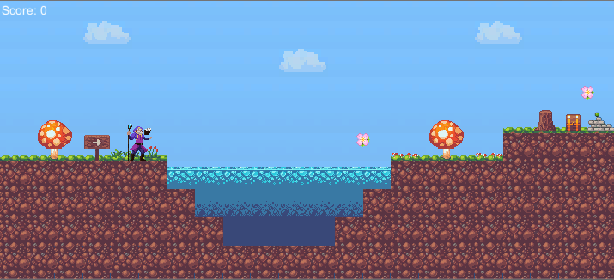
Demo Overview
This demo of Equinox showcases the main features of my final project. In this demo, the player controls a mage who can run, jump, and teleport between two realms. One realm, which is the Solar Plane acts much like a fantasy version of Earth. The other realm, the Lunar Plane, acts like a fantasy version of Earth at night. Each realm has different obstacles and enemies that the player must overcome to reach the end goal--the Victory Banner
Equinox’s Solar Plane

Slide 3
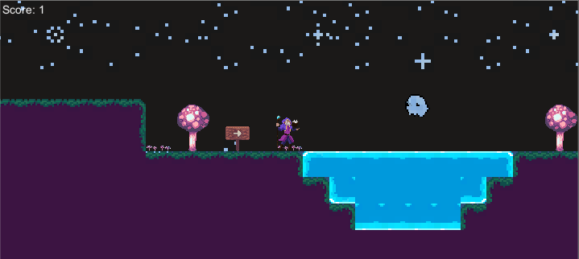
Demo Overview
In addition to that, Equinox also has main menu, pause, and death functionality. The player starts at the main menu with controls and the goal being clearly stated. Clicking the start button starts the game, and hitting escape pauses the game. The player faces many dangers on their path like water and ghosts to name a few!
Equinox’s Lunar Plane

Slide 4
Promises Kept and Not Delivered
Things I Implemented
Fully animated player with movement and teleportation
Main menu, pause menu, point system on a flower(not a rose, unfortunately)
Camera follows player
Two different realms
Ghost enemy
Plant enemy instead of mage enemy due to difficulty finding a good sprite with animations for it.
Deadly spikes and water
Game over, victory, and pause sounds
Things I Wasn’t Able to Implement
Mage enemies
Aesthetic animals(Butterflies, rabbits)
A magical rose point system, instead I had to choose a different flower
Garden bench prop
Sun in the background of the Solar Realm
Hills in the background of the Lunar Realm
A sound for running on ice and another for running on water
Different songs for each realm

Slide 5
Github Link
https://github.com/Keonity/Equinox

