Slide 1

TYPES OF BIOMETRICS
(Based on Chapter 3&4)
Guide to Biometrics
Chang Jia
Sep 12th, 2005

Slide 2
In General
Biometrics can be sorted into two classes:
Physiological
Behavioral
Examples: face, fingerprint, hand geometry and iris recognition
Examples: signature and voice

Slide 3
Biometric Identifiers
Common:
Fingerprint Recognition
Face Recognition
Speaker Recognition
Iris Recognition
Hand Geometry
Signature verification
Others:
DNA
Retina recognition
Thermograms
Gait
Keystroke
Ear recognition
Skin reflection
Lip motion
Body odor

Slide 4
Some More* …
Vein Pattern
Sweat Pores
Fingernail Bed
Hand Grip
Brain Wave Pattern
Footprint and Foot Dynamics
*See details in Chapter 7 Esoteric Biometrics of Biometrics by John D. Woodward, Nicholas M. Orlans, Peter T. Higgins, New York : McGraw-Hill/Osborne, c2003

Slide 5
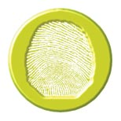
1. Fingerprint Recognition
An extremely useful biometrics technology since fingerprints have long been recognized as a primary and accurate identification method.

Slide 6
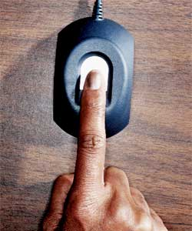
Acquisition Devices
Ink & paper – the oldest way
Ink-less Methods - sense the ridges on a finger
“Livescan” fingerprint scanners
Optical methods (FTIR)
CMOS capacitance
Thermal sensing
Ultrasound sensing

Slide 7
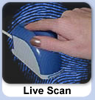




Applications
Authentication, or 1-to-1: matches a person's claimed identity to his/her biometric and one or more other security technologies (password, PIN, Token).
Identification, or 1-to-Many: identifies a person from the entire enrolled population.
(See http://www.biometrics.dod.mil/bio101/index.aspx )

Slide 8
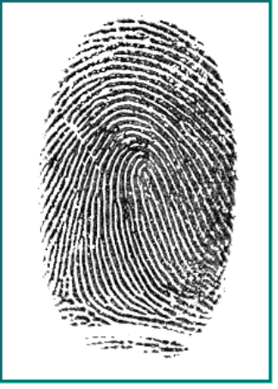
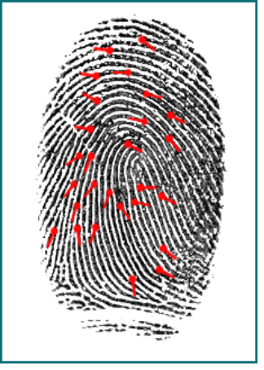
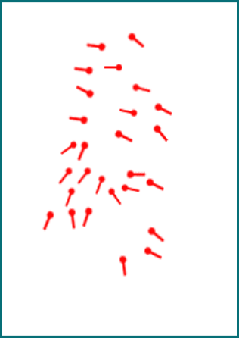
Minutiae
Uses the ridge endings and bifurcation's on a persons finger to plot points known as Minutiae
The number and locations of the minutiae vary from finger to finger in any particular person, and from person to person for any particular finger
Finger Image
Finger Image + Minutiae
Minutiae

Slide 9
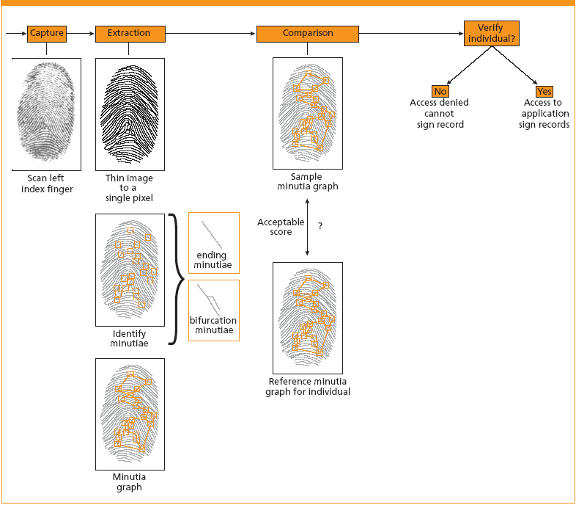
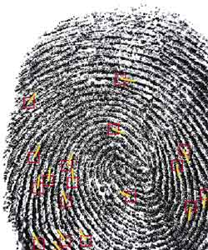
Fingerprint scanning (Minutiae based approach)

Slide 10
Matching Approaches
Two basic classes of matching techniques:
Image techniques
Use both optical and numerical image correlation techniques
Feature techniques
Extracts features and develop representations from these features
Combining the above two techniques:
Hybrid techniques (with improved accuracy)

Slide 11

2. Face Recognition
Uses an image or series of images either from a camera or photograph to recognize a person.
Principle: analysis of the unique shape, pattern and positioning of facial features.

Slide 12
Features
Passive biometrics and does not require a persons cooperation
Highly complex technology and largely software based.
Primary advantage is that the biometric system is able to operate “hands-free” and a user’s identity is confirmed by simply staring at the screen.

Slide 13
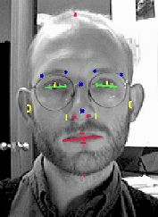
Details
Source of data: Single image, video sequence, 3D image and Near Infrared
Models: weak models of the human face that model face shape in terms of facial texture
Face appearance
Examples: eigenfaces
Face geometry
Examples: feature-based method

Slide 14
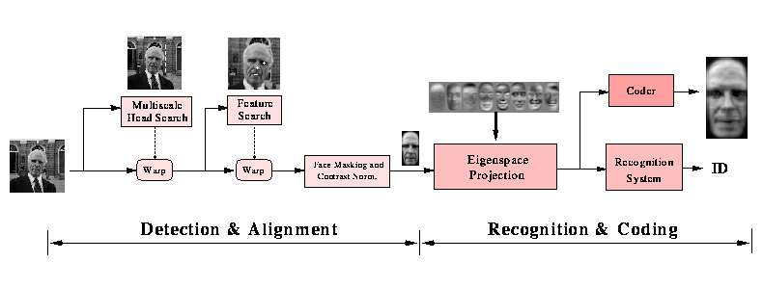
Examples
MIT Media Laboratory
Vision and Modeling Group
Face Recognition Demo

Slide 15
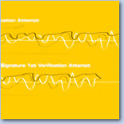
3. Voice Recognition
Voice recognition is not the same as speech recognition, it is speaker recognition
Considered both physiological and behavioral
Popular and low-cost, but less accurate and sometimes lengthy enrollment

Slide 16
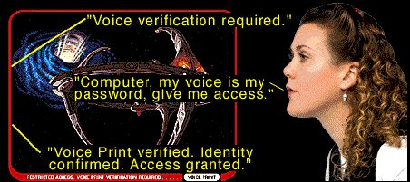
Application categories
Fixed text
Text dependent
Text independent
Conversational

Slide 17
Features
Advantage
Less requirements for users, such that they do not have to go through a separate process for verification
Very little hardware is required, and ideally suited to telephone-based system for a remote identification
Zero client-side cost, no special reader needs to be installed
Disadvantage
Acoustic features : 1. Misspoken or misread phrases; 2. The human voice's tremendous variability, due to colds, aging, and simple tiredness
Can be captured surreptitiously by a third party and replayed

Slide 18

4. Iris recognition
Analysis of the iris of the eye, which is the colored ring of tissue that surrounds the pupil of the eye.
Based on visible features, i.e. rings, furrows, freckles and the corona. Features and their location are used to form the Iriscodes, which is the digital template.
Widely regarded as the most safe, accurate biometrics technology and capable of performing 1-to-many matches at extraordinarily high speeds, without sacrificing accuracy.

Slide 19
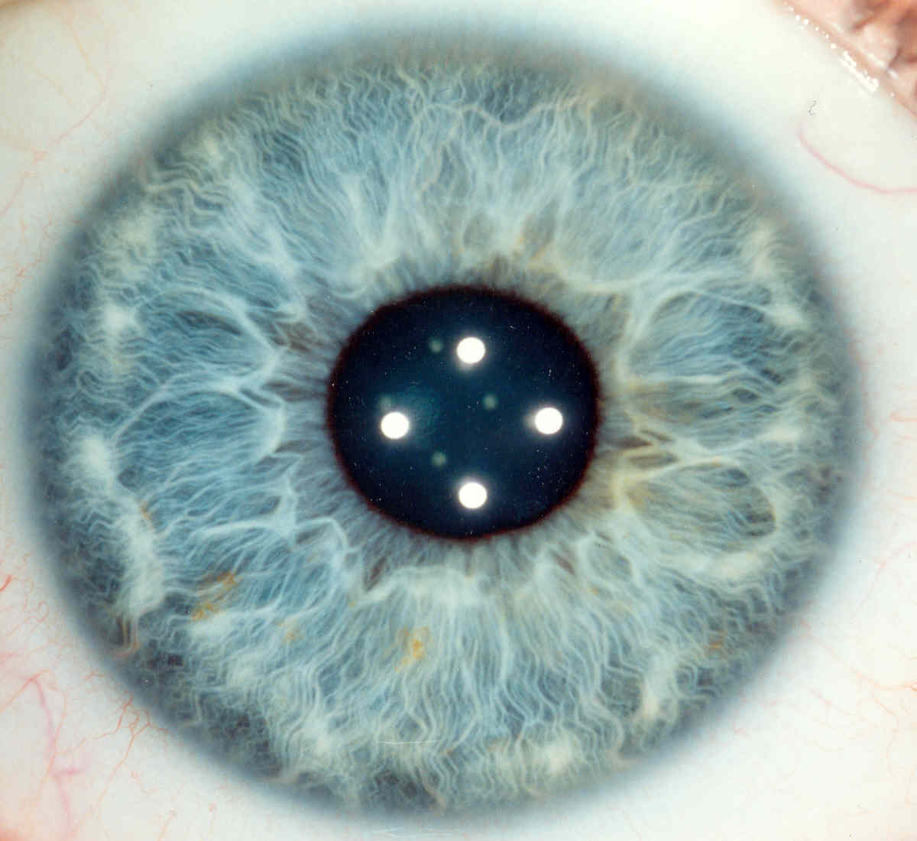
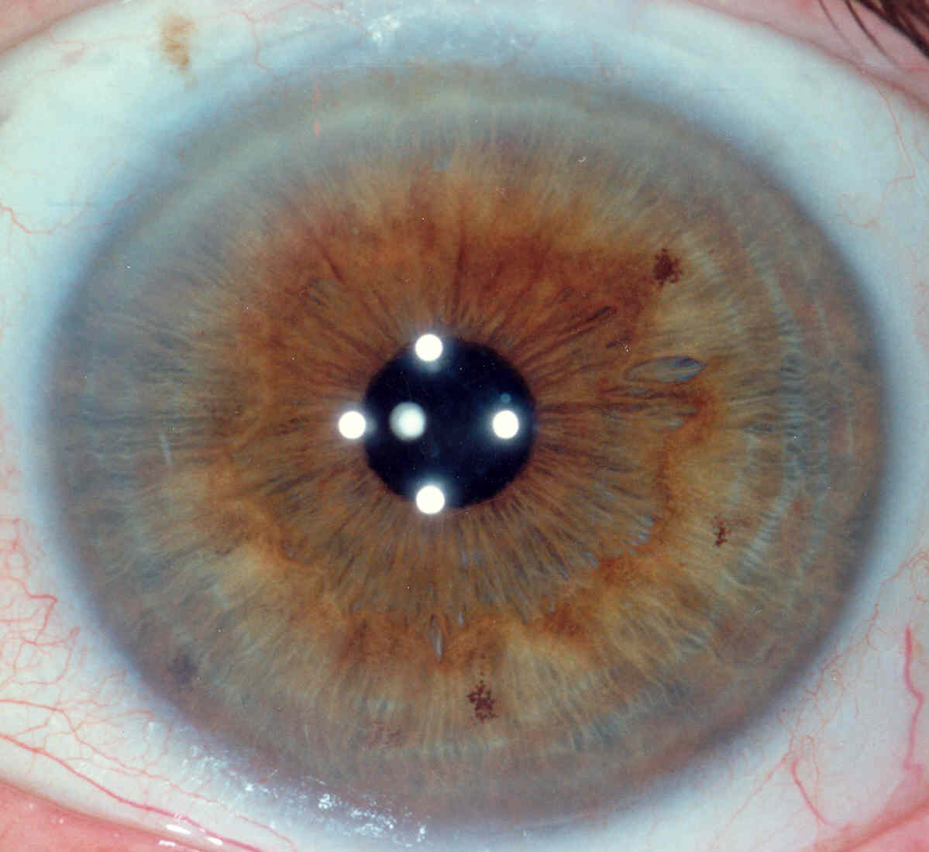
Example Iris Images

Slide 20
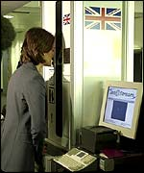
Applications
Iris recognition is a highly mature technology with a proven track record in a number of application areas.
Used very effectively all over the world.
Heathrow Airport (London) - Iris

Slide 21

5. Hand geometry
Hand geometry systems are commonly available in two main forms. Full hand geometry systems take an image of the entire hand for comparison while Two Finger readers only image two fingers of the hand.
Hand recognition technology is currently one of the most deployed biometrics disciplines world wide

Slide 22
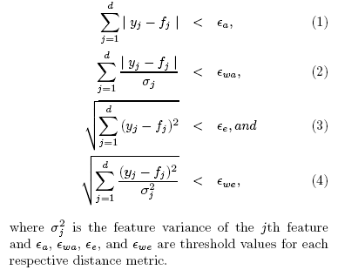
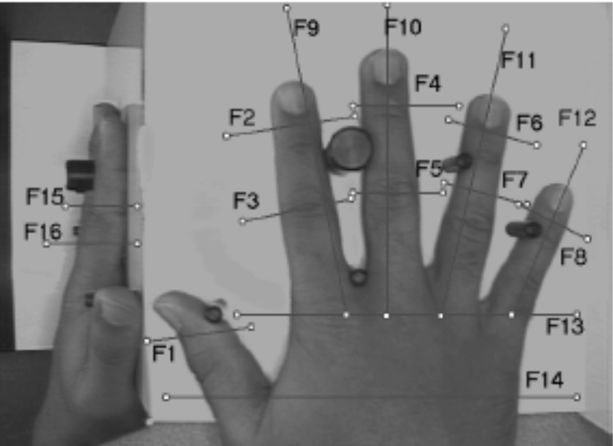
How does it work
A camera capture an image of the hand, with the help of a mirror to get also the edge. The silhouette of the hand is extracted, and some geometrical characteristics stored.
( See Jain et al. A Prototype Hand Geometry-based Verification System )

Slide 23
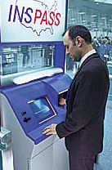
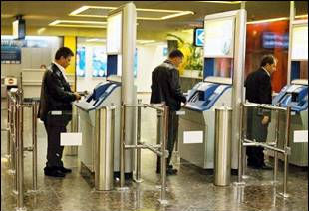
Applications
BenGurion Airport - Hand Geometry
INSPASS - Hand Geometry see INS Passenger Accelerated Service System

Slide 24

6. Signature Verification
Static/Off-line: the conventional way
Dynamic/On-line: using electronically instrumented device
Principle: the movement of the pen during the signing process rather than the static image of the signature.
Many aspects of the signature in motion can be studied, such as pen pressure, the sound the pen makes

Slide 25


Applications
For more technical information:
IBM online signature verification
Examples of Commercial products:
Cyber-SIGN PenOp
CIC Communication Intelligence Corp.
"The power to sign online"

Slide 26
Biometrics in Early Stages
DNA | Retina recognition | Thermograms
Gait | Keystroke | Ear recognition
Skin reflection | Lip motion | Body odor

Slide 27

I. DNA
DNA has been called the “ultimate identifier”
Identify information from every cell in the body in a digital form
Not yet fully automated, not fast and expensive
Theoretical limitation: Identical twins have the same DNA
Privacy issue – DNA contains information about race, paternity, and medical conditions for certain disease

Slide 28
Comparison Chart
DNA | Conventional Biometrics
Requires an actual physical sample | Uses an impression, image, or recording
Not done in real-time; not all stages of comparison are automated | Done in real-time; “lights-out” automated process
Does a comparison of actual samples | Uses templates or feature extraction

Slide 29

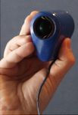
II. Retina recognition
The pattern of blood vessels that emanate from the optic nerve and disperse throughout the retina depends on individuals and never changes.
No two retinas are the same, even in identical twins.
Commercial products: Retinal Technologies

Slide 30
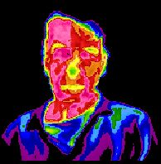
III. Thermograms
Thermograms requires an infrared camera to detect the heat patterns of parts of the body that are unique to every human being (such as the face)
Normally expensive because of the sensors
Useful paper: Illumination Invariant Face Recognition Using Thermal Infrared Imagery (Solikinski & als)

Slide 31

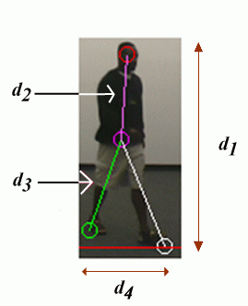
IV. Gait
The final objective: to recognize persons using standard cameras in any conditions.
Gait recognition is particularly studied as it may enable identification at distance.
Examples for measurements
(from Georgia Institute of Technology)

Slide 32

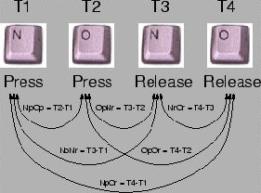
V. Keystroke
The rhythms with which one types at a keyboard are sufficiently distinctive to form the basis of the biometric technology known as keystroke dynamics
100% software-based, requiring no sensor more sophisticated than a home computer
Example

Slide 33

VI. Ear recognition
Ear geometry recognition uses the shape of the ear to perform identification
Suggestions have been made that the shapes and characteristics of the human ear are widely different
An infrared image can be used to eliminate hair
Might be recognized at a distance

Slide 34
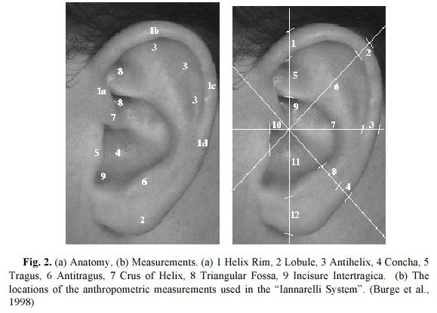
Example

Slide 35
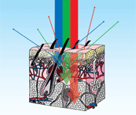
VII. Skin reflection
Lumidigm Inc. has established that the absorption spectrum of the skin depends on the individuals.
In a range of wavelengths over 6mm patch, several LEDs send light into the skin, and photodiodes read the scattered light, which is analyzed to perform the authentication.

Slide 36

VIII. Lip motion
Compares the characteristic lip motions of people while they speak.
Helps identification associated with speaker recognition.
Different imaging conditions: Infrared (high security & cost) and Near Infrared (cheap, normally used for active sensing)

Slide 37
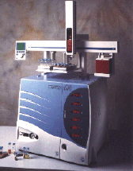
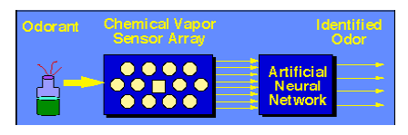
IX. Body odor
  It’s absolutely clear that people with differing immunity genes produce different body odors
  Electronic/artificial noses: developed as a system for the automated detection and classification of odors, vapors, gases.
Prometheus (Alpha Mos) ,
an example of electronic nose
  Artificial noses are not yet sophisticated enough to do all the job
Schematic Diagram of Artificial nose

Slide 38
The Future
“Your body as password” ?
Challenges:
Are biometric technologies ready for what is being expected of them?
Technical issues
legal and privacy issues

Slide 39
Thank you.
Any Question?

