Slide 1
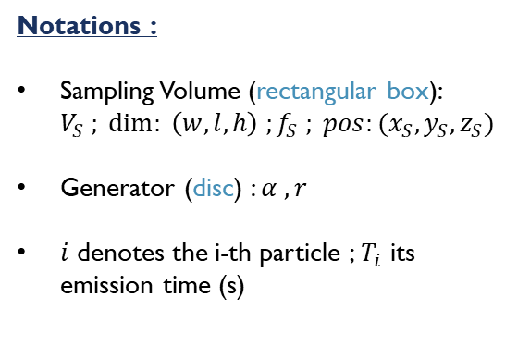
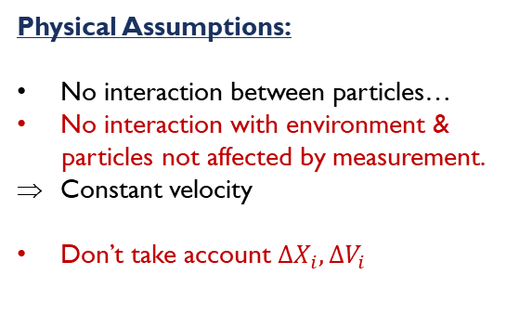

Problem Setup
z
$$α$$
Physical Assumptions:
No interaction between particles…
No interaction with environment &
particles not affected by measurement.
Constant velocity
Don’t take account ${ΔX}_{i},{ΔV}_{i}$
Notations :
Sampling Volume (rectangular box): $V_{S} ; \dim{: }\left(w,l,h\right) ;f_{S} ; pos:(x_{S},y_{S},z_{S})$
Generator (disc) : $α , r$
$i$ denotes the i-th particle ;$T_{i}$ its emission time (s)
Generator
3
r
4
6
1
h
y
x
5
2
7
w
Mathematical framework :
Let’s ${\left(ξ_{i}\right)}_{i}$ i.i.d of mean $τ$ such as : $T_{i+1}=T_{i}+ξ_{i}$ . ${{( X}_{i}\left(T_{i}\right), V_{i})}_{i}$i.i.d too. Finally, let’s define : $r=\frac{1}{τ}$ the emission rate (part/s).
Goal : estimate r or $μ$ .

Slide 2
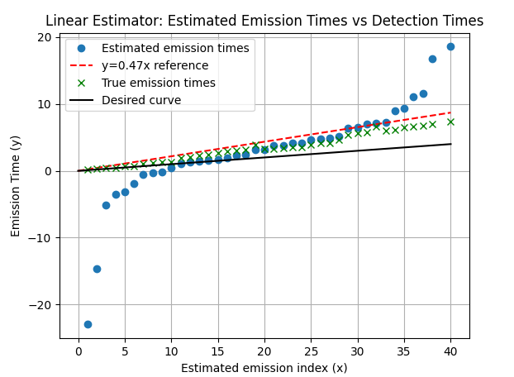
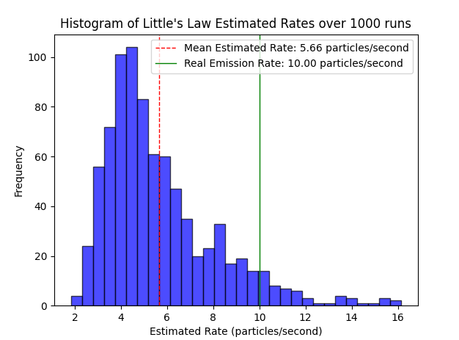
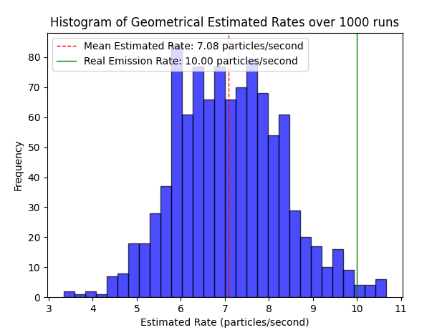



Approach
Initial step: set up a numerical simulation (python) : try 3D visualization -> move backward to a 2D visualization.
Protocol:
-> find / design an unbiased estimator (by myself or/and using scientific literature)
-> analyze with the simulation, then theoretically ( MSE, consistency, asymptotical behavior, confidence region)
ISSUE : Didn’t achieve to design an unbiased estimator
Idea 1 : use $𝔼\left[T_{i}\right]=iτ$
Idea 2 : use Little’s law : $L=λW$
Idea 3 : Estimate $r≈r_{s}\frac{V_{T}}{V_{S}}$
…not precise and difficult to compute

