Slide 1
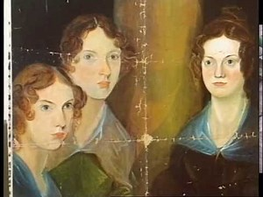
Jane Eyre, Charlotte Brontë
Let’s learn about the mystical environment of the famous novel Jane Eyre.

Slide 2
The type of narrator
A first person narrator
The effect on the reader:
We feel the same way than her
We see the same things as her

Slide 3
The plot
Jane Eyre, the heroine, is penniless orphan left to the care of the horrible Mrs. Reed, a wealthy aunt of hers who bully her.
A few later, after a fit of temper, Jane is sent away to a charitable but austere institution, Lowood Asylum, where after some very unhappy years, she becomes a teacher.
They fall in love and plan to marry but on the day of their wedding it is reveal that Mr. Rochester already has a wife.
She later becomes a governess at Thornfield Hall, the mysterious home of her pupil’s father, the romantic Mr. Rochester.

Slide 4
The parallels
The biography of Jane Eyre is similar to Charlotte Brontë’s one, due to the various parallels between Charlotte Brontë’s life, and the novel.
The effect on the reader:
The reader could see Charlotte Brontë’s character, through Jane Eyre.

