Slide 1
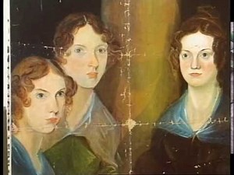
Jane Eyre, Charlotte Brontë
Let’s learn about the mystical environment of the famous novel Jane Eyre.

Slide 2
The type of narrator
A first person narrator
The effect produced:
We feel the same way than her
We see the same things as her

