Slide 1
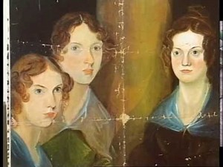
Jane Eyre, Charlotte Brontë
Let’s learn about the mystical environment of the famous novel Jane Eyre.

