Slide 1
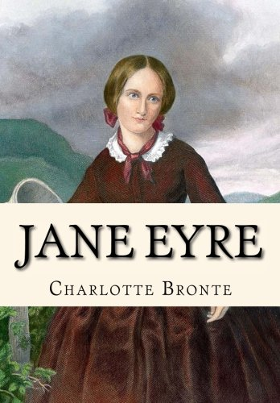
Let’s learn about the mystical environment of the famous novel Jane Eyre.

Slide 2
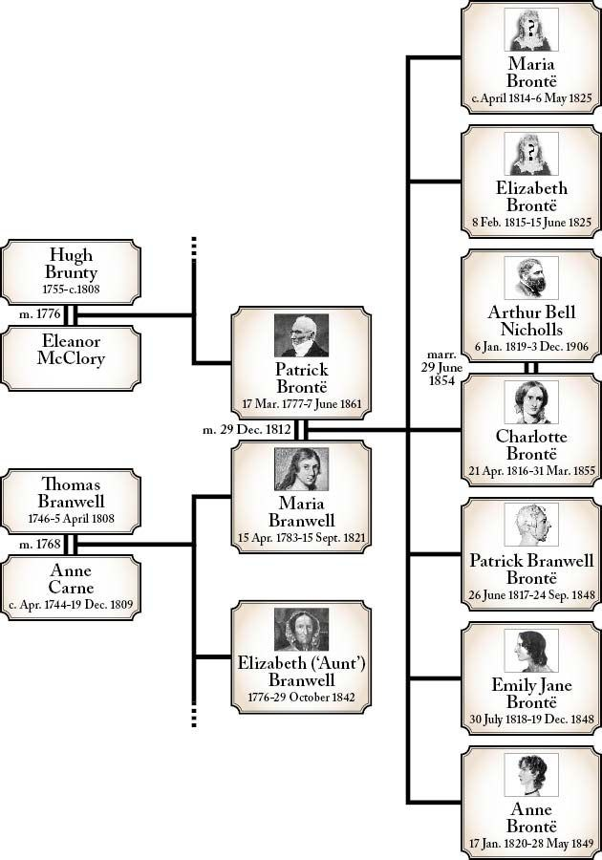
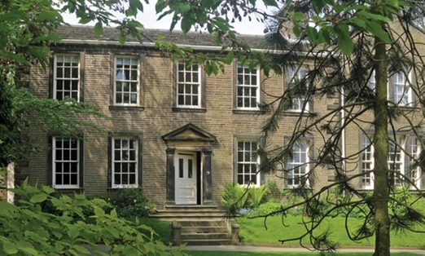
The Brontë family
In 1820 the family moved to the Parsonage in Haworth

Slide 3
Brontë’s biography
Mother’s death : the father became alcoholic, and the brother after some years.
Fear that the bed burn.
Emily and Charlotte went to the Pensionnat Heger, then Charlotte turned into a teacher in the institution.
Marriage between Charlotte and the Reverend Arthur Bell Nicholls
Death of Anne and Emily (again tuberculosis) : end of sister’s ritual, which consists to talk about their novel story at night.

Slide 4
Bildungsroman
Dictionary : a literary genre that focuses on coming-of-age stories, following a character’s progression towards adulthood.
Novel : We follow the childhood of Jane Eyre but also when she is adult in many years: evolution in the novel as when we grow up.

Slide 5
Gothic Romance
Dictionary : usually in the form of the hero rescuing a damsel in distress.
Novel : Mr. Rochester rescued Jane Eyre: first time of the Pensionnat with the teacher job, and second time he saved her from the boring time and the non-sense of the life.

Slide 6
The narrative structure
Exposition: We follow the story of Jane Eyre, a 10-year-old child who lives at Mrs. Reed’s house, her aunt who treats her badly.
Rising action: Jane arrives in a boarding school, Lowood. After a long time, she has become a teacher there. Then, she continues to be a teacher but at Mr. Rochester’s house, where she met him and fell in love. But he wants to marry Mrs. Ingram. Finally, it was a test for Jane, and he admitted his feelings and demanded her in marriage.
Climax: We learn at the marriage of Jane that Mr. Rochester has already a wife!
Falling action: Jane decides to go away.
Resolution: Finally, Jane goes back and finds Mr. Rochester. They decided to get married, and they have a happy ending together.

Slide 7
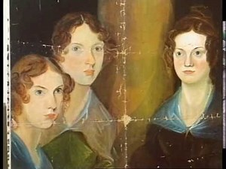
The type of narrator
A first person narrator
The effect on the reader:
We feel the same way than her
We see the same things as her

Slide 8
The plot
Jane Eyre, the heroine, is penniless orphan left to the care of the horrible Mrs. Reed, a wealthy aunt of hers who bully her.
A few later, after a fit of temper, Jane is sent away to a charitable but austere institution, Lowood Asylum, where after some very unhappy years, she becomes a teacher.
They fall in love and plan to marry but on the day of their wedding it is reveal that Mr. Rochester already has a wife.
She later becomes a governess at Thornfield Hall, the mysterious home of her pupil’s father, the romantic Mr. Rochester.

Slide 9
The parallels
The biography of Jane Eyre is similar to Charlotte Brontë’s one, due to the various parallels between Charlotte Brontë’s life, and the novel.
The effect on the reader:
The reader could see Charlotte Brontë’s character, through Jane Eyre.

Slide 10
The Victorian England
The role of women
Many women became maids.
These maids were subdivided in various groups, including the governesses.
The governesses
They are young women.
They come from the mid-class.
They are dressed properly, despite their backgrounds.
Are like the handmaids in the Handmaid’s Tale : they cannot have children, and they go from a family to another.
They made children do extra-work, such as learning languages (French, for instance).

Slide 11
The Victorian England | Part 2
The education:
In 1870, the Forster Elementary Education Act: it enabled some boarding schools to develop, although those schools demanded fees, that some families couldn’t afford. It ended up in the creation of ragged schools (free), and Dame schools (not free, and ran by illiterate women).
As for women… :
They was not allowed to attend the university, though a character, named Sophia Jex-Blake wanted to change it all. Indeed, she attended a medical school, illegally. Eventually, women could attend medical schools, but they couldn’t be graduated. So, Sophia had opened her own hospital, for poor patients. Finally, in 1892, the Edinburgh University admitted women as “undergraduates”.

Slide 12
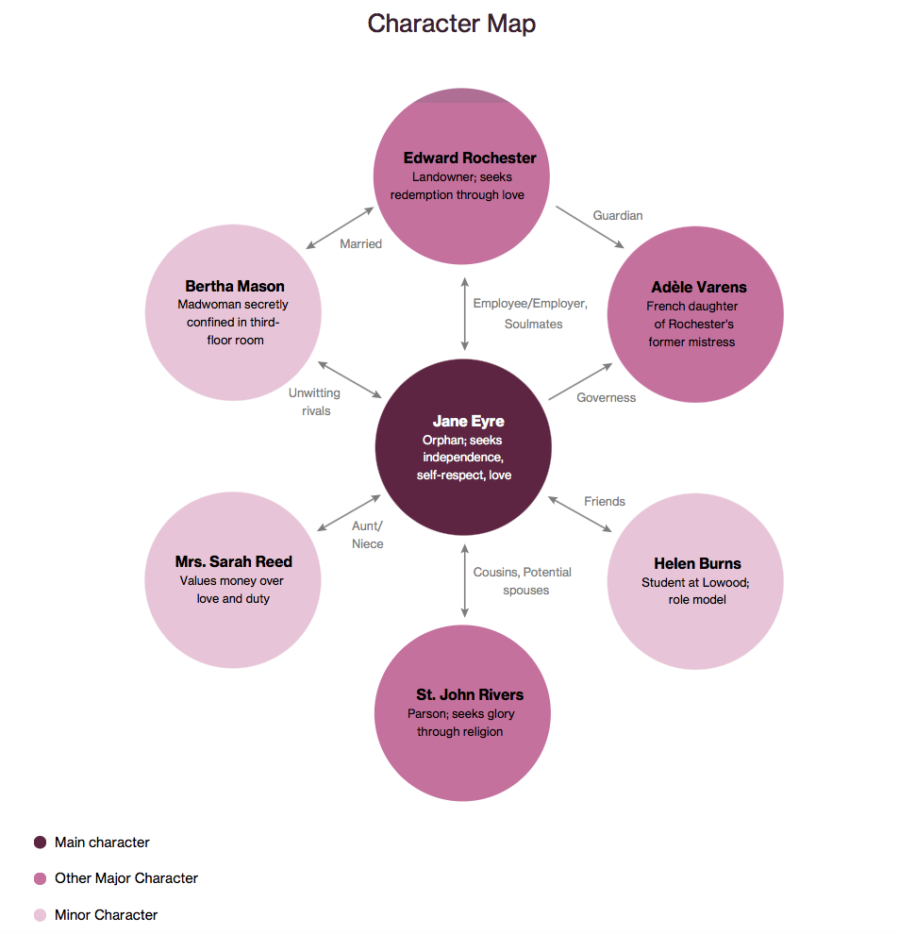
A character map

Slide 13
Themes in Jane Eyre
We can notice several themes in this novel, as following:
Family: Jane is searching for a family, in order to belong to something, as she is an orphan at the beginning of the novel.
Religion: Three models of Christianism can be seen throughout the novel:
Evangelicalism
The forgiveness
The righteousness
Social position: Brontë uses the character of Jane Eyre, to express her critique of the Victorian Era, as Jane Eyre is poor and lives in a well-off environment.
Gender inequality: The author also benefits from this novel by criticizing the gender equality, with Jane Eyre imprisonment in the “red-room” at the beginning of the novel.
External beauty vs. Internal beauty: we can see that both character Bertha Mason and Blanche Ingram are seen as really beautiful, whereas they act in a really mean way.

Slide 14
Jane Eyre at the cinema!
The novel Jane Eyre has become so famous, that some film directors decided to make a film version! You can see below a few version movies based on the novel, in the chronological order:
Jane Eyre – 1934 | Starring Virgina BRUCE & Colin CLIVE
Jane Eyre – 1943 | Starring Orson WELLES & Joan FONTAINER
Jane Eyre – 1970 | Starring Susannah YORK & George C. SCOTT
Jane Eyre – 1983 | Starring Zelah CLARKE & Timothy DALTON
Jane Eyre – 1997 | Starring Samantha MORTON & Ciaran HINDS
Jane Eyre – 2003 | Starring Ruth WILSON & Toby STEPHENS
Jane Eyre – 2011 | Starring Mia WASIKOWSKA & Michael FASSBENDER

