Slide 1
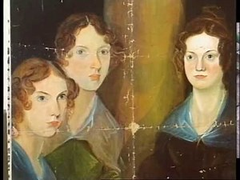
Jane Eyre, Charlotte Brontë
Let’s learn about the mystical environment of the famous novel Jane Eyre.

Slide 2
The type of narrator
A first person narrator
The effect on the reader:
We feel the same way than her
We see the same things as her

Slide 3
The plot
Jane Eyre, the heroine, is penniless orphan left to the care of the horrible Mrs. Reed, a wealthy aunt of hers who bully her.
A few later, after a fit of temper, Jane is sent away to a charitable but austere institution, Lowood Asylum, where after some very unhappy years, she becomes a teacher.
They fall in love and plan to marry but on the day of their wedding it is reveal that Mr. Rochester already has a wife.
She later becomes a governess at Thornfield Hall, the mysterious home of her pupil’s father, the romantic Mr. Rochester.

Slide 4
The parallels
The biography of Jane Eyre is similar to Charlotte Brontë’s one, due to the various parallels between Charlotte Brontë’s life, and the novel.
The effect on the reader:
The reader could see Charlotte Brontë’s character, through Jane Eyre.

Slide 5
The Victorian England
The role of women
Many women became maids.
These maids were subdivided in various groups, including the governesses.
The governesses
They are young women.
They come from the mid-class.
They are dressed properly, despite their backgrounds.
Are like the handmaids in the Handmaid’s Tale : they cannot have children, and they go from a family to another.
They made children do extra-work, such as learning languages (French, for instance).

Slide 6
The Victorian England | Part 2
The education:
In 1870, the Forster Elementary Education Act: it enabled some boarding schools to develop, although those schools demanded fees, that some families couldn’t afford. It ended up in the creation of ragged schools (free), and Dame schools (not free, and ran by illiterate women).
As for women… :
They was not allowed to attend the university, though a character, named Sophia Jex-Blake wanted to change it all. Indeed, she attended a medical school, illegally. Eventually, women could attend medical schools, but they couldn’t be graduated. So, Sophia had opened her own hospital, for poor patients. Finally, in 1892, the Edinburgh University admitted women as “undergraduates”.

