Slide 1
Table of content
Topics introduction
What was already tried
Proposed Architecture
preprocessing
feature extraction
selection
classification
Datasets
References

Slide 2
Topics Introduction
Emotion detection with super resolution
Goals:
Low quality images or video frames
low resolution
blur
noise
Classify each frame
Ekman emotions (anger, disgust, fear, happiness, sadness, surprise) + contempt
Measurements
Topic narrowings:
Single face at a time
Single modal
no audio (speech)
no hand gesture
no background
Face focused

Slide 3
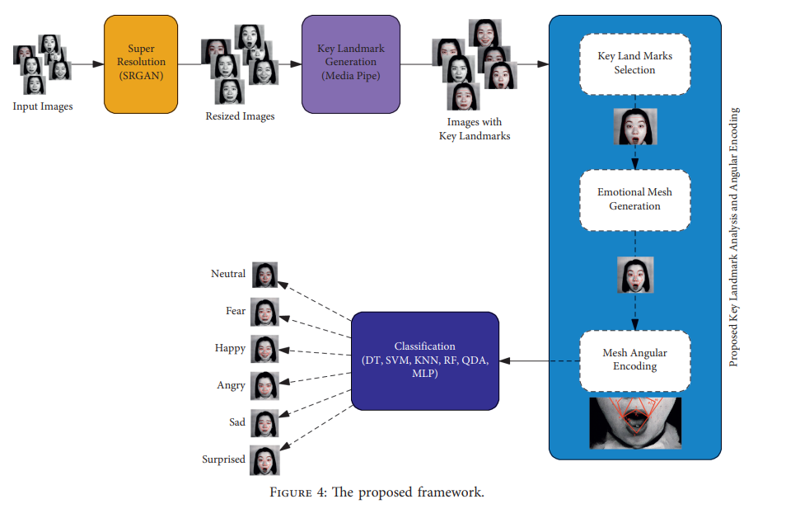
What was already tried

Slide 4
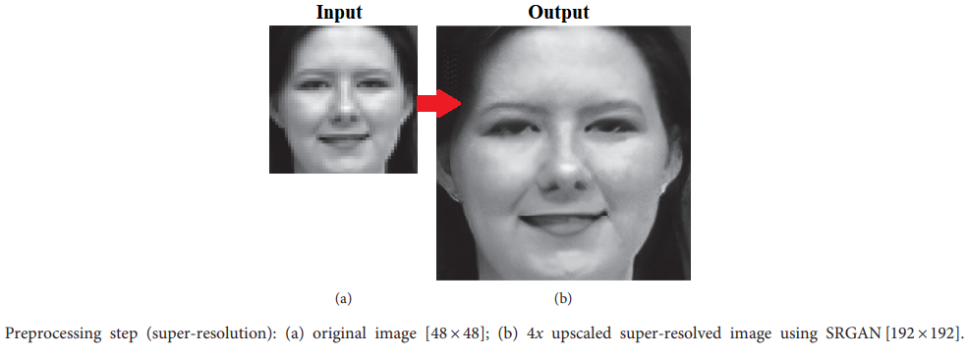

Slide 5
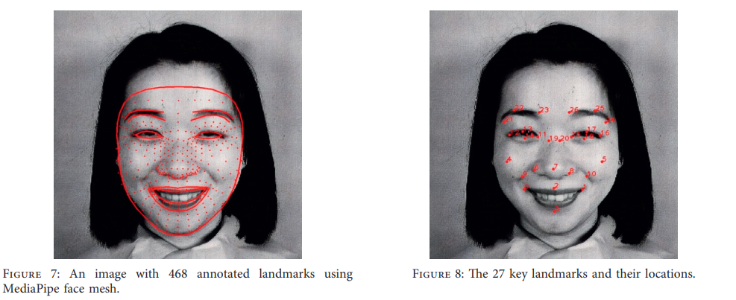

Slide 6
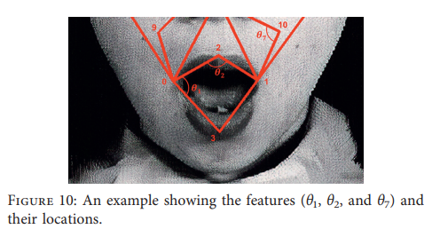
Deformation of emotion face mesh measured by the deviation of angles between edges reflects facial muscle contraction and relaxation, which will be used to identify facial emotions

Slide 7
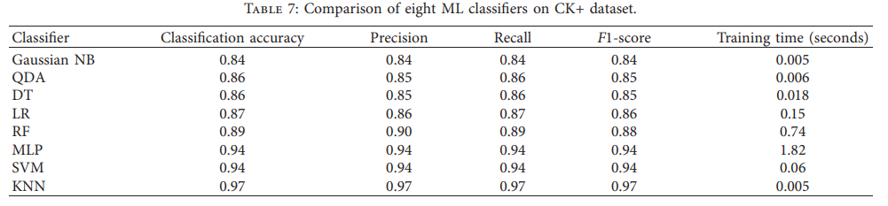

Slide 8
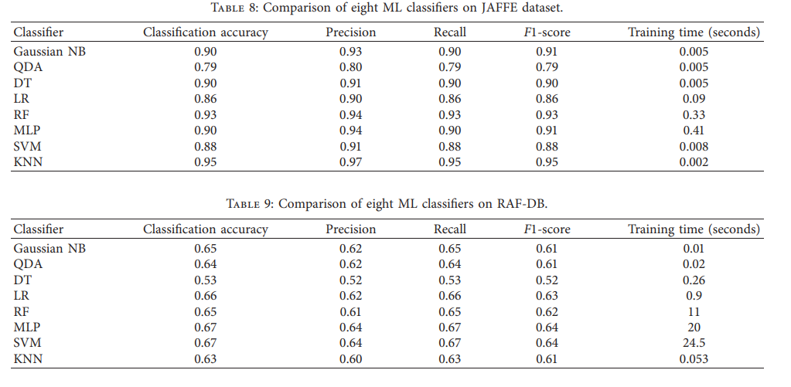

Slide 9
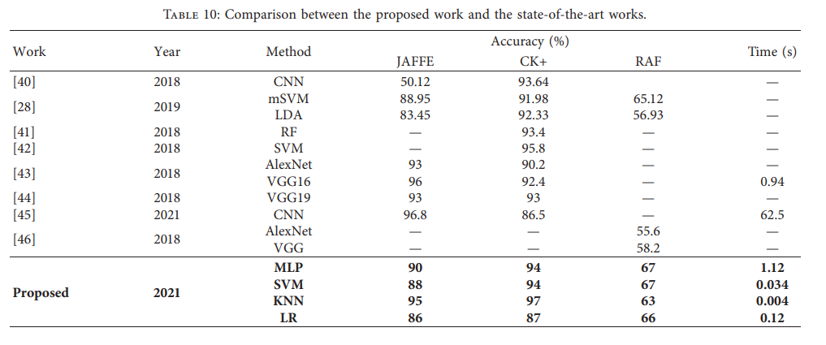

Slide 10
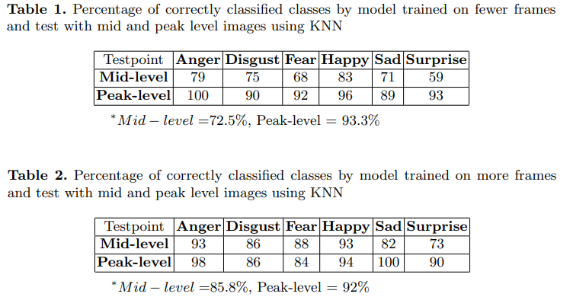
Problems with KNN
Label flickering in video classification
Mostly good at categorizing emotions at their peak level (not as good at mid and subtle emotion detection)

Slide 11
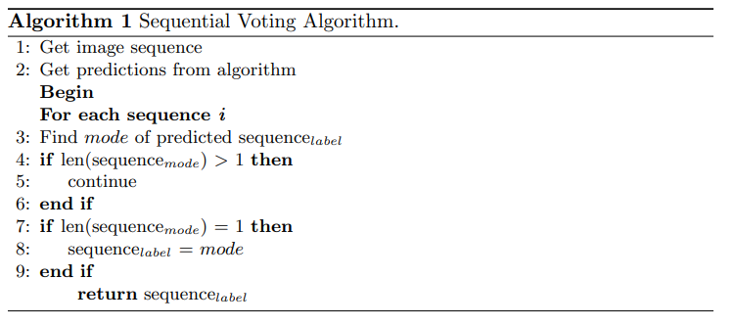

Slide 12
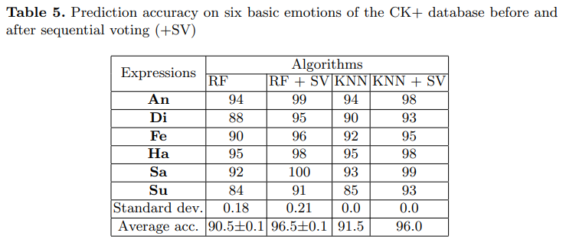

Slide 13
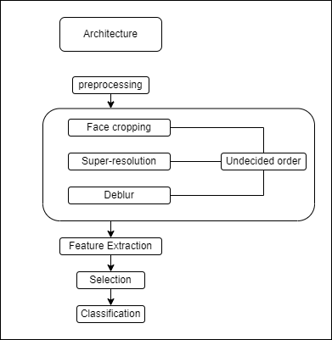

Slide 14
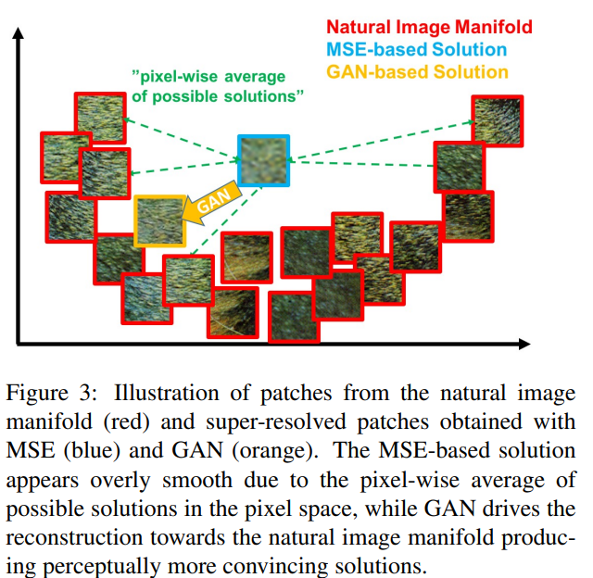
Preprocessing
Super resolution:
SRGAN
The selected super resolution method should minimize the Mean SquareError (MSE) and maximize the Peak Signal-to-Noise Ratio (PSNR)

Slide 15
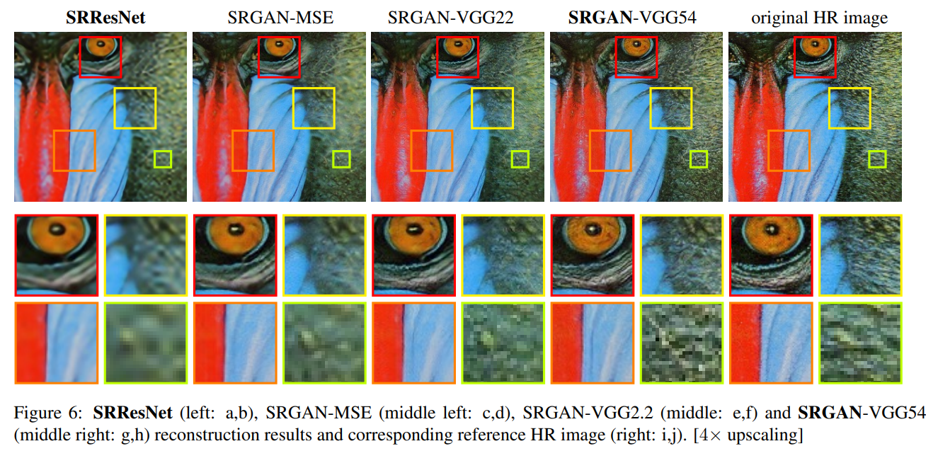

Slide 16
Face cropping (face recognition):
FaceNet
OpenFace
MediaPipe BlazeFace
VGG-Face
DeepFace

Slide 17
Feature extraction (mash of the face)
MediaPipe Face Mesh
OpenFace
Dataset contains it
Classification:
KNN

Slide 18
Dataset
CMU-MOSEI Dataset (6 base emotions = Ekman emotions)
videos
CK+ (Extended Cohn-Kanade dataset)
Ekman emotions (anger, disgust, fear, happiness, sadness, surprise) + contempt
593 video sequences
facial shift from the neutral expression to a targeted peak expression
resolution of either 640x490 or 640x480 pixels
30 frames per second (FPS)
DEMoS (Ekman emotions)

Slide 19
proposed timeline, pipeline
~2 weeks
putting the project together
GitHub (README)
research diary
~1 week
testing measurements
comparisons
~1 week for unexpected complications

Slide 20
References
[1] Ali I. Siam, Naglaa F. Soliman, Abeer D. Algarni, Fathi E. Abd El-Samie, Ahmed Sedik,
"Deploying Machine Learning Techniques for Human Emotion Detection",
Computational Intelligence and Neuroscience,
vol. 2022, Article ID 8032673, 16 pages, 2022.
https://doi.org/10.1155/2022/8032673
[2] Shehu, H. A., Browne, W. & Eisenbarth, H. (2020).
Emotion Categorization from Video-Frame Images Using a Novel Sequential Voting Technique.
Advances in Visual Computing (12510 LNCS, pp. 618-632).
Springer International Publishing. https://doi.org/10.1007/978-3-030-64559-5_49
[3] Photo-Realistic Single Image Super-Resolution Using a Generative Adversarial Network
arXiv:1609.04802
https://arxiv.org/abs/1609.04802

Slide 21
Thank you!

