Slide 1
Dancing Monkeys: Accelerated
GPU-Accelerated Beat Detection for Dancing Monkeys
Philip Peng, Yanjie Feng
UPenn CIS 565 Spring 2012
Final Project – Final Presentation
img src: http://www.dcrblogs.com/wp-content/uploads/2010/03/radioactive-dancing-monkeys-fastest-ani.gif

Slide 2
Project Description
Dancing Monkeys
Create DDR step patterns from arbitrary songs
Highly precise beat detection algorithm (accurate within <0.0001 BPM)
Nov 1, 2003 by Karl O’Keeffe
MATLAB program, CC license
http://monket.net/dancing-monkeys-v2/
GPU Acceleration
Algorithm used = brute force BPM comparisons
GPUs are good with parallel number crunching

Slide 3
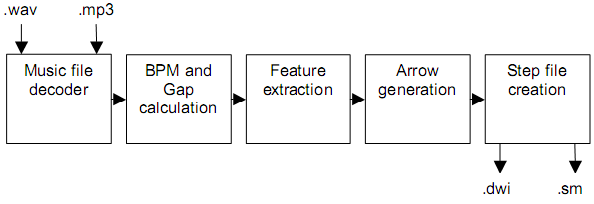
Dancing Monkeys Architecture
Process waveform data
Calculate BPM (first pass)
Calculate BPM (second pass)
Calculate gap time
Generate arrow patterns from waveform data

Slide 4

CPU Parallelization - Approach
MATLAB’s Parallel Computing Toolbox
Replace for loops with MATLAB’s parfor
Run loop in parallel, one per CPU core
http://www.mathworks.com/help/toolbox/distcomp/parfor.html
Require code modification
matlabpool
Temporary arrays
Index recalculations

Slide 5
CPU Parallelization - Results
 | base | parfor | %
timeTest | 126.4 | 47.2 | 37.5%
timeFit | 59.3 | 30.4 | 51.3%
timeBpm | 186.0 | 77.7 | 41.8%
timeProgram | 202.7 | 93.3 | 46.0%

Slide 6
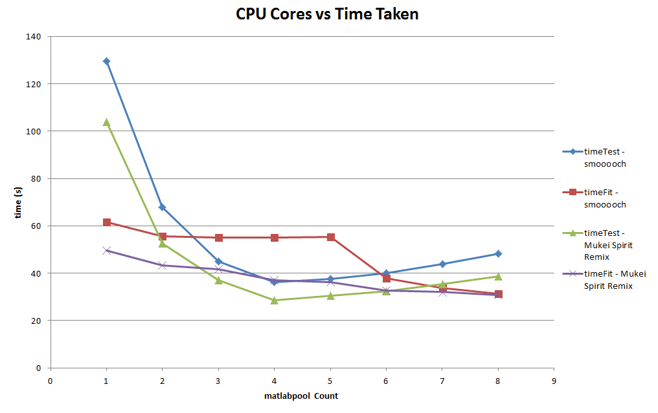
CPU Parallelization - Results

Slide 7

GPUarray
MATLAB’s gpuArray() and gather() function
MATLAB’s build-in GPU functions
Parallel GPU kernel by using arrayfun()
Result: Slower

Slide 8

Jacket - Approach
Jacket is a Matlab plug-in
developed by Accelereyes.
More data structures on GPU side
More functions supported on GPU side
Much faster than GPUarray
Just use its gfor function instead of default for loop

Slide 9
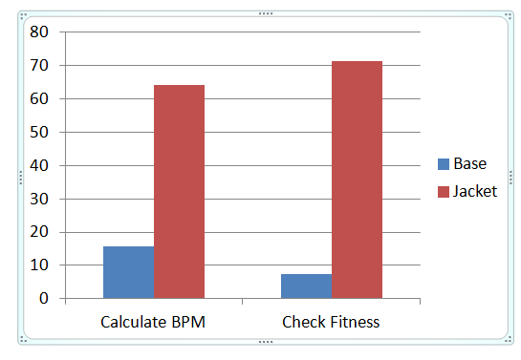
Jacket - Results
Still slower

Slide 10
Why everything on GPU is slower?

Slide 11
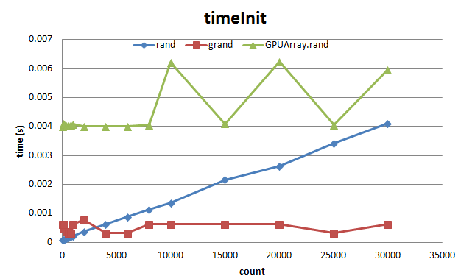
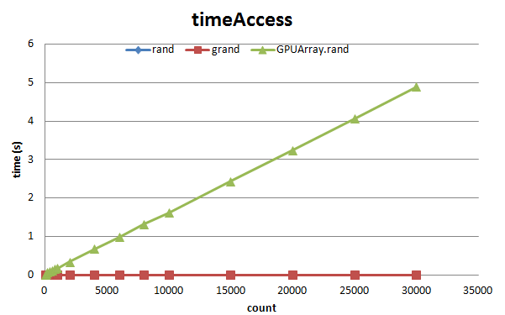
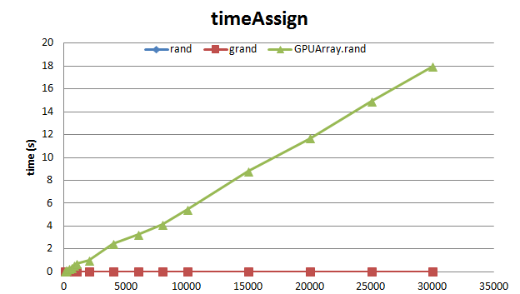
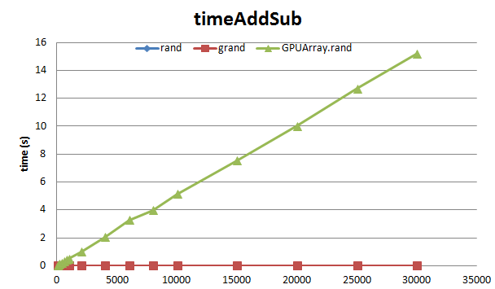
GPU Array

Slide 12
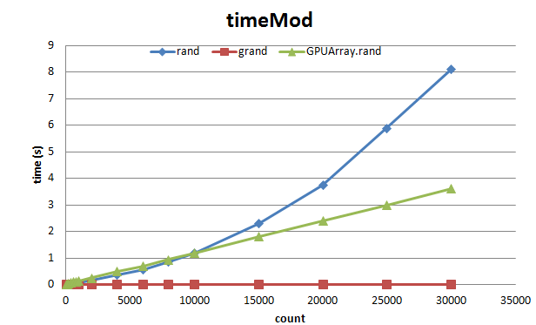
GPU Array
GPU Array is bad!
Except:
But, this doesn’t help much.

Slide 13

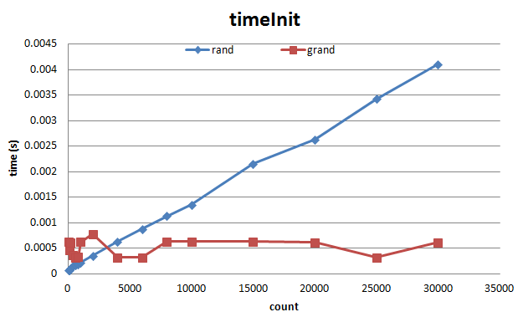

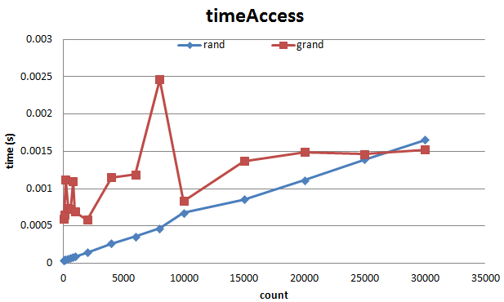
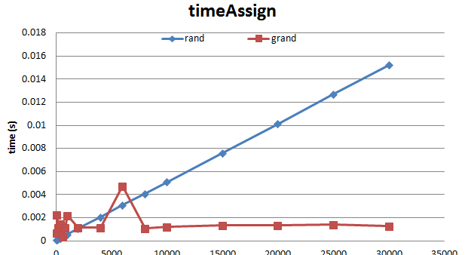
Jacket - Data
Initialize
Access
Assign

Slide 14
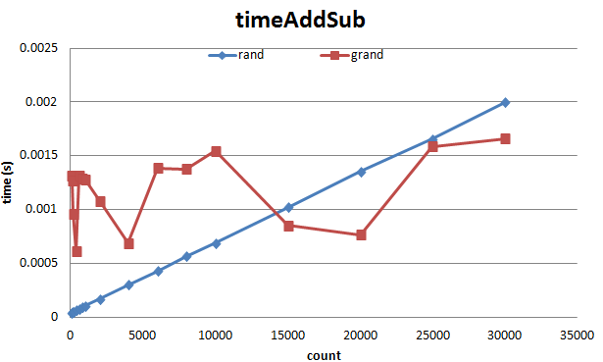
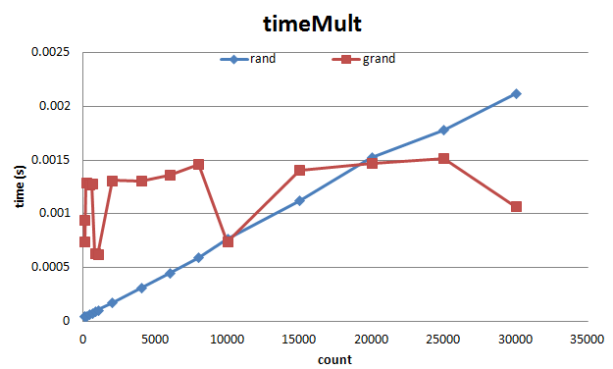
Jacket - Math
Add/Sub
Mult
Large amounts
of data required to show its power!

Slide 15
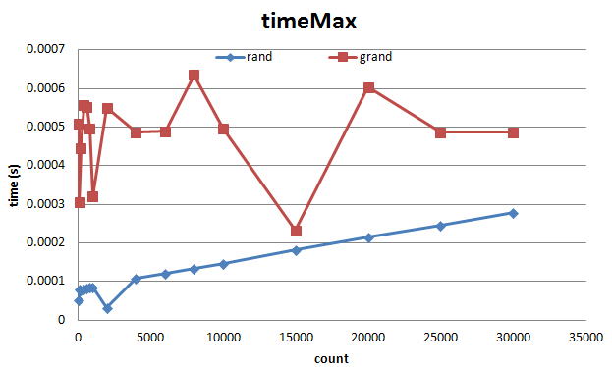
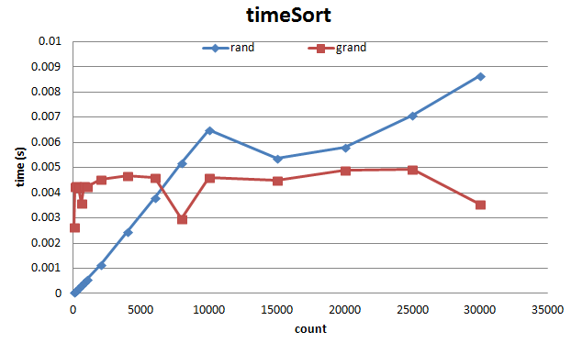
Jacket - Other
Max
Sort

Slide 16
Jacket - Conclusion
Small gain
(sort, math, initialize)
Large loss
(Access)

Slide 17
Future Work
Try rewrite everything in CUDA
Try to modify the algorithm and make it more GPU friendly

Slide 18
Bibliography
Karl O’Keeffe, “Dancing Monkeys”, MEng Individual Project Report 18th June 2003
Will Archer Arentz, “BEAT EXTRACTION FROM DIGITAL MUSIC”

