Slide 1
Dancing Monkeys: Accelerated
GPU-Accelerated Beat Detection for Dancing Monkeys
Philip Peng, Yanjie Feng
UPenn CIS 565 Spring 2012
Final Project – Final Presentation
img src: http://www.dcrblogs.com/wp-content/uploads/2010/03/radioactive-dancing-monkeys-fastest-ani.gif

Slide 2
Project Description
Dancing Monkeys
Create DDR step patterns from arbitrary songs
Highly precise beat detection algorithm (accurate within <0.0001 BPM)
Nov 1, 2003 by Karl O’Keeffe
MATLAB program, CC license
http://monket.net/dancing-monkeys-v2/
GPU Acceleration
Algorithm used = brute force BPM comparisons
GPUs are good with parallel number crunching

Slide 3
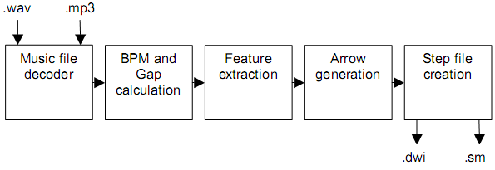
Dancing Monkeys Architecture
Process waveform data
Calculate BPM (first pass)
Calculate BPM (second pass)
Calculate gap time
Generate arrow patterns from waveform data

Slide 4

CPU Parallelization - Approach
MATLAB’s Parallel Computing Toolbox
Replace for loops with MATLAB’s parfor
Run loop in parallel, one per CPU core
http://www.mathworks.com/help/toolbox/distcomp/parfor.html
Require code modification
matlabpool
Temporary arrays
Index recalculations

Slide 5
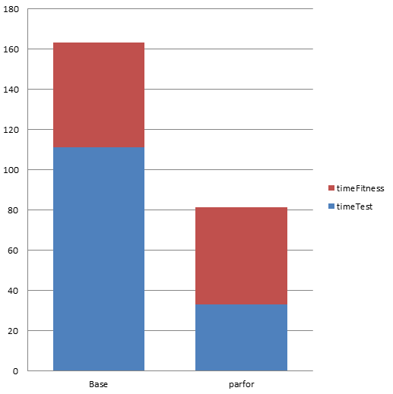
CPU Parallelization - Results
Much faster!

Slide 6
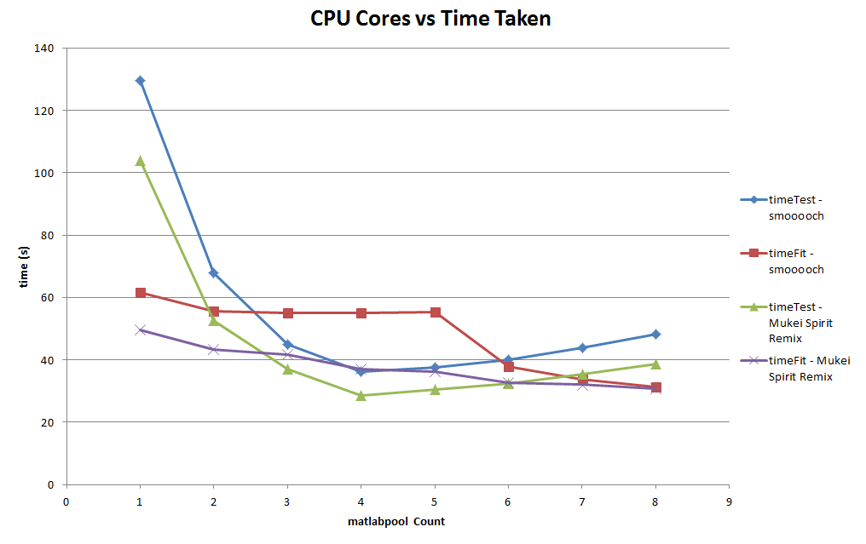
CPU Parallelization - Results

Slide 7

GPUarray
Part of Parallel Computing Toolbox
MATLAB’s gpuArray() and gather() function
Parallel GPU kernel by using arrayfun()

Slide 8

GPUarray – No Good!
arrayfun() only allows for per-element manipulation of arrays
Algorithm operates on shared data
MATLAB’s Parallel Computing Toolbox does NOT support global variables
img src: http://amoderngal.com/wp-content/uploads/2012/02/globe-europe1.jpg

Slide 9

Jacket - Approach
MATLAB plug-in developed by Accelereyes
Far greater function support for GPUs
Allows for shared data on GPU!!!
Minimal code modification
Replace for loops with Jacket’s gfor
Cast data to copy to GPU shared memory
$350 Licensing fee (but free 15-day trial)

Slide 10
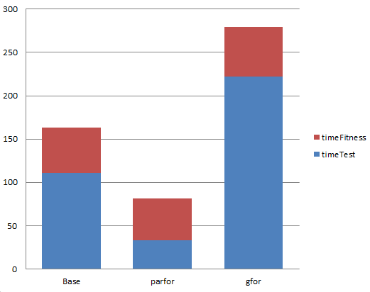
Jacket - Results
Worse!

Slide 11
Why slower on GPU is slower?

Slide 12
Analyzing Algorithm
Operations in Dancing Monkey’s code:
Array initialization
ones(size, 1), zeros(size, 1)
One-time only
Element access/assignment
data = A(x), A(x) = data
LOTS of access, some assignments
Element arithmetic operations
+, -, *, /
Lots of operations but with element of different indices
Array operations
mod, max, sort
A few at beginning and at end

Slide 13
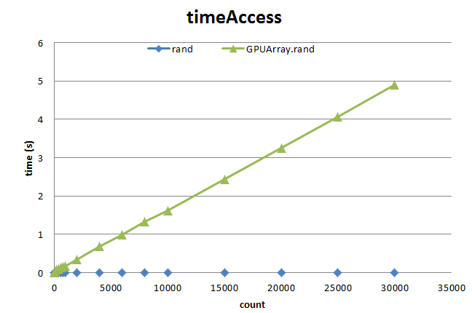
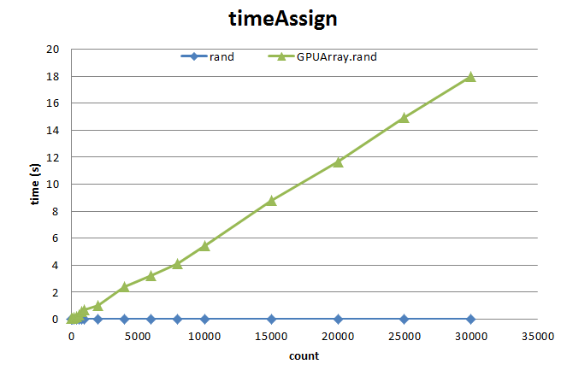
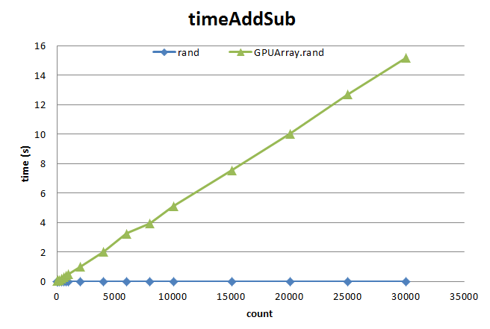

GPU Array
Element operations very slow!

Slide 14
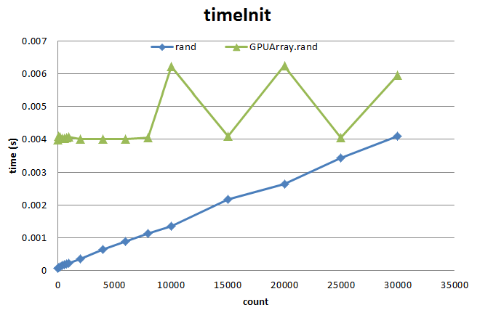
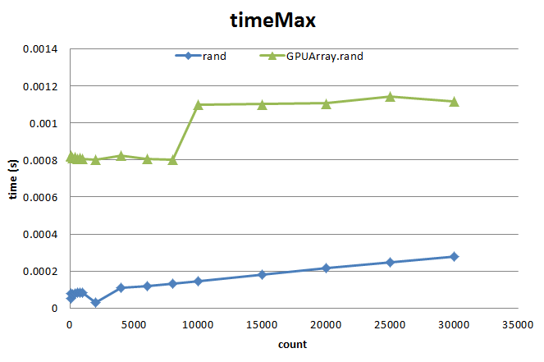
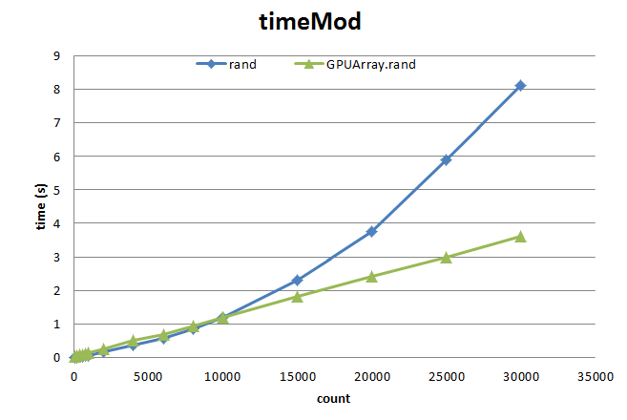
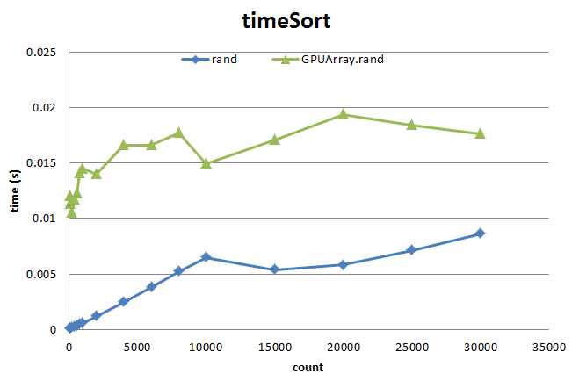
GPU Array
Array operations are a toss-up…

Slide 15
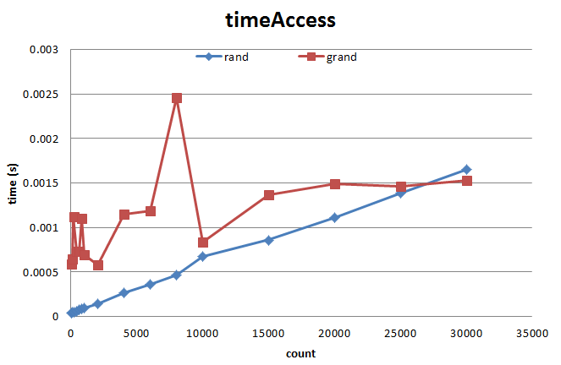
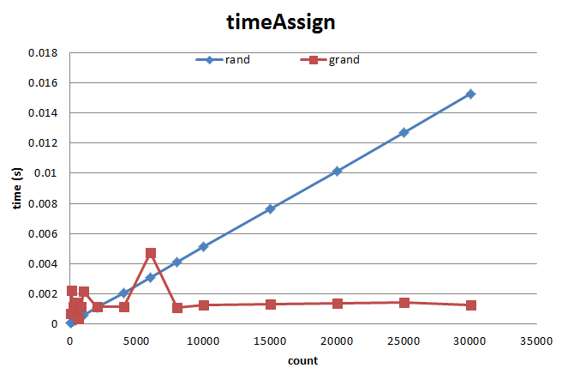
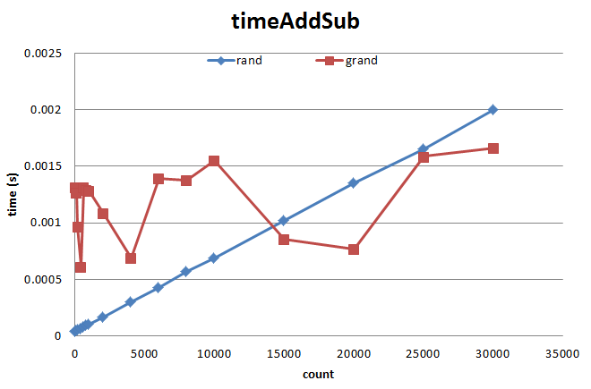
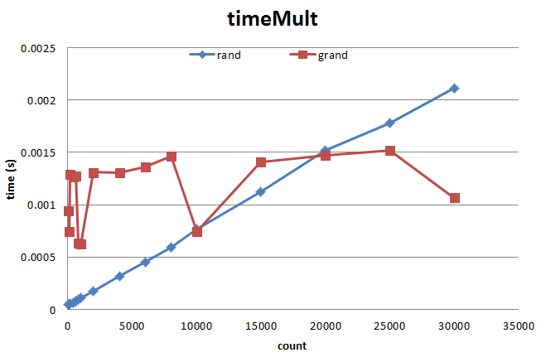
Jacket
Element operations generally good but access break-even point very high…

Slide 16
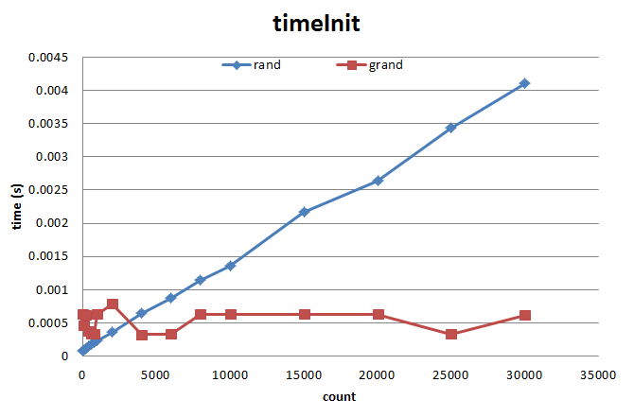
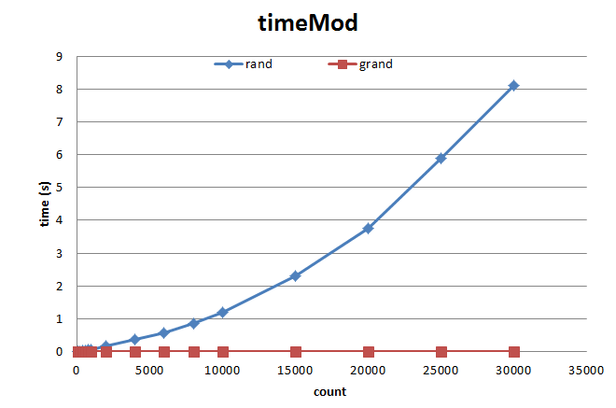
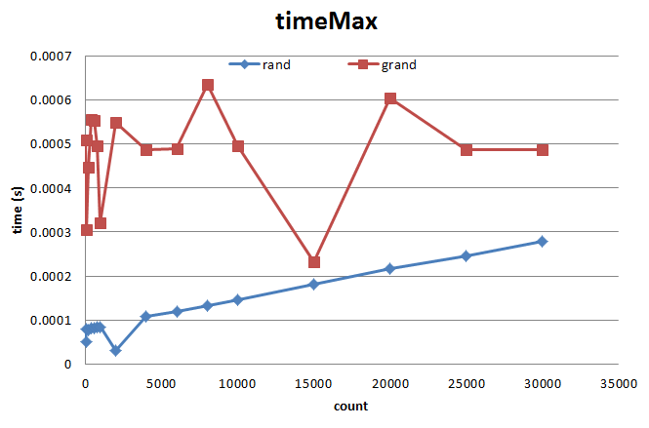
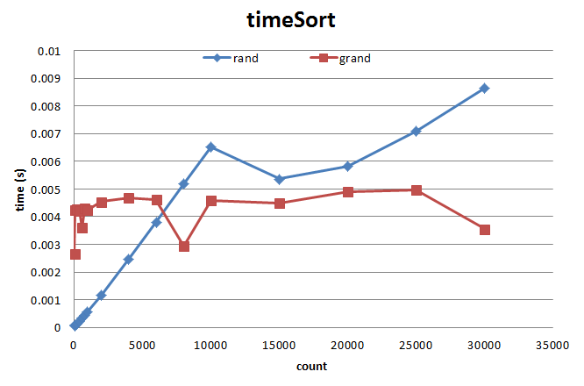
Jacket
Array operations generally good

Slide 17
Jacket – Why it failed
Data size too small to recognize benefits
Fixed 1682 loops (given 44100Hz and checking from BPM[89,205]) much smaller than break even points
Algorithm uses a LOT of array accesses
Benefits gained from arithmetic operations and mod/sort operations lost against Jacket’s overhead

Slide 18

Further Analysis…
Try to rewrite/optimize the algorithm itself?
img src: http://cdn.memegenerator.net/instances/400x/10026690.jpg

Slide 19
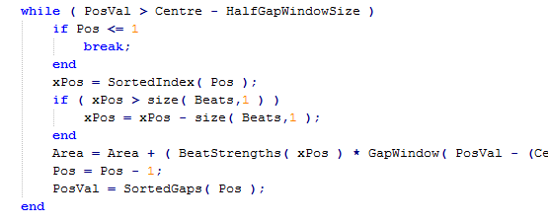
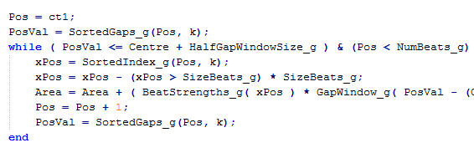
Further Analysis…
Reduce branching and conditional statements

Slide 20
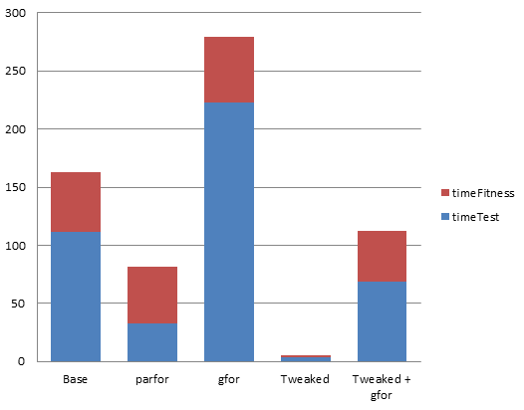
Further Analysis…
Immense speedup…

Slide 21
Conclusion
Algorithm operates on too small a data array and has a high % of access calls
Not good for GPU parallelization as originally though
GPUarray is very poorly implemented at the moment
Jacket offers significant speedups but not realized in this project
Original code poorly optimized
Rewritten version extremely fast, no space for GPU optimization

Slide 22

Questions?
Blog: http://dancingmonkeysaccelerated.blogspot.com/
Code: https://github.com/Keripo/DancingMonkeysAccelerated
img src: http://www.gratuitousscience.com/wp-content/uploads/2010/04/6a00d83451f25369e200e54f94996e8834-800wi.jpg

Slide 23
Bibliography
Karl O’Keeffe, “Dancing Monkeys”, MEng Individual Project Report 18th June 2003
Will Archer Arentz, “BEAT EXTRACTION FROM DIGITAL MUSIC”

