Slide 1

IMAD Practicum
Kerisha Ramsaroop
ST10449054

Slide 2
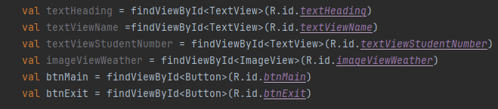
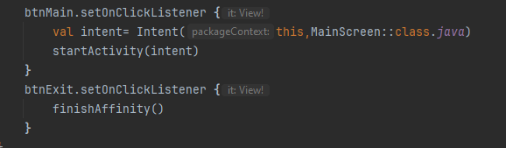
SplashScreen:
I have first declared my variables
I have three TextView(s) -> one for my Heading, another for my Name and the last one for my Student Number.
I have two buttons -> the first button “Main Screen” is to navigate to the next page and the second button “Exit” is to exit the app.

Slide 3
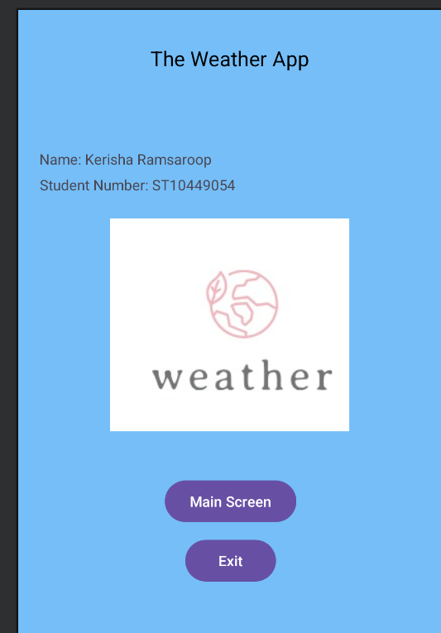
Splash Screen Continued
Once the user opens the App they would see a screen like the one below.

Slide 4
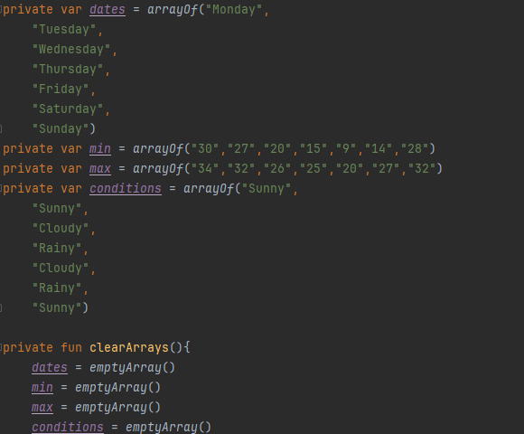
Main Screen:
I have declared my private variables
I have also added a private fun which will clear my array

Slide 5
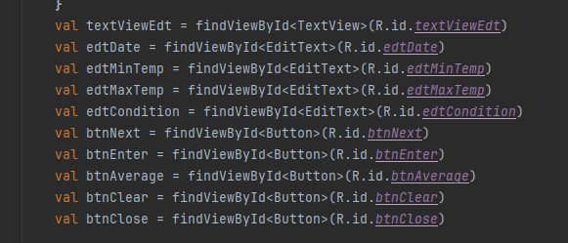
MainScreen Continued:
I have first declared my variables
I have one TextView(s) -> That will display Error messages and messages
I have five buttons -> the first button “Detailed View” is to navigate to the next page , the second button “Enter” which allow the user to enter values and will be saved, the third button “Average” will output the average, the fourth button “Clear” will clear the data and the last button “Close” is to exit the app.

Slide 6
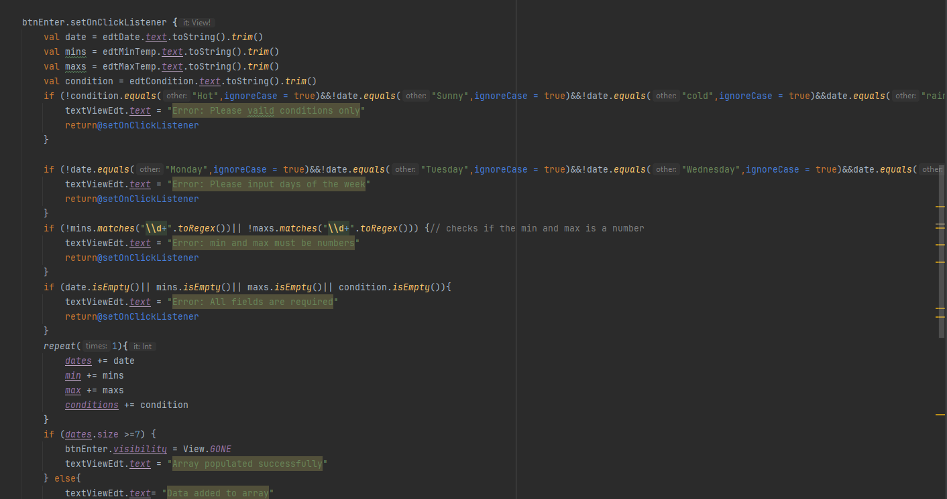
MainScreen Continued:
btnEnter is my enter button that will push the data to the detailed view screen, I have also used loops [else AND if]
Show Message “Array populated successfully”
Else:
Show Message “Data added to array”
If:
Show ErrorMessage “Error: Please input days of the week”
Show ErrorMessage “Error: min and max must be in numbers”
Show ErrorMessage “Error:All fields are required”

Slide 7
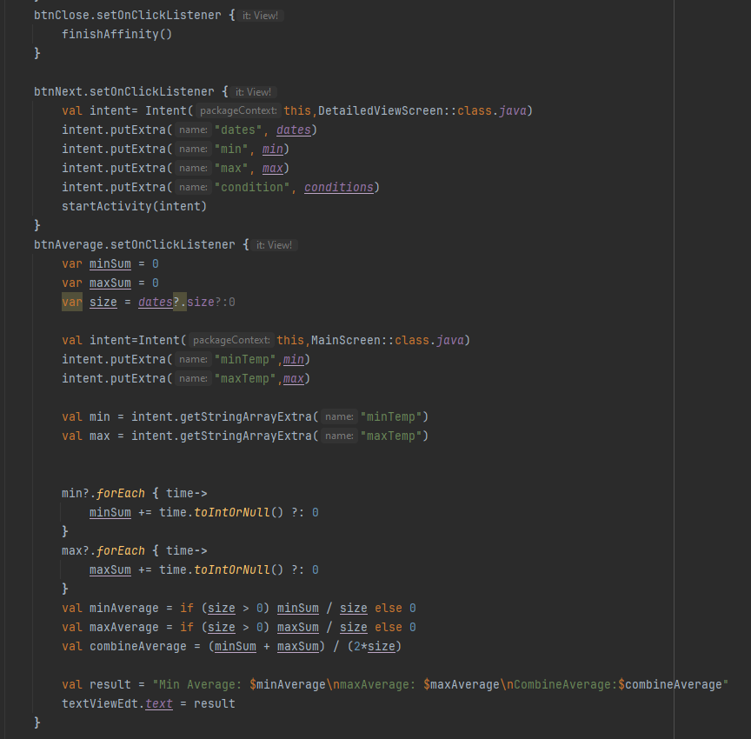
MainScreen Continued:
btnClose will exit the app
btnNext will display the information to the detailed view screen
btnAverage will display the average when clicked on

Slide 8
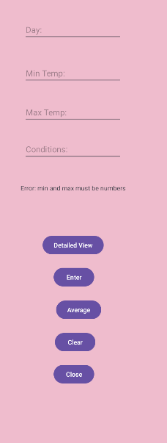
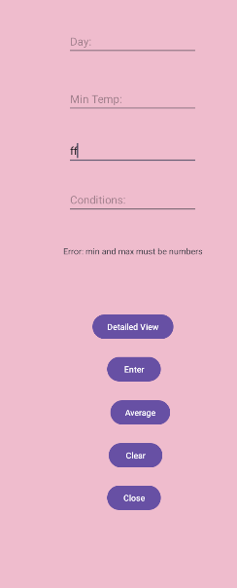
MainScreen Continued:
Error Messages

Slide 9
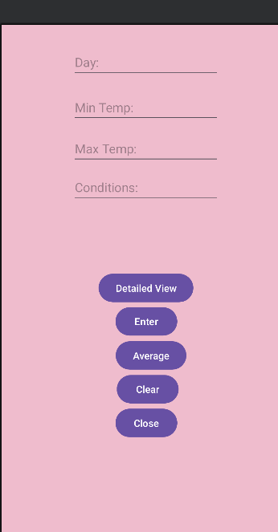
MainScreen Continued:
The user will see a screen that looks like this

Slide 10
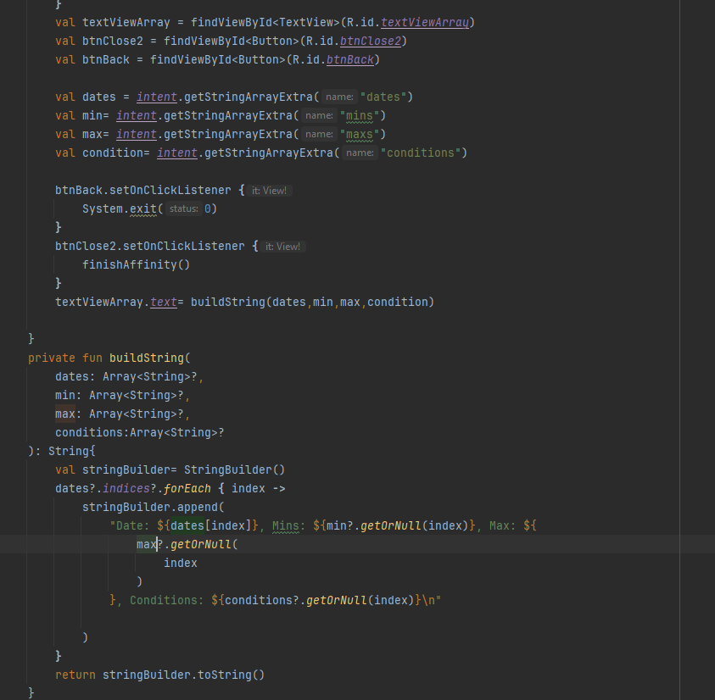
Detailed View Screen:
I have first declared my variables
I have one TextView(s) -> that will display the data
I have two buttons -> the first button “Main Screen” is to navigate to the next page and the second button “Exit” is to exit the app.

Slide 11
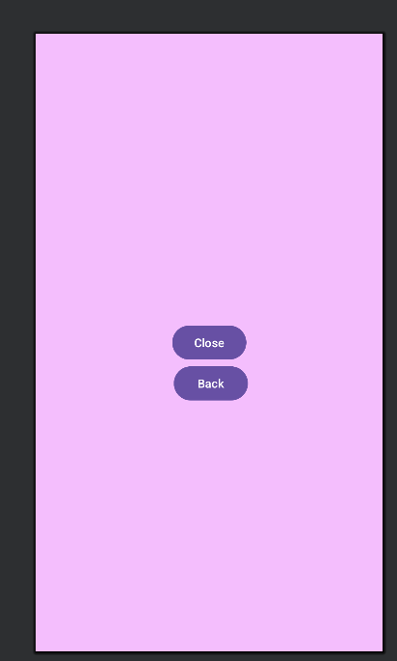
Detailed View Screen:
The user will see a page like this

