Slide 1
A.
Plant Growth
B.
Plant Mortality
C.
Size Distribution
DET: Weibull
ln (growth rate)
ln (mortality rate)
ln (frequency)
DET: b = 0
MST: Pareto
MST: b > 0
ln (plant size)
ln (plant size)
ln (plant size)
Figure 1. Alternative models of plant size distributions based on the balance between growth and mortality, based on demographic equilibrium theory (DET, blue) and metabolic scaling theory (MST, red). A. Both theories assume that growth rate increases allometrically with plant size, but B. they make different assumptions about the scaling of mortality. C. These alternative assumptions yield the Pareto distribution for MST versus a Weibull distribution for DET.

Slide 2
A = 2 ha
N = 1,739
λ = 1.19
β = 0.32
A = 1 ha
N = 2,629
λ = 1.17
β = 0.39
A = 1.44 m²
N = 1,771
λ = 1.25
β = 0.64
A = 1.44 m²
N = 1,514
λ = 1.29
β = 0.76
ln(Probability Density)
A = 1.44 m²
N = 244
λ = 1.20
β = 0.53
A = 1.44 m²
N = 320
λ = 1.28
β = 0.48
A = 1.44 m²
N = 315
λ = 1.15
β = 0.57
A = 1.69 m²
N = 226
λ = 1.35
β = 0.31
A = 1.69 m²
N = 618
λ = 1.21
β = 0.71
A = 1.69 m²
N = 938
λ = 1.29
β = 0.51
A = 1.69 m²
N = 281
λ = 1.20
β = 0.30
A = 1.69 m²
N = 160
λ = 1.21
β = 0.31
ln(Plant Mass (g))
Figure 2. Individual plant size distributions for 12 different plant communities, including forest, succulent desert shrubland, herbaceous wetland, restored prairie, sage grassland, and alpine meadow communities. In all plots, points are logarithmically binned probability density histograms of plant dry mass (g), and the lines are the maximum likelihood models for the Pareto (red) and Weibull (blue) distributions. Highlighted census characteristics include plot area (A), number of plants censused (N), as well as the Pareto exponent (λ) and Weibull shape parameter (β) for the fitted models. In all cases, the Weibull model provided a superior fit based on AIC (see Table 2).

Slide 3
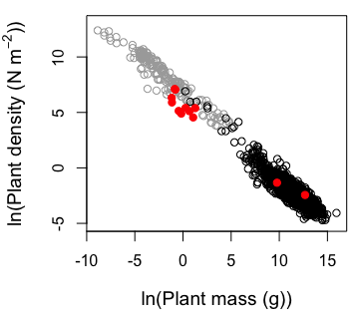
Figure 3. Cross-community scaling relationship for 12 different plant communities from this study (red points). For comparison, data compiled by Deng et al. (2014) are included for forests, plantations, and bamboo (black) as well as crop plants growing at optimal density (gray).

