Slide 1
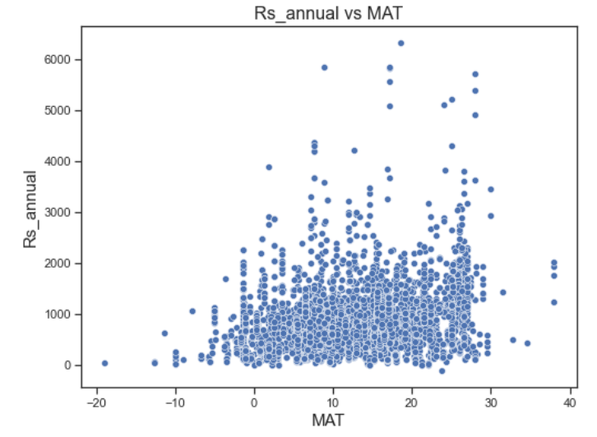
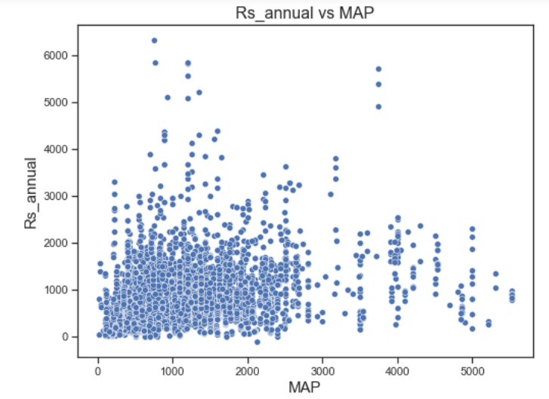
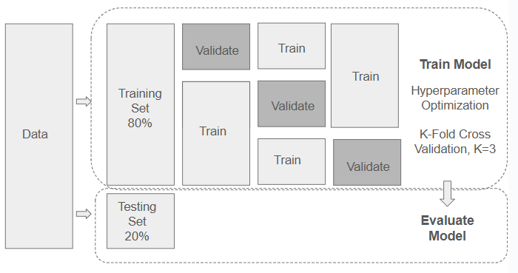
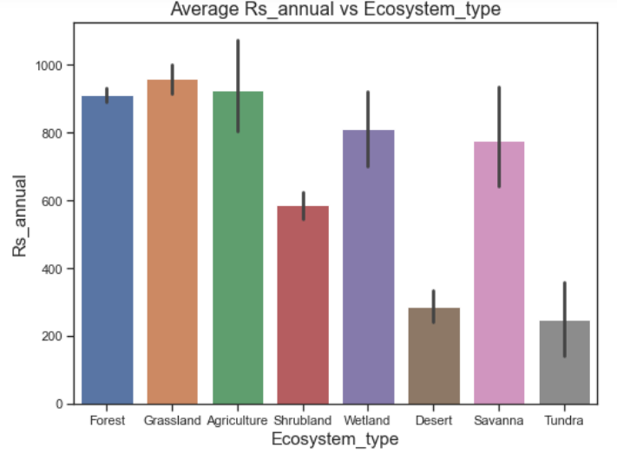
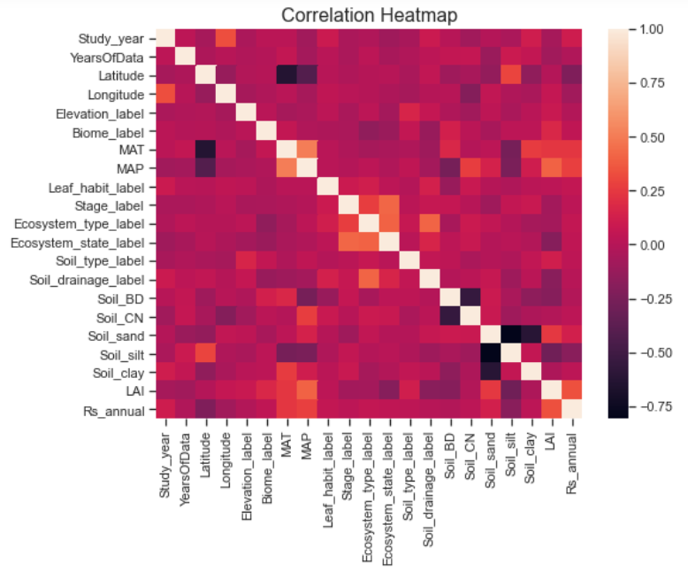
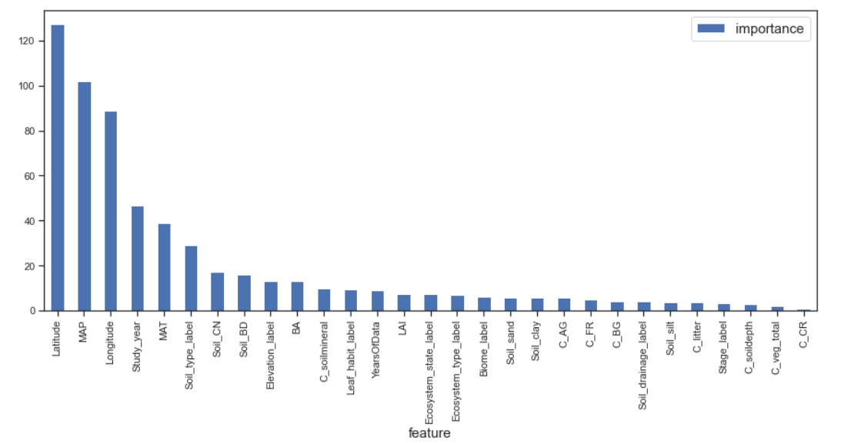
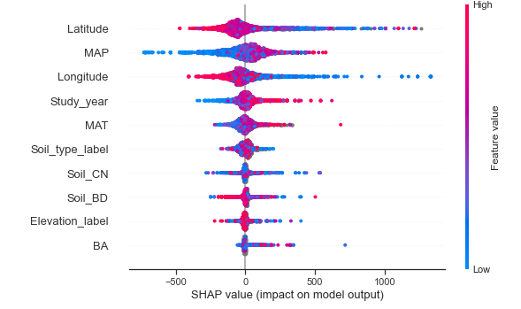
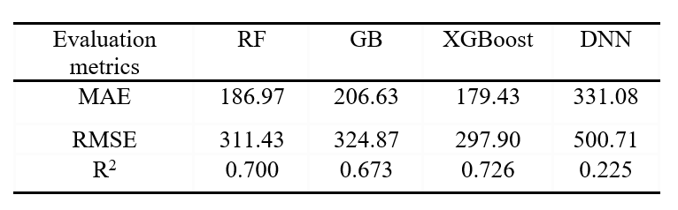
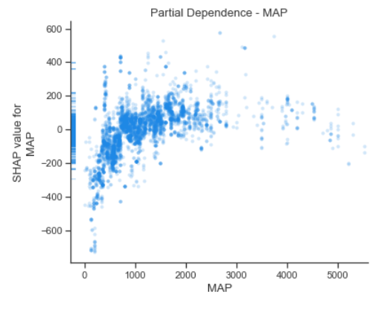
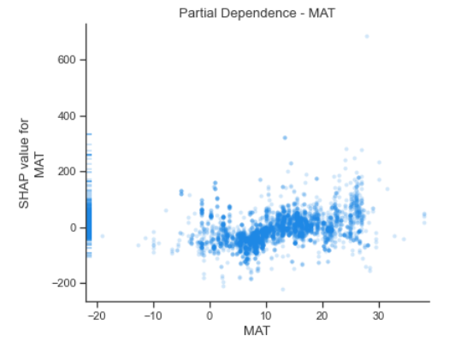
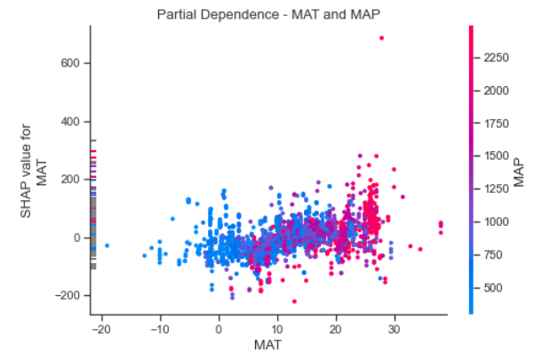
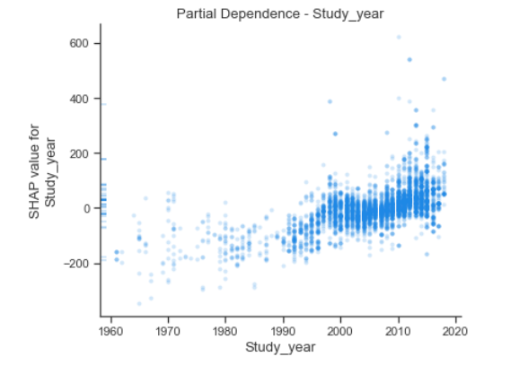
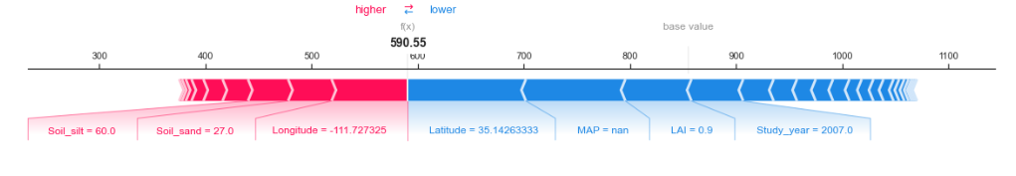
Exploring Innovative Machine Learning Models for
Soil CO² Emission Forecasting
Vincent Lu
Basis Independent Fremont
ABSTRACT
METHODOLOGY
CONCLUSION
Soil respiration, the natural process by which carbon dioxide (CO₂) is released from the soil into the atmosphere, is the largest flux of CO₂ from the Earth’s surface. Despite its significance, accurately predicting CO₂ emissions caused by soil respiration remains challenging, and the influence of environmental variables are not yet fully understood. Early studies using artificial intelligence (AI) to predict soil respirations often relied on linear models or overly simplified datasets which lacked real-world applications.
This study introduces a novel integration of XGBoost and Shapley Additive exPlanations (SHAP) to achieve both high predictive accuracy and detailed feature interpretability. In this study, an innovative ensemble model, XGBoost, is developed to estimate annual soil respiration (Rs) using spatial, temporal, climatic, and other independent variables. Additionally, a deep neural network (DNN) model is explored. Among the machine learning models evaluated, XGBoost shows the best performance, with a 4% reduction in Mean Absolute Error (MAE) and Root Mean Squared Error (RMSE) and a 3.7% increase in R² compared with the Random Forest model, which was so far believed to be the state-of-the-art method. To aid in model explainability, SHAP is used to give feature importance at both the global and individual levels of analysis. Results indicate that Mean Annual Temperature (MAT) and Mean Annual Precipitation (MAP) are the most dominant environmental factors, with geographic variables such as latitude and longitude also significant. Other strong predictors include Study Year, Soil Type, soil composition-related features, Elevation, and Basal Area (BA). This study fills the gap between predictive modeling and interpretability, providing an explainable AI framework that is scalable for real-world environmental research.
Exploratory Data Analysis
Dependent variable: Rs_annual, the quantity of carbon dioxide emitted in a year by soil respiration.
Independent variables (total 29):
Spatial/temporal: Study_year, YearsOfData, Latitude, Longitude, Biome, Elevation
Climate: MAT, MAP
Land use: Ecosystem_type, Ecosystem_state
Soil: Soil type, soil drainage, density etc.
Vegetation and carbon features: LAI, total carbon in vegetation at site, basal area at site etc..
Model Training
Model selection:
Proposed Model: XGBoost
Baseline Models: Random Forest (RF), Gradient Boosting (GB)
Model explored: DNN model
Hyperparameter optimization:
GridSearchCV with K-fold cross-validation.
XGBoost parameters: number of estimators, tree depth, and learning rate …
DNN: neuron counts, learning rate, and batch size…
An innovative ensemble model, XGBoost, is developed to predict annual Rs from spatial, temporal, climate, and other independent variables. In addition, a DNN model is experimented. The models are evaluated against two baseline models, Random Forest (RF) and Gradient Boosting (GB), which are established as benchmarks in previous studies.
The XGBoost model delivers the best performance, achieving a 4% reduction in MAE and RMSE and a 3.7% improvement in R² compared to the Random Forest model, previously identified as the top-performing approach.
The DNN model fails to achieve reasonable results, primarily due to the limited sample size.
SHAP (SHapley Additive exPlanations) is employed as a robust method for model explainability, enabling the assessment of feature impacts on predictions both globally and at the individual observation level.
Results reveal that Mean Annual Temperature (MAT) and Mean Annual Precipitation (MAP) are the most influential environmental factors, alongside geographic features such as latitude and longitude, aligning with previous studies.
In addition, the four features, Study Year, Soil Type, soil composition related features, Elevation, and Basal Area (BA) also demonstrate high impact on Rs estimates.
Fig. 1. illustrates the model training with hyperparameter optimization and model evaluation process.
Model Evaluation Metrics
Mean Absolute Error (MAE): Average absolute difference between predicted and real observed values
Root Mean Squared Error (RMSE): Square root of the mean of the squared differences between the predicted and actual values.
Coefficient of Determination (R²): The amount of variance in the dependent variable that can be explained by the independent variables in the regression model.
FUTURE WORK
OBJECTIVES
A notable challenge in this study is the significant amount of missing data for vegetation and carbon-related features. As a next step, further exploration of alternative data repositories, such as ERA5, is planned to improve data quality and model performance.
Another challenge is the small sample size, especially after excluding records with quality issues. Identifying reliable data sources and addressing data quality issues will be critical areas of focus to improve model robustness and performance.
Accurately predict CO₂ emissions from soil respiration based on spatial, temporal, climatic, and other observable variables by machine learning models.
Provide model explainability to understand the environmental drivers behind soil respiration process.
RESULTS AND DISCUSSION
Performance
REFERRENCE
XGBoost model has the best performance in terms of predictive accuracy and error reduction compared with the other three models:
Lowest MAE and RMSE
Highest R2
D. M. Lawrence et al., "The Community Land Model version 5: Description of new features, benchmarking, and impact of forcing uncertainty," J. Adv. Model. Earth Syst., vol. 11, no. 12, pp. 4245–4287, 2019.
J. Liu, J. Hu, H. Liu, et al., "Global soil respiration estimation based on ecological big data and machine learning model," Sci. Rep., vol. 14, 13231, 2024. doi: 10.1038/s41598-024-64235-w.
H. Lu, S. Li, M. Ma, et al., "Comparing machine learning-derived global estimates of soil respiration and its components with those from terrestrial ecosystem models," Environ. Res. Lett., vol. 16, no. 5, Art. 054048, 2021. doi: 10.1088/1748-9326/abf526.
H. Luo, C. Xiang, L. Zeng, et al., "SHAP-based predictive modeling for 1-year all-cause readmission risk in elderly heart failure patients: Feature selection and model interpretation," Sci. Rep., vol. 14, 17728, 2024. doi: 10.1038/s41598-024-67844-7.
DATA COLLECTION AND PREPROCESSING
Fig. 2. Diagram of feature importance illustrates average impact from features
Fig. 3. SHAP dispersion plot visualizes the distribution of SHAP values for a given feature across different instances in a dataset, illustrating the variability of a feature's impact on model predictions.
Data source
All data is taken from Soil Respiration Database Version 5
(SRDB-V5), a comprehensive global archive of published research data on soil respiration.
Data cleaning and preprocessing
Records with entries flagged in the Quality_flag field were excluded from the analysis.
Extreme outliers, with Rs_annual values above 5000 gCm⁻², were also removed; this corresponded to 22 records from a total of 12,272 entries (less than 0.2%).
Missing values for the independent variables were replaced by the median value of each respective feature.
Model Explainability
Partial dependence plots from SHAP illustrate how the model outcome changes as a specific feature change, while other features remain unchanged.
Machine learning methods are mostly seen as "black boxes." To overcome this, SHAP is applied together with the XGBoost model to analyze feature importance, feature distribution, partial dependence, and the interactions between different features. A SHAP value quantifies how much each feature contributes to a model’s prediction for a specific instance, compared to the average prediction.
Global level: Feature importance (Fig 2) and dispersion plot (Fig 3)
Individual prediction level: partial plot (Fig 4-7) and force plot (Fig 8)
A slight upward trend between MAT and Rs.
As MAP increases up to 1000 mm, Rs increases. However, beyond 1000 mm of MAP, the predicted Rs values level off.
Fig. 4. Patial dependence - MAP
When both MAT and MAP are low, predicted Rs values are also low. High MAT and MAP lead to higher Rs. However, when MAT is moderate, the positive correlation between MAP and predicted Rs becomes less pronounced.
Fig. 5. Patial dependence - MAT
A clear upward trend between study year and predicted Rs, indicating higher Rs in recent years.
Fig. 8. SHAP force plot
SHAP force plot visualizes how different features influence the model prediction for a specific observation. The features driving the prediction higher are in red and the features decreasing the predicted value are in blue.
Fig. 6. Patial dependence – MAP and MAT
Fig. 7. Patial dependence – Study_year

