Slide 1

Profile
Revon Pereira
9820739399
revon.p@gmail.com

Slide 2

Branding / Interior Design for UL

Slide 3
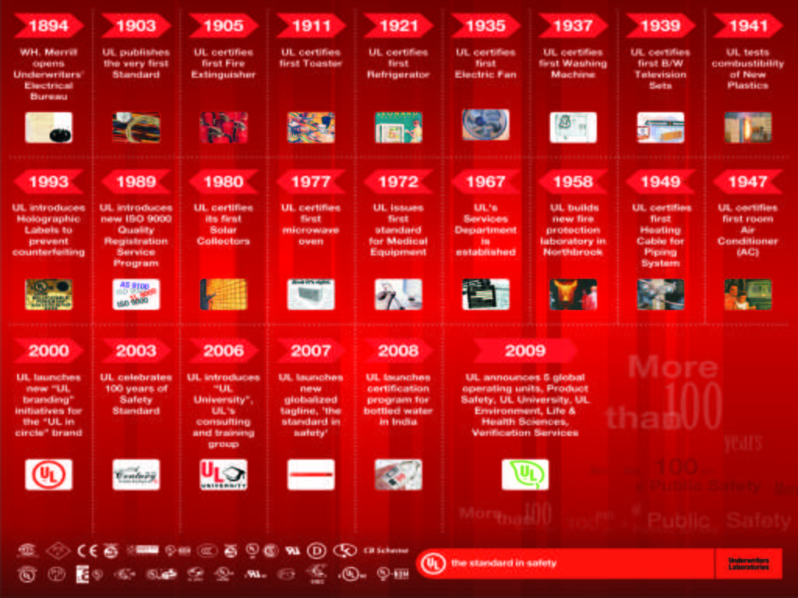
10x10 feet history wall graphic

Slide 4
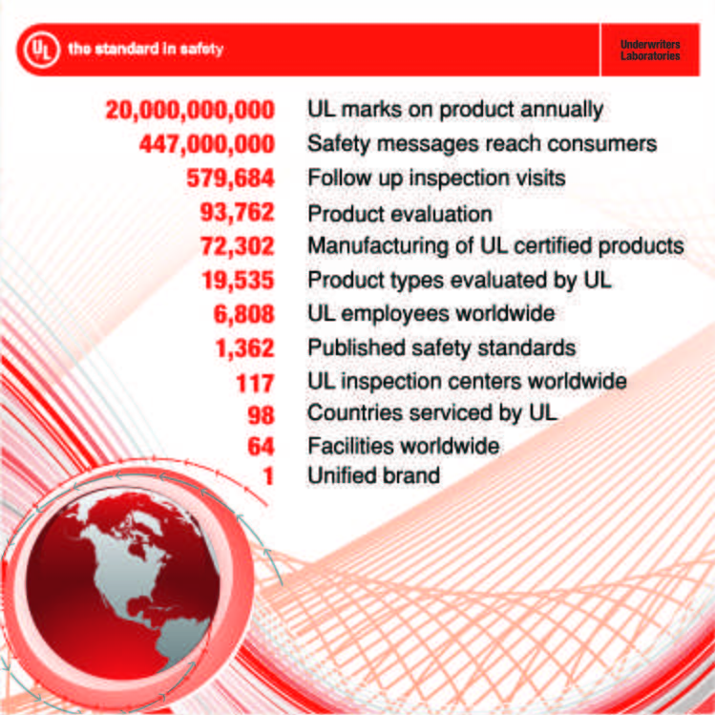
8x8 feet poster

Slide 5
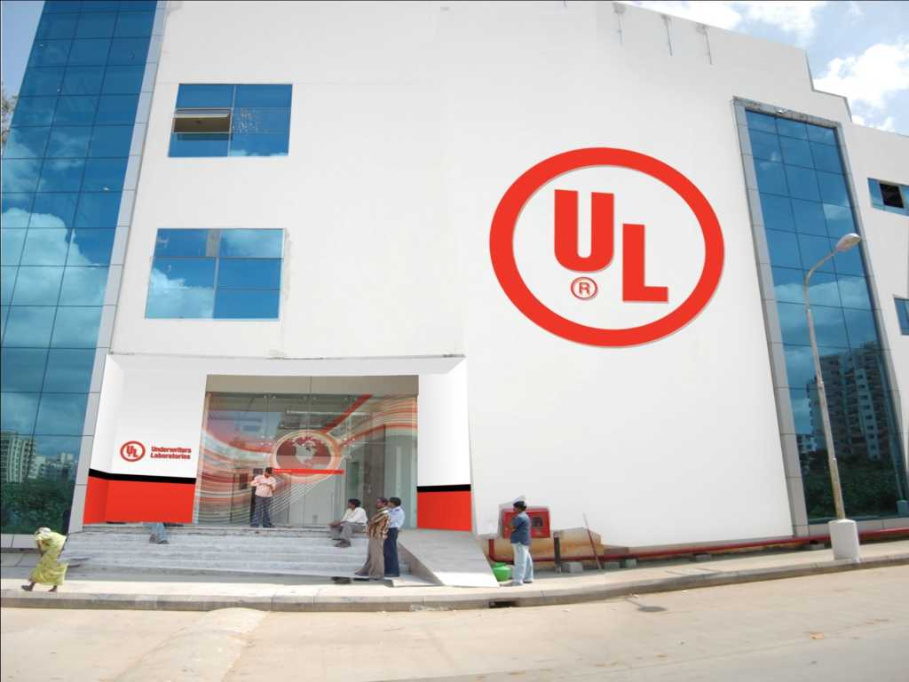
UL Enterance Glass Door desng & Neon logo placement

Slide 6
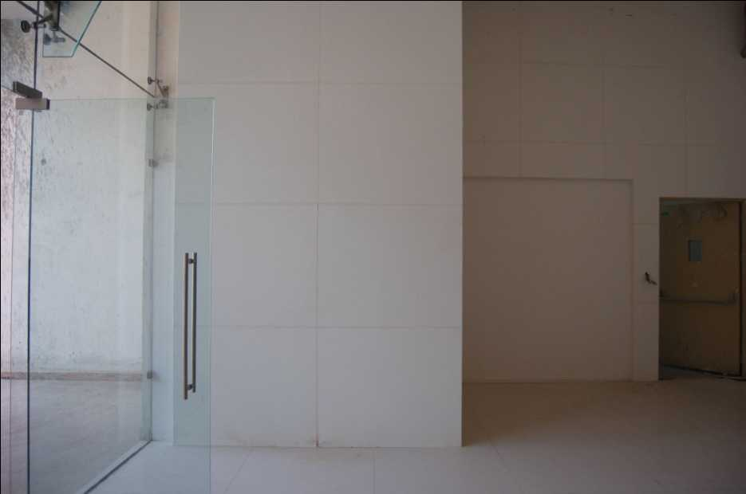
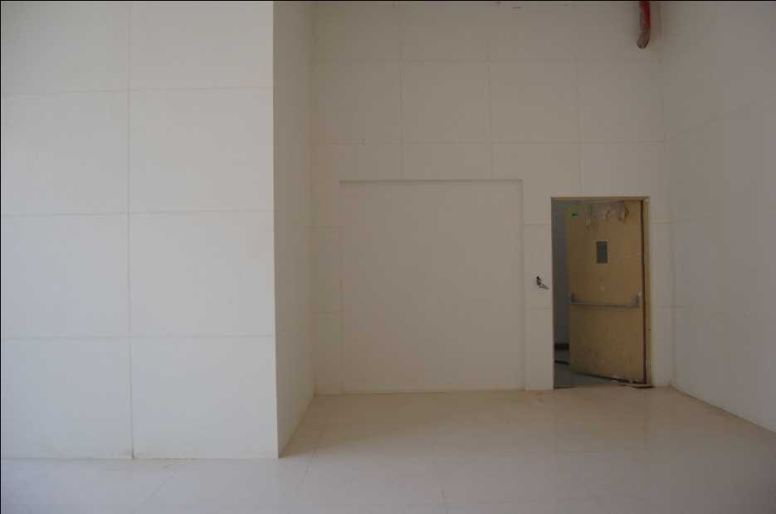
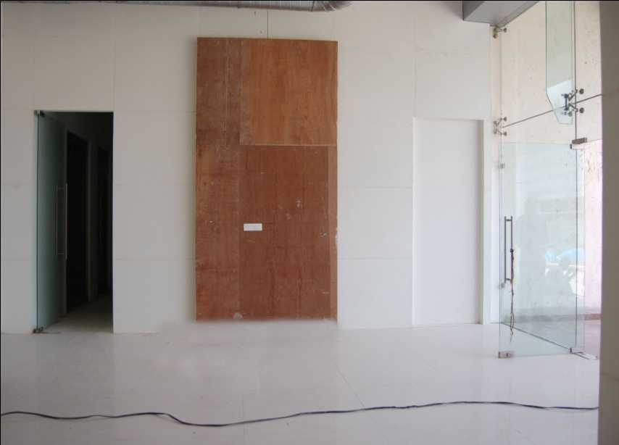
Clients need for graphics for the current entrance space below, and the process by which designs were sent to the client for approvals

Slide 7

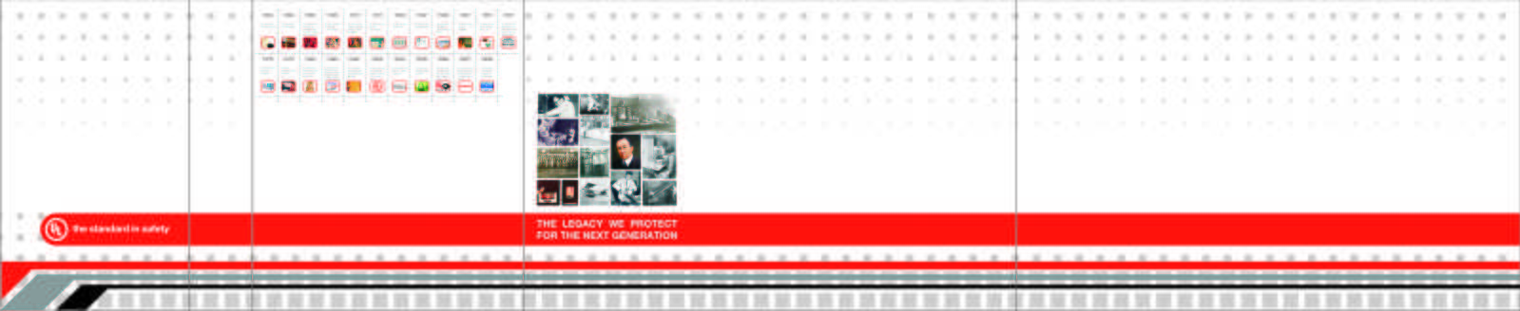
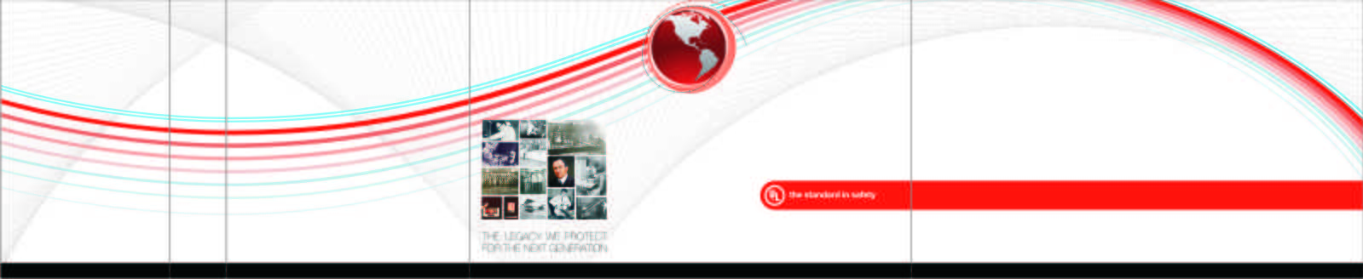
Designs proposed for the entrance space

Slide 8
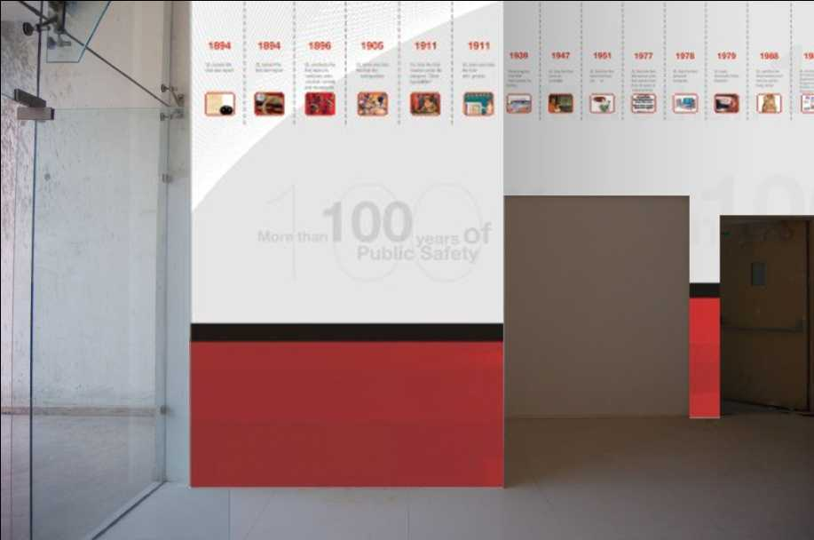
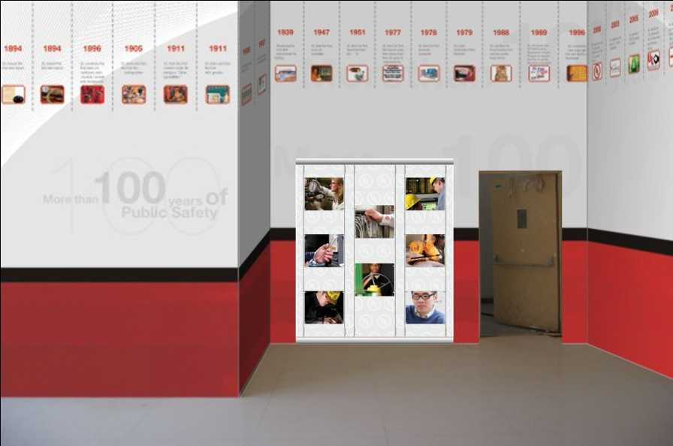
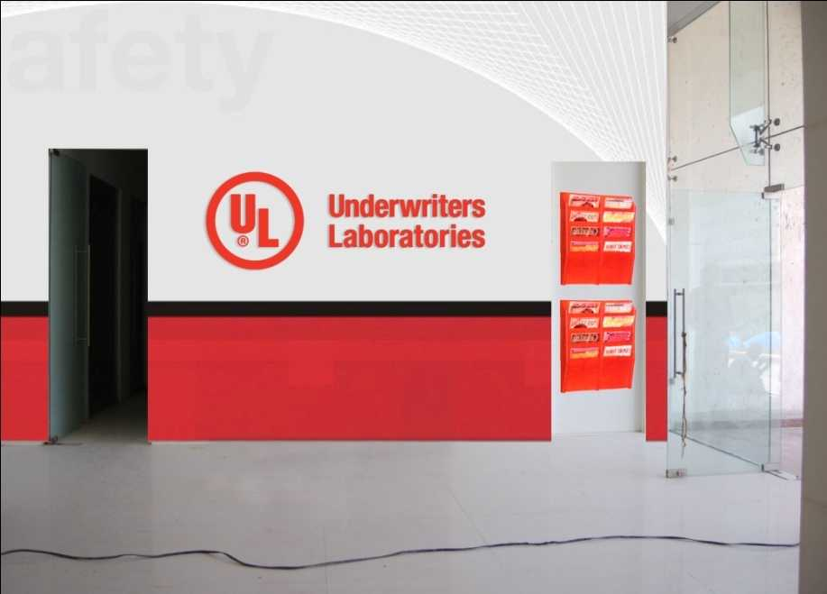
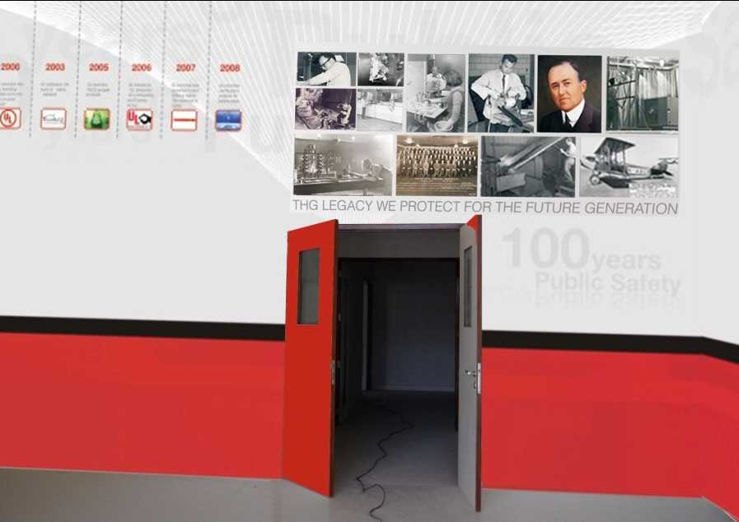
Application of the first design

Slide 9
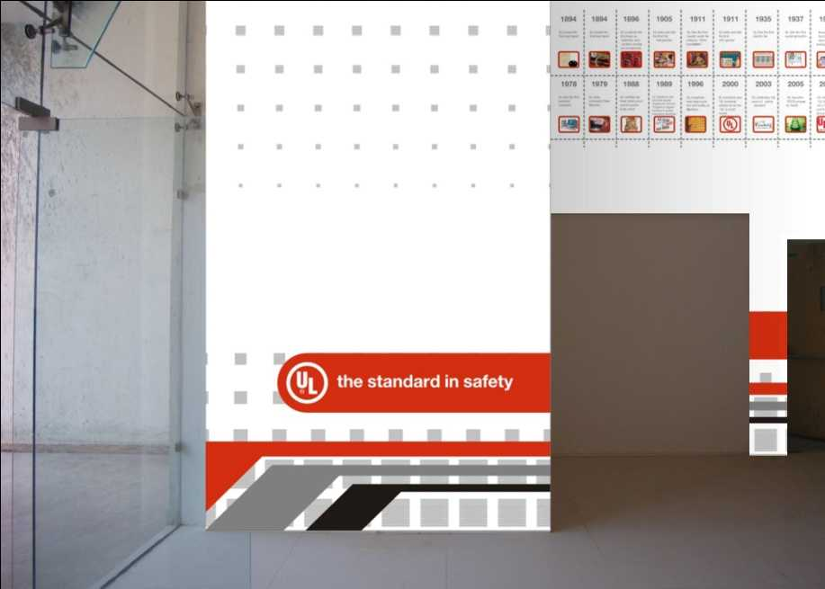
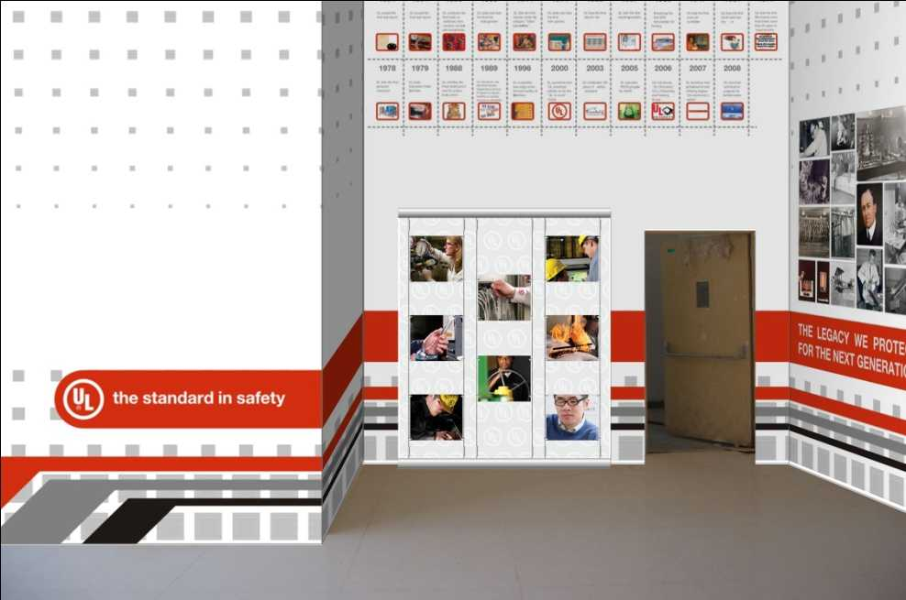
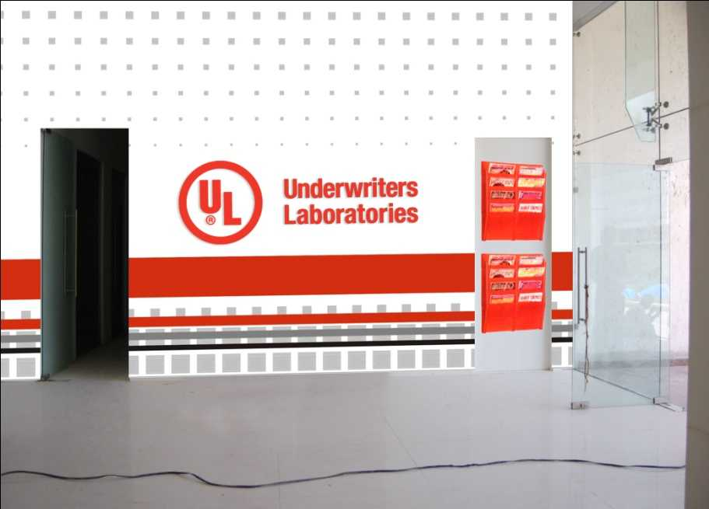
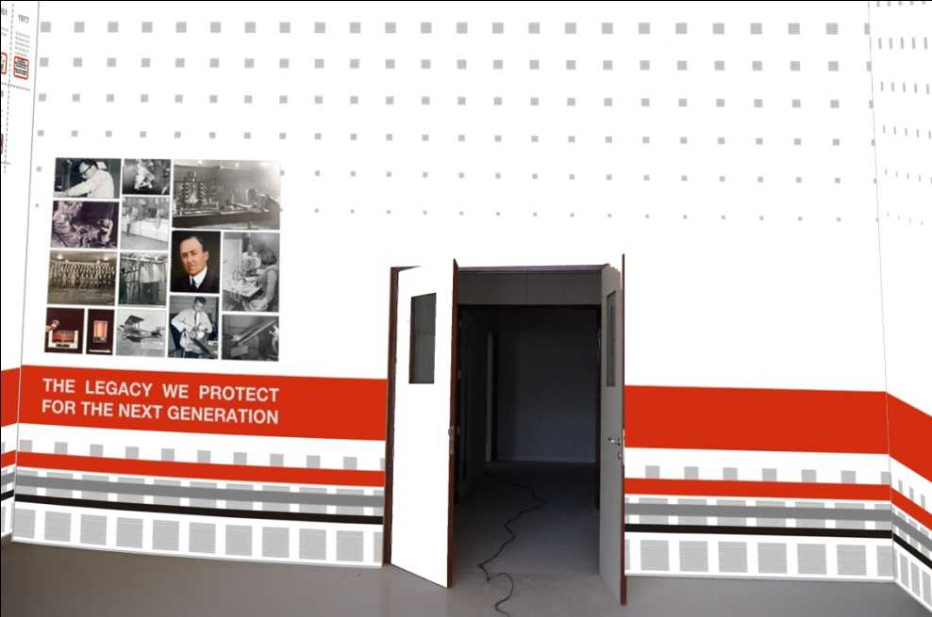
Application of the second design

Slide 10
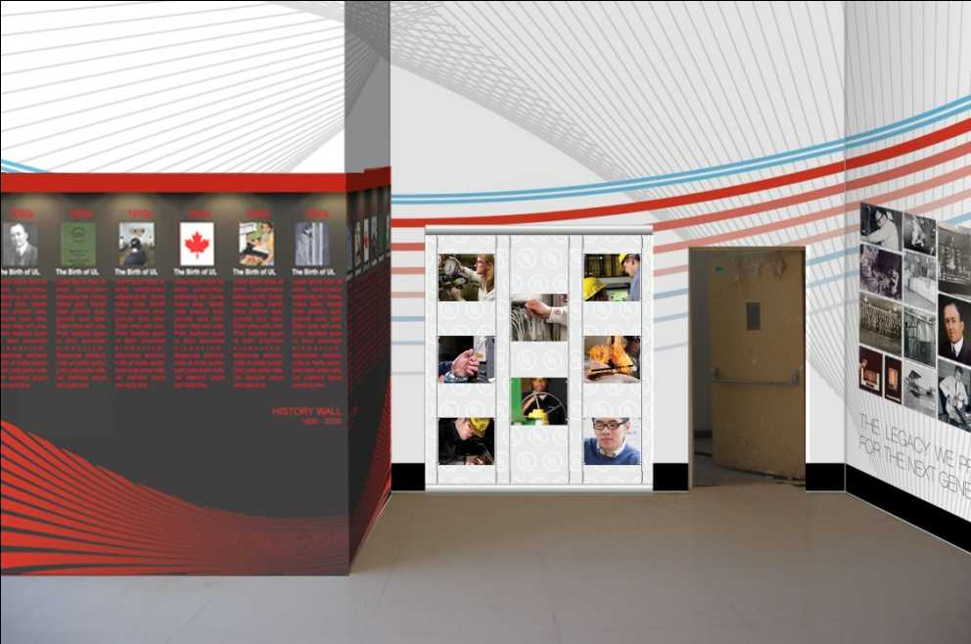
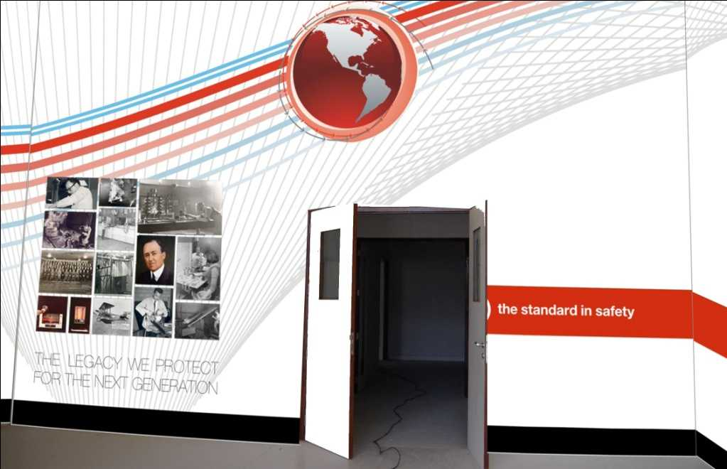
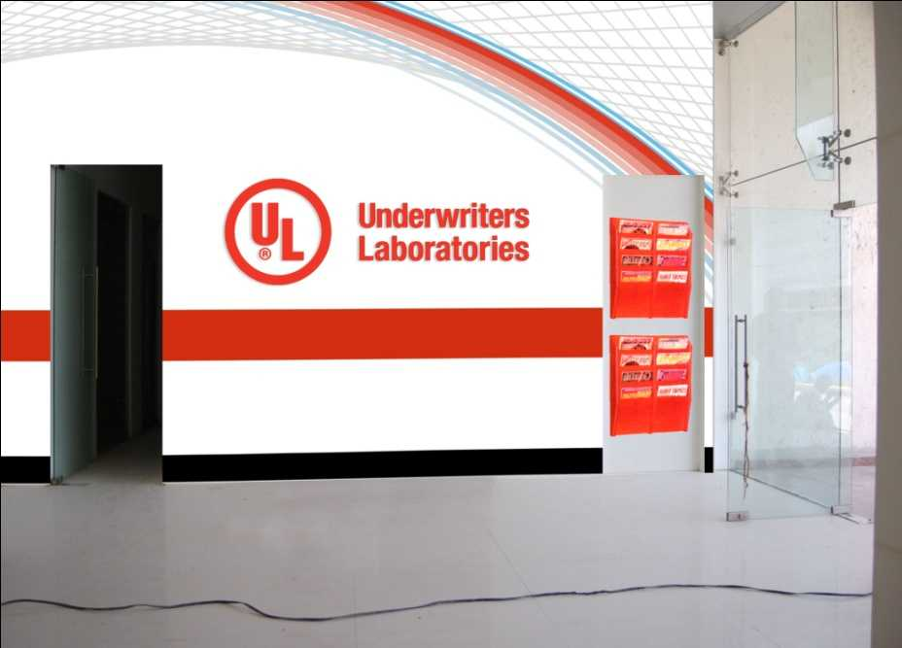
Application of the first design

Slide 11
Brand Identity Design

Slide 12


Slide 13
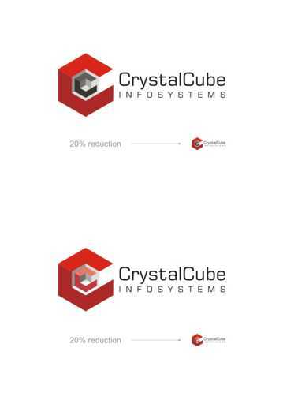

Slide 14


Slide 15


Slide 16
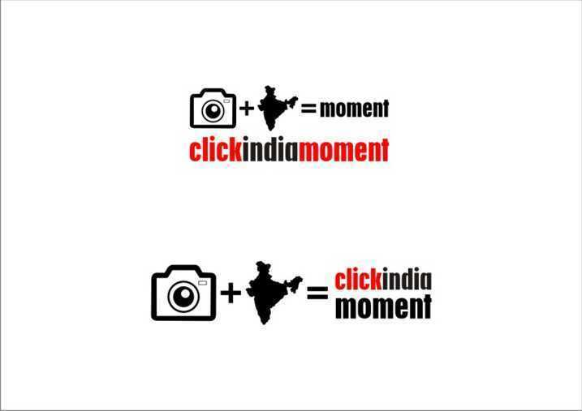

Slide 17


Slide 18


Slide 19


Slide 20


Slide 21


Slide 22

Logo for GE Day event in mumbai

Slide 23


Logo for future brands symposium

Slide 24
Web Layout & backdrop Design

Slide 25

Backdrop for DIESEL fuel for life launch

Slide 26


Slide 27
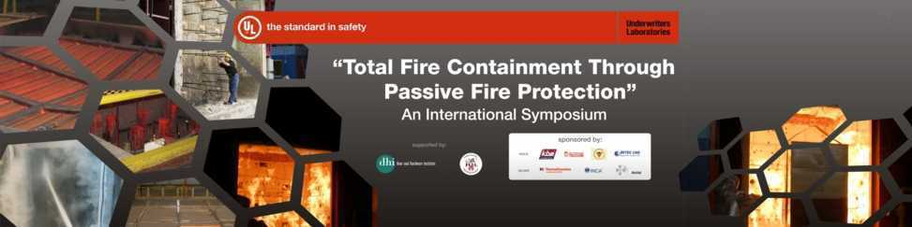
Backdrop design for UL

Slide 28
Other Illustrations & Designs

Slide 29
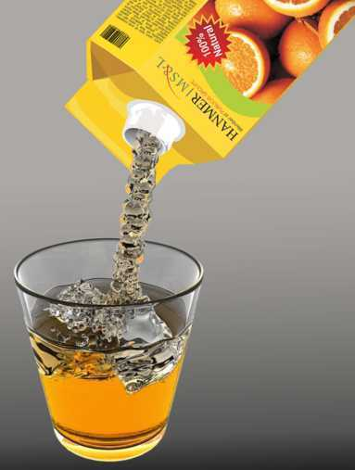
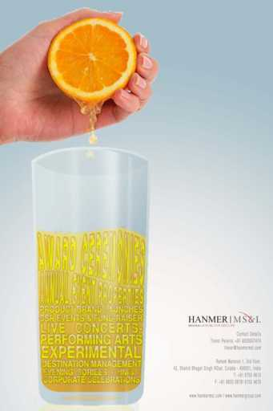
Concept illustration for a Newsletter

Slide 30
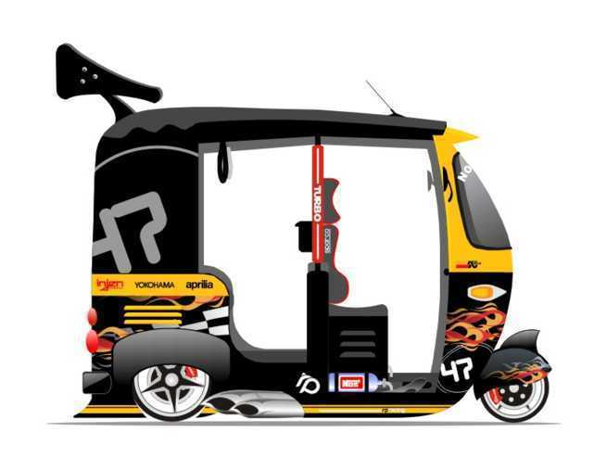
Indian Hot-Rod

Slide 31

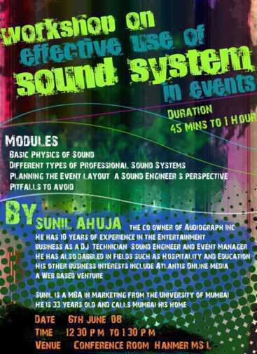

Slide 32
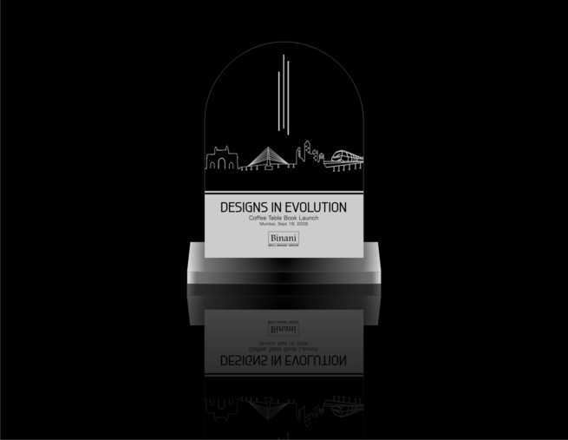
Trophy Design

Slide 33
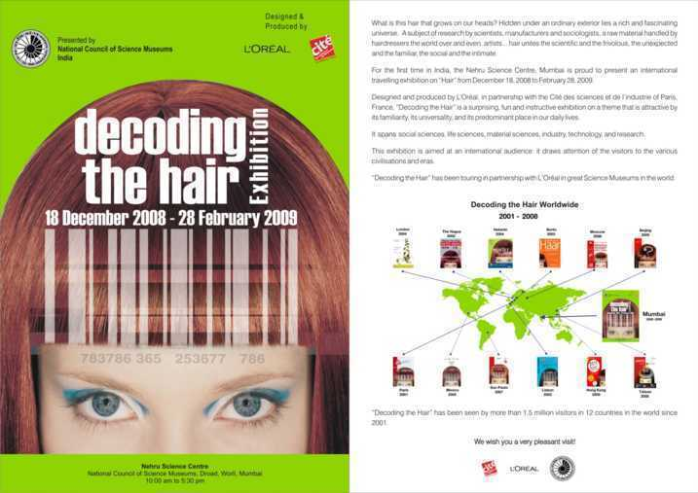

Slide 34
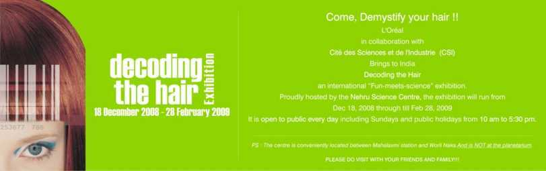
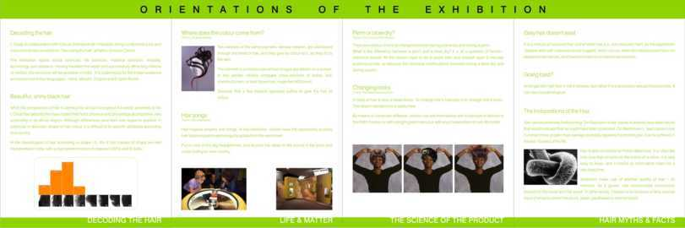
Brochure for L’Oreal Hair exhibition

Slide 35
Exhibition Stall Design

Slide 36
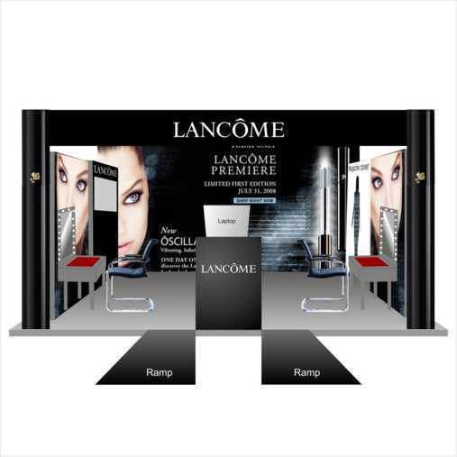

Slide 37
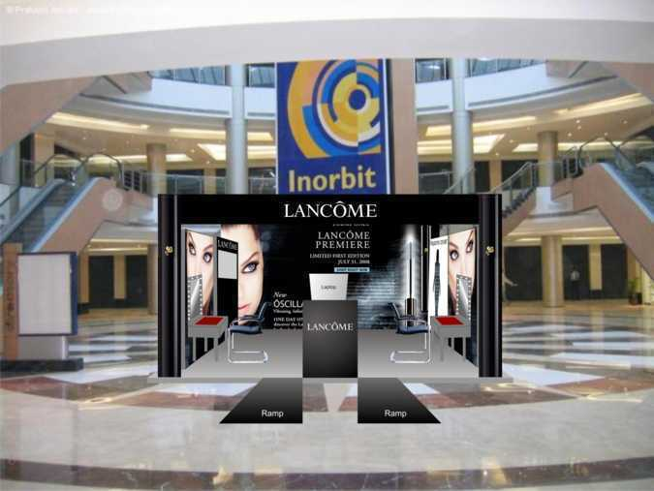

Slide 38
Photography

Slide 39
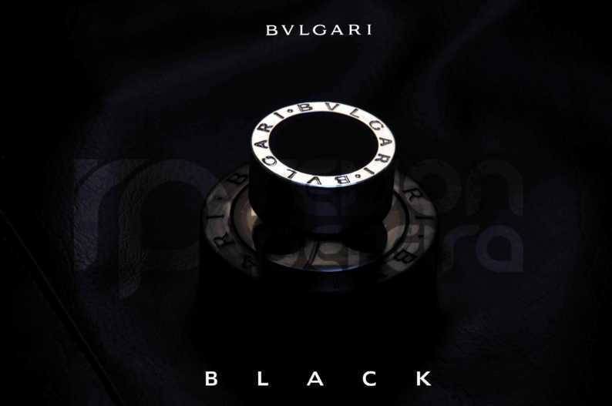

Slide 40
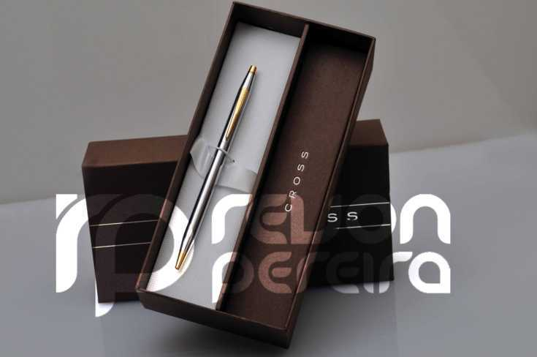

Slide 41


