Slide 1
Strut 2: Building the view
Thành viên:
Đặng Thành Nhân – 12520298
Lê Xuân Nam – 12520272
Trần Quốc Tuấn Khanh - 12520192

Slide 2
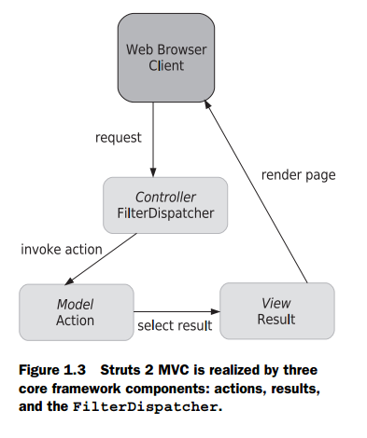
Agenda
Building a view: tags
UI component tags
Results in detail

Slide 3
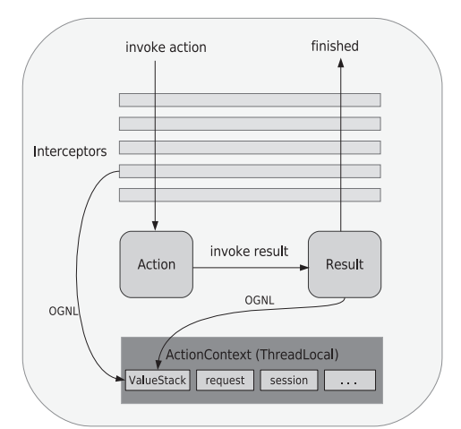
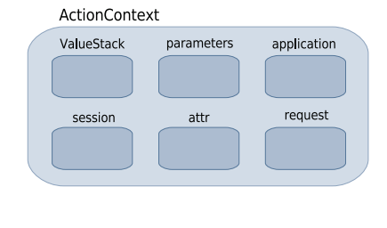
Building a view: tags
The Struts 2 tag libraries are divided into four categories: data tags, control-flow tags, UI tags, and miscellaneous tags
Data can come from ValueStack or ActionContext…

Slide 4
Building a view: tags - systax
JSP SYNTAX
<s:property value="name"/>
<%@ taglib prefix="s" uri="/struts-tags" %>
VELOCITY SYNTAX
#sproperty( "value=name" )
FREEMARKER SYNTAX
<@s.property value="name"/>

Slide 5
Building a view: tags - Using OGNL to set attributes on tags
ONGL: Object-Graph Navigation Language
OGNL is a powerful technology that’s been integrated into the Struts 2 framework to help with data transfer and type conversion, provide a simple syntax for binding things like Struts 2 tags to specific Java-side properties

Slide 6
Building a view: tags – data tags
Data tags let you get data out of the ValueStack or place variables and objects onto the ValueStack:
Property Tag: provides a quick, convenient way of writing a property into the rendering HTML
<s:property value="user.username"/>
Set tag: assigning a property to another name
<s:set name="username" value="user.username"/>
Hello, <s:property value="#username"/>. How are you?

Slide 7
Building a view: tags – data tags
push tag: push properties onto the ValueStack
<s:push value="user">
This is the "<s:property value="portfolioName"/>" portfolio,
created by none other than <s:property value="username"/>
</s:push>
The bean tag: hybrid of the set and push tags. The main difference is that you don’t need to work with an existing object
<s:bean name="org.apache.struts2.util.Counter" var="counter">
<s:param name="last" value="7"/>
</s:bean>
<s:iterator value="#counter">
<li><s:property/></li>
</s:iterator>
Notes:
The bean tag is like a hybrid of the set and push tags. The main difference is that you don’t need to work with an existing object. You can create an instance of an object and either push it onto the ValueStack or set a top-level reference to it in the ActionContext. By default, the object will be pushed onto the ValueStack

Slide 8
Building a view: tags – data tags
action tag: invoke another action from our view layer
<h3>Action Tag</h3>
<h4>This line is from the ActionTag action's result.</h4>
<s:action name="TargetAction" executeResult="true"/>

Slide 9
Building a view: tags – Control tags
iterator tag: allows you to loop over collections of objects easily (Collection, Map, Enumeration, Iterator, or array),
<s:iterator value="users" status="itStatus">
<li>
<s:property value="#itStatus.count" />
<s:property value="portfolioName"/>
</li>
</s:iterator>
if and else tags: provide these familiar if and else control logic
<s:if test="user.age > 35">This user is too old.</s:if>
<s:elseif test="user.age < 35">This user is too young</s:elseif>
<s:else>This user is just right</s:else>

Slide 10
Building a view: tags – Miscellaneous tags
include tag: execute a Servlet API–style include, like jsp tag, but more advanced
URL tag: supports everything you might want to do with a URL, from controlling parameters to automatically persisting sessions in the absence of cookies.
<s:url action="IteratorTag" var="myUrl">
<s:param name="id" value="2"/>
</s:url>
<a href='<s:property value="#myUrl" />'> Click Me </a>

Slide 11
Building a view: tags – Miscellaneous tags
i18n and text tags: internationalization, or i18n for short
<s:i18n name="manning.chapterSix.myResourceBundle_tr">
In <s:text name="language"/>,
<s:text name="girl" var="foreignWord"/>
</s:i18n>
"<s:property value="#foreignWord"/>" means girl
param tag: passing parameters into your own custom utility objects
Notes:
The text tag is used to display language-specific text, such as English or Spanish, based on a key lookup into a set of text resources
The i18n tag simply specifies a resource bundle to use

Slide 12
UI components tags

Slide 13
Result in detail

Slide 14
FAQ

