Slide 1
Strut 2: Building the view
Thành viên:
Đặng Thành Nhân – 12520298
Lê Xuân Nam – 12520272
Trần Quốc Tuấn Khanh - 12520

Slide 2
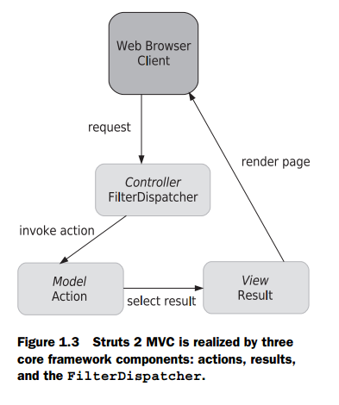
Agenda
Building a view: tags
UI component tags
Results in detail

Slide 3
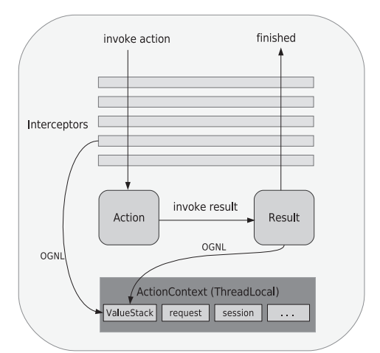
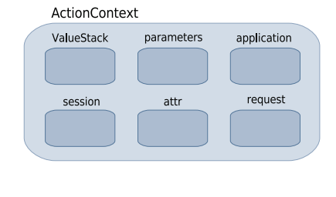
Building a view: tags
The Struts 2 tag libraries are divided into four categories: data tags, control-flow tags, UI tags, and miscellaneous tags
Data can come from ValueStack or ActionContext…

Slide 4
Building a view: tags - systax
JSP SYNTAX
<s:property value="name"/>
<%@ taglib prefix="s" uri="/struts-tags" %>
VELOCITY SYNTAX
#sproperty( "value=name" )
FREEMARKER SYNTAX
<@s.property value="name"/>

Slide 5
Building a view: tags - Using OGNL to set attributes on tags

Slide 6
Building a view: tags – data tags
Data tags let you get data out of the ValueStack or place variables and objects onto the ValueStack:
Property Tag: provides a quick, convenient way of writing a property into the rendering HTML
<s:property value="user.username"/>
Set tag: assigning a property to another name
<s:set name="username" value="user.username"/>
Hello, <s:property value="#username"/>. How are you?

Slide 7
Building a view: tags – data tags
push tag: push properties onto the ValueStack
<s:push value="user">
This is the "<s:property value="portfolioName"/>" portfolio,
created by none other than <s:property value="username"/>
</s:push>
The bean tag: hybrid of the set and push tags. The main difference is that you don’t need to work with an existing object
<s:bean name="org.apache.struts2.util.Counter" var="counter">
<s:param name="last" value="7"/>
</s:bean>
<s:iterator value="#counter">
<li><s:property/></li>
</s:iterator>

Slide 8
Building a view: tags – data tags
action tag: invoke another action from our view layer
<h3>Action Tag</h3>
<h4>This line is from the ActionTag action's result.</h4>
<s:action name="TargetAction" executeResult="true"/>

Slide 9
Building a view: tags – Control tags
iterator tag: allows you to loop over collections of objects easily (Collection, Map, Enumeration, Iterator, or array),
<s:iterator value="users" status="itStatus">
<li>
<s:property value="#itStatus.count" />
<s:property value="portfolioName"/>
</li>
</s:iterator>
if and else tags: provide these familiar if and else control logic
<s:if test="user.age > 35">This user is too old.</s:if>
<s:elseif test="user.age < 35">This user is too young</s:elseif>
<s:else>This user is just right</s:else>

Slide 10
Building a view: tags – Miscellaneous tags
include tag: execute a Servlet API–style include, like jsp tag, but more advanced
URL tag: supports everything you might want to do with a URL, from controlling parameters to automatically persisting sessions in the absence of cookies.
<s:url action="IteratorTag" var="myUrl">
<s:param name="id" value="2"/>
</s:url>
<a href='<s:property value="#myUrl" />'> Click Me </a>

Slide 11
Building a view: tags – Miscellaneous tags
i18n and text tags: internationalization, or i18n for short
<s:i18n name="manning.chapterSix.myResourceBundle_tr">
In <s:text name="language"/>,
<s:text name="girl" var="foreignWord"/>
</s:i18n>
"<s:property value="#foreignWord"/>" means girl
param tag: passing parameters into your own custom utility objects

Slide 12
UI components tags

Slide 13
Result in detail

Slide 14
FAQ

