Slide 1
Struts 2: Building the view
Thành viên:
Đặng Thành Nhân – 12520298
Lê Xuân Nam – 12520272
Trần Quốc Tuấn Khanh - 12520192

Slide 2
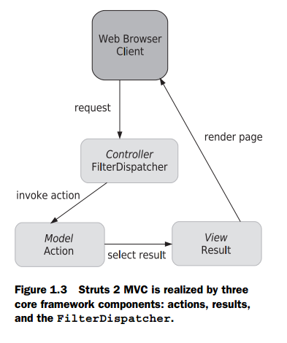
Agenda
Building a view: tags
UI component tags
Results in detail

Slide 3
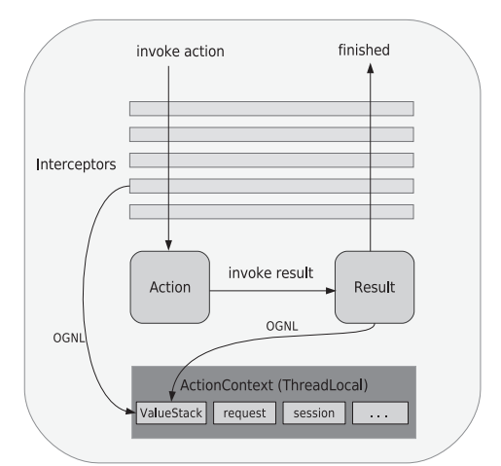
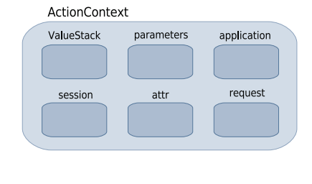
Building a view: tags
The Struts 2 tag libraries are divided into four categories: data tags, control-flow tags, UI tags, and miscellaneous tags
Data can come from ValueStack or ActionContext…

Slide 4
Building a view: tags - systax
JSP SYNTAX
<s:property value="name"/>
<%@ taglib prefix="s" uri="/struts-tags" %>
VELOCITY SYNTAX
#sproperty( "value=name" )
FREEMARKER SYNTAX
<@s.property value="name"/>

Slide 5
Building a view: tags - Using OGNL to set attributes on tags
ONGL: Object-Graph Navigation Language
OGNL is a powerful technology that’s been integrated into the Struts 2 framework to help with data transfer and type conversion, provide a simple syntax for binding things like Struts 2 tags to specific Java-side properties

Slide 6
Building a view: tags – data tags
Data tags let you get data out of the ValueStack or place variables and objects onto the ValueStack:
Property Tag: provides a quick, convenient way of writing a property into the rendering HTML
<s:property value="user.username"/>
Set tag: assigning a property to another name
<s:set name="username" value="user.username"/>
Hello, <s:property value="#username"/>. How are you?

Slide 7
Building a view: tags – data tags
push tag: push properties onto the ValueStack
<s:push value="user">
This is the "<s:property value="portfolioName"/>" portfolio,
created by none other than <s:property value="username"/>
</s:push>
The bean tag: hybrid of the set and push tags. The main difference is that you don’t need to work with an existing object
<s:bean name="org.apache.struts2.util.Counter" var="counter">
<s:param name="last" value="7"/>
</s:bean>
<s:iterator value="#counter">
<li><s:property/></li>
</s:iterator>
Notes:
The bean tag is like a hybrid of the set and push tags. The main difference is that you don’t need to work with an existing object. You can create an instance of an object and either push it onto the ValueStack or set a top-level reference to it in the ActionContext. By default, the object will be pushed onto the ValueStack

Slide 8
Building a view: tags – data tags
action tag: invoke another action from our view layer
<h3>Action Tag</h3>
<h4>This line is from the ActionTag action's result.</h4>
<s:action name="TargetAction" executeResult="true"/>

Slide 9
Building a view: tags – Control tags
iterator tag: allows you to loop over collections of objects easily (Collection, Map, Enumeration, Iterator, or array),
<s:iterator value="users" status="itStatus">
<li>
<s:property value="#itStatus.count" />
<s:property value="portfolioName"/>
</li>
</s:iterator>
if and else tags: provide these familiar if and else control logic
<s:if test="user.age > 35">This user is too old.</s:if>
<s:elseif test="user.age < 35">This user is too young</s:elseif>
<s:else>This user is just right</s:else>

Slide 10
Building a view: tags – Miscellaneous tags
include tag: execute a Servlet API–style include, like jsp tag, but more advanced
URL tag: supports everything you might want to do with a URL, from controlling parameters to automatically persisting sessions in the absence of cookies.
<s:url action="IteratorTag" var="myUrl">
<s:param name="id" value="2"/>
</s:url>
<a href='<s:property value="#myUrl" />'> Click Me </a>

Slide 11
Building a view: tags – Miscellaneous tags
i18n and text tags: internationalization, or i18n for short
<s:i18n name="manning.chapterSix.myResourceBundle_tr">
In <s:text name="language"/>,
<s:text name="girl" var="foreignWord"/>
</s:i18n>
"<s:property value="#foreignWord"/>" means girl
param tag: passing parameters into your own custom utility objects
Notes:
The text tag is used to display language-specific text, such as English or Spanish, based on a key lookup into a set of text resources
The i18n tag simply specifies a resource bundle to use

Slide 12
UI component tags
Why we need UI component tags
More than just form elements
GENERATING THE HTML MARKUP
BINDING FORM FIELDS TO VALUESTACK PROPERTIES
INTEGRATION WITH TYPE CONVERSION, VALIDATION, AND INTERNATIONALIZATION
Tags, templates, and themes
Tags
Teamplates
Themes
CHANGING THE THEME

Slide 13
UI component tags
UI Component tag reference
Common attributes
Simple components
THE HEAD COMPONENT
THE FORM COMPONENT
THE TEXTFIELD COMPONENT
THE PASSWORD COMPONENT
THE TEXTAREA COMPONENT
THE CHECKBOX COMPONENT
Collection-backed components
THE SELECT COMPONENT
THE RADIO COMPONENT
THE CHECKBOXLIST COMPONENT
PREPOPULATION WITH COLLECTION-BACKED COMPONENTS

Slide 14
UI component tags
Bonus components
THE LABEL COMPONENT
THE HIDDEN COMPONENT
THE DOUBLESELECT COMPONENT
Summary

Slide 15
Why we need UI component tags
■ Generate HTML markup ■ Bind HTML form fields to Java-side properties ■ Tie into framework type conversion ■ Tie into framework validation ■ Tie into framework internationalization

Slide 16
Why we need UI component tags
GENERATING THE HTML MARKUP
Struts 2
<s:textfield name="username" label="Username"/>
HTML
<td class="tdLabel"> <label for="Register_username" class="label">Username:</label> </td> <td> <input type="text" name="username" value="" id="Register_username"/> </td>

Slide 17
Why we need UI component tags
The Struts 2 UI component tags were carefully designed as a mini-MVC UI component framework of their own.
FreeMarker template that can easily be edited.
Can tweak the Struts 2 UI components to generate HTML that meets your own idiosyncratic requirements.

Slide 18
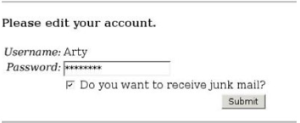
Why we need UI component tags
BINDING FORM FIELDS TO VALUESTACK PROPERTIES
The account form is prepopulated with data from properties on the ValueStack

Slide 19
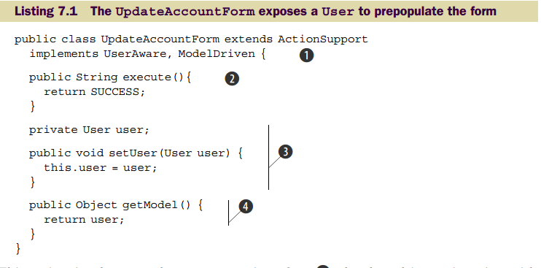
Why we need UI component tags
This binding lays the foundation for a bidirectional flow of data between UI components and the domain model objects on the ValueStack
we’ll expose our User object as a
domain model object rather than as a local JavaBeans property

Slide 20
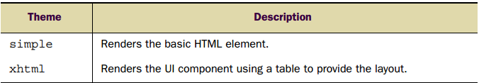
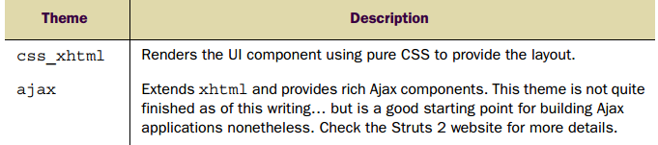
Theme

Slide 21
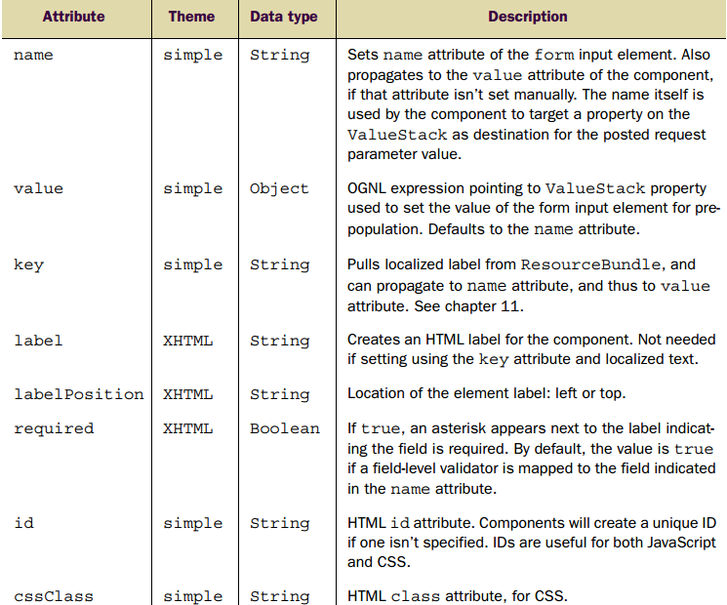
Common attributes

Slide 22
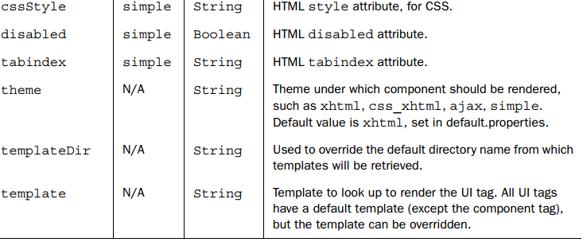
Common attributes

Slide 23
Results in detail
Life after the action
Commonly used result types
JSP (JavaServer Page) alternatives
Global results
Summary
Notes:
Ajax = Asynchronous JavaScript and XML (JavaScript và XML không đồng bộ) là một kỹ thuật mới để tạo ra các ứng dụng web giàu tính tương tác, nhanh hơn, mượt mà hơn với sự giúp đỡ của HTML, XML, CSS và JavaScript.
JSON = JavaScript Object Noattion (định dạng hoán vị dữ liệu nhanh) được sử dụng để lưu trữ và trao đổi dữ liệu.
JavavScript là một ngôn ngữ kịch bản được dùng để xây dựng các chức năng tương tác web đối với người dùng.
JavaSript hoàn toàn không liên quan tới ngôn ngữ lập trình Java.
JSP là một công nghệ để phát triển các Webpage mà hỗ trợ nội dung động, giúp các lập trình viên chèn java code vào trong các HTML page bằng việc sử dụng các JSP tag đặc biệt, hầu hết bắt đầu với <% và kết thúc với %>.

Slide 24
Life after action
Beyond the page: how to use custom results to build Ajax applications with Struts 2
Implementing a JSON result type

Slide 25
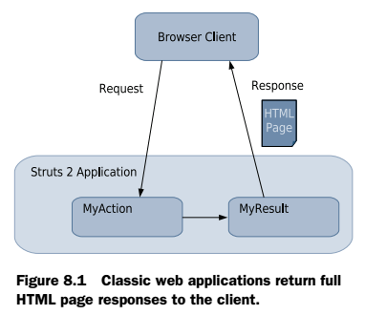
Life after the action
Beyond the page: how to use custom results to build Ajax applications with Struts 2
In figure 8.1, the client makes a request that maps to some action. This action, most likely, takes some piece of request data, conducts some business logic, then exposes the subsequent domain data on the ValueStack. The action then passes control to a result that renders a full HTML page, using the prepared data, to build the new HTML page. The key thing here is that the response is a full HTML page, which the client browser uses to rerender its entire window. The response sent back to the client in figure 8.1 is probably rendered by a JSP under the default dispatcher result type. As we’ve seen, the framework makes this classic pattern of usage easy.
Notes:
Trong hình 8.1, khách hàng yêu cầu ánh xạ tới một số hành động.
Hành động này, rất có thể, lấy một số dữ liệu yêu cầu, thực hiện một số logic kinh doanh, sau đó cho thấy dữ liệu miền tiếp theo trên các ValueStack.
Hành động sau đó vượt qua kiểm soát đến một kết quả mà làm cho một đầy đủ trang HTML, sử dụng dữ liệu chuẩn bị để xây dựng trang HTML mới.
Điều quan trọng đây là phản hồi là một trang HTML full mà trình duyệt của khách hàng sử dụng để rerender toàn bộ cửa sổ của nó.
Phản hồi gửi lại cho khách hàng trong hình 8.1 là có thể được hiển thị bởi một JSP theo loại kết quả của trình gửi mặc định.
Như chúng ta đã thấy, khuôn khổ này làm cho cổ điển mô hình dễ dàng sử dụng.

Slide 26
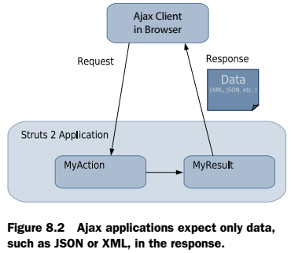
Life after the action
Beyond the page: how to use custom results to build Ajax applications with Struts 2
On the other hand, Ajax applications do something entirely different. Instead of requesting full HTML pages, they only want data. This data can come in many forms. Some Ajax applications want HTML fragments as their responses. Some want XML or JSON responses. In short, the content of an Ajax response can be in a variety of formats. Regardless of their differences, they do share one distinct commonality: none of them want a full HTML page. Figure 8.2 illustrates a typical Ajax request and response cycle.
Notes:
Mặt khác, các ứng dụng Ajax làm điều gì đó hoàn toàn khác.
Thay vì yêu cầu các trang HTML đầy đủ, họ chỉ muốn dữ liệu.
Dữ liệu này có thể có nhiều hình thức.
Một số ứng dụng Ajax muốn các đoạn HTML là phản hồi của chúng.
Một số muốn trả lời XML hoặc JSON.
Tóm lại, nội dung phản hồi Ajax có thể ở nhiều định dạng khác nhau.
Bất kể sự khác biệt của họ, họ chia sẻ về sự khác biệt rõ ràng: không ai trong số họ muốn có một trang HTML đầy đủ.
Hình 8.2 minh hoạ một chu kỳ yêu cầu và chu trình phản hồi của Ajax điển hình.

Slide 27
Life after the action
Beyond the page: how to use custom results to build Ajax applications with Struts 2
When the Ajax client receives the response, it won’t cause the browser to rerender the entire HTML page. On the contrary, it carefully examines the data serialized in the XML or JSON and uses that data to make targeted updates to the affected regions of the current browser page. This is a different kind of response. Luckily, Struts 2 can easily handle this with the flexibility of its result component.
Notes:
Khi khách hàng Ajax nhận được phản hồi, nó sẽ không gây ra trình duyệt để rerender toàn bộ trang HTML.
Ngược lại, nó kiểm tra kỹ lưỡng các dữ liệu được liệt kê trong XML hoặc JSON và sử dụng dữ liệu đó để thực hiện các cập nhật được nhắm mục tiêu tới các vùng bị ảnh hưởng trang trình duyệt hiện tại.
Đây là một loại phản ứng khác nhau. May mắn thay, Struts 2 có thể dễ dàng xử lý này với sự linh hoạt của các thành phần kết quả của nó.

Slide 28
Life after the action
Implementing a JSON result type
AN AJAX CLIENT TO DEMO OUR RESULT
CODING THE JSONRESULT
AN AJAX CLIENT
THE ACTION
DECLARING AND USING THE JSONRESULT TYPE

Slide 29
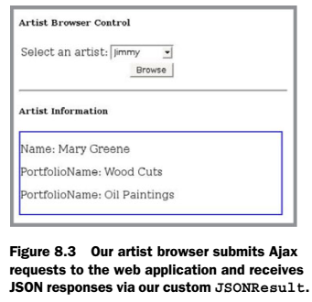
Life after the action
Implementing a JSON result type
AN AJAX CLIENT TO DEMO OUR RESULT
For these purposes, we add an Ajax artist browser to the Struts 2 Portfolio page. This browser provides the visitor with a means of browsing the various artists who’re currently hosting portfolios on the site. The visitor can peruse the list of artists and see such details as each artist’s full name and the set of portfolios that artist has on the site. The artist browser is simple. The visitor can peruse some basic information about the selected artist. This information is displayed in the blue box and is updated when the visitor selects a different artist in the select box control.
This selection causes an Ajax request to be sent to our Struts 2 application. The response to this request is a JSON serialization of the artist in question. When this response arrives, our JavaScript client code instantiates a JavaScript object from that JSON and uses it to dynamically update the information in the blue window. Nothing else in the window is changed.
While simple, this demonstrates a solid Ajax strategy where the page in the browser is an application unto itself. Requests to the server are for JSON-based data, not new pages.

Slide 30
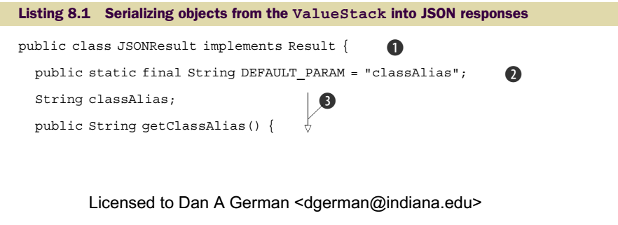
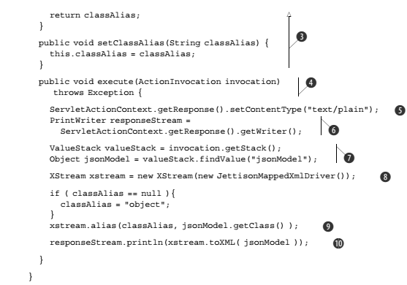
Life after the action
Implementing a JSON result type
CODING THE JSONRESULT
First things first. If we plan to have Ajax clients demanding JSON responses, we need to build a result that can do that. This leads us to our custom JSONResult.

Slide 31
Life after the action
Implementing a JSON result type
CODING THE JSONRESULT
First, we implement the result interface (1)
Before getting to the execute() method (4) which we must implement to fulfill the responsibilities of that interface, we do some stuff to parameterize our result. With a little code, we can allow our results to accept parameters from their XML declarations via the param tag. For this result, we want to accept a parameter than gives us a logical name under which our root data object will be serialized to the JSON.
We’ll explain why in a moment, but for now just observe that we implement a JavaBeans property classAlias (3) and then provide a constant called DEFAULT_PARAM (2) that names our classAlias as the default parameter. Each result can define a default parameter, which can be passed in without being named.

Slide 32
Life after the action
Implementing a JSON result type
CODING THE JSONRESULT

Slide 33
Life after the action
Implementing a JSON result type
AN AJAX CLIENT

Slide 34
Life after the action
Implementing a JSON result type
THE ACTION

Slide 35
Life after the action
Implementing a JSON result type
DECLARING AND USING THE JSONRESULT TYPE

Slide 36
Commonly used result types
The RequestDispatcher, a.k.a. dispatcher
The ServletRedirectResult, a.k.a. redirect
The ServletActionRedirectResult, a.k.a. redirectAction

Slide 37
Commonly used result types
The RequestDispatcher, a.k.a. dispatcher
THE SERVLET HEART OF THE DISPATCHER RESULT

Slide 38
Commonly used result types
The RequestDispatcher, a.k.a. dispatcher
NORMAL WORKFLOW: DISPATCHING AS A FORWARD()

Slide 39
Commonly used result types
The RequestDispatcher, a.k.a. dispatcher
FORWARDING TO ANOTHER SERVLET

Slide 40
Commonly used result types
The RequestDispatcher, a.k.a. dispatcher
DISPATCHING AS AN INCLUDE()

Slide 41
Commonly used result types
The RequestDispatcher, a.k.a. dispatcher
SETTING UP A REQUESTDISPATCHER RESULT

Slide 42
Commonly used result types
The ServletRedirectResult, a.k.a. redirect
SETTING UP A REDIRECT RESULT

Slide 43
Commonly used result types
The ServletRedirectResult, a.k.a. redirect
EMBEDDING OGNL TO CREATE DYNAMIC LOCATIONS
<action name="SendUserToSearchEngineAction" class="myActionClass"> <result type='redirect' > http://www.google.com/?myParam=${defaultUsername} </result> </action>

Slide 44
Commonly used result types
The ServletActionRedirectResult, a.k.a. redirectAction
The redirectAction result does the same thing as the plain redirect result, with one important difference. This version of redirect can understand the logical names of the Struts 2 actions as defined in your declarative architecture. This means that you don’t have to embed real URLs in your result declarations. Instead you can feed the redirectAction names and namespaces from your action and package declarations. This makes your declarations more robust in the face of changes to URL patterns. As an example of such a URL pattern change, let’s say you wanted to change the action extension from .action to .go. If you’d used the plain redirect result extensively to target Struts 2 actions, then you’d have a lot of hard-coded URLs to adjust. As an example, let’s look at the Login action mapping from our earlier versions of the Struts 2 Portfolio application. This mapping, as seen in the following snippet, uses the plain redirect result: <action name="Login" class="manning.chapterSeven.Login"> <result type="redirect"> /chapterSeven/secure/AdminPortfolio.action </result> <result name="input">/chapterSeven/Login.jsp</result> </action> As you can see, we have a real URL embedded in our declarative architecture. This would have to be manually corrected in the face of our hypothetical action extension change. The following snippet, from the chapter 8 version of the application, shows how we can do the same thing with the redirectAction instead: <action name="Login" class="manning.chapterEight.Login"> <result type="redirectAction"> <param name="actionName">AdminPortfolio</param> <param name="namespace">/chapterEight/secure</param> </result> <result name="input">/chapterEight/Login.jsp</result> </action>

Slide 45
JSP alternatives
VelocityResult, a.k.a. velocity
FreemarkerResult, a.k.a. freemarker

Slide 46
JSP alternatives
VelocityResult, a.k.a. velocity
USING VELOCITY RESULTS
The first thing you need to do is make sure that you have the Velocity JAR files in your application. At the time of writing, the Struts 2 distribution doesn’t come with the Velocity JAR files. It does come with a built-in velocity result type, defined in the following snippet from struts-default.xml: <result-type name="velocity" class="org.apache.struts2.dispatcher.VelocityResult"/>

Slide 47
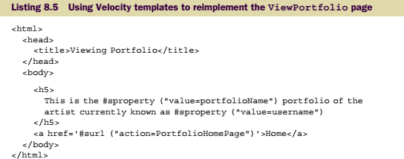
JSP alternatives
VelocityResult, a.k.a. velocity
USING VELOCITY RESULTS
Now let’s take a look at our Velocity version of the ViewPortfolio action. If you go to the visitor’s page of the chapter 8 version of the application, you’ll find three versions of the ViewPortfolio page, one each for JSPs, Velocity, and FreeMarker templates. If you test them out, you’ll see that they all work exactly the same. Even the XML declarations themselves look very similar. Here’s how we declare our velocity result version of the ViewPortfolio action: <action name="ViewPortfolioVM" class="...ViewPortfolio" > <result type="velocity">/chapterEight/ViewPortfolio.vm</result> </action>

Slide 48
JSP alternatives
VelocityResult, a.k.a. velocity
USING VELOCITY RESULTS
This is just like all declarations we’ve seen. With this in place, we can use the logical name to specify Velocity as the type for our results. Note that many applications that choose to use Velocity templates as their view-layer technology will want to go ahead and declare the velocity result type as the default result for their packages. We aren’t doing this for the Struts 2 Portfolio application, but if you want to do so you can. Just add a redeclaration of the velocity result to your package’s result-types element with the default attribute set to true, as in the following snippet: <result-types> <result-type name="velocity" class="org.apache.struts2.dispatcher.VelocityResult" default="true"/> </result-types>

Slide 49
JSP alternatives
FreemarkerResult, a.k.a. freemarker
USING FREEMARKER RESULTS
You won’t have to add any JAR files to use FreeMarker. Since the framework uses FreeMarker itself, those resources are already included in the distribution. And the result itself is already declared in struts-default.xml with the following line:
<result-type name="freemarker" class="org.apache.struts2.views.freemarker.FreemarkerResult"/>

Slide 50
JSP alternatives
FreemarkerResult, a.k.a. freemarker
USING FREEMARKER RESULTS
As long as you extend the struts-default package, this result type is available for your use. All you have to do is specify the logical name freemarker in your result’s type attribute. Again, if you plan to make FreeMarker your primary view-layer technology, you might as well make it the default result type for your packages by adding a line to your package’s result-type element, as in the following snippet:
<result-types> <result-type name="freemarker" class="org.apache.struts2.views.freemarker.FreemarkerResult" default="true"/> </result-types>

Slide 51
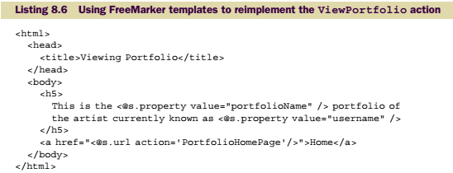
JSP alternatives
FreemarkerResult, a.k.a. freemarker
USING FREEMARKER RESULTS
Again, we point the result’s type attribute to FreeMarker, and the location parameter at the FreeMarker template itself. As with the Velocity result, you can use OGNL embedding to pass dynamic values into your parameter values. Or you can turn this parsing off with the parse parameter.

Slide 52
Global results
As an alternative to configuring results locally to specific actions, you can also configure results globally.
This means that a result can be used from any action in the entire package.
When an action returns a result control string, such as "error", the framework first consults the set of results as defined locally to the action. If no error result is found, it then consults the set of globally defined results for an error result.
In this fashion, your actions can utilize any globally defined result just by returning the appropriate string.
Note that a locally defined result will override a globally defined result during this lookup process.
This is particularly useful for such results as errors. It’s common to display all error
states via a standard error page. This page can be reused throughout the application.

Slide 53
Summary
First, it helps demonstrate how to integrate Ajax applications into the Struts 2 framework. Ajax techniques are still somewhat of a moving target, and integrating with them will be a focal point for many development teams in the near to immediate future. The flexibility of the Struts 2 framework was intended for just such cases.
We hope that the JSON custom result also demonstrates the internal details of results in general, so that you can confidently come up with custom result types as solutions to the unforeseen integration problems you’ll assuredly be faced with. Custom results can provide powerful solutions. They can access all the important data from the request, including the ValueStack, ActionContext, and even the action itself. Furthermore, the result component has been designed to keep the action completely oblivious to the details of the result. This can provide powerful reuse of both results and actions. As we noted when implementing the Ajax artist browser for the Struts 2 portfolio, our action that looks up an artist by username could just as easily be used in a non-Ajax context.
Notes:
Trong chương này, chúng ta đã thấy phần cuối của các thành phần MVC cốt lõi của khung, kết quả.
Kết quả cung cấp sự đóng gói của bất kỳ công việc nào nên xảy ra sau khi hành động đã
Bị sa thải. Như chúng ta đã thấy, đây thường là thế hệ của phản ứng HTTP
Gửi lại trình duyệt của khách hàng như là một câu trả lời cho yêu cầu ban đầu. Đối với nhiều nhà phát triển, việc tạo ra một trang HTML dựa trên JSP sẽ đáp ứng hầu hết nhu cầu của
các ứng dụng. Chúng tôi đã thấy rằng khuôn khổ cũng cung cấp hỗ trợ cho việc sử dụng một cặp vợ chồng
Các công nghệ khác để hiển thị các trang này: Velocity và FreeMarker.
Một trong những điều quan trọng nhất mà chúng tôi đã đề cập đến trong chương này là triển khai một kết quả tùy chỉnh có thể trả về phản hồi JSON phù hợp với yêu cầu của Ajax. Điều này
Kết quả tùy chỉnh phục vụ một vài mục đích. Thứ nhất, nó giúp chứng minh làm thế nào để tích hợp
Ứng dụng Ajax vào khung công tác Struts 2. Kỹ thuật Ajax vẫn còn một phần của một
Di chuyển mục tiêu, và tích hợp với họ sẽ là một điểm nhấn cho nhiều phát triển
Các đội gần đây trong tương lai. Tính linh hoạt của khung công tác Struts 2 là
Chỉ dành cho những trường hợp như vậy.
Chúng tôi hy vọng rằng kết quả tùy chỉnh JSON cũng thể hiện các chi tiết nội bộ của
Kết quả nói chung, để bạn tự tin có thể đưa ra các loại kết quả tùy chỉnh như
Giải pháp cho những vấn đề hội nhập không lường trước bạn chắc chắn sẽ phải đối mặt. Kết quả tùy chỉnh có thể cung cấp các giải pháp mạnh mẽ. Họ có thể truy cập vào tất cả các dữ liệu quan trọng
Từ yêu cầu, bao gồm ValueStack, ActionContext, và thậm chí hành động
chinh no. Hơn nữa, thành phần kết quả đã được thiết kế để giữ cho hành động
Hoàn toàn không để ý đến các chi tiết của kết quả. Điều này có thể cung cấp việc tái sử dụng mạnh mẽ
Cả kết quả và hành động. Như chúng ta đã lưu ý khi triển khai trình duyệt nghệ sĩ Ajax cho
Danh mục đầu tư Struts 2, hành động của chúng tôi để tìm kiếm một nghệ sĩ theo tên người dùng cũng có thể dễ dàng được sử dụng trong một ngữ cảnh không phải Ajax.
Với việc hoàn thành chương này, chúng tôi đã hoàn thành không chỉ tham quan của chúng tôi về xem
Lớp Struts 2 mà là các tour chính của chúng ta về các thành phần cốt lõi. Phần tiếp theo của
Book địa chỉ điểm tốt hơn của đánh bóng ứng dụng web, chẳng hạn như hội nhập với mùa xuân
Cho IOC quản lý tài nguyên, dữ liệu kiên trì với Hibernate, khuôn khổ của
Khuôn khổ xác nhận dựa trên XML và hỗ trợ quốc tế hóa.

Slide 54
Answer and Question

