Slide 1
Pokédex (using PokeAPI)
By: Luo Hong Jun, Kerpics Katrin

Slide 2
Pokédex Website
A modern Pokédex powered by PokéAPI, created with: - HTML - JavaScript - Axios - Bootstrap - CSS

Slide 3
Project overview
This page allows user to: - search Pokémon by name or ID - view detailed Pokémon stats, types, and abilities - filter Pokémon by type - browse random Pokémon suggestions

Slide 4
Key technologies
Built with: - HTML/CSS & Bootstrap: Responsive, styled layout - JavaScript: DOM manipulation, logic - Axios: For API requests - PokéAPI: Real-time data on Pokémon

Slide 5
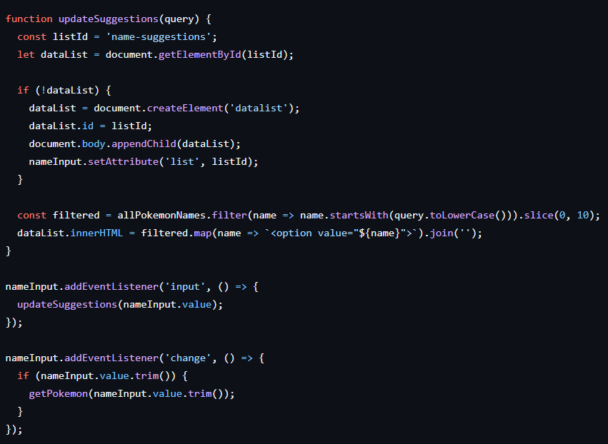
Search function
Users can search by: - Name (with autocomplete suggestions) - ID (numeric entry)
Real-time suggestions are provided as the user types using a <datalist>.

Slide 6
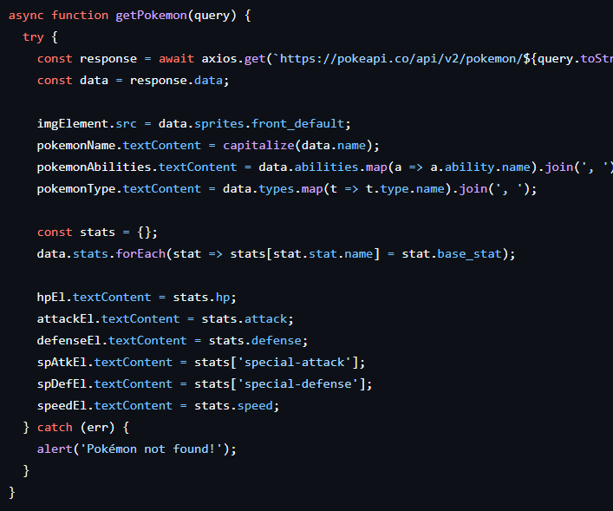
Pokémon Details Display
Once selected, the app displays: - Official sprite - Name (capitalized) - Abilities and types - Base stats (HP, Attack, Defense, etc.)
Powered by structured API data parsing.

Slide 7
Random Pokémon Scroll Row
Shows 8 random Pokémon at the bottom. - Clickable sprites load full details - Refreshed at startup - Uses Math.random() to pick from IDs 1–898.

Slide 8
Filtering by Type
Summary: - Interactive and intuitive Pokédex - Real-time data fetching - Filtering, searching, and exploring Pokémon
Possible improvements: - Add evolutionary chain display - Paginated browsing - Support for shiny sprites or forms

