Slide 1
ECON 2103 · UNIT 2 · IN-CLASS ACTIVITY
Build-Your-Own Coffee Shop
How big should you build?
Long-Run Cost & Economies of Scale · Dr. Ke Lyu
Notes:
Two-person activity. Students build a coffee shop on the website, find the output with the lowest average cost per cup, then compare sizes to discover the long-run cost curve.

Slide 2
THE SETUP
Your mission
You and a partner open a coffee shop.
Goal: find the size with the lowest cost per cup.
1
Choose your shop
2
See your cost curve
Work in pairs. Build it, decide, defend it.
3
Decide the size
Notes:
Frame it as a real decision with a partner. 'Lowest cost per cup' = average total cost (ATC).

Slide 3
THE ONE RULE
Every cost is one of two kinds
Fixed cost
Per-cup cost
Paid no matter what — rent, machines, staff.
Paid on every cup — beans, milk, cup.
Shrinks per cup as you sell more.
Creeps up as you get busy.
Cost per cup = Fixed cost ÷ cups + per-cup cost
Fixed falls, per-cup rises → a U-shaped curve.
Notes:
ATC = TFC/Q + (a + b·Q). AFC falls, the per-cup term rises; the sum is the U. Everything on the menu moves one or both pieces.

Slide 4
THE MENU · PART 1
What you can buy — fixed costs
Paid once. Bigger shop = bigger bill to spread.
▸ Storefront rent $50–$500
▸ Espresso machine $20–$100
▸ Baristas / shift $50 each
▸ Roasting workshop $400 · unlocks cheapest beans
▸ POS / app ordering $30–$150
▸ Aux equipment $40
▸ Fit-out / seating $40–$100
▸ Staff training $50
▸ Management $100–$250
▸ Brand & membership $80
Notes:
Don't read all — point out that every item adds to fixed cost (TFC), a bigger number for a bigger shop to divide over its cups. The roaster is the gateway to the cheapest beans (Part 2).

Slide 5
THE MENU · PART 2
Per-cup choices — and the trade-offs
Bean sourcing
Retail $0.85 → Bulk $0.65 → Direct $0.50/cup. Buy bigger, pay less.
Baristas
More hands → per-cup cost rises slower.
Automation
$200 fixed → −$0.10/cup. Worth it only at high volume.
Extra branches
+$300 & +$0.10/cup. Grow too fast → cost per cup RISES.
Notes:
These move the per-cup side (branches add fixed cost too). Automation = fixed-for-variable swap; have them reason about break-even volume. Extra branches is the built-in diseconomies lever.

Slide 6
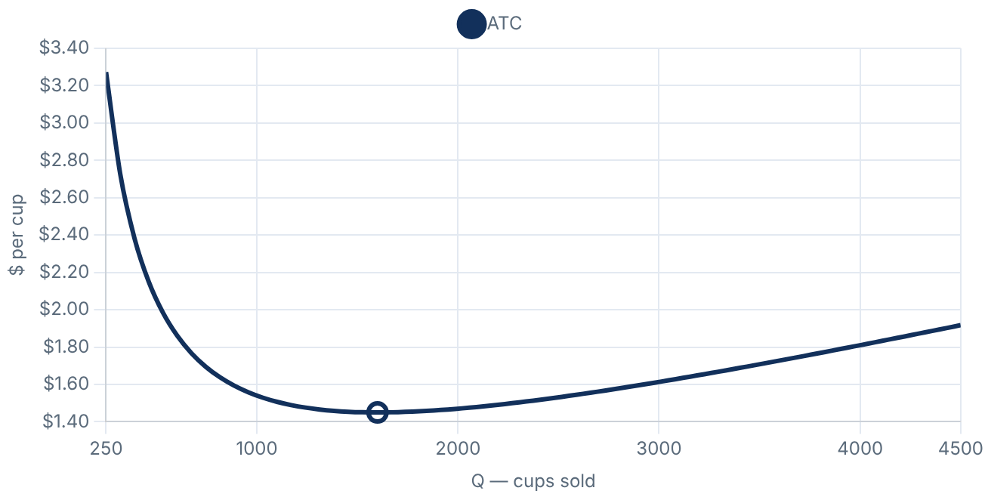
THE TOOL
Using the Cost Builder
1
Pick a preset or build your own
2
Read the cost table
3
Find the bottom of the U your lowest cost/cup
4
Save the curve
Table & curve update as you choose.
5
Compare → envelope combine shops
Notes:
Demo it live once on the projector before turning students loose.

Slide 7
WHAT YOU'LL SEE
A U-shaped cost curve
Few cups → pricey
More cups → drops fast
Too many → creeps back up
Bottom of the U = most efficient
Large shop: lowest ≈ $1.45/cup near 1,600 cups.
Notes:
This is average total cost (ATC): AFC falls, per-cup term rises, sum is the U. The open circle marks the minimum.

Slide 8
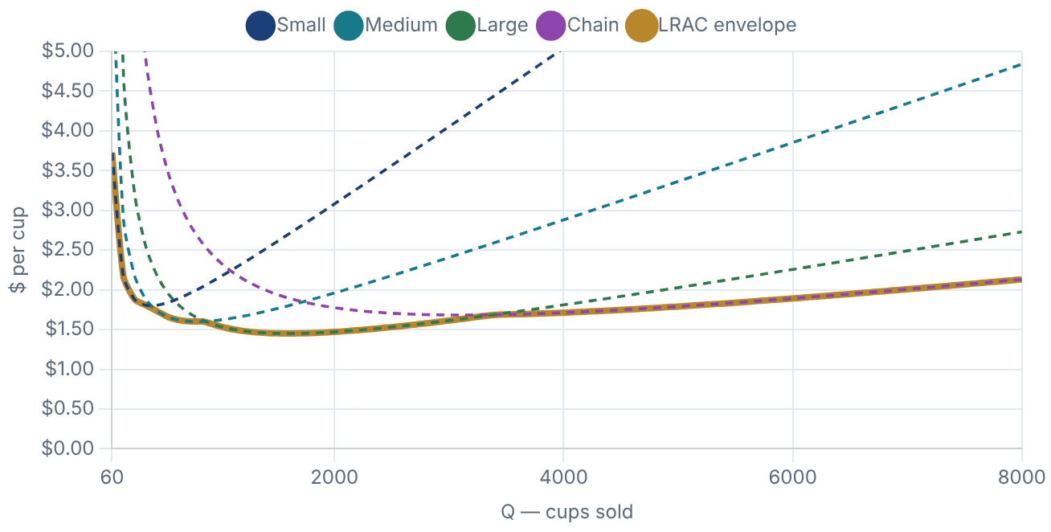
PUT THE SHOPS TOGETHER
The long-run curve (LRAC)
Gold line = long-run average cost
the cheapest cost/cup at any size
Bottom = best size (MES)
Turns up = too big
diseconomies (extra branches)
Dashed = each shop's short-run ATC. Gold = the envelope.
Notes:
The envelope is the lower boundary of the short-run curves. Minimum = MES; it rises again at the chain because of the coordination cost built into extra branches.

Slide 9
YOUR TASK
With your partner
1
Build a shop you'd actually open
2
Find your lowest cost per cup
3
Add all four → see the envelope
Share: What size, and why? Bigger = cheaper? A branch — worse? Automation worth it?
Notes:
~10–12 min to build and decide, then 5–8 min share-out. Push them to justify size with the curve, not a hunch.

Slide 10
WHAT YOU JUST DISCOVERED
The economics behind it
Economies of scale
Minimum efficient scale
Cost per cup falls as you grow.
Smallest size at the lowest cost — the envelope's bottom.
Diseconomies of scale
LRAC envelope
Too big to coordinate → cost rises (extra branches).
The lower edge of all the short-run curves.
Back to Lecture 3: the cost advantage of scale is why a few big firms can dominate.
Notes:
Tie the four terms to the shapes: falling part = economies of scale, trough = MES, rising part = diseconomies, lower edge = LRAC. Bridges to minimum efficient scale and market structure.

