Slide 1
Econ Glider Factory — The Game
Your table is a paper-airplane factory. 3 factories, 5 people each.
Setup & roles
The Rules
Your table = one factory. Fixed capital never changes: one workbench, one marker, one test lane. Paper is free.
Fold only on the workbench, using the folding card.
Sign every plane “Econ Glider” with the one marker.
A plane counts only if it flies PAST the test line.
At the end of the round, count the good planes — that is your output.
One scorekeeper + folders. After each round the scorekeeper counts the planes that passed the line and fills the table. In the final round the scorekeeper folds too.
Each round = 2 minutes.
Add one folder each round: 1 → 2 → 3 → 4 → 5.

Slide 2
How to Win
The prize goes to the cheapest factory — not the biggest.
The winning factory has the lowest average cost — the lowest cost per plane in any single round (that round is its efficient scale).
Making the MOST planes does not win — making the CHEAPEST plane does.
Prize: your call — candy, a bonus point, or bragging rights.

Slide 3
Building Your Cost Table
Total cost is just two things added up — rent plus wages.
The pieces
Worked example: 3 workers
Fixed cost (rent) = $50 every round
— the workbench/marker/lane; never changes.
Wages = $20 × number of workers
— the only variable cost; grows as you add people.
Paper is free.
Planes made (Q) | 20
Rent (TFC) | $50
Wages (TVC = $20 × 3) | $60
Total Cost ($50 + $60) | $110
ATC ($110 ÷ 20) | $5.50
MC ($20 ÷ 6 more planes) | $3.33
Total Cost = Rent + Wages
ATC (cost per plane) = Total Cost ÷ Planes
MC = change in Total Cost ÷ change in Planes
Each group fills one row like this for 1, 2, 3, 4, 5 workers using their own plane counts.

Slide 4
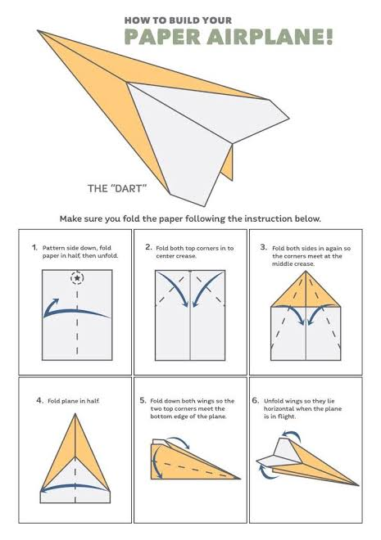
How to Fold the Econ Glider
Everyone in your group folds this same “Dart.”
Everyone in your group folds this same “Dart.”
Up next: 1 minute to practice — teammates, teach each other before the game starts.

Slide 5
PRACTICE
1:00
practice — no scoring
⏱ 1 MINUTE
Fold a couple of Darts together. Teammates, help each other get it — this round does not count.

Slide 6
ROUND 1
1
folder folding
⏱ 2 MINUTES
Fold on the workbench · sign each plane · it must fly PAST the line · scorekeeper counts & records

Slide 7
ROUND 2
2
folders folding
⏱ 2 MINUTES
Fold on the workbench · sign each plane · it must fly PAST the line · scorekeeper counts & records

Slide 8
ROUND 3
3
folders folding
⏱ 2 MINUTES
Fold on the workbench · sign each plane · it must fly PAST the line · scorekeeper counts & records

Slide 9
ROUND 4
4
folders folding
⏱ 2 MINUTES
Fold on the workbench · sign each plane · it must fly PAST the line · scorekeeper counts & records

Slide 10
ROUND 5
5
folders folding
⏱ 2 MINUTES
Final round: the scorekeeper folds too — all 5 fold! Count the planes right after time is called.

Slide 11
Why Cost Per Plane Is U-Shaped
The U in cost comes straight from the hump in output.
MC = wage ÷ marginal product = $20 ÷ (extra planes this worker made)
Workers | Extra planes (MP) | MC = $20 ÷ MP
1 | 6 | $3.33
2 | 8 | $2.50 ← lowest
3 | 6 | $3.33
4 | 4 | $5.00
5 | 2 | $10.00
Read it out loud:
Extra planes rise then fall (diminishing returns) — so cost per plane falls then rises.
Early workers help each other; later ones just wait for the one marker and one table.

