Slide 1
The Price Is Yours
What the game just showed us
Monopoly, price discrimination, and why resale matters
Notes:
One line: we are going to name what we just did and connect it to the monopoly graph for Exam 2.

Slide 2
The three stages, side by side
Stage 1: one price
Stage 2: two prices
Stage 3: resale on
Best price 8 dollars
Insured 8, uninsured 4
Two prices collapse
3 doses, profit 18
6 doses, profit 24
Profit back toward 18
The uninsured group is shut out, even though they would pay above cost. That wasted value is the loss.
Everyone gets served and the firm earns more. The people a single price left behind are now reached.
Uninsured buyers resell to insured buyers. The firm cannot hold two prices once resale is possible.
ECON 2103 . Price Discrimination Game . Debrief
2
Notes:
Read across: splitting the market raised both output and profit, then resale broke it. Hold the theory names for the next slides.

Slide 3
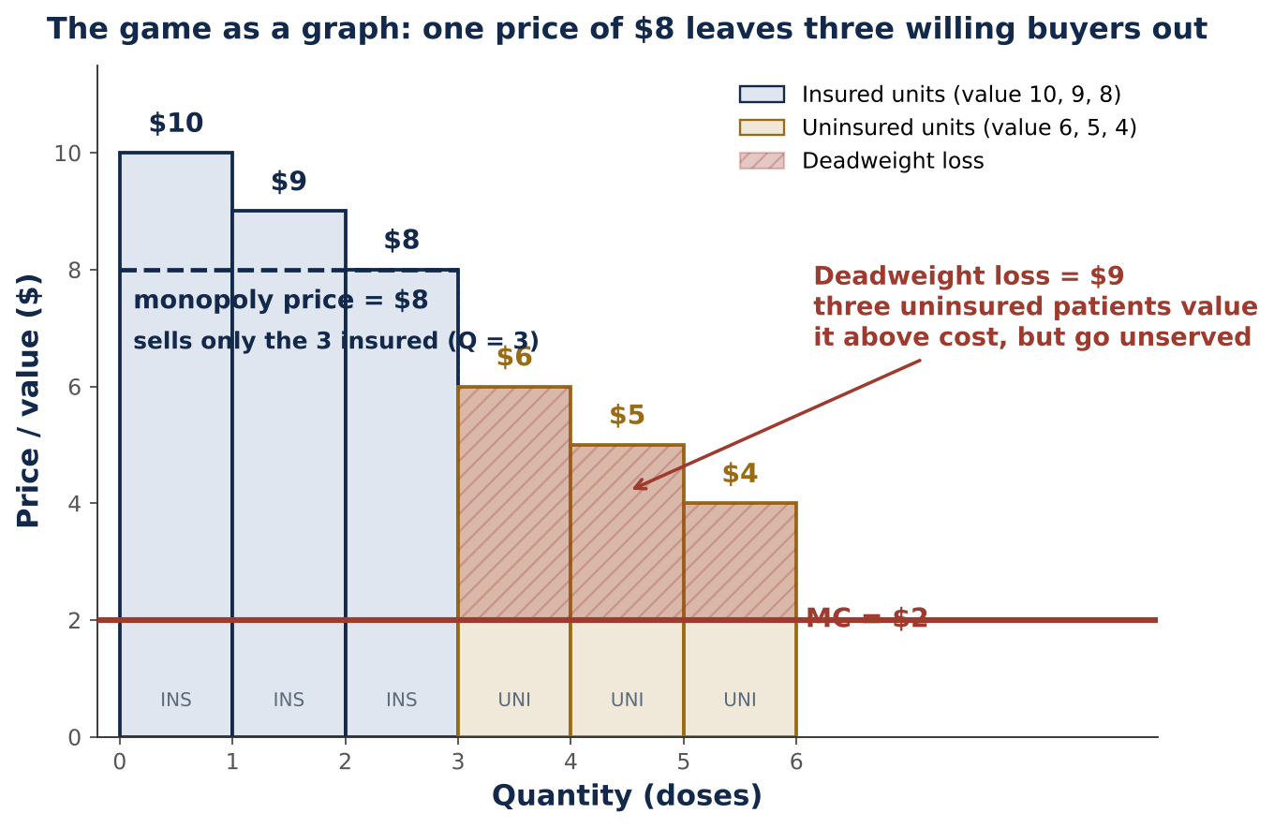
Stage 1 wasted value: deadweight loss
This is the game drawn as a graph. The six cards, sorted top to bottom, are the demand. The flat line is the 2 dollar cost per dose.
At the single price of 8, only the three insured units sell. The three uninsured units sit above cost but go unserved.
That shaded block is the deadweight loss: 9 dollars of value that never happened.
The live simulator shows the smooth version of the same picture, where the cost curve slopes up. Open it to show the triangle move.
ECON 2103 . Price Discrimination Game . Debrief
3
Notes:
Tie the discrete game to the continuous graph. Name deadweight loss here for the first time. Link: kerrlyu.github.io/econ2103-monopoly

Slide 4
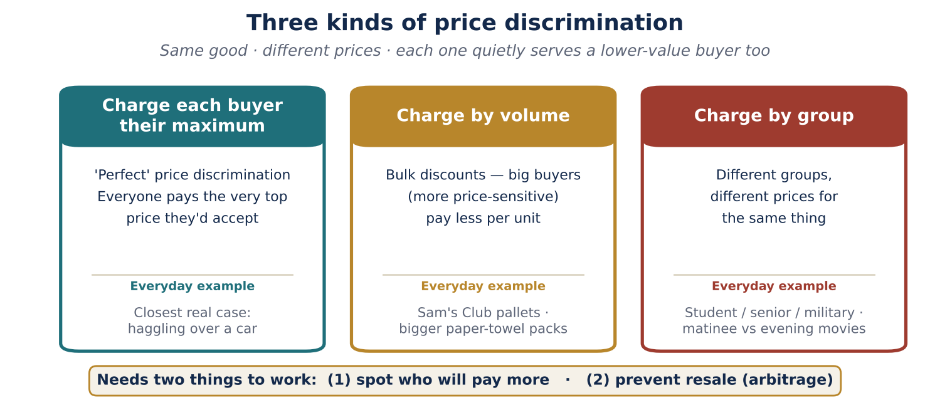
What the CEO did: price discrimination
We played the third kind: charge different groups different prices. Uninsured patients and insured patients paid different amounts for the very same drug.
ECON 2103 . Price Discrimination Game . Debrief
4
Notes:
Name price discrimination. We did third degree (by group). First degree is each person's max, second degree is by quantity. Everyday examples on the panel.

Slide 5
What makes it work, and the exam
1. Tell the groups apart
2. Stop resale (no arbitrage)
The firm must identify who values it more: student or senior ID, location, insured versus uninsured.
If buyers can resell to each other, the two prices collapse. Round 3 showed exactly this.
When one firm has too much power, the policy tools are antitrust and price regulation.
Real cases: EpiPen, airline fares, student and senior discounts, cross border drug pricing.
For Exam 2
You can read all of this off the monopoly graph: find the monopoly quantity and price where MR equals MC, shade the deadweight loss triangle up to demand, and name the three kinds of price discrimination.
ECON 2103 . Price Discrimination Game . Debrief
5
Notes:
Close on the two requirements, the policy tools, and the exam read-off. Point back to the simulator.

