Slide 1

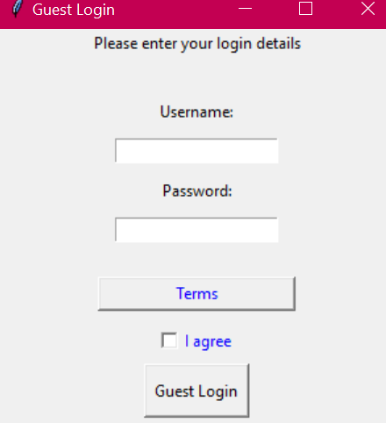
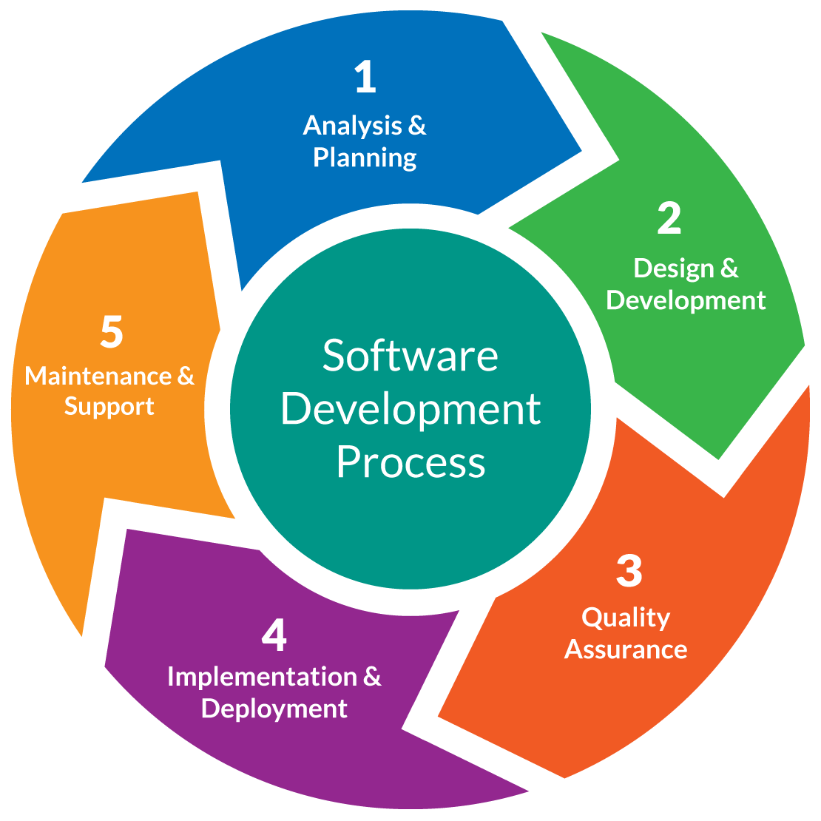
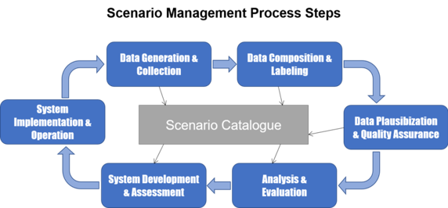
Team 2 Group 5 Training and Recruitment
Vision Statement
Plan
Documentation types for software development
This department exists to recruit individuals with the same values as us. People who are always willing to learn and improve themselves. The purpose of this department is to provide adequate training opportunities for all staff members. Our core values are integrity, team-focused working, and life-long learning.
Creating a plan: The plan will explain how the project is run, who the users are and its requirements:
Requirements: Our user interface will be based on our audience’s software knowledge; so we will test this before we start our project. The software must be time saving and cost efficient. It will have offline working features, data storage and backup of data for every user.
Managing requirements: Requirements of the software might change over the course of our project so we might need to prioritize some other features. Also, documentation for the whole project will need to be written.
There are a number of different types of documentation for software development. These include the following:
User manuals, this is the main documentation to which a user can access in the event that they struggle to use a system and need expert advice.
The requirements documentation. This is the documentation that details exactly what a system should include in order to be successful, e.g. Hardware requirements.
The technical documentation. This includes things such as the code, interface of the system and various algorithms.
The project documentation. This may include things like best practices, contribution policies, product requirements and design guidelines. It can be useful for your team due to the fact that they can use it for guidance in the project and can improve on it.
Finally, the architecture documentation, this details the various architectural design of the system, such as its features and functionalities, its components and the flow of data.
Quality, Description of a quality with a scenario for evaluation
Evaluating different scenarios is a good way to see how different policies could play out. Comparisons can be made as to which policies would be best in the long run. This assures a more effective quality of the project overall. In our project, we used scrum to break it down and evaluate it at every stage. This is kind of like scenario evaluation. In the future, we will create a plan to incorporate a more scenario related approach to our evaluation.
Architecture Decision
We have made the decision based on feedback to have one check box for the terms and conditions instead of two. Now, we only have a check box that allows the user to agree. If they disagree then they won’t check the box and can’t continue.
Kerri-Anne, Zaki, Saleh, Hossam, Luke

