Slide 1
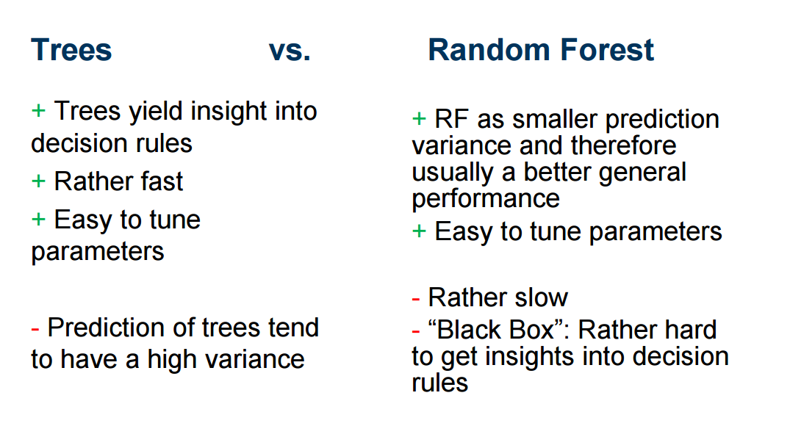

Slide 2
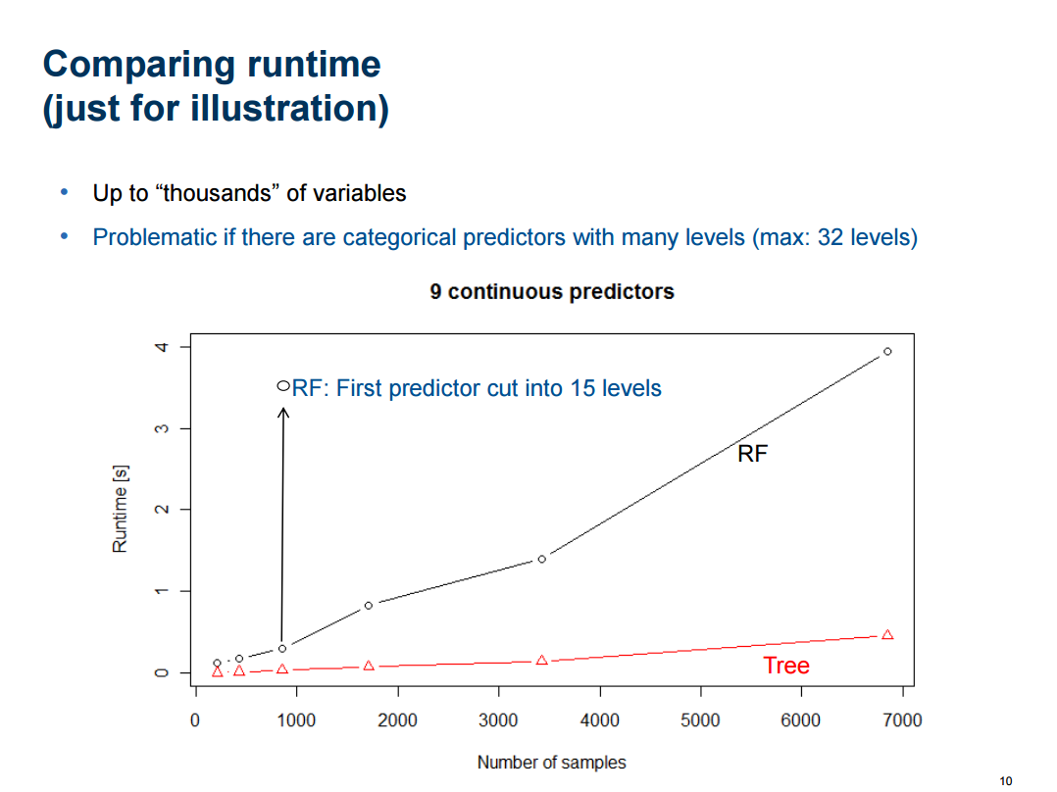

Slide 3
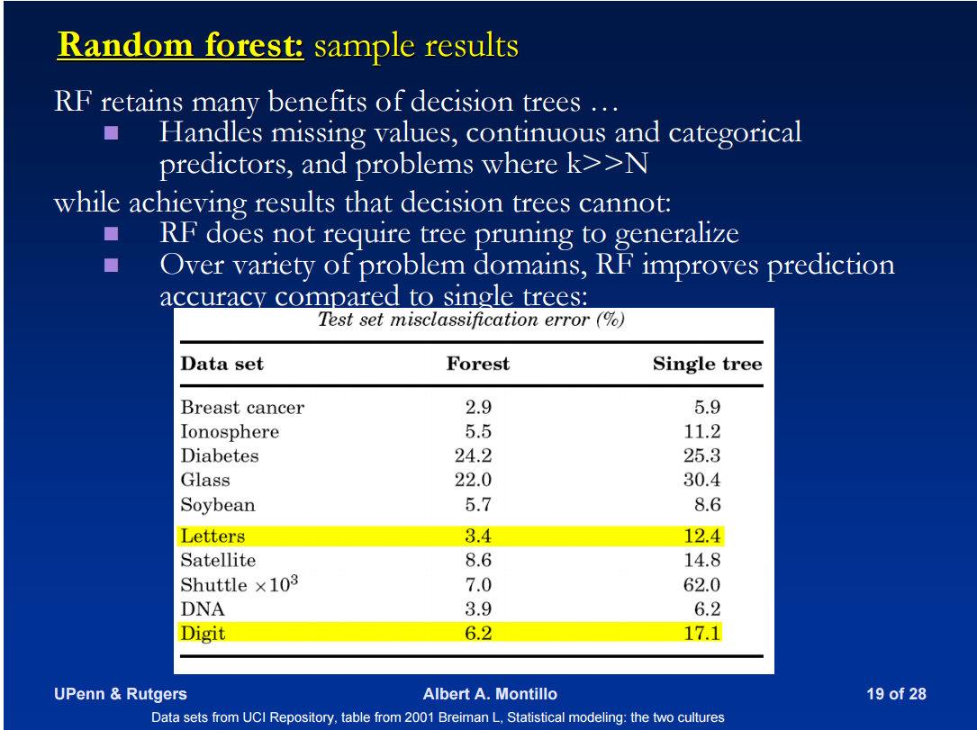
Further comparisons

Slide 4
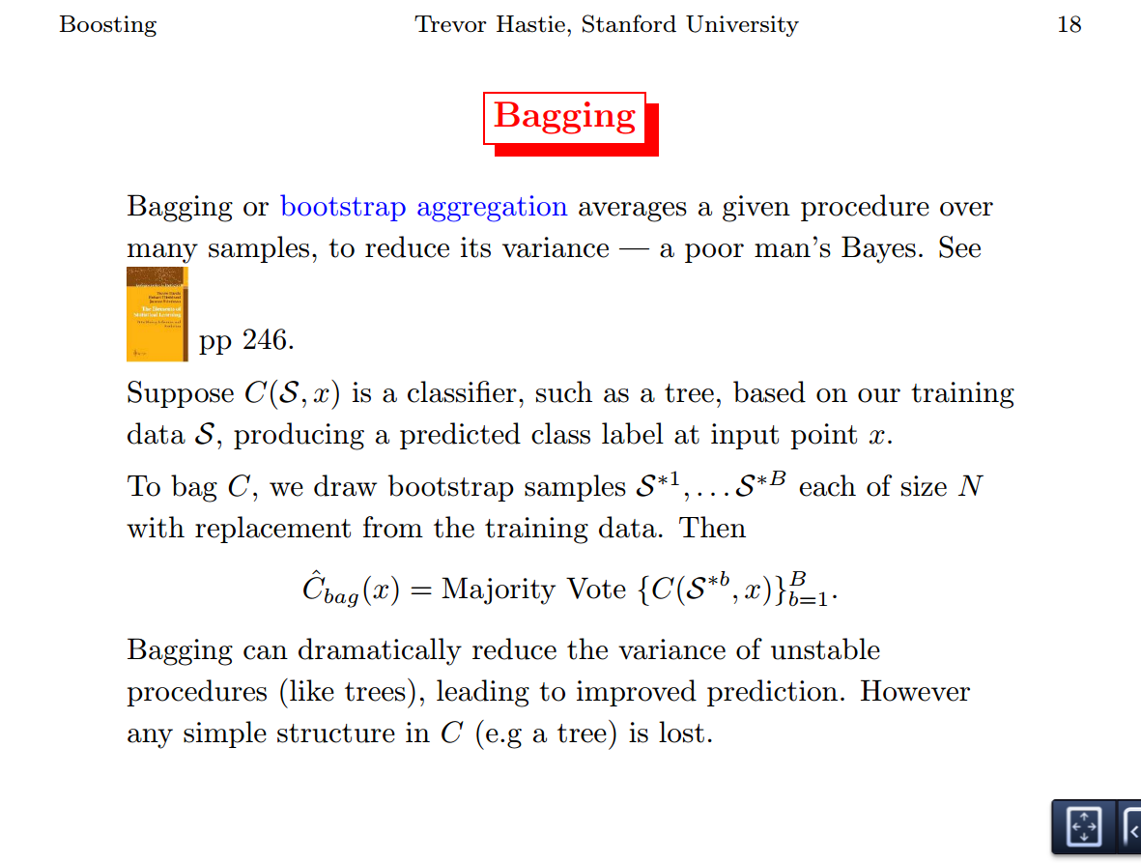

Slide 5
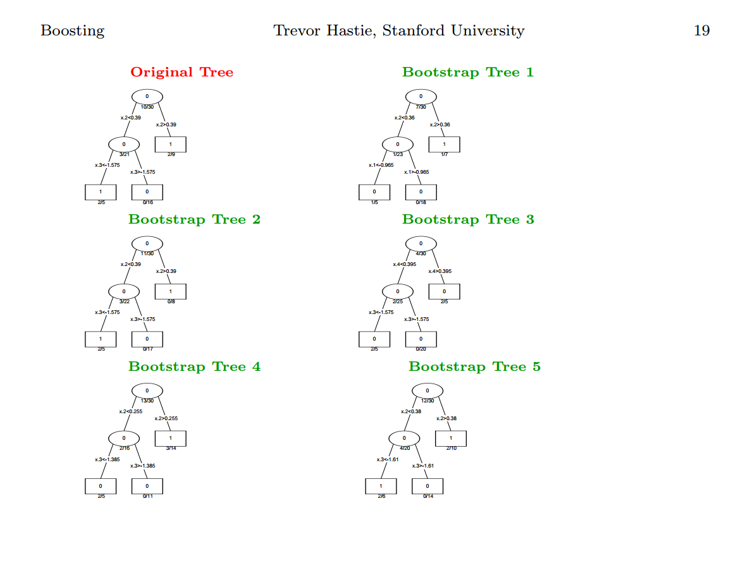

Slide 6
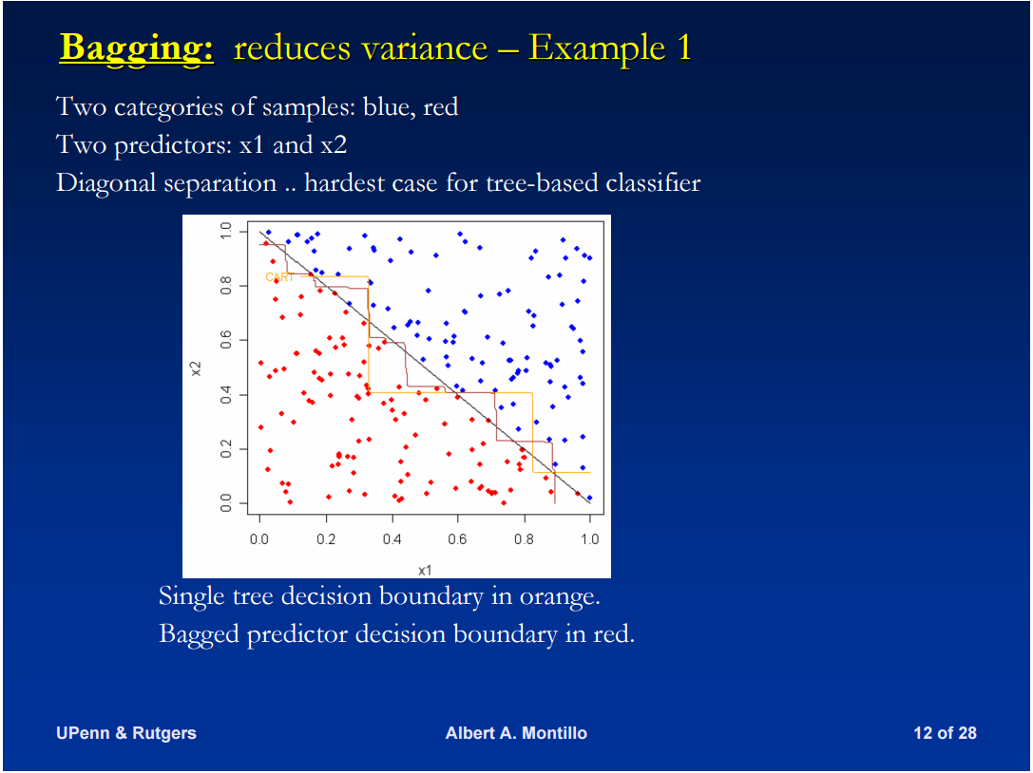

Slide 7
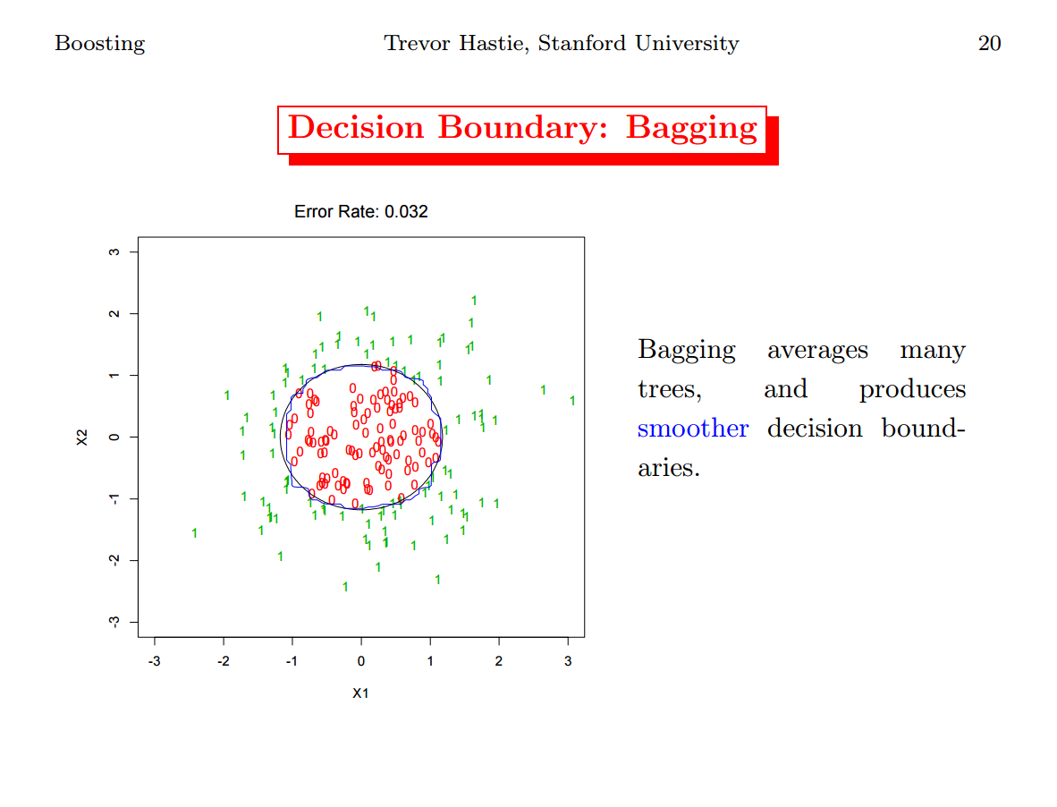

Slide 8
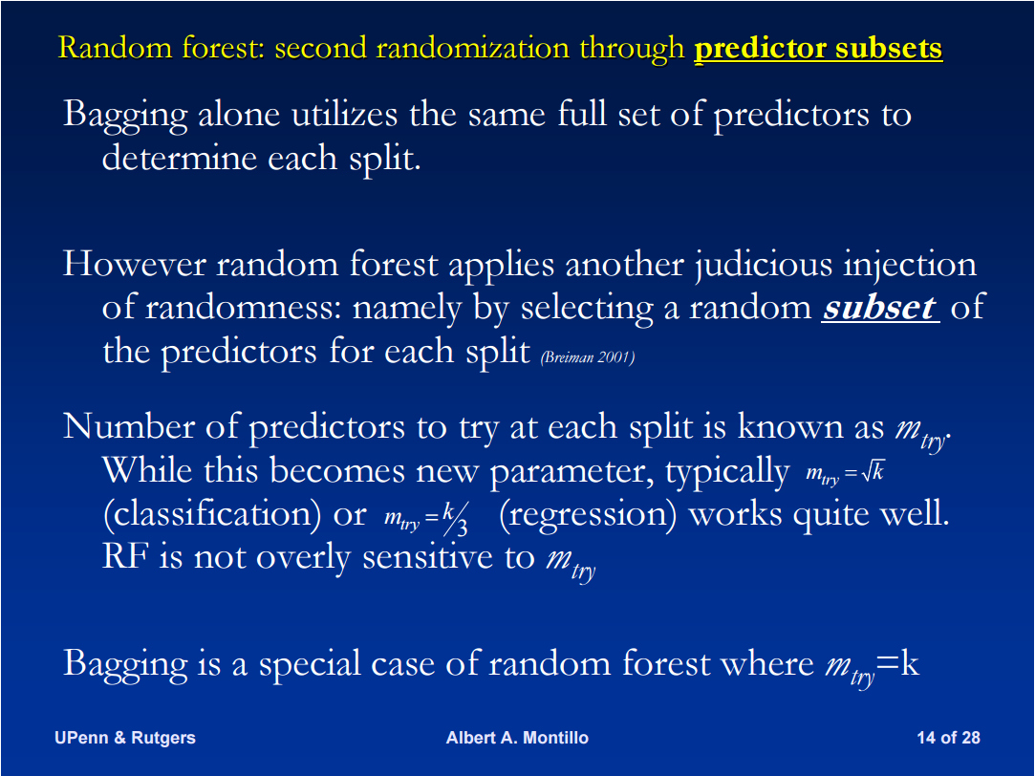

Slide 9
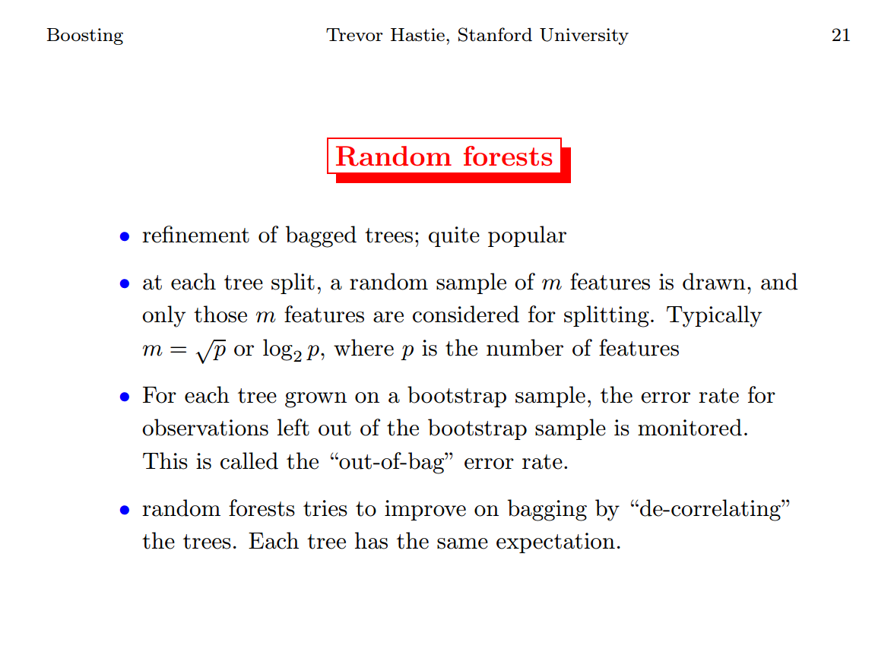

Slide 10
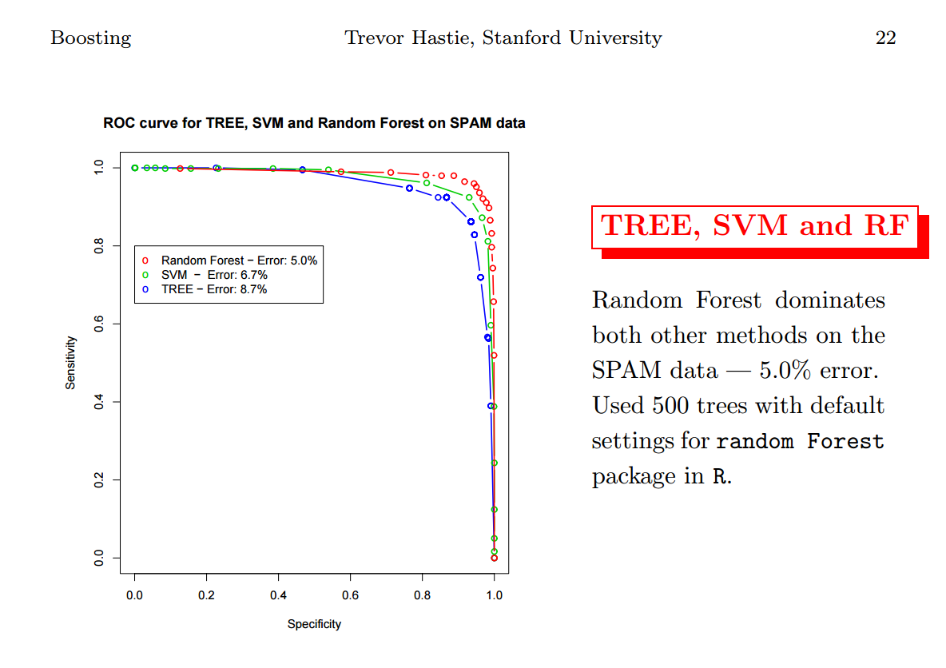

Slide 11
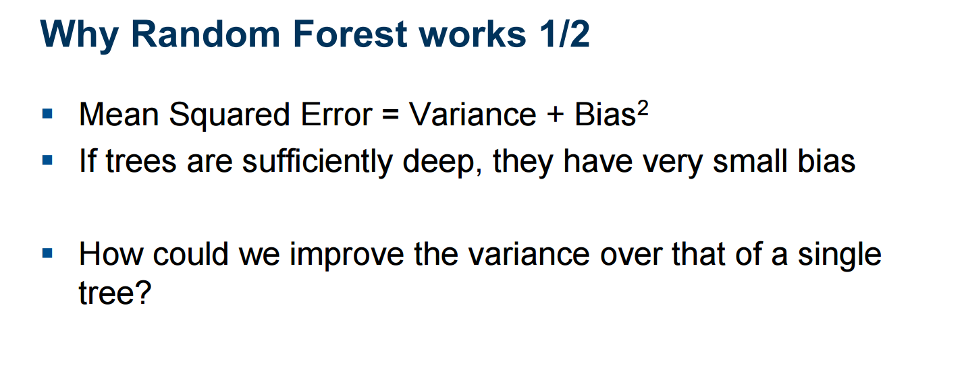

Slide 12
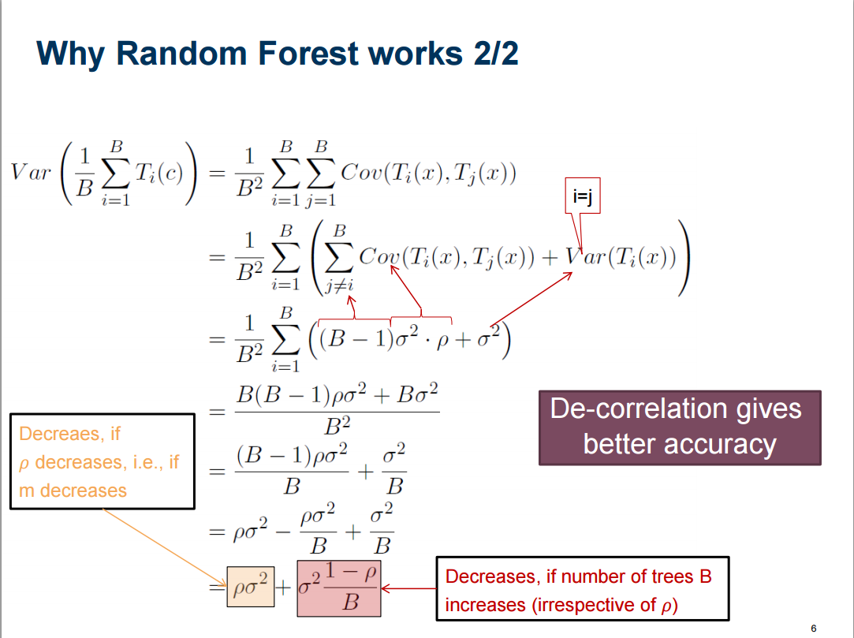

Slide 13
Missing Data
Random forests has two ways of replacing missing values.
The first way is fast.
Numeric: the median of all values of this variable in class j, then it uses this value to replace all missing values of the mth variable in class j.
Categorical: If the mth variable is categorical, the replacement is the most frequent non-missing value in class j.

Slide 14
Missing Data
The second way is computationally more expensive but has given better performance than the first, even with large amounts of missing data.
It replaces missing values only in the training set with rough inaccurate values
Does a forest run and computes proximities.
Estimates an NA as an average over the non-missing values weighted by the proximities between the nth case and the non-missing value case.
If missing categorical, replace it by the most frequent non-missing value where frequency is weighted by proximity.
Now iterate-construct a forest again using these newly filled in values, find new fills and iterate again. Our experience is that 4-6 iterations are enough.

Slide 15
Gini Importance
Every time variable m is used for a split, the gini impurity for the two descendent nodes is less than the parent node.
Adding up the gini decreases for each individual variable over all trees in the forest gives a fast variable importance that is often very consistent with the permutation importance measure.

Slide 16
Variable Importance – be careful
Gini importance: for variables of different types this is biased in favor of continuous variables and variables with many categories
Permutation importance is less biased
Refer papers by Strobl or her slides:
http://www.statistik.uni-dortmund.de/useR-2008/slides/Strobl+Zeileis.pdf

Slide 17
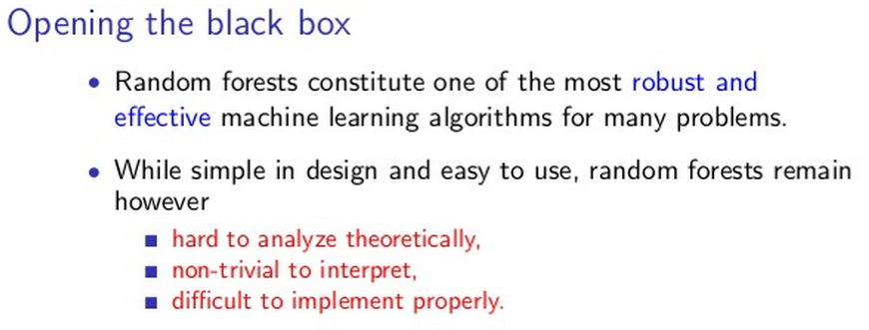
Limitations
Gilles Louppe, Universite de Liege, Belgium, Oct 9 2014 Research fellow at CERN

