Slide 1

Decision Trees and Ensemble Tree Methods

Slide 2
Goal
Understand what decision trees are as well as ensemble tree methods and the mathematical basis behind them
Be able to implement these models in R

Slide 3
Theory
Basic decision tree theory
Hands-on example – pen and paper
More detailed theory
Try rpart

Slide 4
What are decision trees?
Predictive model
Creates rules that map input variables to the target variable
Iteratively considers each possible binary split in every variable, and calculates the ‘best’ place to split the data in relation to the target variable
Once the rules are ‘learned’, can predict new cases!
Statistics, machine learning, data mining

Slide 5
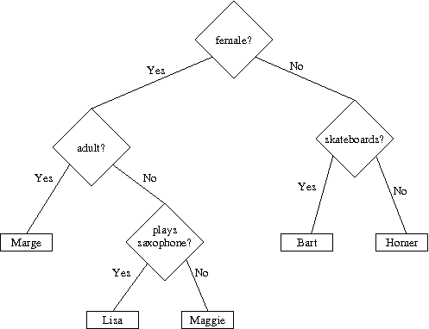
Very simple example
(Goldwasser, 2008)

Slide 6
Original data (guess)
Character | Female | Adult | Skateboards | Saxophone | Springfield
Homer | N | Y | N | N | Y
Marge | Y | Y | N | N | Y
Bart | N | N | Y | N | Y
Lisa | Y | N | N | Y | Y
Maggie | Y | N | N | N | Y

Slide 7



Why are they important?
Predictive capabilities
Unique features
High performance: ensemble methods

Slide 8
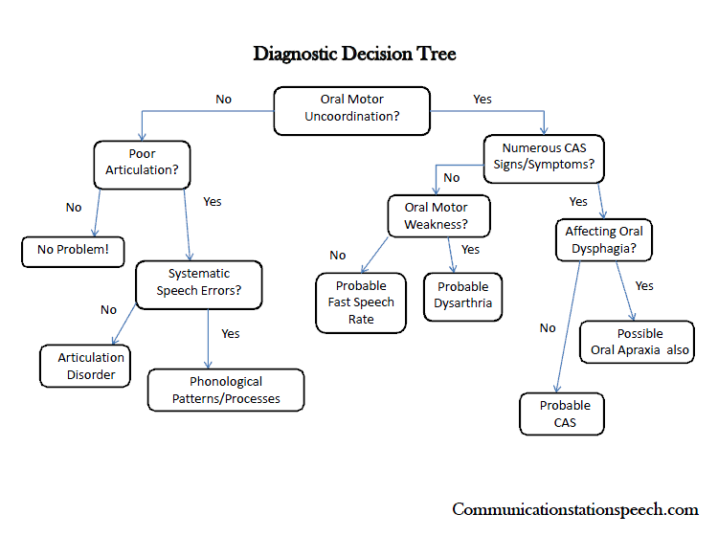
Why are they important?
Communication
vs. black box

Slide 9
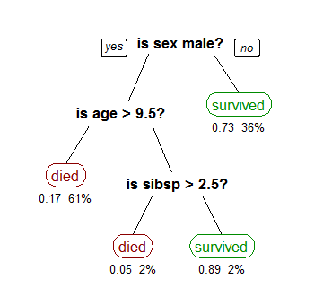
Basic theory
Tree structure
Root node
Leaf node
Internal or decision node
Branch
Leaf node

Slide 10
Two general types
Classification
Binary
Survival
Yes/no
Multiple
Regression
Numeric response variable
Probability
Income
Can regression be converted to classification?
CART

Slide 11
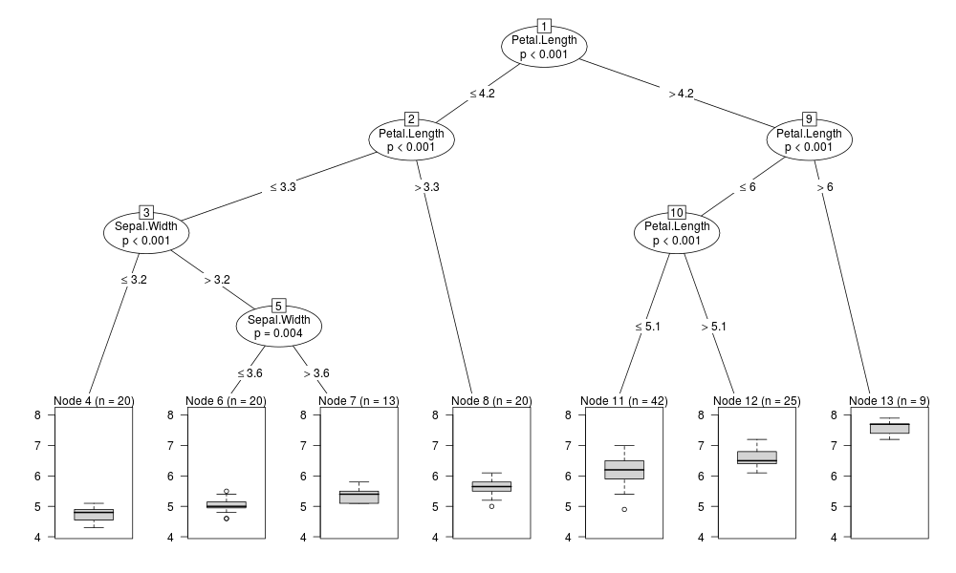
Example regression tree output

Slide 12
How to build a tree?
Start with classification problem, with categorical variables only
Do test splits of the data with each predictor variable.
Note how ‘pure’ each variable split makes the next nodes in terms of dependent variable
Choose split using variable that creates the most ‘pure’ split
Repeat process for each node until end nodes are as pure as possible in terms of dependent variable
Purity = correct data points/ total data points in node

Slide 13
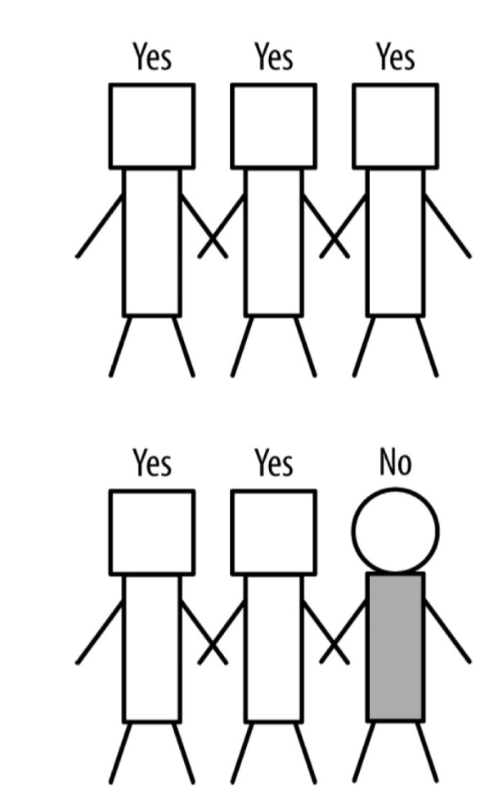
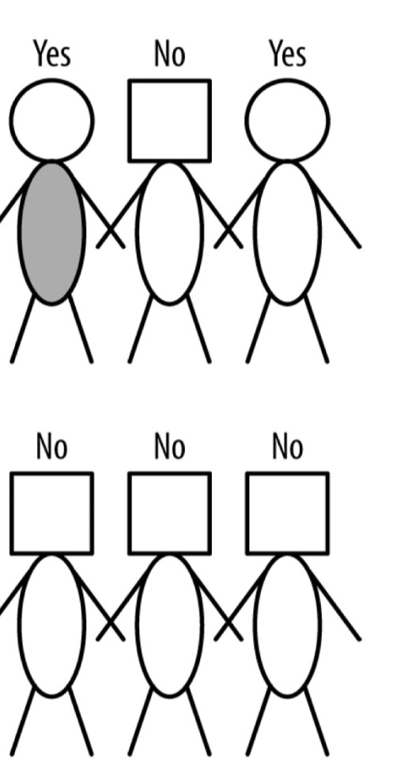

How to build a tree – optional paper exercise
Shape people → predict if red person will buy or not!

Slide 14
Answer
Rectangle?
Red guy? yes
y
n
Square head?
circle head?
y
n
y
n
yes
no
yes
Shaded?
y
n
yes
no
The iterative process is a
huge job with a bigger data
set. The iterative learning
Process is what makes this
Machine learning.

Slide 15
Questions that arise
Can you ensure an end node is always pure?
Should you want an end node to be pure?
What if there is more than two categories in a variable?
What if there is a numeric variable?
Would the algorithm sacrifice purity at early node to increase purity at later node?

Slide 16
More than two categories
Still binary split: split categories into two groups
Country
india, china
Japan, korea, cambodia, malaysia
Width of noodle < 2mm
Number of spices >6

Slide 17
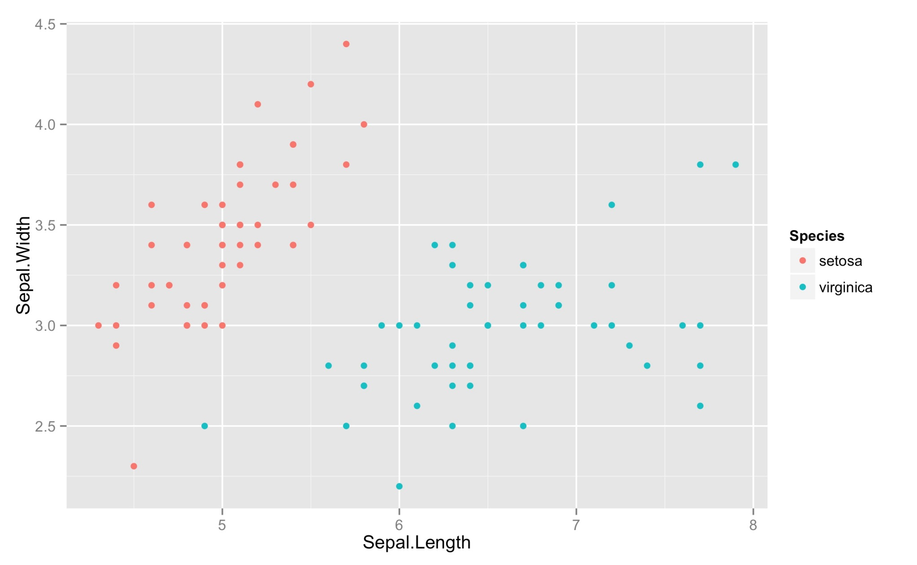
Numeric variable

Slide 18

Logistic regression - compare

Slide 19
Regression tree
Numeric response variable
How to calculate equivalent ‘node purity’ for each possible split point?
Maximise below formula
SST − (SSL + SSR)
where SST = ∑(y_{i} − ȳ)² for the node, SSL and SSR is sum of squared error for the left and right nodes

Slide 20
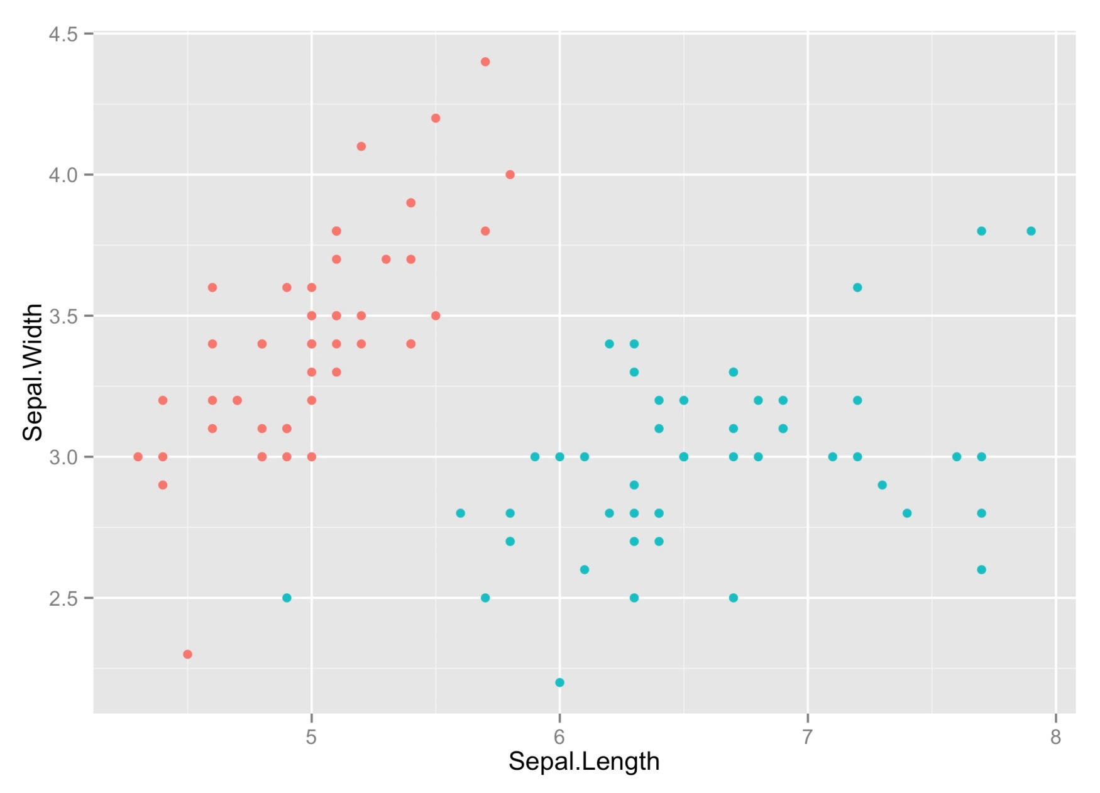
Visualising Regression Tree
← Response variable
ȳ
ȳ - y_{i}
ȳ

Slide 21
Regression Tree
Choose binary split using one variable at a time.
Greedy: choose binary split that gives biggest reduction in sum of squared errors
What if two variables give same reduction in SSE?
When is natural point to stop splitting?
All points have the same response values/categories
Response values differ, but all other variables are the same

Slide 22
rpart splitting methods
Gini index (default)
often best
P_{L}(p_{L})(1-p_{L}) + P_{R}(p_{R})(1-p_{R})
Example:
Y/N
289/911
Total no. cases?
P_{L}?
P_{R}?
p_{L}?
p_{R}?
1200
400/1200
800/1200
Y/N
189/211
Y/N
100/700
189/400
100/800

Slide 23
rpart splitting methods
Example, cont..
Y/N
289/911
Total no. cases?
P_{L}?
P_{R}?
p_{L}?
p_{R}?
1200
400/1200
800/1200
189/400
100/800
Y/N
189/211
Y/N
100/700
P_{L}(p_{L})(1-p_{L}) + P_{R}(p_{R})(1-p_{R})
= 4/12 * 189/400 * (1-189/400) + 8/12 * 1/8 * (1-1/8)
= 0.156

Slide 24
rpart splitting methods
Example: choose best possible split to predict yes/no below
Possible split | Gini Index Value
Kids? ‘no’; Kids? ‘yes’ | 0.213
Age<30; Age≥30 | 0.190
Age<40; Age≥40 | 0.156
Age<50; Age≥50 | 0.168
Age<60; Age≥60 | 0.208
Age<70; Age≥70 | 0.219

Slide 25
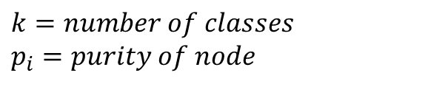
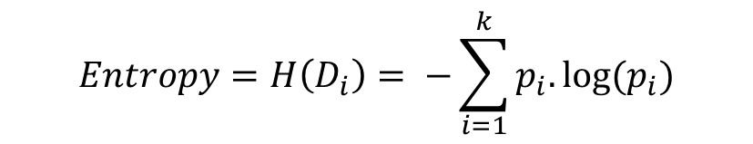
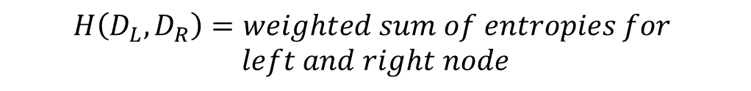
rpart splitting methods
Information gain (entropy)
Measures amount of disorder or uncertainty in a system. Lower entropy means more pure
$$Entropy=H\left(D_{i}\right)= −\sum_{i=1}^{k}{p_{i}.log⁡(p_{i})}$$
$$k=number of classes$$
$$p_{i}=purity of node$$
$$Information Gain=H\left(D\right)−H(D_{L},D_{R})$$
$$H\left(D_{L},D_{R}\right)=weighted sum of entropies for$$
$$left and right node$$

Slide 26
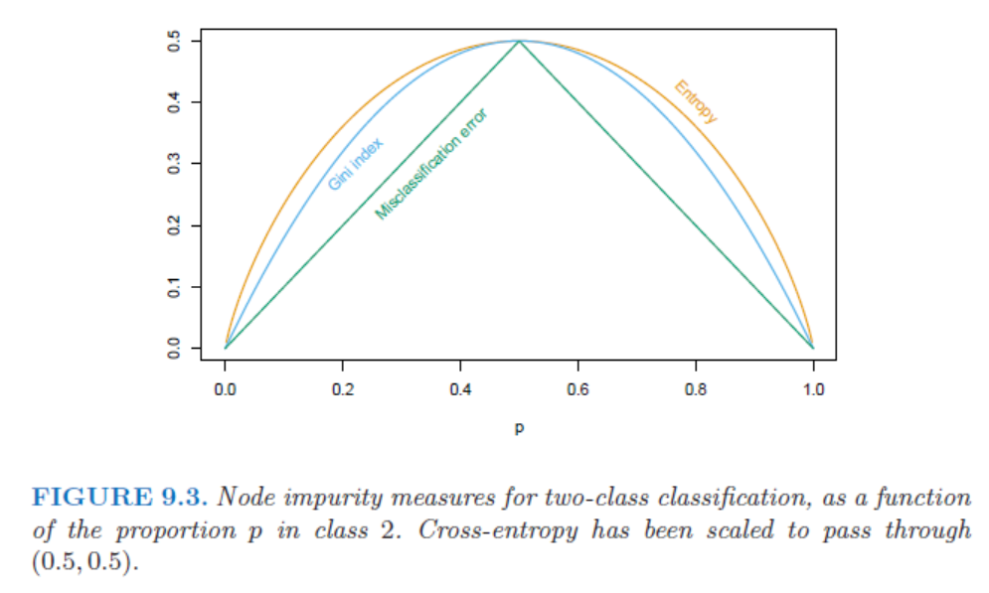
Which splitting method to use?
Good to try both Gini and Information gain in rpart package
Gini tends to classify the largest class first
Entropy tends to find groups of classes that split the data approx 50-50
Gini and Information gain favour purer splits while misclassification doesn’t differentiate

Slide 27
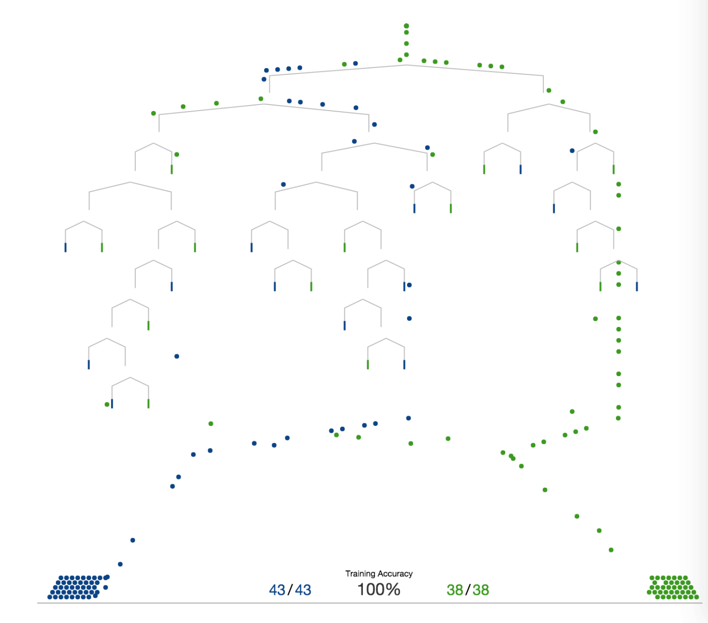
Decision tree animation
http://www.r2d3.us/visual-intro-to-machine-learning-part-1/

Slide 28
Overfitting
If we fit a tree perfectly to a set of data down to each point, does it mean the next set of data from the same source will fit perfectly?
No, we have most likely fit noise in the data
Methods for cross validation
Automatic in rpart package
Split data into train and test set

Slide 29

Pruning
Tree trained: use test set
Aim: delete splits that provide no predictive power
Bottom up method: Run test-set through tree – comb through errors
interactive pruning
Top down method: stopping rules..

Slide 30
Stopping Rules
Complexity parameter, cp
*most popular*
increase R² of model by at least cp
rpart sets 0.01 as default. This is
good starting point
over-prunes for big data sets.
Min number of observations in a node before split
Min number in terminal node
Maximum depth of tree

Slide 31
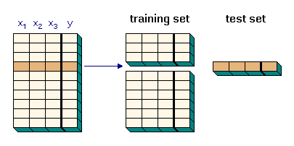
Cross validation
Cross validation using test set – ie pruning
5 or 10 fold cross validation is recommended
Tuning parameters:
Depth of tree, cp

Slide 32
Cross Validation
Cross validation done automatically by rpart
At each stage of growth, a hold-out sample is automatically generated.
The split is made using the data not including hold-out.
The hold-out data is then run through the model with the new split and error reported.

Slide 33
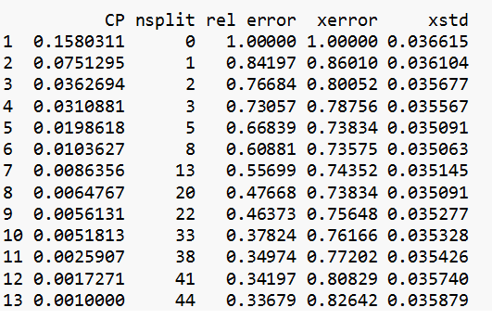
Cross validation
rpart: cross validation error

Slide 34
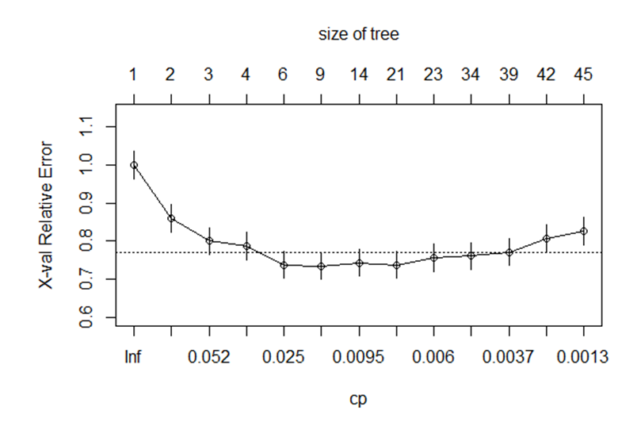
Cross validation
rpart cross validation plot

Slide 35
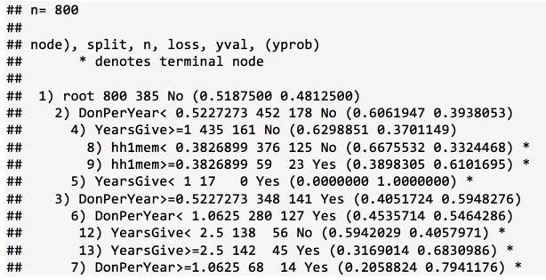
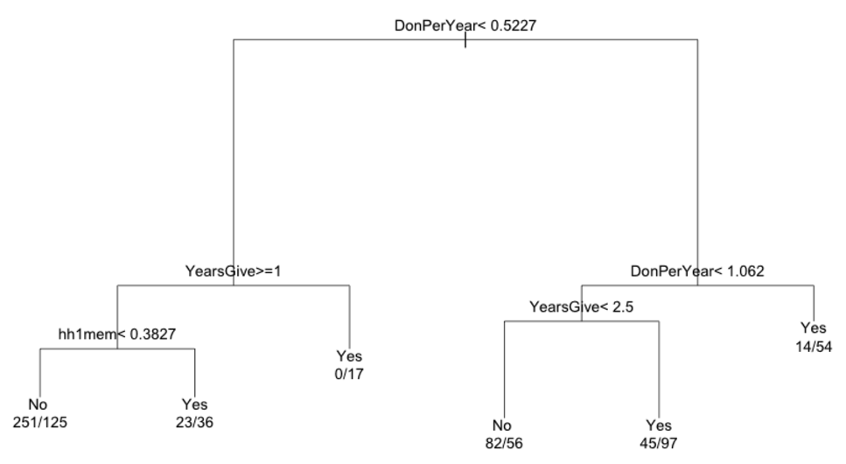
rpart output
Number of cases in node
Probability ‘yes’
Leaf node
Number of cases that don’t match node classification
Node classification
Probability ‘No’

Slide 36
rpart output
Proportional to the error in the fit

Slide 37

Missing Data
rpart package – omits cases if either:
Response variable missing
All explanatory variables missing
At right and left splits, impurity index is calculated only for non-missing cases.
To determine which way to send a case which is missing the current splitting variable, surrogate variables are used

Slide 38
Missing Data
Surrogate variables
For example, say algorithm has determined the split shall be age<40 or age ≥40. A case is missing age.
Use other independent variables (one at a time) to predict age<40 or age ≥40.
Calc misclassification rate
Rank each surrogate variable
Use highest ranking!

Slide 39
Limitations
Strongest variables can ‘set the path’ of the tree
Weaker variables do not shine even if they are meaningful in parts of the data
Result of ‘greedy’ algorithm
Overfitting
High variance: small change in data can result in very different series of splits.
ensembles

Slide 40
Limitations
Variable importance can be biased towards variables with many categories.
More categories, more likely to find a good split for the data at hand
Does not pick up on combinations of variables
Correlated variables: interpretability

Slide 41
Advantages
Robust
White box
Minimal data preparation
Handles categorical and numerical data well
Handles missing data well
Performs quickly with large data sets
Including correlated variables

