Slide 1


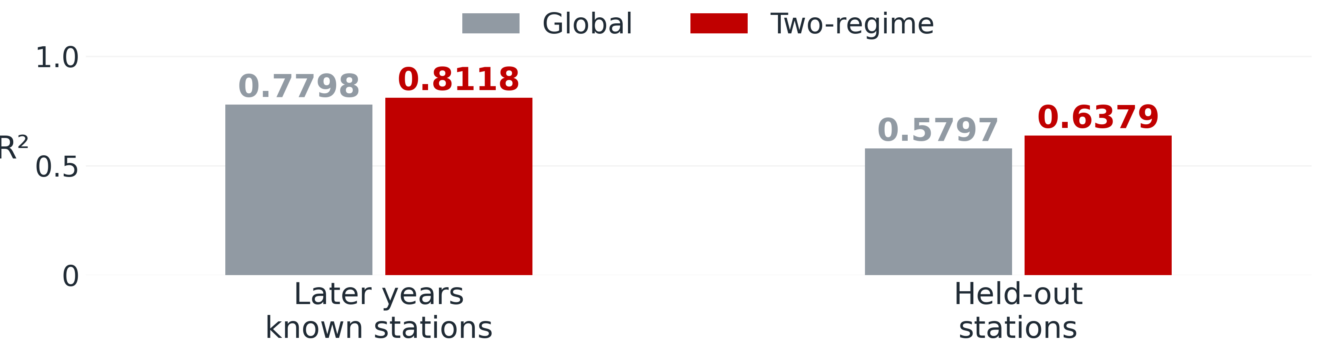
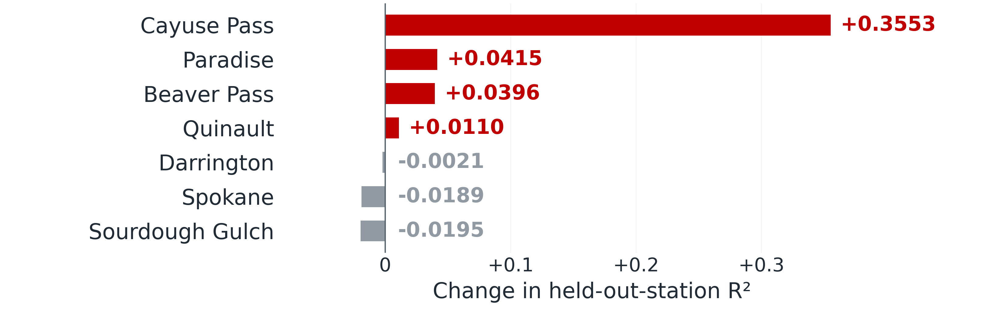
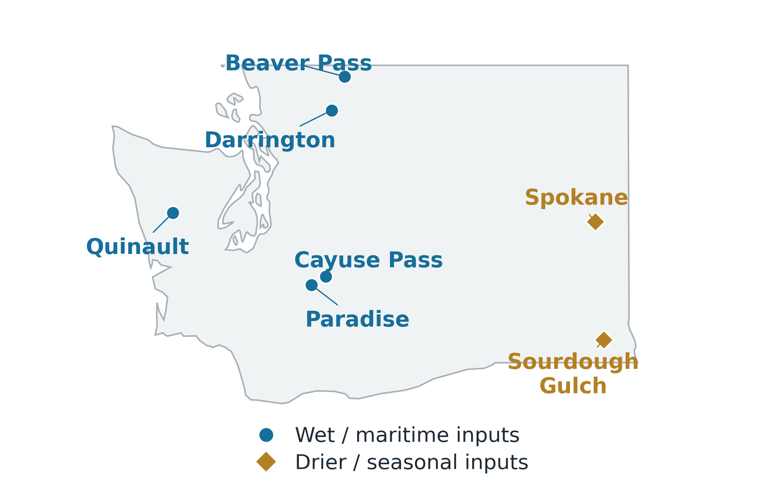
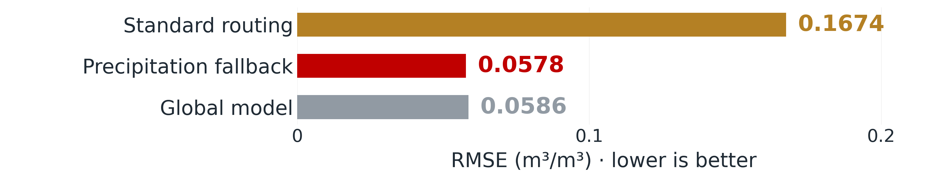
Two-Regime Models for Daily Soil-Moisture
Estimation in Washington
[Author names] · Mentored by [Mentor name, credentials]
Department of Computer Science, Seattle University
SUMMER RESEARCH SHOWCASE · 2026
Project Overview
Two-Regime Method
Results
Why daily estimates?
Group observations by their inputs, then fit an XGBoost specialist
to each group's conditions.
+0.0320 R²
+0.0581 R²
Soil moisture informs irrigation and drought monitoring. Ground
sensors provide local measurements; satellites cover larger
areas but leave gaps in daily observations.
Later years
Held-out stations
SATELLITE
WEATHER
SITE
Moisture, radar,
vegetation, heat
Rainfall and
recent history
Terrain, climate,
land cover
We combine satellite, weather, and site data for daily
soil-moisture estimation. Earlier work established the pipeline
and a single global predictor.
THE SUMMER QUESTION
Feature-based grouping
Matched inputs and settings: 30 later-year runs; five per held-out station.
Two-regime R² leads in every later-year run.
Can two specialists improve estimates across
Washington's contrasting conditions?
K-means selects a specialist
Where does specialization help?
Study Area & Data
Specialist A
Specialist B
Wet / maritime
input conditions
Drier / seasonal
input conditions
XGBoost regressor
XGBoost regressor
Daily soil-moisture estimate
Gains at four stations; losses at three. Eastern holdouts reduce representation of
the smaller regime.
One observation → one specialist → one estimate
Known stations keep one specialist; new stations are assigned using their
features.
New Sensor Sites: Routing Matters
Station colors show fitted memberships across western Washington, the
Cascades, and the east.
Grouping uses no observed in-situ targets.
Missing SMAP inputs triggered automatic routing based on available
precipitation history at five new ECE sites.
What the Regimes Capture
7
54
5 cm
Wet / maritime
Drier / seasonal
public stations
shared features
target depth
5 training stations
2 training stations
Satellite, weather, and site features are aligned to daily
observations; public in-situ sensors supply training targets.
Western Washington:
coastal and Cascade
conditions together.
Eastern Washington:
less rain and lower
satellite moisture.
150 observations, July–August 2026; one fallback specialist. Full-season
evaluation remains.
Wettest-month rain: 391 mm
Satellite moisture: 0.414 m³/m³
Wettest-month rain: 70 mm
Satellite moisture: 0.192 m³/m³
Takeaways
2017–2022
Fit period
2023–2025
Later-year test
Specialization helps when routing is reliable and training sites
represent new conditions. Next: evaluate more stations and seasons
with the ECE team's sensors.
Group medians describe this Washington sample. Choose regime counts using
local data.
Target: daily soil moisture (m³/m³).
Sources: [1] Balkovec et al., IEEE AIIoT (2026), doi:10.1109/AIIoT68874.2026.11569136. [2] MDR Project, technical report 1.5 (2026).
In-situ data: NOAA USCRN and USDA ISMN SNOTEL. New sensor-site evaluation in collaboration with the Seattle University ECE team.

