Slide 1


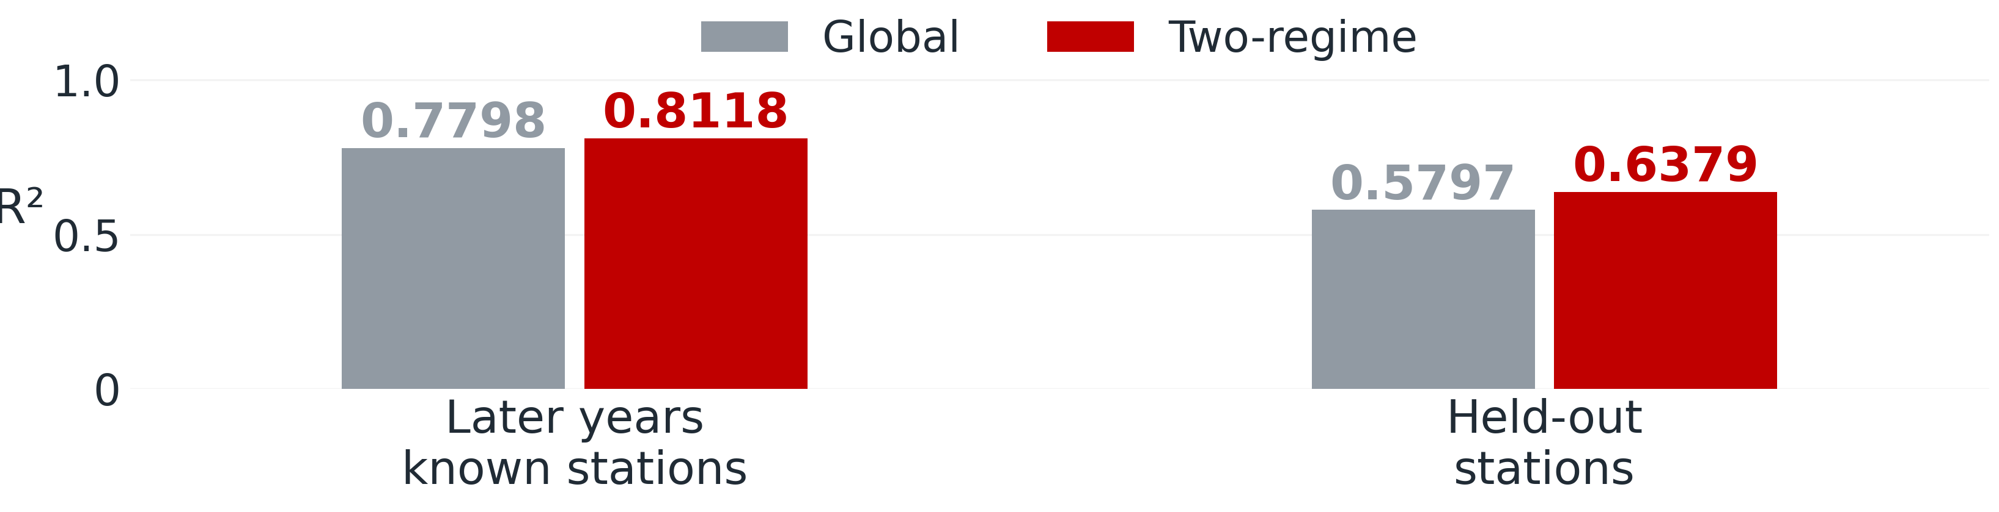
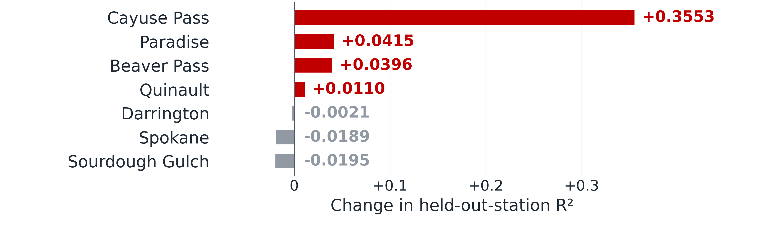
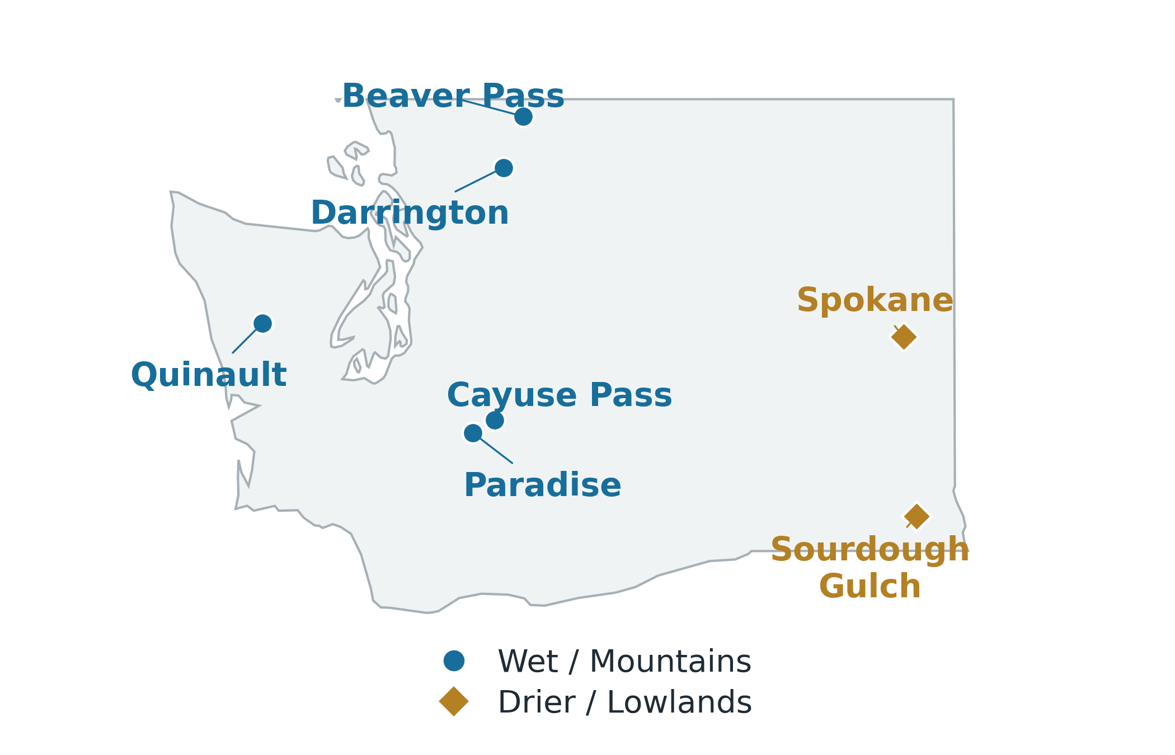
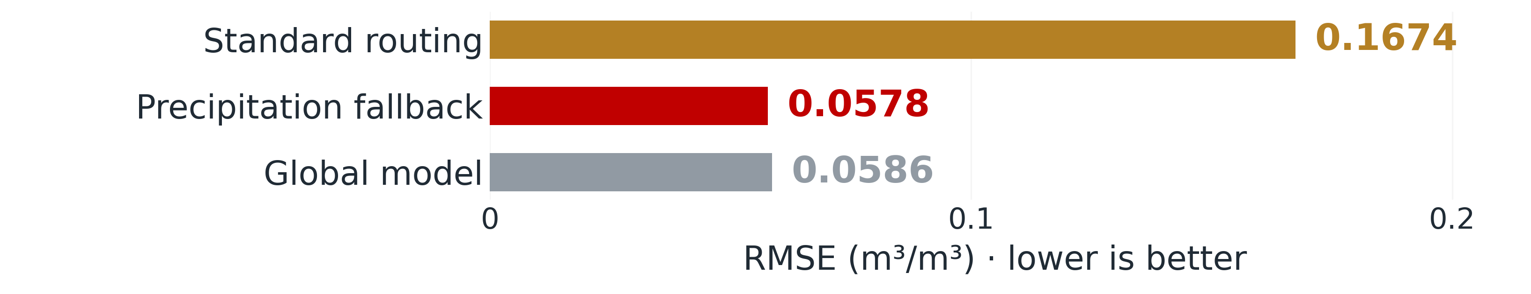
Two-Regime Models for Daily Soil-Moisture
Estimation in Washington
[Author names] · Mentored by [Mentor name, credentials]
Department of Computer Science, Seattle University
Summer research showcase · 2026
Background and research question
Two-regime modeling
Evaluation and results
Why soil moisture estimation?
A global model learns one input-to-soil-moisture relationship from all
stations. We divide observations into two groups and fit an XGBoost
model to each. Each specialist predicts daily volumetric soil moisture
at 5 cm depth (m³/m³).
+0.0320
+0.0581
Soil moisture is the amount of water held in soil. Daily estimates help
with irrigation planning and drought monitoring. They show how
moisture changes after rain and during dry periods, including places
with few direct measurements.
Later-year R² gain
Station-holdout R² gain
Satellite
Weather
Site properties
Ground sensors measure moisture at individual sites. Satellite
observations cover larger areas but are intermittent, with some
retrievals missing. We combine satellite, weather, and site data for
daily estimates. Earlier work produced the pipeline and a global
XGBoost model.
Moisture, backscatter,
vegetation, land-surface
temperature
Rainfall totals and
recent rainfall history
Terrain, climate,
land cover, soil
Feature-based grouping
Figure 3. Mean R² from 30 later-year runs and five per held-out station, with
matched seeds. Higher is better.
Summer research question
Standardize → K-means → fixed groups for known stations
Can two specialists improve estimates across
Washington's contrasting conditions?
Two-regime R² is higher in all 30 later-year runs. Leaving out stations
also favors specialization on average, although improvements vary by
location.
Specialist A
Specialist B
Our comparison uses the same evaluation conditions for both models.
For known stations, we fix a single specialist; tests at new sites
examine how missing satellite inputs affect assignment.
Wet / Mountains
Drier / Lowlands
XGBoost regressor
XGBoost regressor
Study area and data
Daily soil-moisture estimate
ŷ = fᵣ(x), r = g(s, x) ∈ {A, B}
Regional contrast
Figure 2. Each observation uses one specialist. x denotes the inputs, s the
station, g the assignment rule, and fᵣ the selected model.
Our stations span the
coast, Cascade
mountains, and drier
eastern Washington.
They let us study how soil
moisture relates to inputs
under different
conditions. Station
holdouts test whether the
models can estimate
moisture at a new site.
1. We fill missing router inputs with their fitting-data means and
standardize features to comparable scales. K-means finds two cluster
centers; a new observation goes to the nearest center. The router uses
inputs alone, without measured target labels.
Figure 4. Mean R² change: four gains and three losses (five runs).
Cayuse Pass has the largest R² increase. Leaving out either eastern
station reduces the smaller group's training coverage.
2. For a station included in fitting, its most common group selects one
specialist for all its observations. New stations receive an assignment
each day. Missing routing inputs can trigger the precipitation fallback.
ECE sensor-site evaluation
3. Both approaches use identical features, XGBoost settings,
evaluation observations, and random seeds. Each specialist trains on
its assigned group. Seeds control training randomness; repeated fits
measure training variation, leaving uncertainty across new sites and
seasons unmeasured.
Missing SMAP inputs at five new sites deployed by Seattle University's
ECE team triggered automatic assignment using an index of recent
rainfall. We used Washington validation data to choose a specialist for
each rainfall class.
Figure 1. The seven training stations and their fitted groups. Colors identify
station assignments, with no geographic boundaries implied.
NOAA USCRN and SNOTEL stations provide measured soil moisture.
Satellite inputs include SMAP soil moisture, Sentinel-1 radar
backscatter from the land surface, and Sentinel-2 surface reflectance
and indices of vegetation greenness and canopy water content. We
also use MODIS land-surface temperature and vegetation indices,
ERA5-Land weather, and terrain, climate, land-cover, and soil
descriptors.
Regime interpretation
Wet / Mountains
Drier / Lowlands
5 training stations
2 training stations
Figure 5. Pooled ECE RMSE. Rainfall fallback and global model errors are
similar; lower is better.
The pipeline puts observations on a daily grid, fills gaps, smooths the
time series, and calculates features describing recent satellite readings
and weather.
Western and Cascade sites:
more rain and higher
SMAP soil moisture.
Spokane and Sourdough Gulch:
less rain and lower
SMAP soil moisture.
For all 150 daily observations from July 20 to August 19, 2026, the
fallback selected the same specialist. Full-season performance at these
ECE sites remains untested.
Wettest-month rain: 391 mm
SMAP soil moisture: 0.414 m³/m³
Wettest-month rain: 70 mm
SMAP soil moisture: 0.192 m³/m³
2017 to 2022
Final fitting period
2023 to 2025
Later-year test
The groups differ mainly in rainfall and SMAP soil moisture. The wetter
group includes lowland and mountain stations, so elevation alone does
not distinguish them. Values above are input-data medians. Two
groups worked for these stations; other deployments should choose
their group count using local data.
Discussion and next steps
Development uses 2017 to 2020 for training and 2021 to 2022 for
validation. The final fit combines both periods. We test later years and
refit without each station in turn to evaluate new Washington locations.
These gains depend on reliable assignment and training sites that
cover the conditions encountered. We will test more Washington sites
and seasons with ECE sensors, including changes in satellite
availability.

