Slide 1
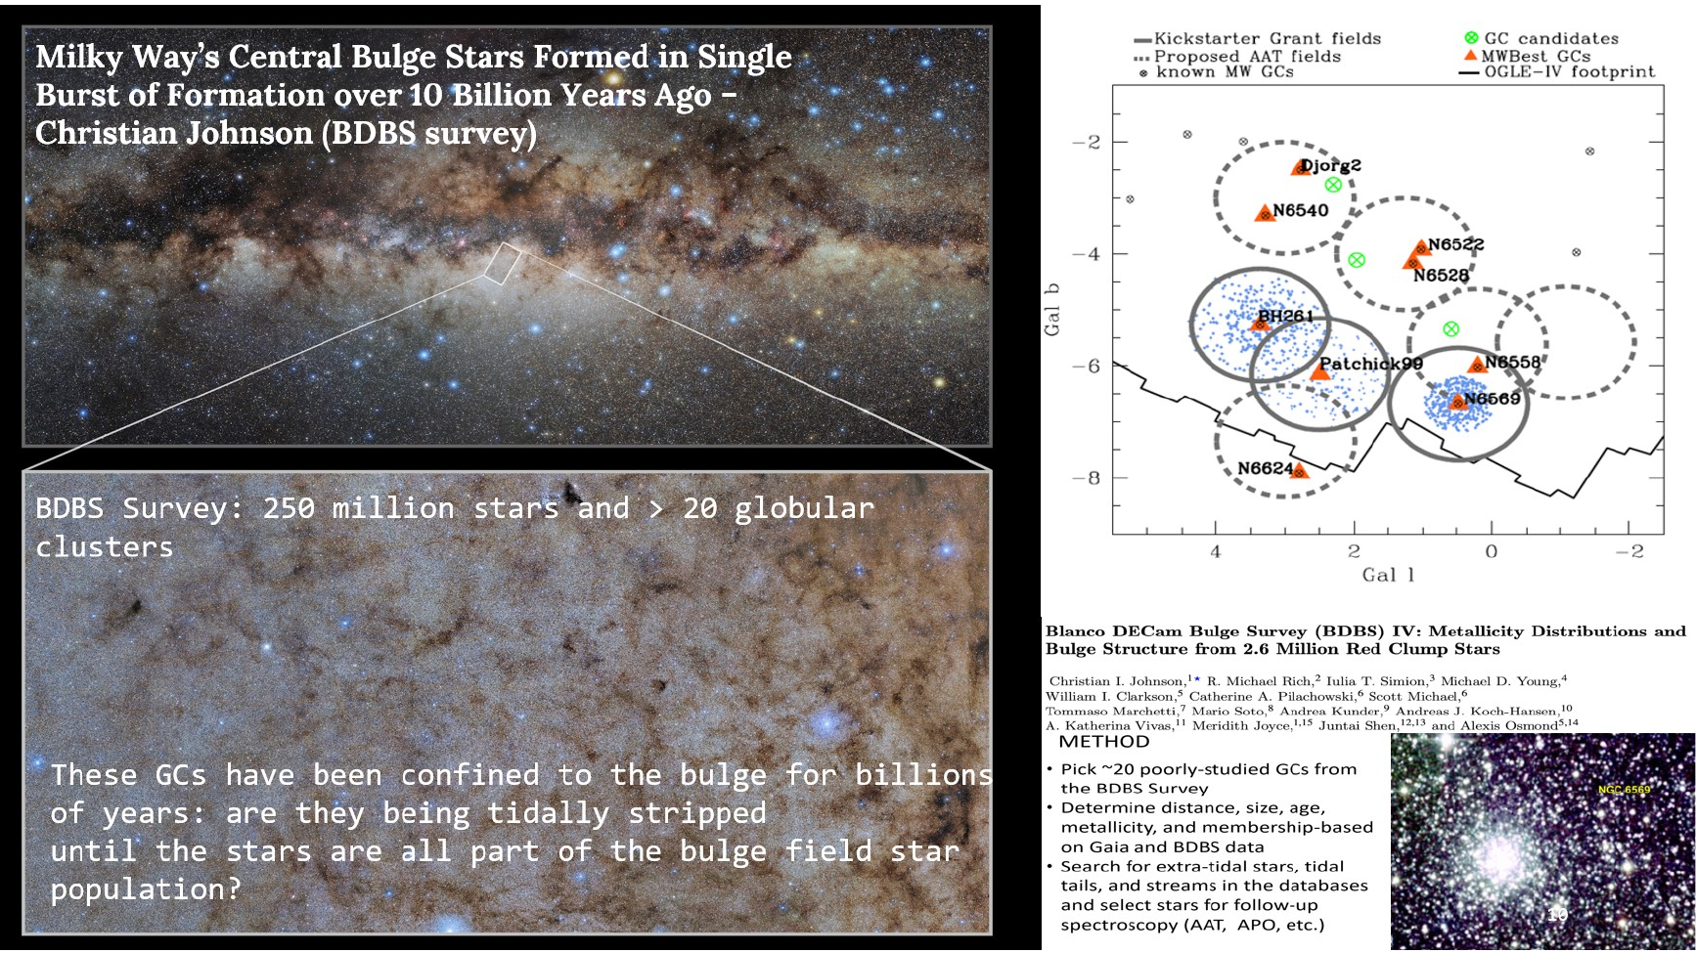
PHYS 2550 — Data Science for Physicists and Scientists
A 2000-level CREL course built from real astronomical data-analysis workflows
Course purpose
Students learn to turn messy scientific measurements into defensible results using Python, plots, model fits, uncertainty checks, and reproducible notebooks.
Core scientific habit
Do not trust an automated result until the data, residuals, model assumptions, and physical interpretation have been checked.
Course level
Start with an accessible 2000-level course; build toward a future advanced astrophysics data-science course.
The NGC 6569 analysis provides a complete case study: photometry, astrometry, spectroscopy, SED fitting, and quality-controlled summary tables.
PHYS 2550 / CREL Data Science for Physicists and Scientists

Slide 2
Why astronomy makes a good data-science laboratory
Students see how one scientific question draws on surveys, catalogs, spectra, models, and visual diagnostics.
PHYS 2550 / CREL Data Science for Physicists and Scientists

Slide 3
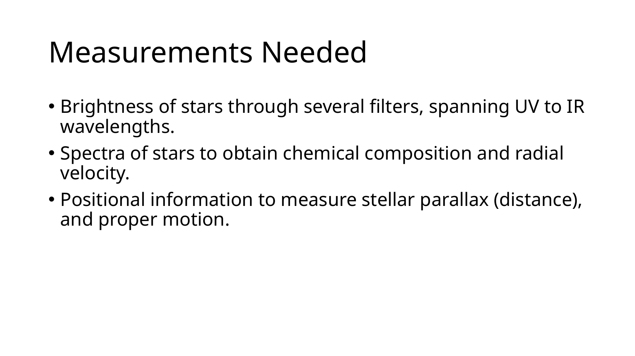
The three measurement families
Photometry, spectra, and astrometry become a data-integration problem
Photometry
Brightness through filters → colors, temperatures, CMDs, extinction corrections, SEDs.
Spectroscopy
Flux versus wavelength → line strengths, radial velocities, metallicity, model residuals.
Astrometry
Positions, parallaxes, and proper motions → distances, motion, membership, selection effects.
This framing gives students a coherent map of the course: each data type answers a different scientific question.
PHYS 2550 / CREL Data Science for Physicists and Scientists

Slide 4
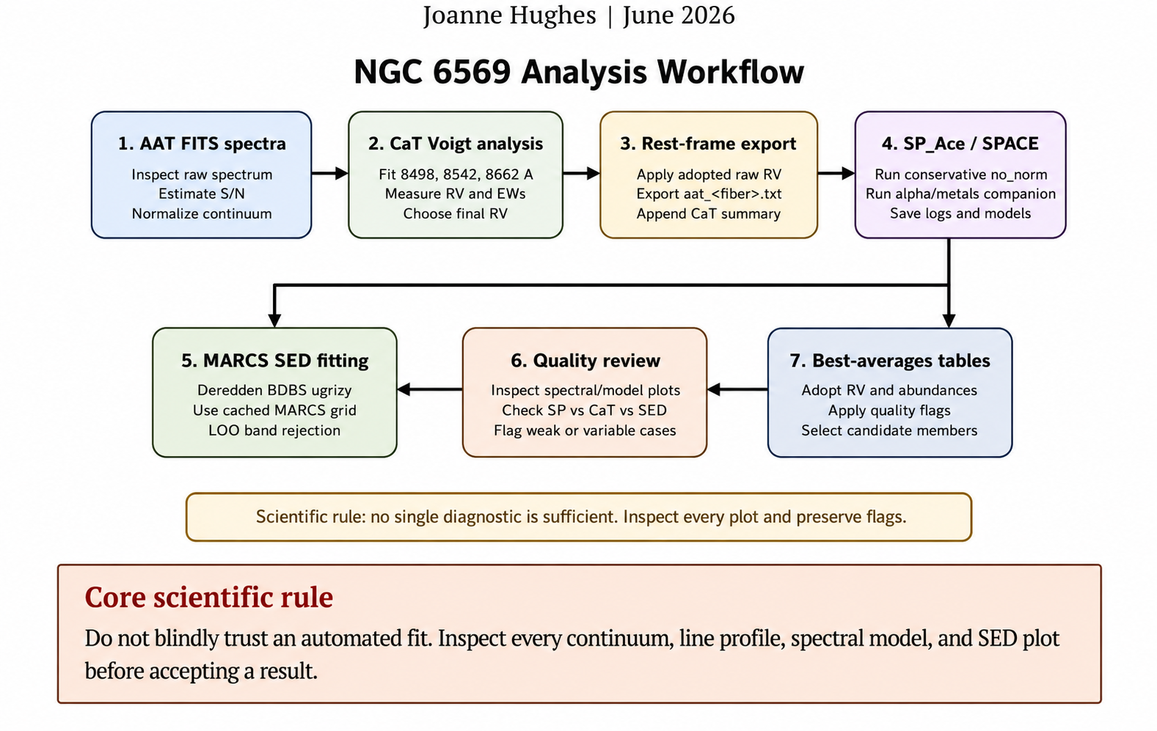
From raw files to a defensible result
The course uses pieces of a real workflow as lab modules
PHYS 2550 / CREL Data Science for Physicists and Scientists

Slide 5
A 2000-level workflow for students
The same scientific logic, scaled to a lower-division course
Read
CSV, FITS, text spectra
Clean
flags, missing data, outliers
Plot
CMDs, spectra, residuals
Fit
simple models, uncertainties
Check
diagnostics and quality flags
Report
notebook, table, memo
Students learn why each step exists, not just how to run code.
Every lab produces a plot, a short interpretation, and a reproducible notebook cell.
The final project combines the same steps into a mini research pipeline.
Best-practice emphasis
A good result includes a numerical value, uncertainty, plot, residual check, and an honest quality flag.
AI integration
AI tools can help generate or debug code, but the student must verify the code and own the scientific interpretation.
PHYS 2550 / CREL Data Science for Physicists and Scientists

Slide 6
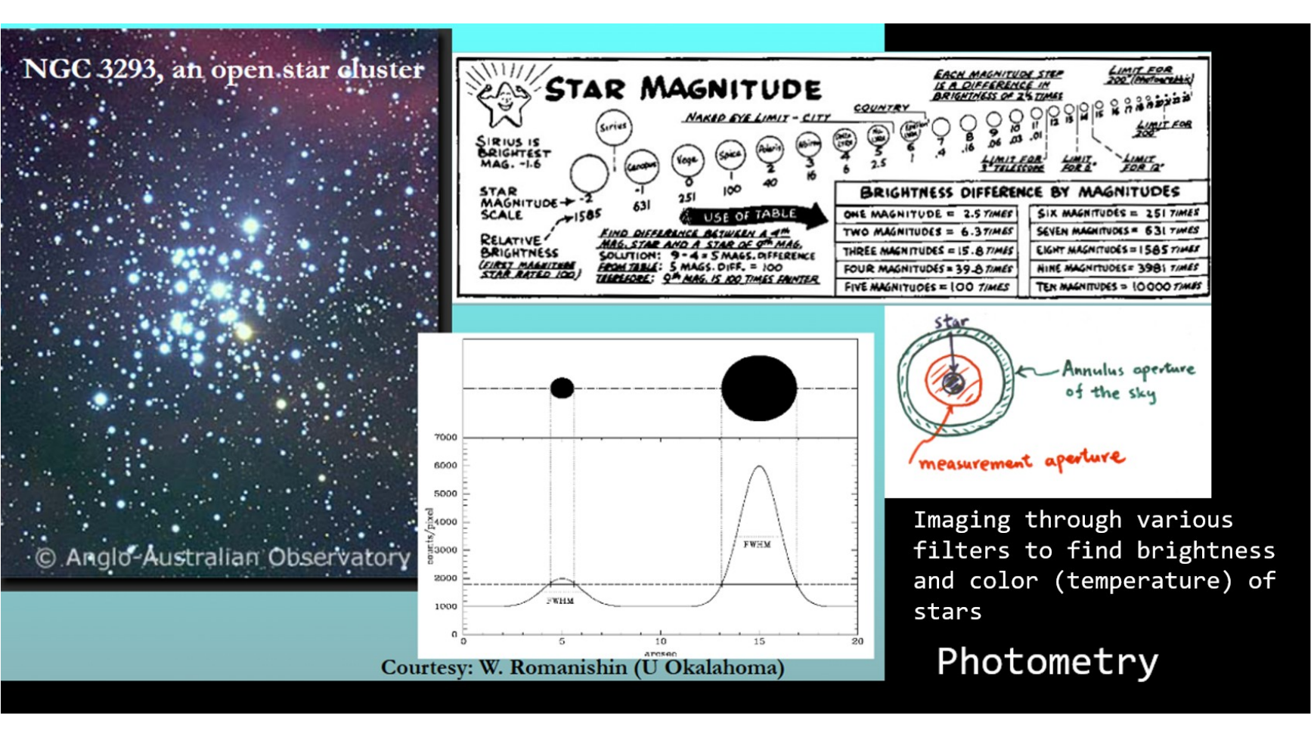
Photometry: brightness, filters, and measurement choices
Students learn that a magnitude or color is a measured quantity with aperture choices, uncertainties, and calibration assumptions.
PHYS 2550 / CREL Data Science for Physicists and Scientists

Slide 7
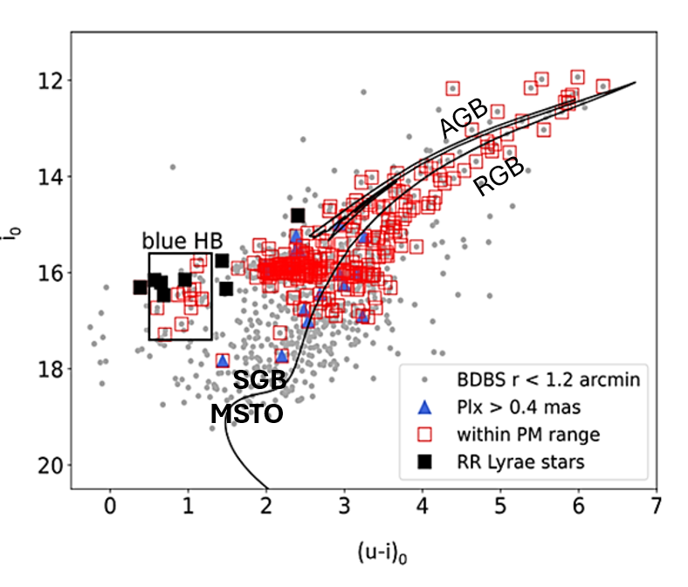
Color–magnitude diagrams as scientific maps
A visual entry point to stellar populations and sample selection
Use dereddened magnitudes and colors.
Identify RGB, AGB, horizontal branch, red clump, subgiant branch, and main-sequence turnoff regions.
Apply selection rules and explain what is included or excluded.
Connect visual structure to physical interpretation.
Brightness ~ Magnitude
Lab idea
Build a CMD from BDBS/Gaia-style data, add error cuts, mark selected targets, and write a paragraph explaining the sample.
Color ~ Temperature
PHYS 2550 / CREL Data Science for Physicists and Scientists

Slide 8
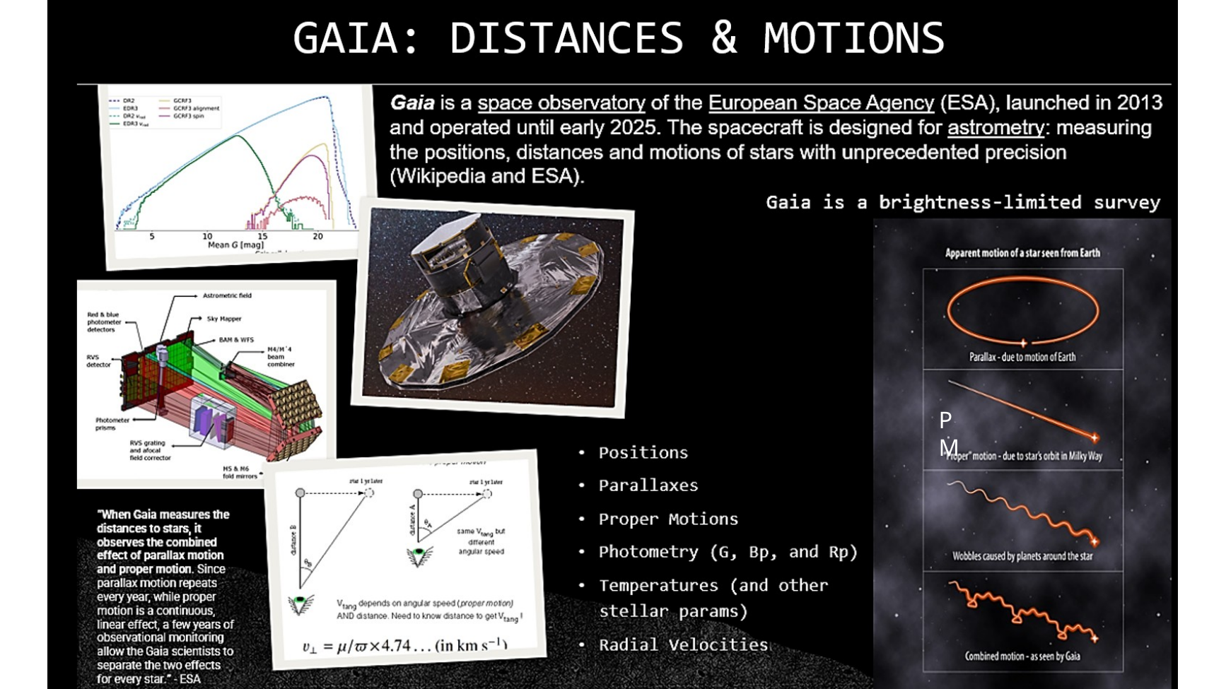
Astrometry: positions, parallax, and proper motion
Gaia-style data let students connect catalog quantities to distance, motion, membership, and selection effects.
PHYS 2550 / CREL Data Science for Physicists and Scientists

Slide 9
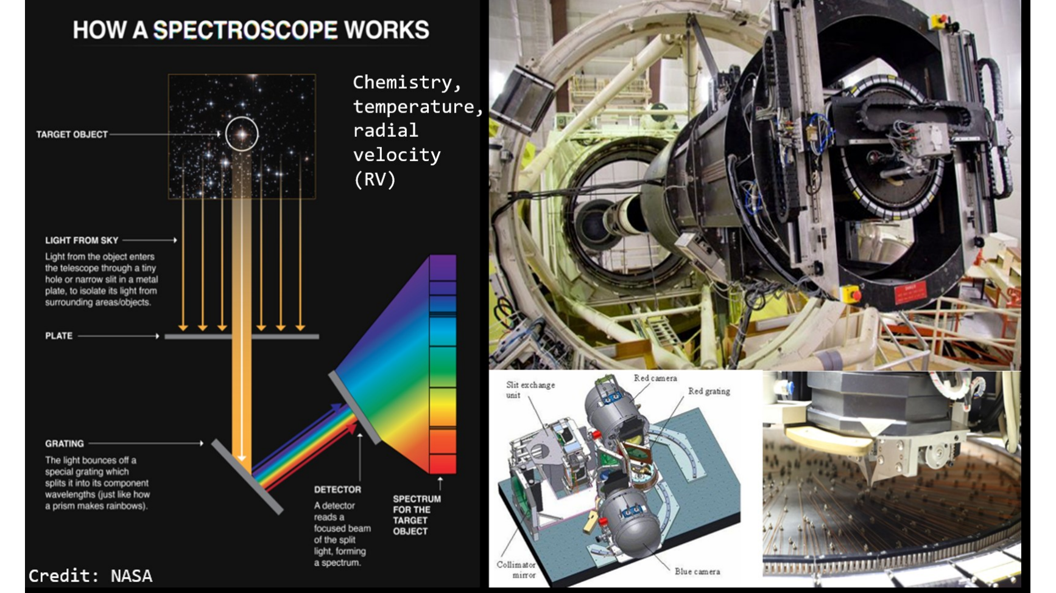
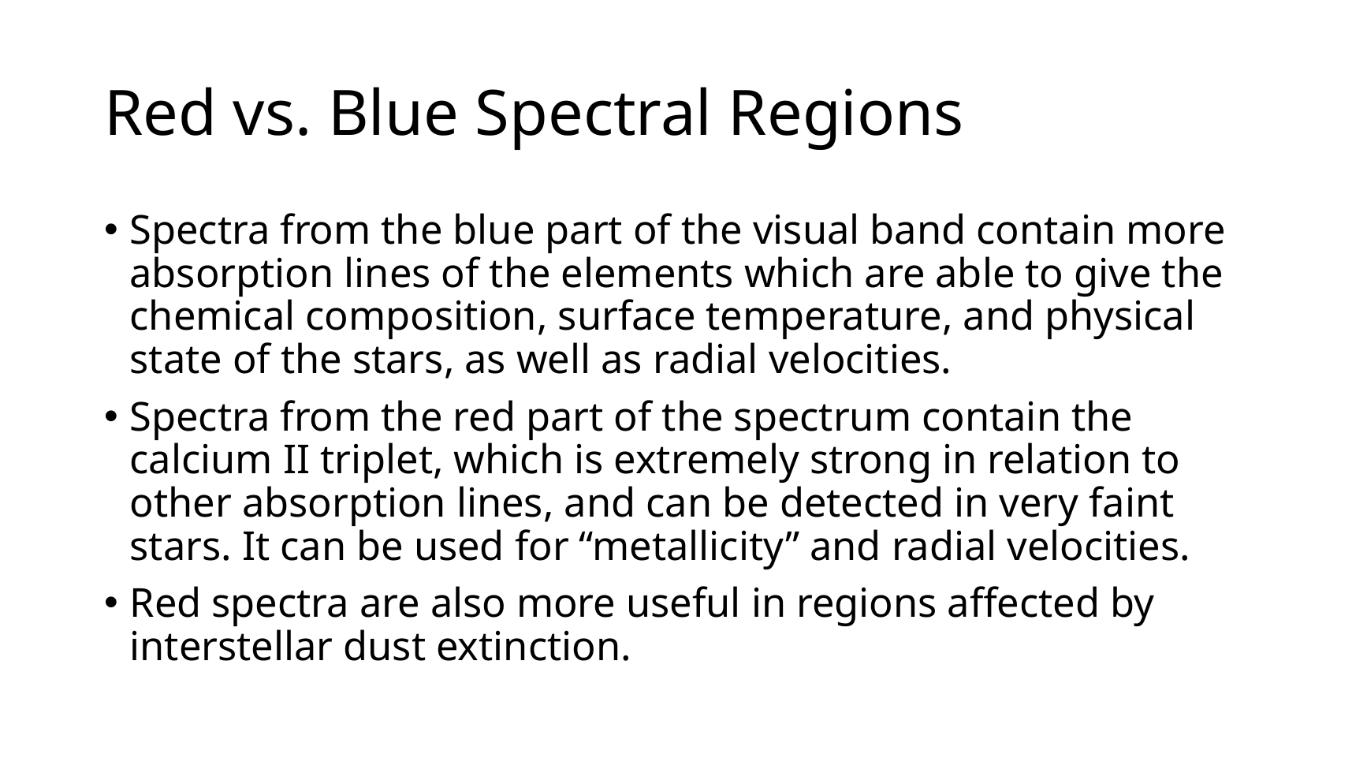
Spectroscopy turns light into physical information
Wavelength shifts and line strengths become radial velocities (RV) and chemical clues
Students compare blue and red spectral regions: rich blue spectra can constrain many parameters; the red Ca II triplet is powerful for faint, reddened stars.
PHYS 2550 / CREL Data Science for Physicists and Scientists

Slide 10
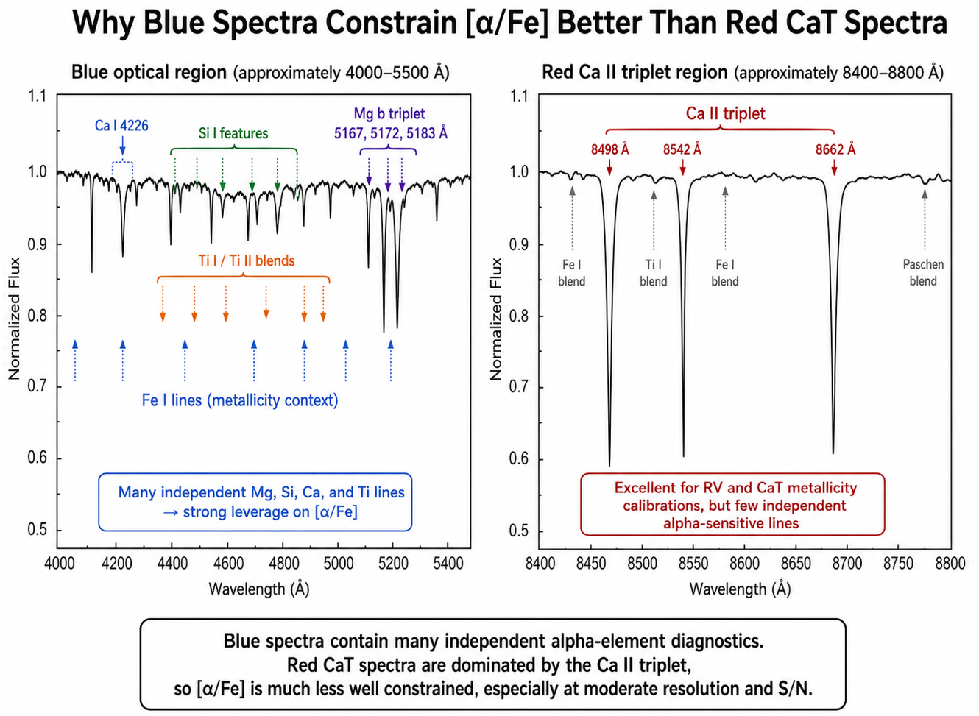

Slide 11
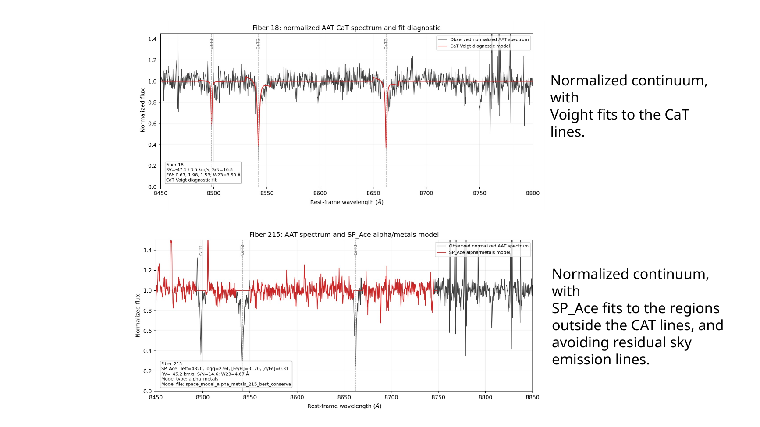
Spectral fitting diagnostics
The class can inspect normalized spectra, line-profile fits, SP_Ace/SPACE model regions, and sky-line residuals.
PHYS 2550 / CREL Data Science for Physicists and Scientists

Slide 12
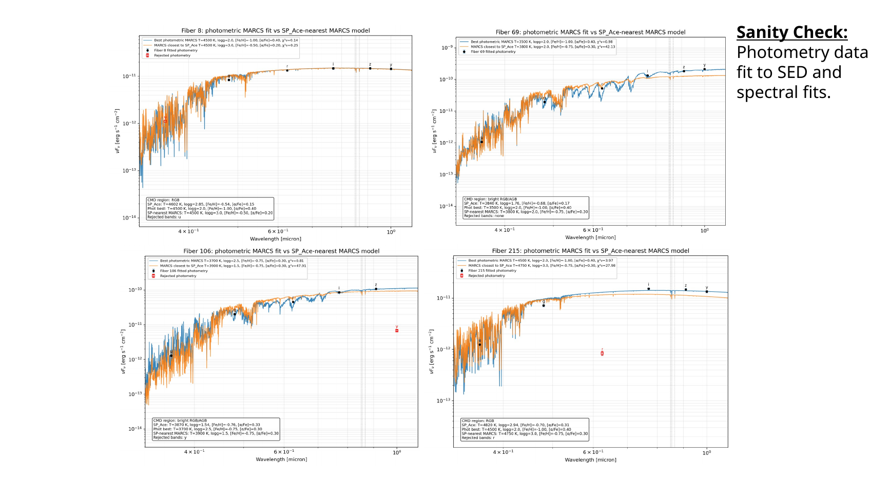
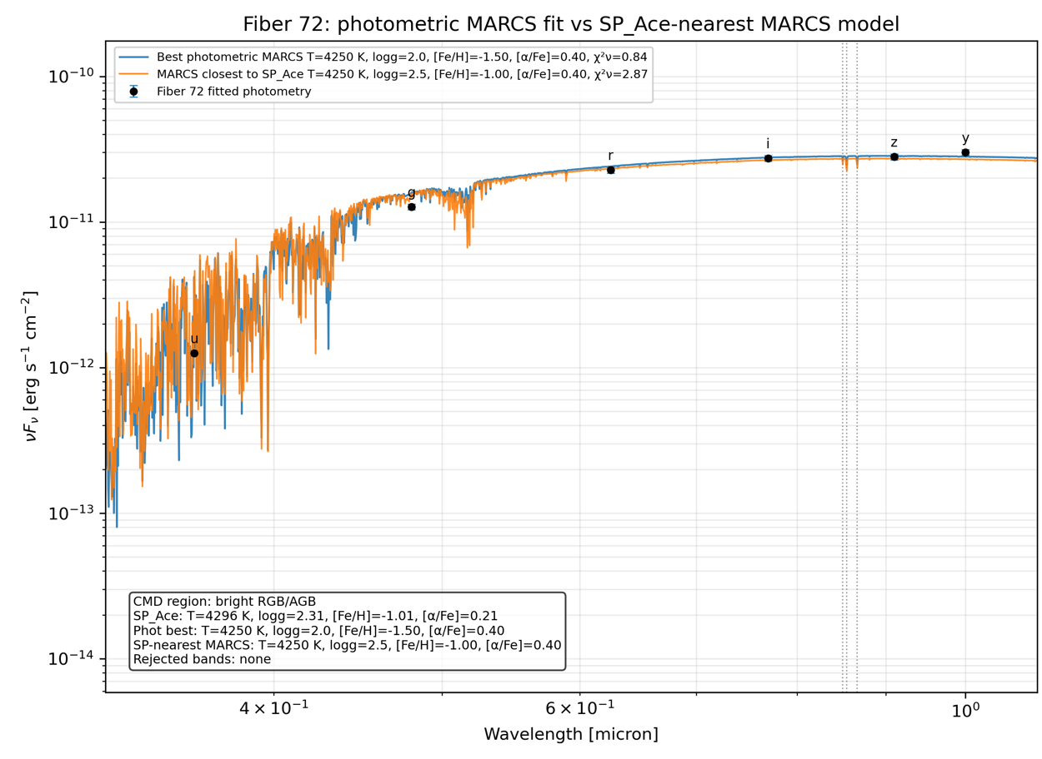
SED fitting as a physical sanity check
Photometry can test whether the spectroscopic solution is plausible
Students learn that SED disagreement is a caution flag, not an automatic rejection: RGB, AGB, and HB stars may be variable, and photometry may be non-simultaneous.
PHYS 2550 / CREL Data Science for Physicists and Scientists

Slide 13
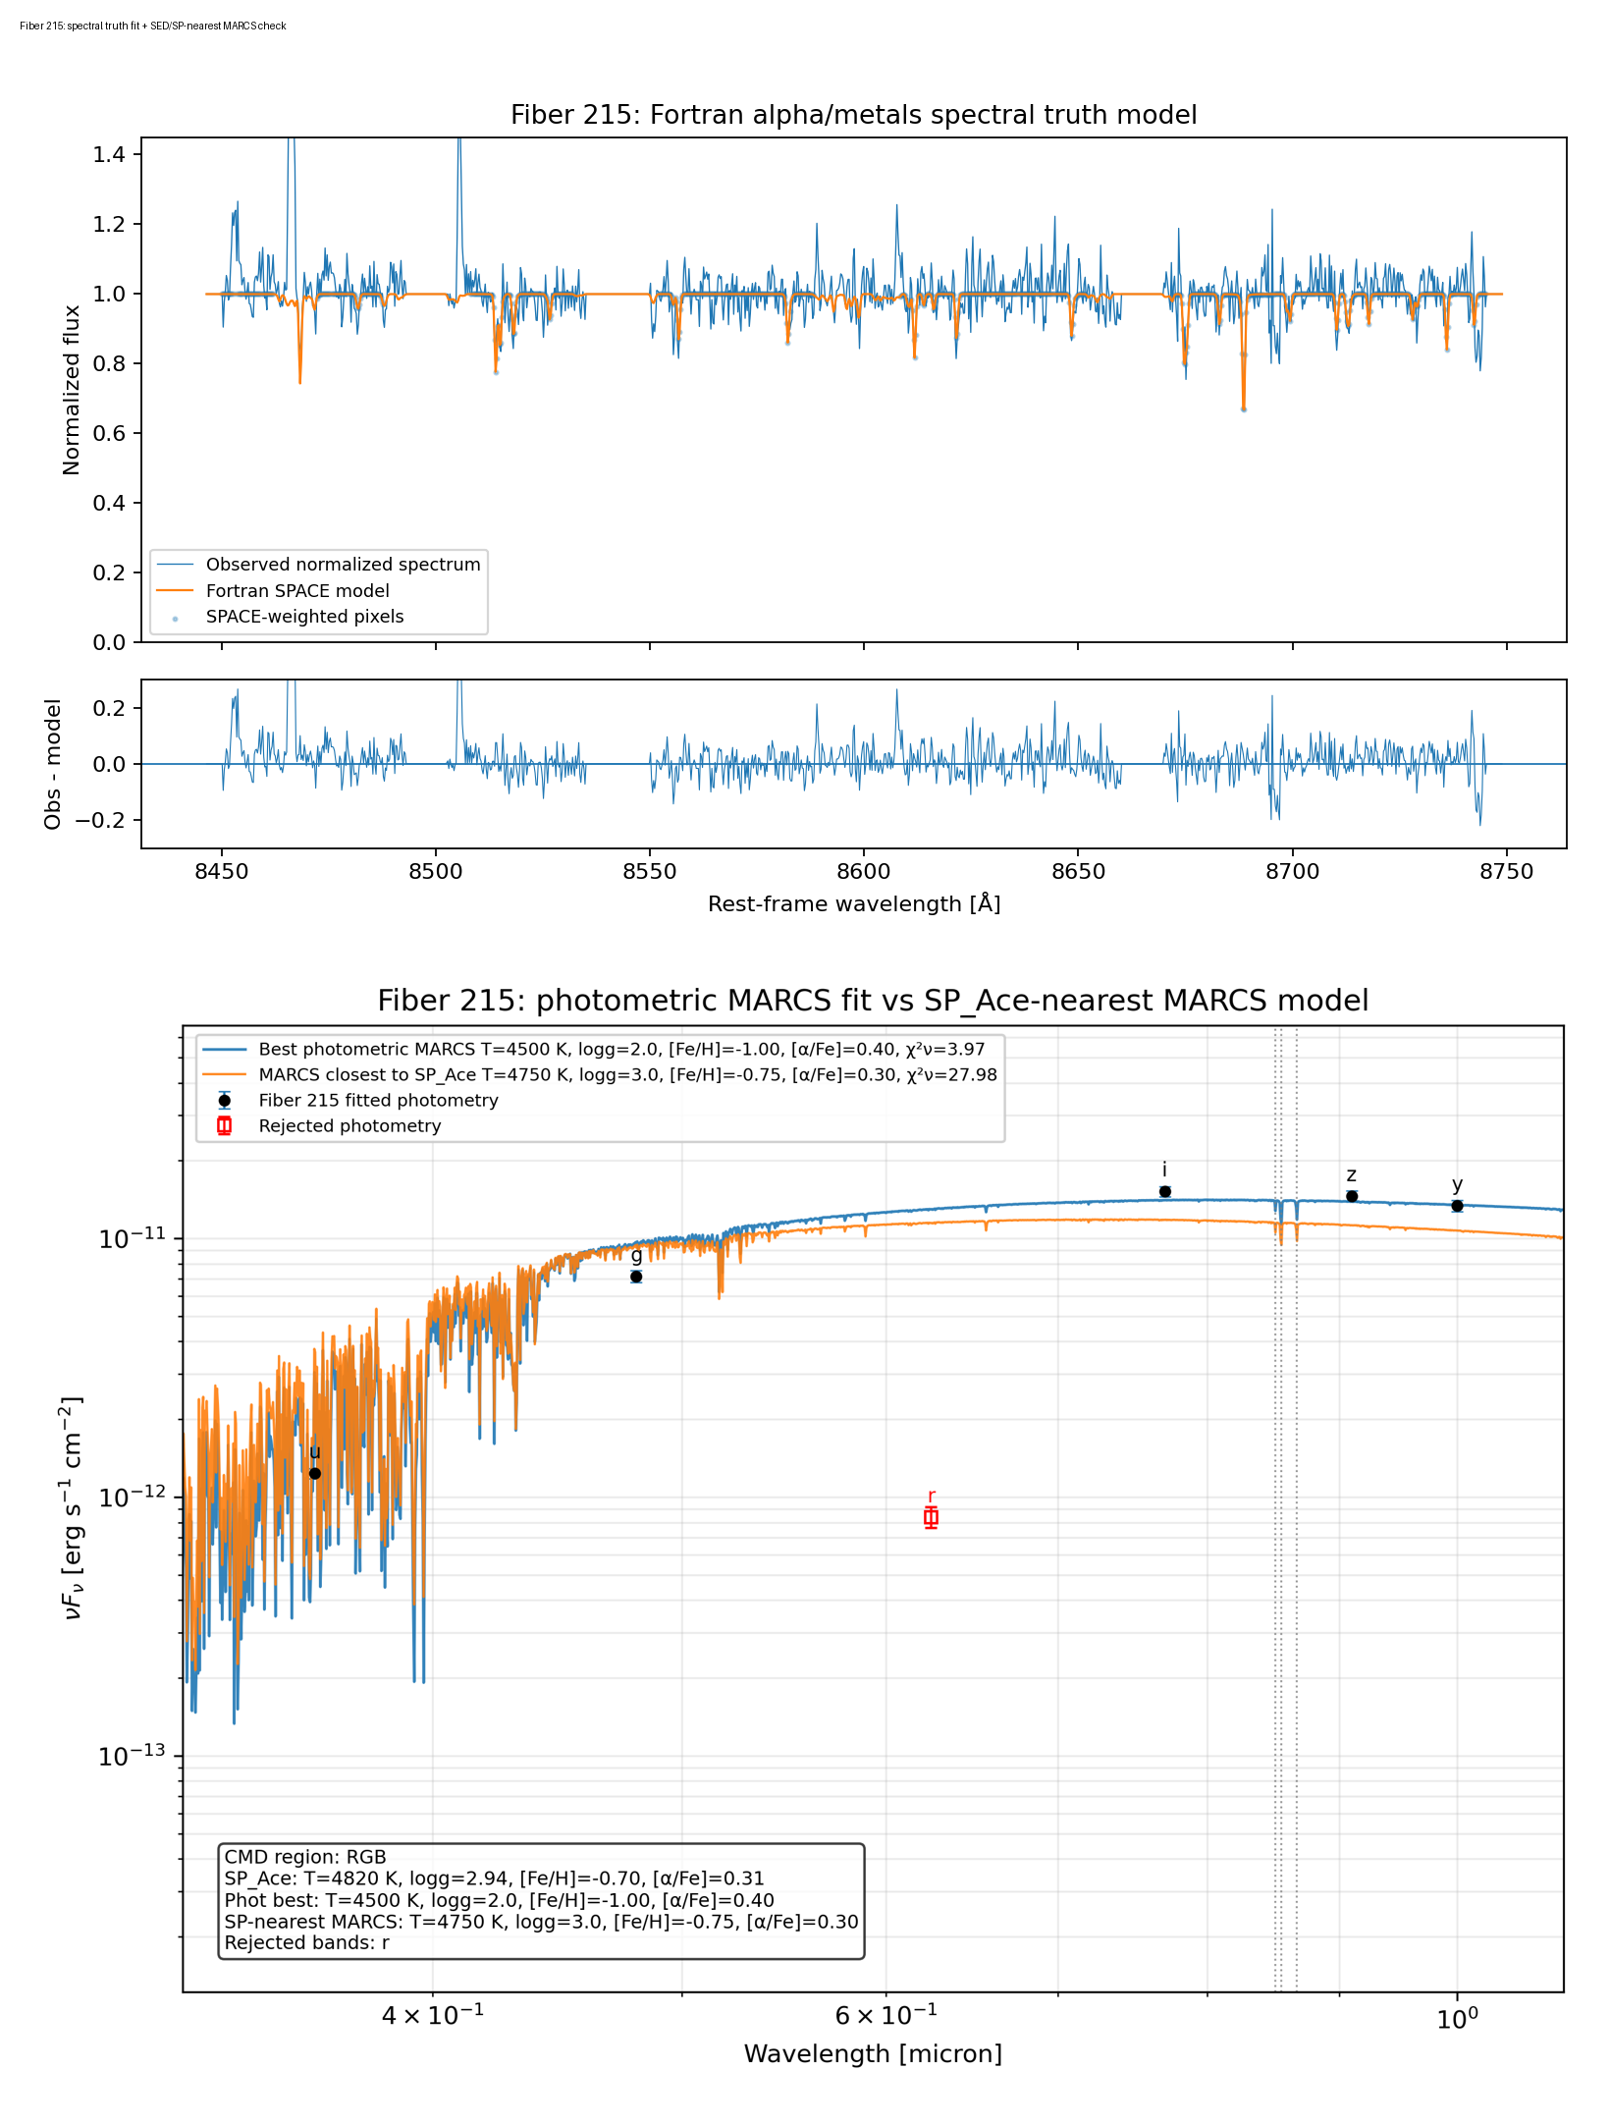
Integrated diagnostic plot: spectra + SED
The target style for student quality-control plots
Top: observed spectrum, model, and residuals.
Bottom: dereddened photometry and MARCS SED model comparison.
Report flags when spectra, photometry, or abundance methods disagree.
Students learn to justify which quantity should be trusted for the final table.
Classroom rule
No single diagnostic wins by default. The final result is a best-practices judgment based on all available evidence.
PHYS 2550 / CREL Data Science for Physicists and Scientists

Slide 14
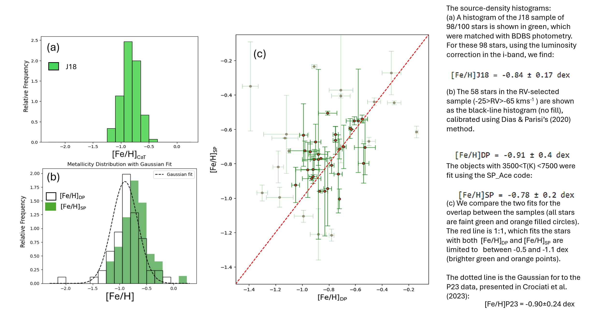
Metallicity checks and calibration
Students compare independent abundance estimates rather than trusting one method
Use CaT equivalent widths plus a luminosity correction to estimate [Fe/H].
Compare [Fe/H]DP with SP_Ace / SPACE spectral fits.
Use the 1:1 line, scatter, and error bars to decide whether methods agree.
Flag disagreements instead of hiding them.
Best-practice lesson
The final table should preserve multiple metallicity estimates, uncertainties, and quality flags so students can see how the adopted value was chosen.
PHYS 2550 / CREL Data Science for Physicists and Scientists

Slide 15
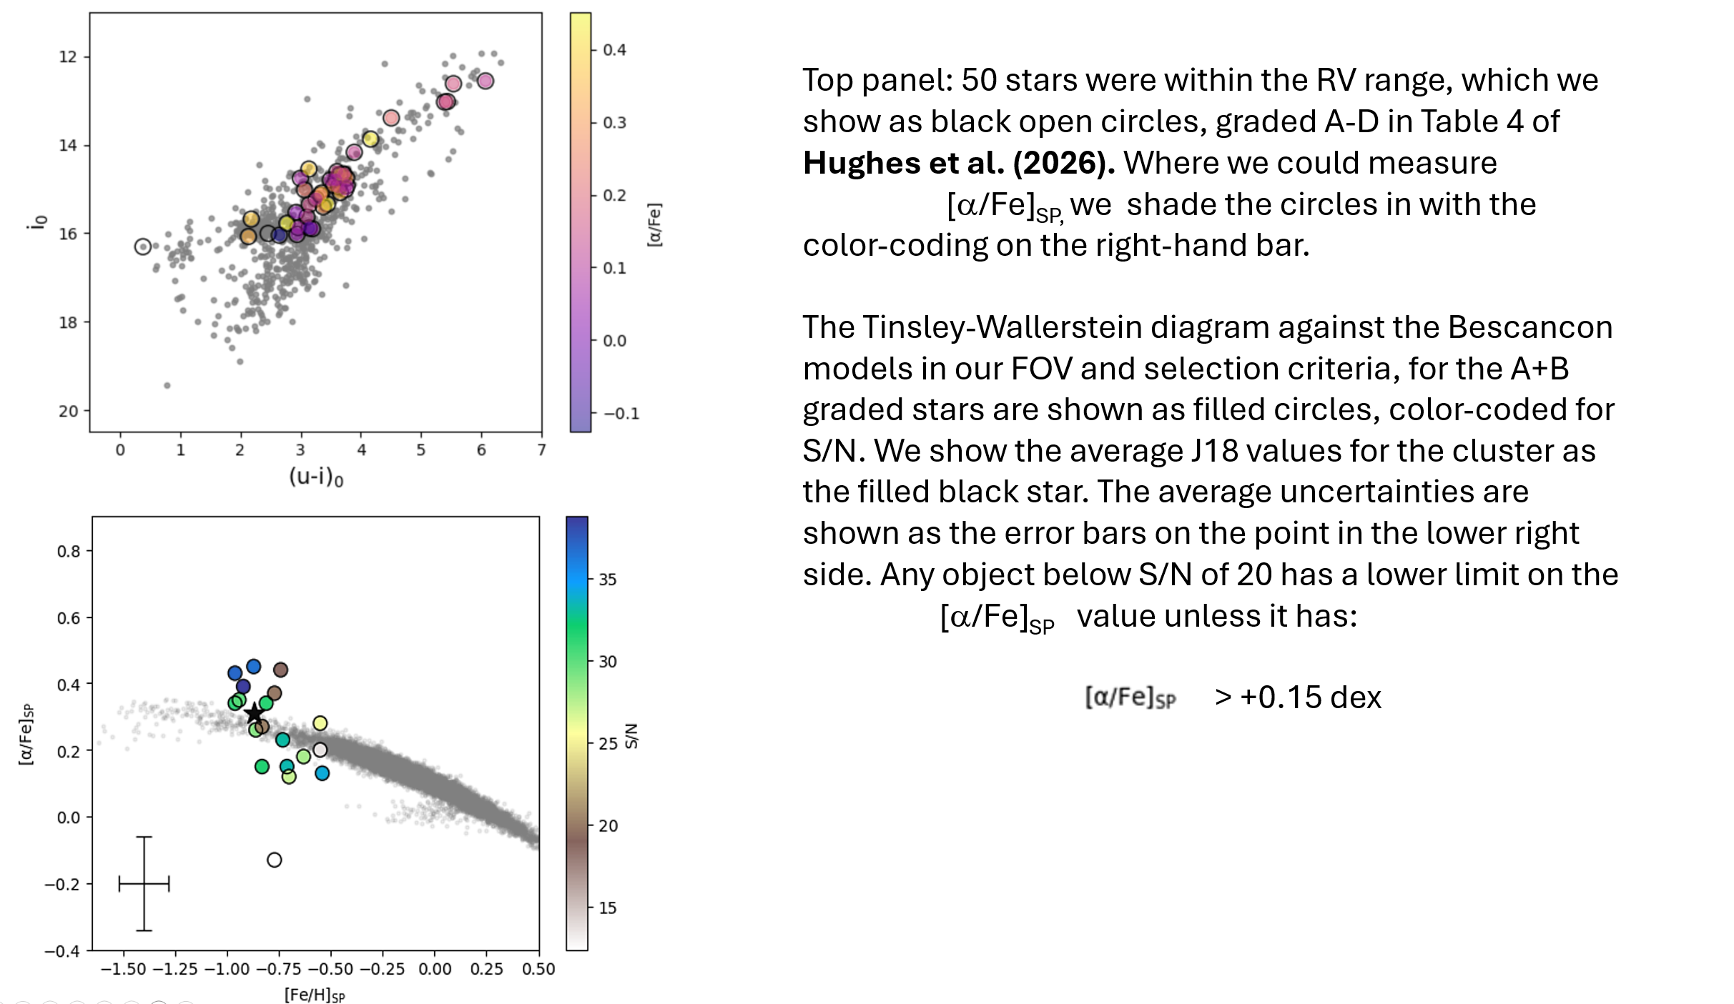
Chemical diagnostics and quality flags
Tinsley–Wallerstein-style diagrams provide a natural place to discuss abundance ratios, signal-to-noise, and selection bias.
PHYS 2550 / CREL Data Science for Physicists and Scientists

Slide 16
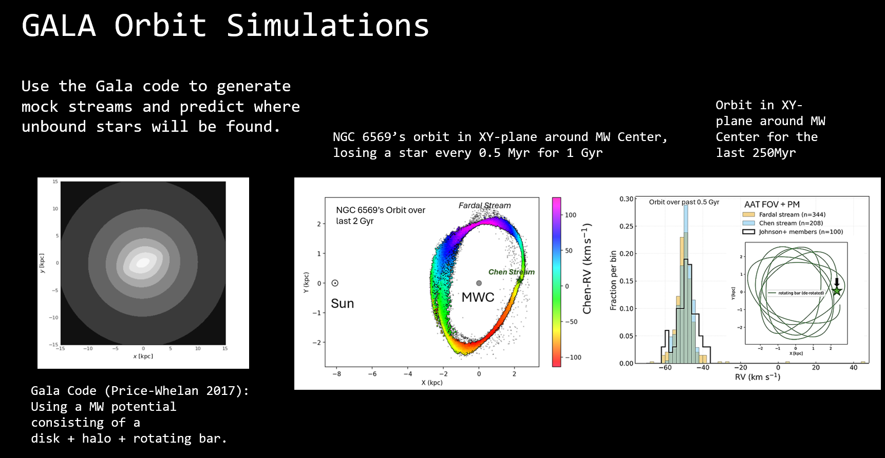
PHYS 2550 / CREL Data Science for Physicists and Scientists

Slide 17
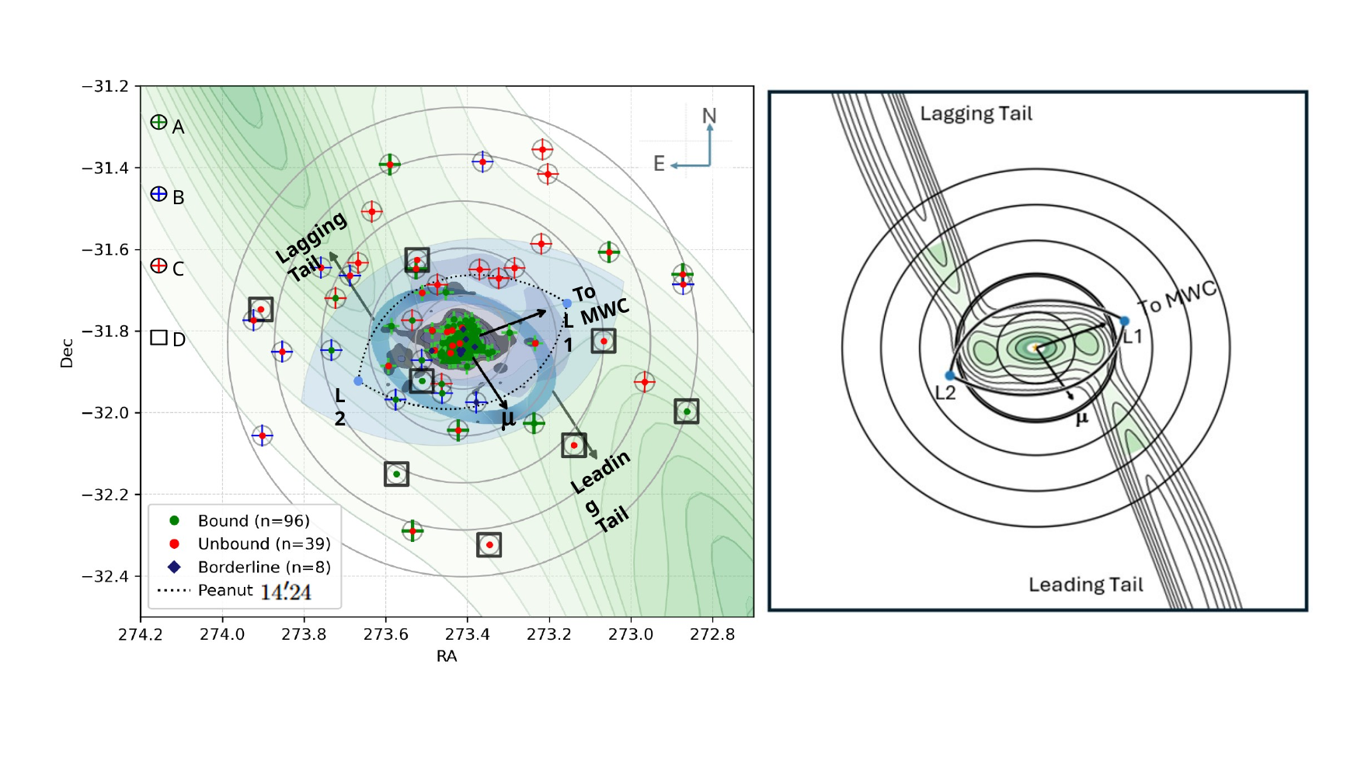
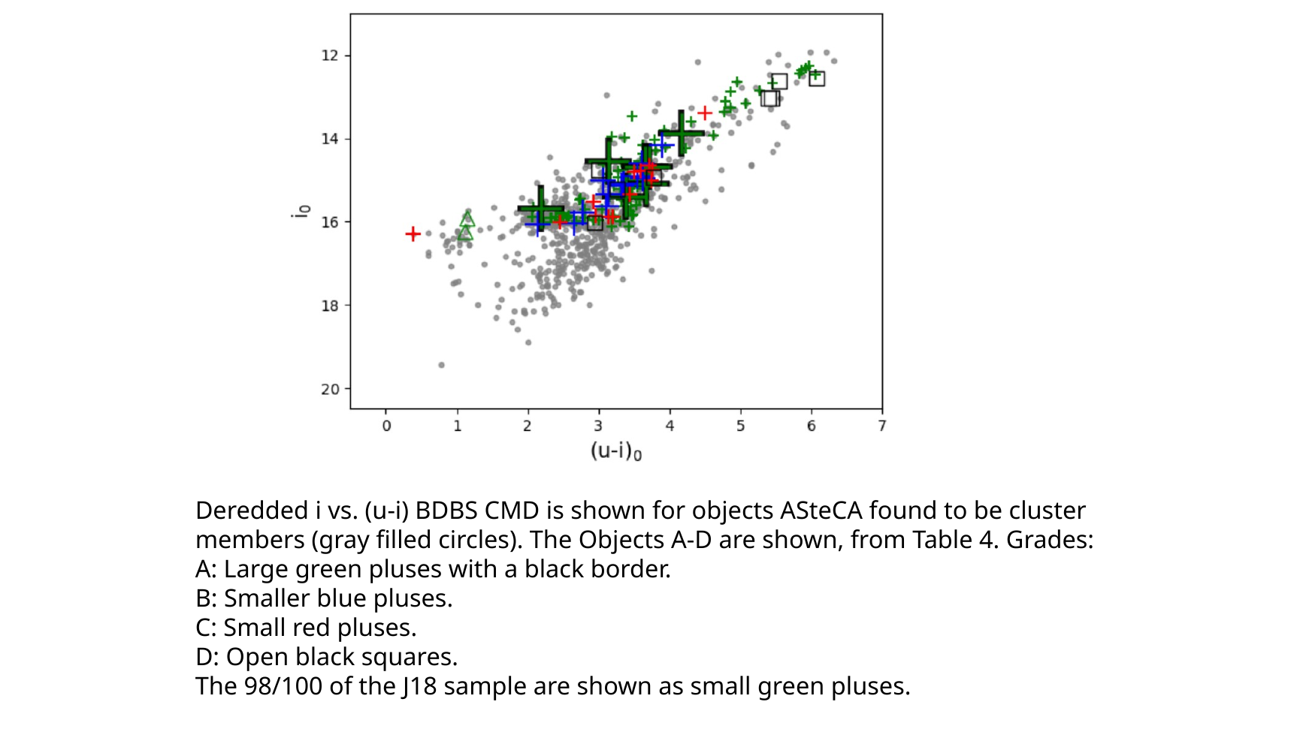
Spatial context: from measurements to interpretation
Advanced examples motivate why the lower-level skills matter
Students at the 2000 level do not need to run full dynamical models, but they can understand how clean data products support larger scientific interpretations.
PHYS 2550 / CREL Data Science for Physicists and Scientists

Slide 18
Ten-week course map
A quarter-long 2000-level implementation
Week 1: Data, notebooks, reproducibility
Week 6: Spectra or light curves
Week 2: Measurement, units, uncertainty
Week 7: Catalog matching and selection
Week 3: Cleaning, flags, outliers
Week 8: Intro ML: classification / clustering
Week 4: Visualization and CMDs
Week 9: Mini-pipeline work session
Week 5: Model fitting and residuals
Week 10: Presentations and reporting
Each week produces a notebook artifact: a plot, a fit, a quality check, or a short written interpretation.
PHYS 2550 / CREL Data Science for Physicists and Scientists

Slide 19
Assessment and responsible AI use
Deliverables make scientific reasoning visible
Weekly labs — 40%
Notebook exercises with plots, code, short interpretations, and verification checks.
AI-generated code must be run and tested.
Students must document meaningful AI use.
Plots, residuals, and simple sanity checks are required evidence.
Students explain the scientific reasoning in their own words.
Midterm data-analysis assignment — 20%
A guided analysis that combines cleaning, plotting, fitting, and residual interpretation.
Final project — 30%
A reproducible notebook, summary table, diagnostic plots, short report, and presentation.
Participation and AI logs — 10%
Peer review, code review, and documentation of AI-assisted coding or explanation.
Long-term growth
This lower-level course can seed a later 4xxx/5xxx astrophysics data-science course with more advanced statistics, machine learning, and large-scale surveys.
PHYS 2550 / CREL Data Science for Physicists and Scientists

