Slide 1
Weather Vibes
A 7-Day Forecast You Can Actually Feel
Kerry Basham
End-to-End Data Engineering Project
MSBA-692 Pipelines to Insights
Louisville, KY | Open-Meteo API | Python + SQLite + Power BI
Notes:
Good morning. My name is Kerry Basham, and this is Weather Vibes — a 7-day forecast you can actually feel.
Over the next five minutes I will walk you through an end-to-end data engineering project that takes raw weather numbers and turns them into something people can actually use.

Slide 2
The Business Problem
The Gap
The Solution
Weather apps give you numbers.
They tell you it is 87°F.
They do not tell you what to do about it.
What should I wear today?
Is this a stay-in day or a go-outside day?
How bad is this week actually going to be?
Weather Vibes translates raw forecast data into 11 human-scale categories that answer those questions directly.
Each vibe comes with an outfit recommendation, an accessory callout, and a plain-language description of the day.
😎 Main Character
Energy
🥵 Offensively
Hot
🌧️ Lo-Fi
Chill Day
⛈️ Dramatic
Weather Era
Notes:
Here is the problem. Weather apps give you numbers. They tell you it is 87 degrees. They do not tell you what to do about that.
What should I wear? Is this a stay-in day or a go-outside day? How bad is this week actually going to be?
Weather Vibes answers those questions directly. It translates raw forecast data into 11 human-scale categories called vibes — each one paired with a description, an outfit recommendation, and an accessory callout.
You can see four of those vibes at the bottom of the slide. Main Character Energy, Offensively Hot, Lo-Fi Chill Day, Dramatic Weather Era. These are not just labels — they are actionable daily decisions.

Slide 3
Data Source
Open-Meteo API
6 Variables Extracted
open-meteo.com
01 apparent_temperature_max
No API key required
Fully open and free
02 apparent_temperature_min
Endpoint
api.open-meteo.com/v1/forecast
Location
Louisville, KY (38.25°N, 85.76°W)
03 precipitation_sum
Forecast window
7-day rolling daily forecast
04 precipitation_hours
Units
Fahrenheit, mph, inches
05 wind_speed_10m_max
Timezone
Auto-detected (America/Louisville)
06 weather_code
License
CC BY 4.0 — open for academic use
(extracted but not used in vibe logic)
Notes:
The data comes from the Open-Meteo API — a free, open weather service that requires no API key.
We pull a 7-day daily forecast for Louisville, Kentucky. Six variables per day: apparent temperature max and min, precipitation sum in inches and hours, and then the max wind speed.
We use apparent temp rather than actual temp because it includes humidity and wind speed which we can and does alter what it feels like outside.
Also, notice we pull precipitation hours in addition to total inches. That is intentional. Three hours of light drizzle affects your day very differently than 30 minutes of heavy rain — and our vibe logic uses both signals to get the classification right.
The pipeline uses 5-retry logic and a one-hour response cache to handle any transient API issues.

Slide 4
Pipeline Architecture
01
Extract
02
Transform
03
Validate
04
Load
05
Export
Open-Meteo API
5-retry + 1hr cache
data/.cache
Cast, clean, round
Derive temp_range_f
Assign weather_vibe
7 quality checks
PASS/FAIL logging
Halts on failure
4-table SQLite
via SQLAlchemy
data/weather.db
5 CSV files
forecast_fits.csv
Primary PBI source
▶
▶
▶
▶
Single Python script — weather_vibes_app.py | All outputs written to data/ directory
11
7
7
4
5
Weather vibes
Rows per run
Quality checks
DB tables
CSV exports
Notes:
The entire ETL pipeline runs as a single Python script — five stages from start to finish.
Extract pulls the API data.
Transform cleans it, casts types, rounds temperatures to whole numbers, and derives two new metrics: temp range and the weather vibe label.
Validate runs seven named quality checks before anything touches the database. If any check fails the pipeline halts and logs a clear FAIL messages. So, nothing bad gets written.
Load writes a four-table normalized schema to SQLite.
Export produces five CSV files including forecast fits csv, which is the primary Power BI source.
The stats row at the bottom tells the story: 11 vibes, 7 rows per run, 7 quality checks, 4 database tables, 5 CSV exports.
One thing I want to emphasize here is that the design decision to have the entire ETL workflow in a single Python script rather than a distributed pipeline connected to Postgre or Supabase came from a point of practicality.
I work on a managed desktop and cannot install new applications, which ruled out a local Postgres instance. By the time Supabase was introduced in the course materials, I was already deep enough into this pipeline that rebuilding the database layer would have meant scrapping weeks of validated, working code.
That said, I want to be clear that this was an informed tradeoff, not a gap in understanding. In a production environment, I understand you would absolutely separate the ETL orchestration from the database layer. The SQLAlchemy connection in this pipeline is written so that migrating from SQLite to Postgres is a single line change -- just the connection string.
The schema, the loading logic, the validation framework — none of that changes. The architecture is production-ready in everything except the database backend. I did use Claude to help with portion of the project.
So, moving onto the database schema…

Slide 5
Database Schema
LAYER 1 — Normalized Database (weather.db)
weather_forecast
vibe_dimension
fit_recommendations
forecast_vibe
(bridge)
PK: forecast_id
PK: vibe_id
PK: fit_id
PK: FK: forecast_id
vibe_id, fit_id
date, temp max/min
precip, wind, vibe
vibe_name, description
parameters, emoji
vibe_name, fit
accessory, emoji
SQL JOIN
3 foreign keys
linking all tables
▼
LAYER 2 — Power BI Star Schema (forecast_fits.csv)
vibe_dimension — DIM
forecast_fits — FACT
fit_recommendations — DIM
PK: vibe_id
PK: forecast_fits_id
FK: vibe_id, fit_id
PK: fit_id
1:* vibe_id
1:* fit_id
11 rows — all vibes
7 rows — current forecast
11 rows — all fits
Notes:
The schema is designed in two layers, which reflects something we covered in this course.
Layer one is a normalized database in SQLite — four tables with primary and foreign key constraints: the forecast table, vibe dimension, fit recommendations, and a bridge table connecting them all.
Layer two is what Power BI actually uses — a flat denormalized export called forecast fits. This is a SQL join of all three main tables, scoped to only the seven current forecast days, with explicit primary and foreign key columns so the star schema relationships are unambiguous.
The bottom half of this slide shows what Power BI sees: forecast fits as the central fact table, with vibe dimension and fit recommendations as the two dimension tables hanging off it.

Slide 6
ETL and Validation
Vibe Classification Engine
7 Data Quality Checks
11 vibes | Dominance-first logic | 4 inputs
Pipeline halts and logs FAIL if any check fails
→ apparent_temperature_max
1
Null check
No NaN values after cleaning
→ precipitation_sum
2
Duplicate dates
All 7 dates are unique
→ precipitation_hours (2nd rain signal)
3
Row count
Exactly 7 rows expected
→ wind_speed_10m_max
4
Temp range
-50F to 130F bounds check
Meaningful rain = precip >= 0.10 in OR hours >= 2
Dominant condition wins — strongest vibe first
5
Precipitation
No negative values
6
Schema / dtypes
int64 temps, float64 precip/wind
⛈️ Dramatic Weather Era
🌧️🥵 Hot Mess Express
7
Vibe completeness
Every row has a vibe label
😎 Main Character Energy
Notes:
The vibe classification engine uses dominance-first logic with four inputs. The strongest weather condition wins. Heavy rain plus strong wind is always Dramatic Weather Era regardless of temperature.
One detail worth calling out: we use precipitation hours as a second rain signal in addition to total inches. Meaningful rain is defined as either 0.10 inches OR two or more hours of precipitation. That dual-signal approach makes the classification significantly more accurate. When adding this into the logic, we went from ‘Existential Meh’ vibe being the catch all for the parameters that did not fit into the other vibes to adding a new vibe called ‘Hot Mess Express’.
On the validation side, the pipeline runs seven named checks before any data is written. You can see them listed here — null check, duplicate detection, row count, temperature range, precipitation bounds, schema dtypes, and vibe completeness.
Every check logs either PASS or FAIL with detail. If anything fails the pipeline raises an error and stops. No silent failures, no bad data getting written to the database.

Slide 7
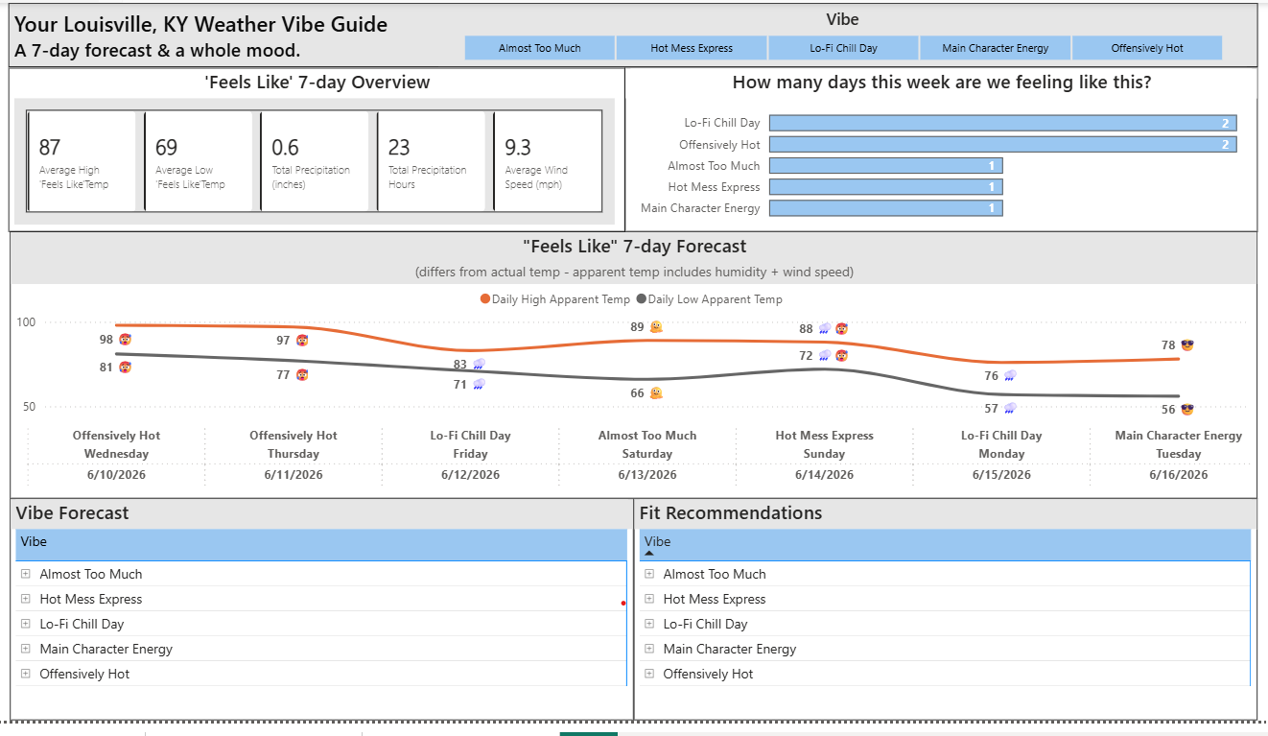
Dashboard Demonstration
Power BI Dashboard — Louisville, KY 7-Day Weather Vibe Guide
Live demo — Power BI dashboard filtering by vibe in real time
Notes:
This slide gives you the view of the Power BI dashboard
At the top you have five KPI cards — average high and low feels like temp, total precipitation by inches and hours, and then the average wind speed for the week.
The bar chart on the right shows how many days fall into each vibe category this week.
The line chart shows seven days of daily highs and lows with the vibe emoji at each data point so you can see the conditions at a glance.
The Vibe Forecast matrix shows the description and trigger parameters for each day. The Fit Recommendations matrix shows the outfit and accessory for each vibe.

Slide 8
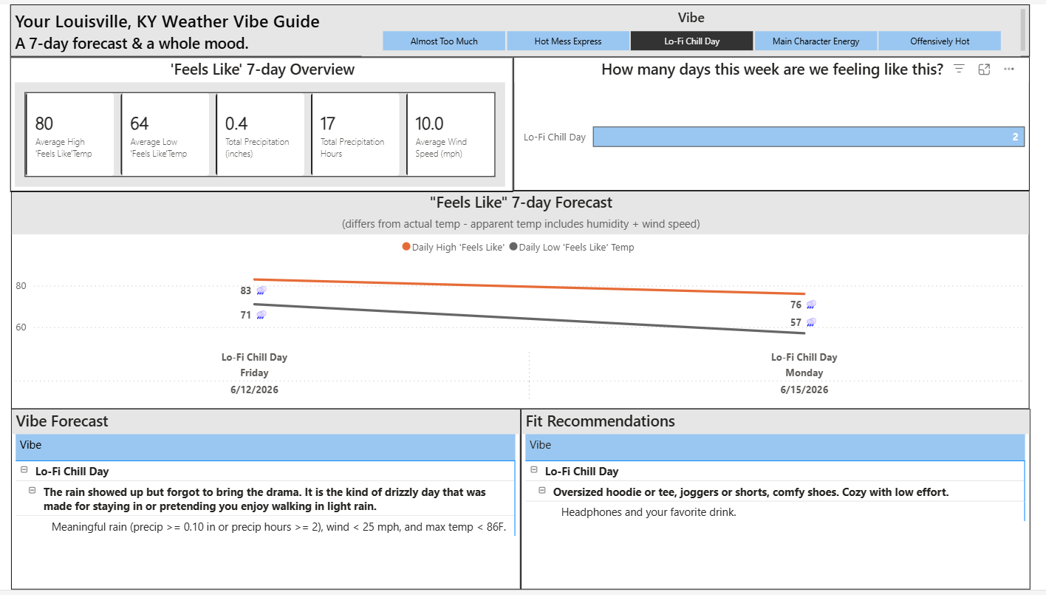
Notes:
And here is where it gets interactive. When I filter to just Lo-Fi Chill Day, every visual updates.
the KPI cards, the chart, the matrices, all scoped to just the vibe.

Slide 9

Notes:
Here we see more weather vibes that could be a part of a ‘Feels Like’ forecast.
For example, when a forecast includes apparent temperatures where it feels like 35 or colder, you would see the vibe: ‘Just Let It Go Day’
This vibe is described as cold and blustery with something to prove and includes a fit recommendation of a puffer jacket, thermal underwear, and a beany. It also includes recommending accessorizing with gloves and hand warmers.

Slide 10
Key Insights and Business Value
🌡️ Temperature is only half the story
🌧️ Precipitation hours matter as much as total rain
The temp_range_f metric reveals daily volatility — a 77°F day with a 30°F swing requires a very different wardrobe than one with a 10°F swing.
A day with 0.08 in of rain over 3 hours is more disruptive than 0.15 in over 30 minutes. The dual-signal approach makes vibe classification significantly more accurate.
🥵 86°F with rain is nothing like 65°F with rain
📊 Vibes make forecasts actionable
The Hot Mess Express vibe closed a real gap — high-humidity hot rainy days were previously misclassified as Lo-Fi Chill Days until a temperature ceiling was added.
Translating 7 days of numeric data into 11 labeled categories enables filtering, comparison, and planning that raw temperature data cannot support on its own.
Notes:
Four insights I want to leave you with.
First — temperature is only half the story. The temp range metric we derived shows daily volatility. A 77-degree day with a 30-degree swing requires a very different wardrobe than one with a 10-degree swing.
Second — precipitation hours matter as much as total rain. The dual-signal approach is what makes this project more than just a basic weather lookup.
Third — 86 degrees with rain is nothing like 65 degrees with rain. The Hot Mess Express vibe closed a real classification gap that existed in earlier versions of this pipeline.
And fourth — vibes make forecasts actionable. Translating seven days of numeric data into 11 labeled categories enables filtering, comparison, and daily decision-making that raw numbers simply cannot support.

Slide 11
Challenges and Lessons Learned
Vibe logic gaps
86-89°F rainy days were falling through to Existential Meh. Adding temperature ceilings to rain-based vibes and a dedicated Hot Mess Express vibe fixed the classification accurately.
Schema evolution
The project grew from 3 tables to 4, then added a flat star schema export layer. Planning the two-layer approach from the start would have saved iteration time.
Data type consistency
The Open-Meteo API returns float32 by default. Standardizing to float64 early in the transform stage prevented unexpected schema validation failures downstream.
Pipeline as documentation
Investing in structured logging, named validation checks, and detailed docstrings made the 700-line script readable to anyone — including a professor who does not audit every line.
Kerry Basham | MSBA-692 Pipelines to Insights | End-to-End Data Engineering Project
Notes:
Here is what surprised me along the way or what I would do differently:
First — vibe logic gaps. An 87-degree rainy day was being labeled Existential Meh in early versions because there was no temperature ceiling on the rain-based vibes. That fix taught me that edge cases in classification logic surface through real data, not theory.
Second — schema evolution. The project grew from three tables to four, then I added a flat star schema export layer on top. Planning both layers from day one would have saved significant rework.
Third — data type consistency. The Open-Meteo API returns float32. Standardizing to float64 early in the transform stage prevented downstream validation failures that were initially confusing to debug.
And Fourth – Pipeline as documentation - Investing in structured logging, named validation checks, and detailed docstrings made the 700-line script readable to anyone — including a professor who does not audit every line.
I want to thank you for listening to my presentation, again my name is Kerry Basham . I did the best I could in this course as online student. Please feel free to reach out to me with any questions. And remember, your internal vibe is what matters most. May it shine, no matter what the vibe is outside.

