Slide 1

Data Cleansing
Feature Selecting
Cross Section Analysis
Correlation Analysis
Model Fitting
Predicting

Slide 2
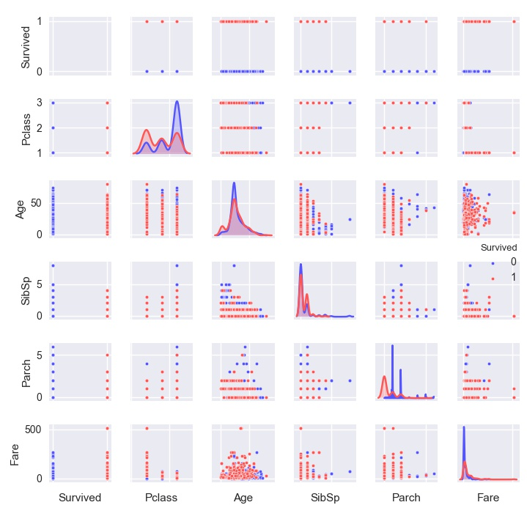

Slide 3
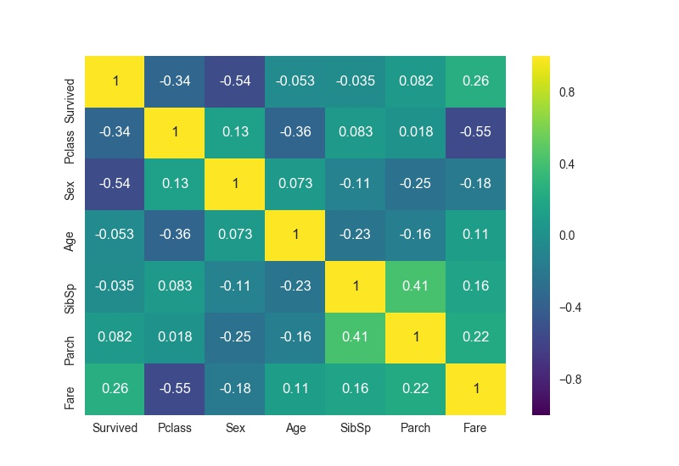

Slide 4

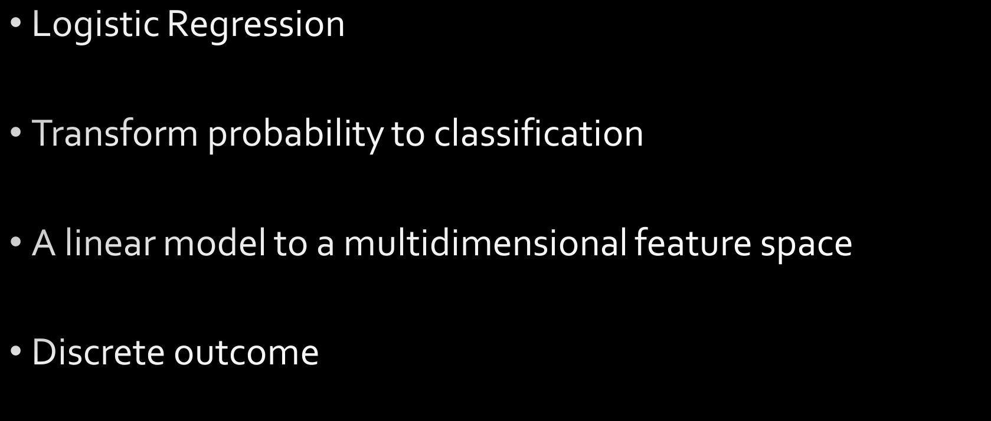

Slide 5

PassengerId | Pclass | Name | Sex | Age | SibSp | Parch | predict_survival
892 | 3 | Kelly, Mr. James | 1 | 34.5 | 0 | 0 | 0
893 | 3 | Wilkes, Mrs. James (Ellen Needs) | 0 | 47 | 1 | 0 | 0
894 | 2 | Myles, Mr. Thomas Francis | 1 | 62 | 0 | 0 | 0
895 | 3 | Wirz, Mr. Albert | 1 | 27 | 0 | 0 | 0
896 | 3 | Hirvonen, Mrs. Alexander (Helga E Lindqvist) | 0 | 22 | 1 | 1 | 1
897 | 3 | Svensson, Mr. Johan Cervin | 1 | 14 | 0 | 0 | 0
898 | 3 | Connolly, Miss. Kate | 0 | 30 | 0 | 0 | 1

