Slide 1

Galaxy Garage
Group 2

Slide 2
What Do We Do?
We are developing a fully autonomous parking garage for the modern world.
Customers will be able to make a reservation for a parking spot days in advance from our optimized website.
For simplicity, the customer will be assigned a QR code for their reservation that they will scan to gain entrance to the garage.
When pulling into our garage, the customer will be directed to their parking spot through our automated system in place in our garage.
Paying is a breeze with our in app billing method. Customers will be able to pay for their stay inside of our web application at their convenience.

Slide 3
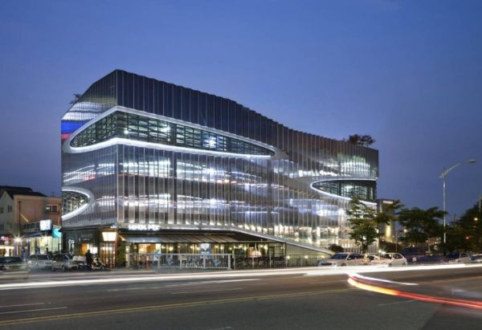
Who is This For?
This system is for parking garage owners looking to upgrade or build their garage with modern 21st technologies.
Though this system, garage owners will be able to monitor all aspect of their investment.

Slide 4



Target User Base
Target Customers:
Commuters
Local Residents
Tourists/Day Travelers

Slide 5
User Interface

Slide 6

Live Demonstration

