Slide 1

Maker Space
Kyler Kershaw
Daniel Bigler
Marcus Mitchell
Jessica Prater

Slide 2
What is the program?
The program will be a working login page.

Slide 3
What does the program do?
The overall program at the end will be the full working systems needed for a maker space to function.
Inventory management, scheduling and booking, logins, newsletters, admin access.

Slide 4
Who's the program for?
It will be aimed towards creatives in the STEM fields looking to further their projects who may not be able to afford the things needed to continue working on their own.

Slide 5
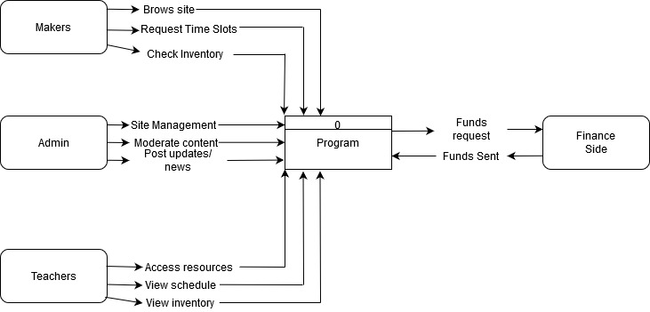
Context diagram

Slide 6
Diagram zero

Slide 7
Wireframe

Slide 8
User Manuel

Slide 9
Data dictionary

Slide 10
Source code

Slide 11
Additional Notes

Slide 12
Q&A
Questions?

