Slide 1

Maker Space
Kyler Kershaw
Daniel Bigler
Marcus Mitchell
Jessica Prater

Slide 2
What is the program?
The program will be a working login page.

Slide 3
What does the program do?
The overall program at the end will be the full working systems needed for a maker space to function.
Inventory management, scheduling and booking, logins, newsletters, admin access.

Slide 4
Who's the program for?
It will be aimed towards creatives in the STEM fields looking to further their projects who may not be able to afford the things needed to continue working on their own.

Slide 5
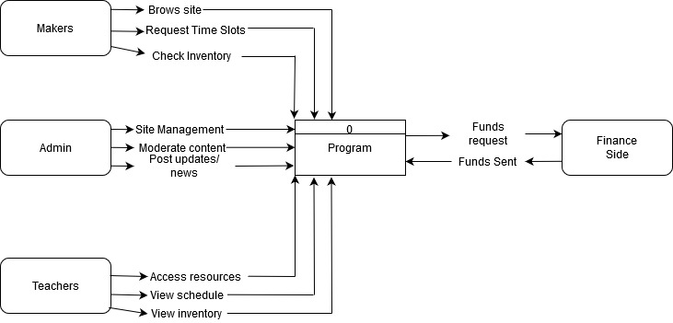
Context diagram

Slide 6
Diagram zero

Slide 7
Wireframe
The wire is going to a blue print of the website and how it malfunctions through different programs
Flask is being used as a behind the scenes source in order for everything to work correctly

Slide 8
What is Makerspace
Makerspace is a collaborative work space inside schools, libraries, or even separate public/private facility for making, learning, exploring and sharing that uses high tech to no tech tools.
Makerspaces provide hands-on, creative ways to encourage students to design, experiment, build and invent as they deeply engage in science, engineering and tinkering.
A makerspace is not solely a science lab, woodshop, computer lab or art room, but it may contain elements found in all of these familiar spaces.

Slide 9
Possible future additions to code
Scheduling spaces and materials
Subscriptions so you don’t have to pay each time you walk in
View available and scheduled spaces and materials, can also be used when restocking

Slide 10
Front End
Responsible for designing a making the website look presentable
Having login forms and making it available for customers to sign up and make accounts

Slide 11
What we’re using
Python
Flask
SQLite
Bootstrap/ HTML

Slide 12
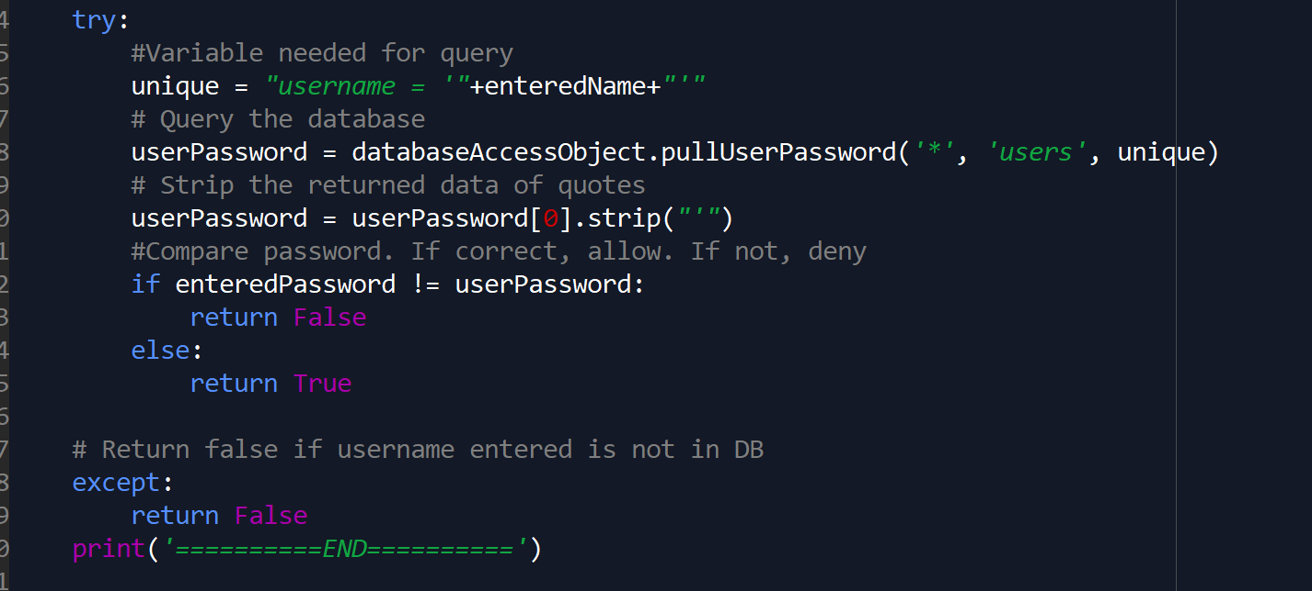
Python
Used for logic and processing
Pass information back and forth

Slide 13
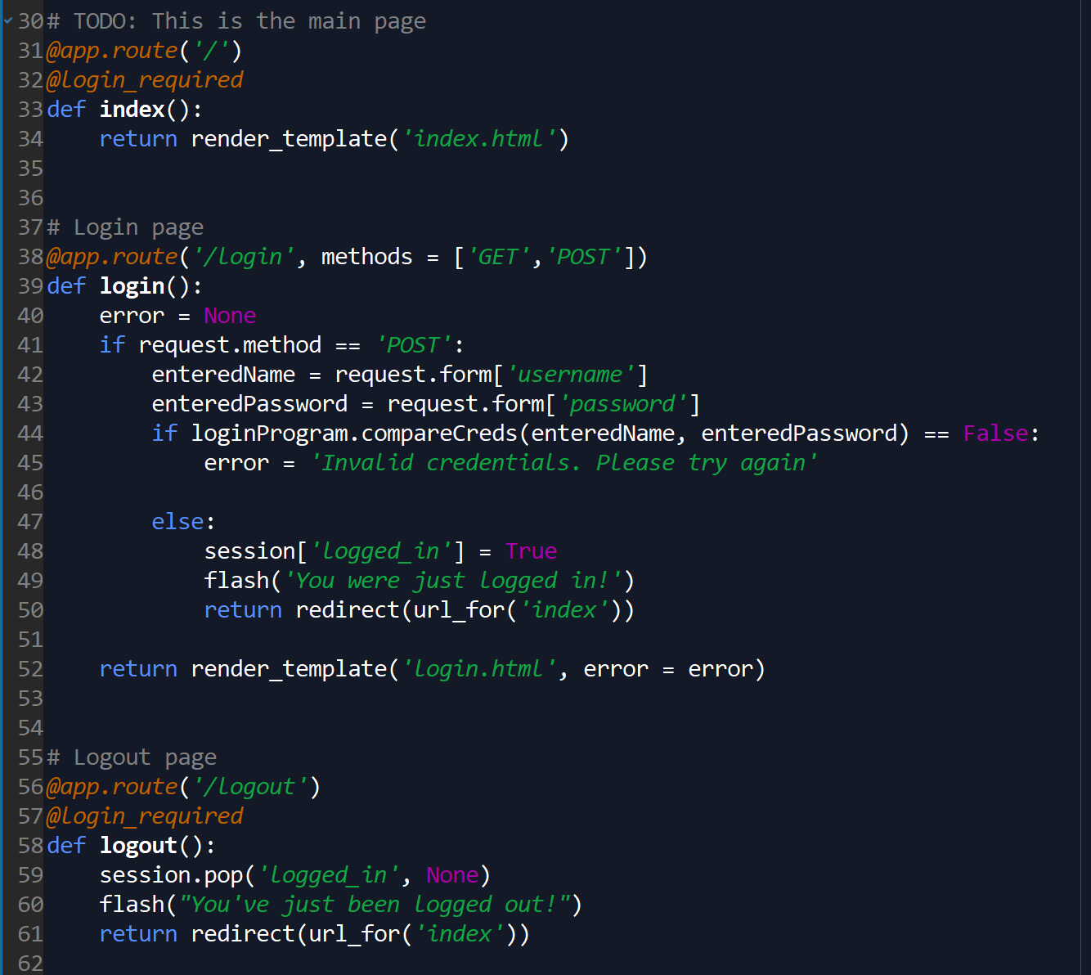
Flask
Used to patch Python and HTML
Handles routing users through the site
Manages login status and session information

Slide 14
SQLite
Database structure
Queries sent by Python to manage/work the db
Stores and returns data based on program needs

Slide 15
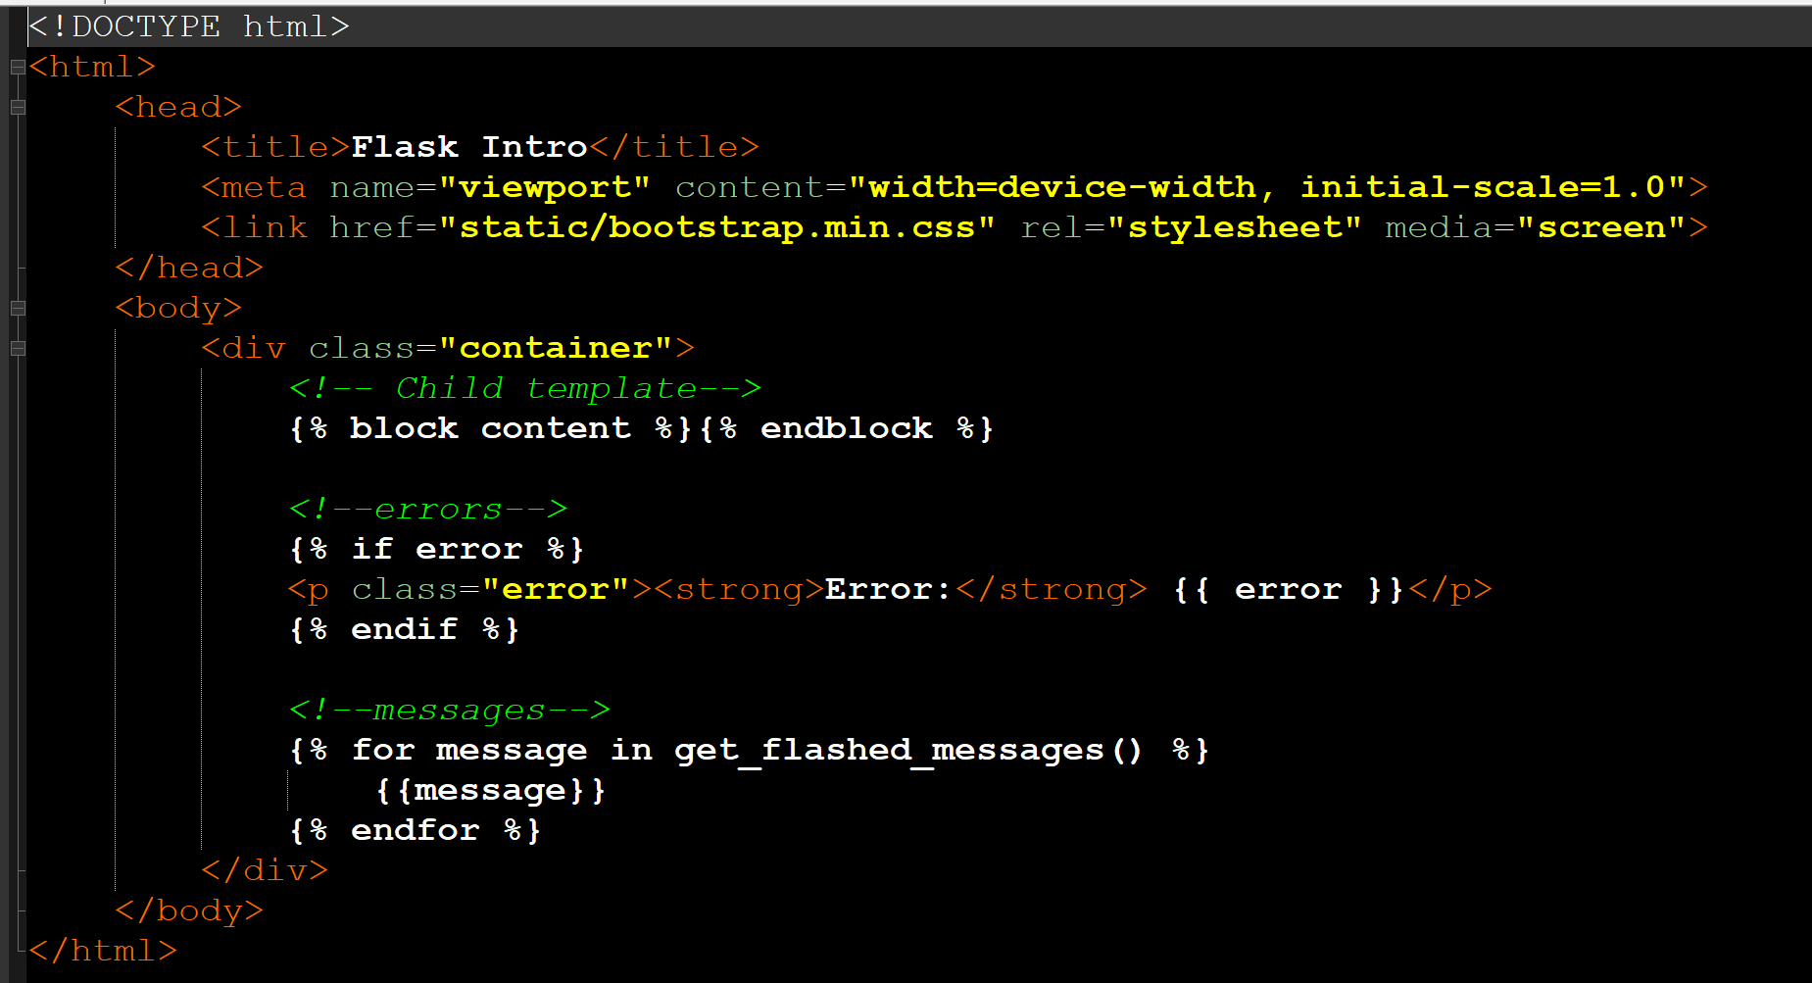
Bootstrap/HTML
HTML is the website displaying in browser
Bootstrap to arrange

Slide 16
Additional Notes

Slide 17
Q&A
Questions?

