Slide 1

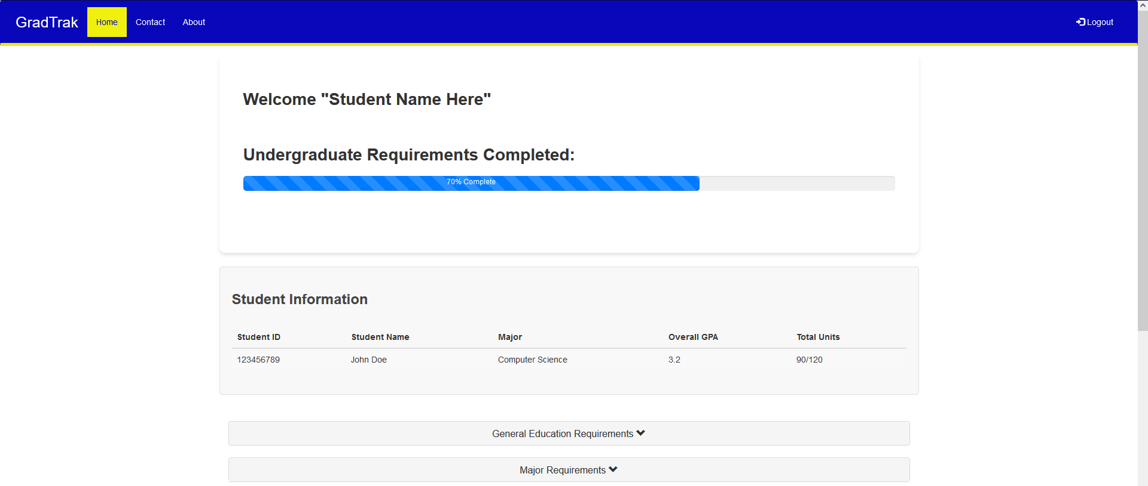
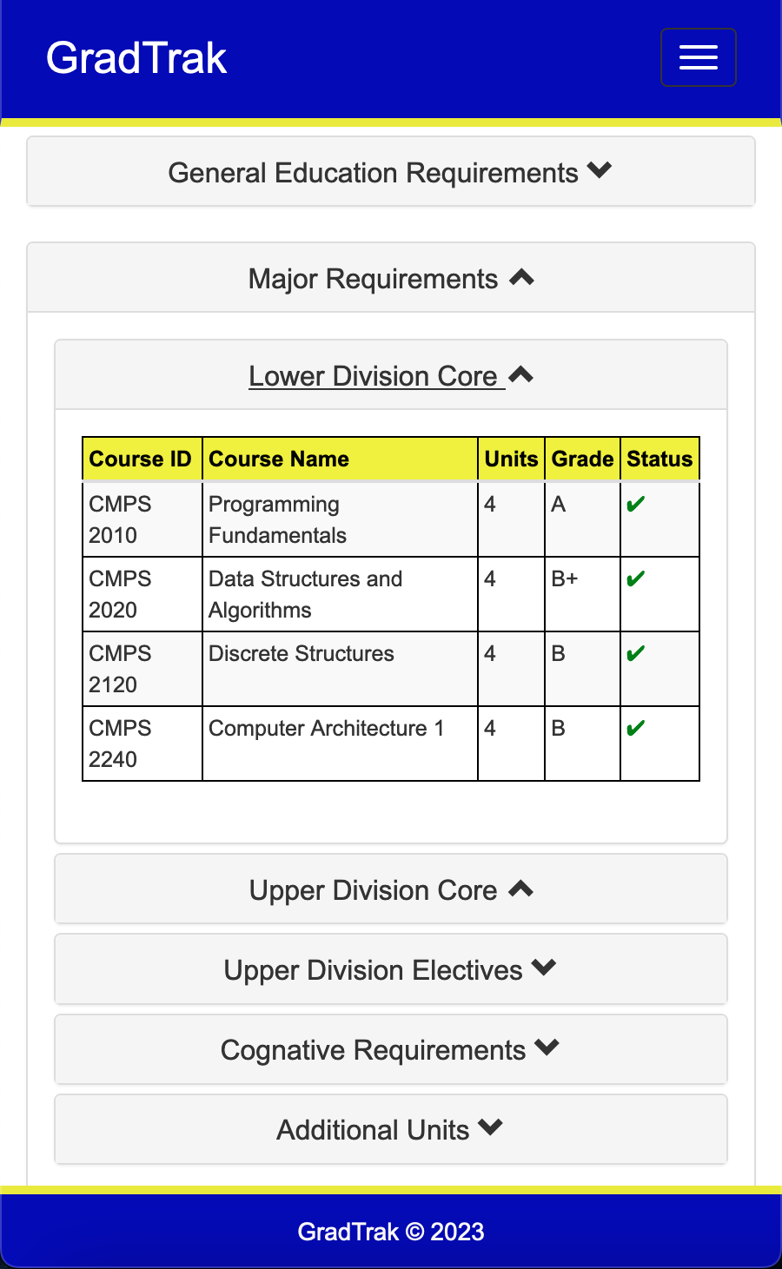
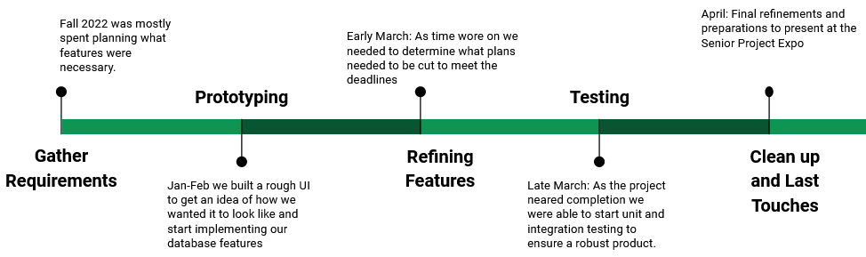
GradTrak: A Better Graduation Progress Bar
By
Ulloa, Justin; Allen, Haylee; Abdul-Razzak, Shadi; Bock, Tristan
What is GradTrak?
GradTrak is our vision of a simpler way to monitor one’s progress toward a finished degree to allow quick understanding of completed, in-progress, and unfinished criteria at a glance, without needing to dig through dozens of drop-down menus. It is a web-based application that runs alongside the school’s records to pull accurate, up-to-date information for the student as well as inform on possible fits for each requirement.
How does it work?
As GradTrak is initially made to connect to the school’s records as mentioned, it pulls everyone’s class information including their login as it would be the same to log into here as well. GradTrak would recognize your major, and list you classes appropriate to said major from the school’s road-map recommendation. Per semester finished as as the records are updated, completed and remaining classes are updated and the progress bar would recalculate to show your new progress percentage towards completion.
See What You’ve Done And What You Haven’t
Quickly and easily see what courses are left, which are done, and what you could take to quickly finish your degree!
* Overall Progress Bar toward graduation
* Required and Recommended Course Lists
* Easy to read Course History
* Mobile and Desktop Supported
Inspiration
The primary inspiration for this project was a group lamentation that CSUB’s website was cumbersome to use and unclear at first glance to see what was still needed and what was already finished. Some of us remembered other schools using Ellucian’s DegreeWorks program and we decided to try making our own version of that.
Challenges
We had different UI approaches in the beginning, it’s not until after some feedback that we got the idea to make our web application to look similar to our school website, as they’re supposed to go hand in hand. At this point, it was now about getting our database to work with the school’s style.
Timeline
Career Resources
GradTrak provides job and internship resources to help find the right place for you, as well as resume builders/template sources to help you create a professional resume.
School of Natural Sciences, Mathematics, and Engineering Department of Computer and Electrical Engineering and Computer Science

