Slide 1
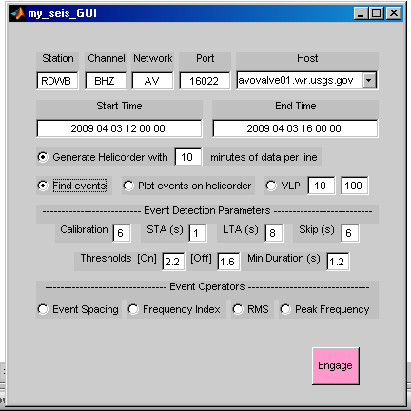
my_seis_GUI: User-Interface grabs a waveform object defined
by ‘Station’, ‘Channel’, ‘Network’, ‘Port’, ‘Host’
Start and Stop times are in form [YYYY MO DD HH MI SS]
Generate a helicorder matlab figure for extracted waveform
Plot events in red over raw helicorder data
Plot VLP energy over raw helicoder data
(default period range is 10 s to 100 s)
Detect and extract events (1xn array of waveform objects)
using 7 event detection parameters:
1. Calibration – Station background seismicity scalar
2. STA (s) – Short-Time Average window (seconds)
3. LTA (s) – Long-Time Average window (seconds)
4. Threshold [On] – STA/LTA thresh to turn on trigger
5. Threshold [Off ] – STA/LTA thresh to turn off trigger
6. Min Duration – Shortest allowable event length
Event Operators – Create plots based on detected set of events:
1. Event Spacing – Inter-event spacing of events
2. Frequency Index – Based on FI developed by Buurman & West
3. RMS – Root Mean Square
4. Peak Frequency – Most energetic frequency (based on Fourier analysis)
Engage – This button makes all the magic happen. It is pink.

Slide 2
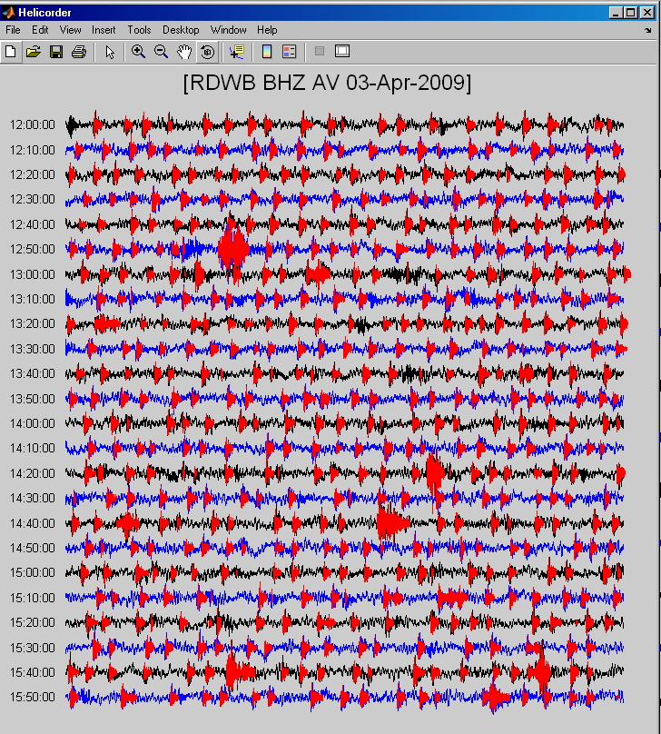
Helicorder:
helicorder(wave,events,tra_w_m,vlp_rng)
wave – waveform object (required)
events – waveform array (optional)
tra_w_m – trace width in minutes (required)
vlp_rng – VLP range, (1x2), (optional)
Shown: (event overlay mode)
helicorder(wave,events,10)
Event overlay creates an interactive interface with the individual events (plotted in red).
Clicking on a red path will activate specific code (easily modified) within the helicorder program. The current code calls programs ‘hht_vs_fft’ and ‘event_view’.
This event was clicked to generate the plots shown in slide 4.

Slide 3
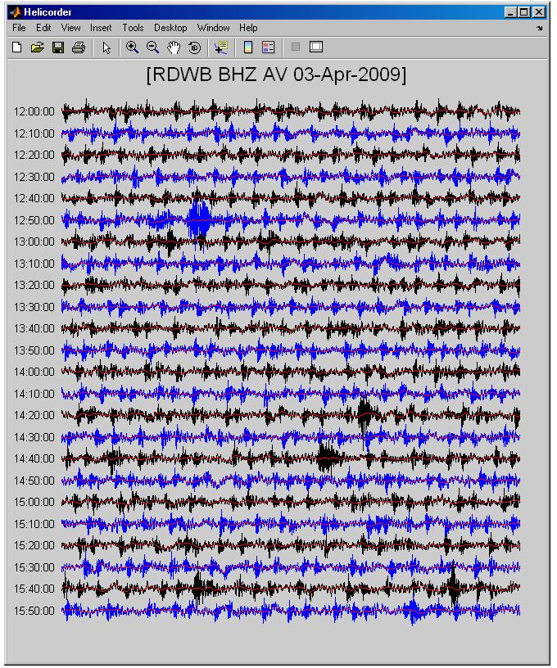
Helicorder:
Shown: (VLP overlay mode)
helicorder(wave,10,[10 100])
VLP overlay plots filtered data in red over the original signal

Slide 4
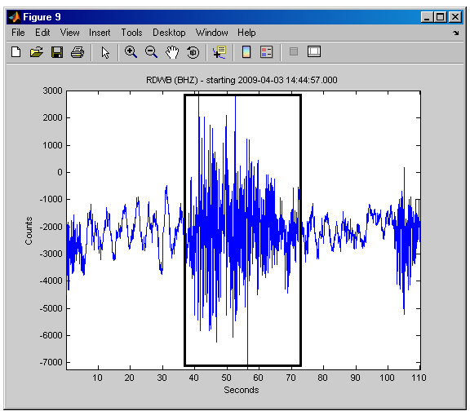
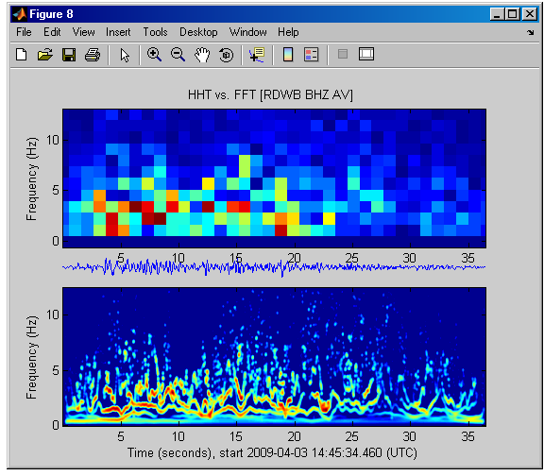
Event View:
event_view(event,frame)
event – waveform object of detected event (required)
frame – (1x2 double) defines amount of data before and after event
to plot in event lengths.
Shown: event_view(event,[1 1])
Total length of time axis is 3 times that of event
event_view highlights the event with a box (shown)
HHT vs FFT:
hht_vs_fft(wave,nf_rng,imf_rng)
wave – waveform object (required)
nf_rng – Normalized Frequency Range (1x2 double), (optional)
[0 1] plots from 0 Hz to the Nyquist Frequency (default)
[0 .5] is shown (0 Hz to 12.5 Hz)
imf_rng – IMF range (HHT plot), (1x2 integer),(optional)
[1 end] plots all IMFs (default)
[1 4] plots IMF 1 through IMF 4

Slide 5
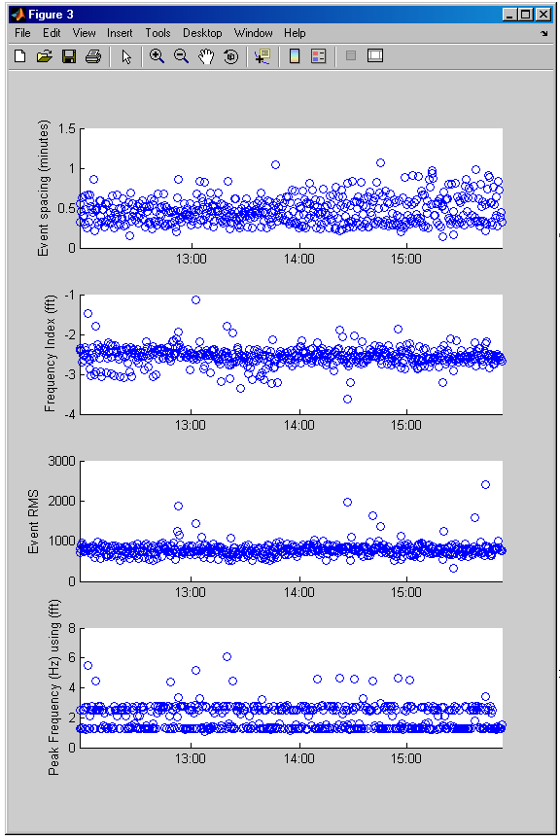
Event Operations:
Event Spacing:
spacing = event_space(events,unit,op)
events – Waveform object array of detected events
unit – Spacing returned in (‘s’, ‘m’, ‘h’, or ‘d’)
op – Operation: (‘plot’, ‘logplot’, ‘val’, ‘logval’)
Frequency Index:
findex = freq_index(events,lf_r,hf_r,op,tech)
events – Waveform object array of detected events
lf_r, hf_r – Low & High FI windows i.e. [1 2], [10 20]
op – Operation: (‘plot’, ‘val’)
tech – Technique: (‘fft’, ‘hht’)
Event RMS:
event_rms(events,op)
events – Waveform object array of detected events
op – Operation: (‘plot’, ‘val’)
Peak Frequency:
peakfreq = peak_freq(events,op,tech)
events – Waveform object array of detected events
op – Operation: (‘plot’, ‘val’)
tech – Technique: (‘fft’, ‘hht’)

