Slide 1
Spring Scheduled
Krzysztof Serkowski
CONFIDENTIAL | © 2021 EPAM Systems, Inc.

Slide 2

Task Execution and Scheduling
What it is?
Notes:
The Spring Framework provides abstractions for asynchronous execution and scheduling of tasks. In a variety of ways, we can run some task at some point in the future. There are some simple solutions for that like Java annotation or more complex like TaskScheduler interface.

Slide 3
@Schedule annotation
Notes:
With this annotation, we can annotate void methods without arguments. This method will be executed with some time parameters.

Slide 4
Real life scenarios
Timeout check
notification
Retention
Notes:
For what we can use in a real-life scenario? For example for timeout check if some time-consuming action already finished like generating report from 200 tables. If not we can mark it as failed or run some retry process. A good scenario will be also some notification like we need to grab some data in the one-hour interval for example user metrics and send some email about that.
One of the scenarios which come to my mind is the retention process for example if we need to remove some data or mark it as archived once a day.

Slide 5
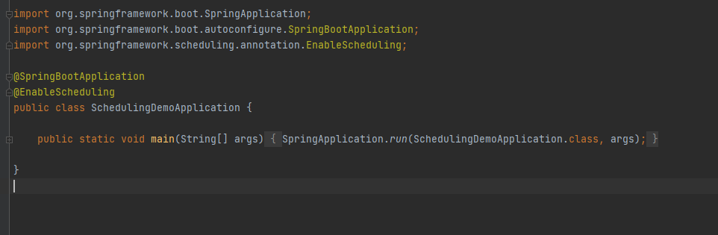
@EnableScheduling
Notes:
To use @Scheduled annotation we need to add @EnableScheduling to the configuration file. In a more detailed word, this annotation ensures that a background task executor is created. Without it, nothing gets scheduled.

Slide 6
Fixed Delay, Fixed Rate, Initial Delay
Fixed Delay:
Will not start the next execution until the orevious one will be ended
Fixed Rate:
Executed independent
Initial delay
Task will be executed first time after this value
Can be used with Fixed Delay and Fixed Rate
Notes:
In case of fixed delay and fixed rate we set up a time interval in milliseconds. The difference between these two is that the fixed delay will not start the next execution until the previous one will be ended. The fixed rate scenario is executed independent. The initial delay is a property that drives after how many seconds the first execution should be done.

Slide 7
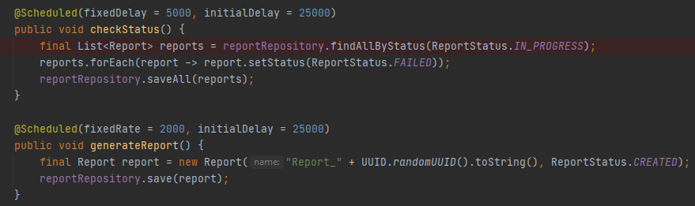
Fixed Delay, Fixed Rate, Initial Delay
Notes:
Example

Slide 8
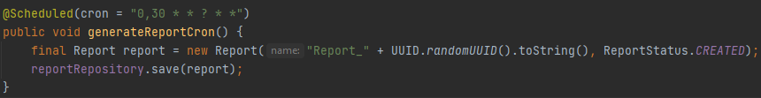
Cron
Notes:
Sometimes „fixed rate” and „fixed delay” is not enough to configure the scheduling task. With help comes to us the "cron". Cron is a flexible string expression that allows us to set simple pattern like on the first screen or even very precisely like on the second screen where we can set up to execute a task every Monday and Wednesday at 4 am and 11 pm. On the last slide, there will be a link to some online tool to play with cron.

Slide 9
Live Coding
Notes:
Ok time for some live coding. I will quickly show on live already mentioned examples of use „Scheduled” annotation.

Slide 10
Task Scheduler
Notes:
Let's talk about some advanced options for scheduling. I will introduce the interface Task Scheduler. Which allow us better control over task scheduling.

Slide 11
Real life scenarios
Async tasks
Cancel task
Better controL
Notes:
For what we can use in a real-life scenario? For example for async tasks because in this case, we have control over thread pool size. For example, we want to track the status of just the submitted report. Another real-life scenario is „Cancel Task”: Thanks to return value ScheduledFuture we are able to cancel tasks or even check if they are done. Backing to the already mentioned example if our report is finished we don’t want anymore to track it so we can cancel that scheduled task. As the last example, I would say we have better control over params like fixed rate, fixed delay or cron. We can get these parameters from the database or some external services if we can’t pass them via annotation or application parameters.

Slide 12
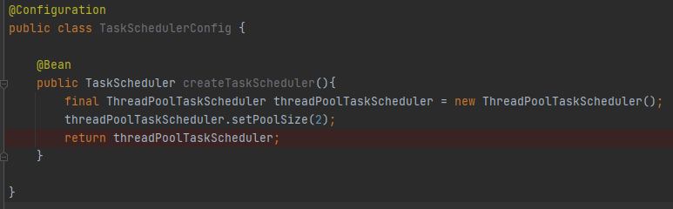
Configuration
Notes:
To manually configure the implementation of the TaskScheduler interface we can create a configuration method like on screen. We can pass some specific values like pool size or remove the task from the queue when it is cancelled.

Slide 13
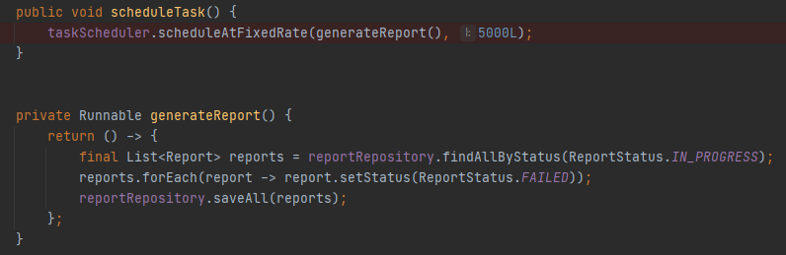
Fixed Rate
Notes:
Similar to the annotation example we are able to schedule tasks in „fixed rate” and „fixed delay” ways.

Slide 14
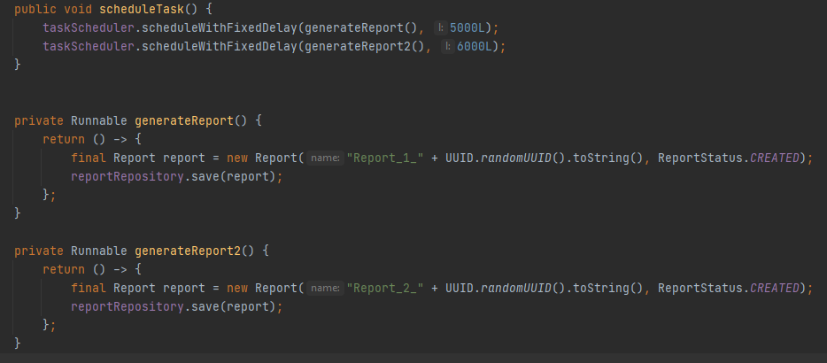
Fixed Delay
Notes:
Similar to the annotation example we are able to schedule tasks in „fixed rate” and „fixed delay” ways.

Slide 15
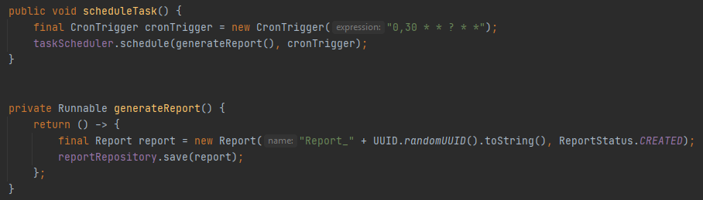
Cron Trigger
Notes:
Also in this implementation, we can still use the „Cron” expression. This time „cron” is represented as „CronTrigger” class which implement the Trigger interface. We can easily pass to constructor string expression and use the „schedule” method from our interface.

Slide 16
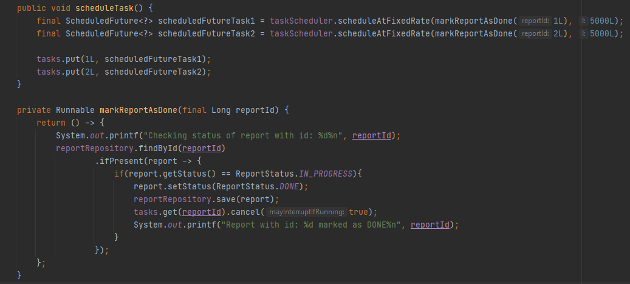
Shutdown task
Notes:
One of the most useful features of „TaskScheduler” interface is the possibility to cancel already scheduled tasks. Every „scheduled” method return a „ScheduleFuture” class with methods like „isCanceled”, „isDone” and „cancel”. If we use the „cancel” method we are able to stop scheduling a task or even interrupt the already running process under this task if we pass „true” as an argument to this method. Why do we need that method? For example when do not need to track/read/check some process any more and we want to free some resources to not constantly execute some unused task.

Slide 17
Live Coding
Notes:
Ok, it is time for the last live coding session. I will walk through already mentioned examples of use the „TaskScheduler” interface.

Slide 18
Links
https://www.baeldung.com/spring-scheduled-tasks
https://www.baeldung.com/spring-task-scheduler
https://docs.spring.io/spring-framework/docs/current/javadoc-api/org/springframework/scheduling/annotation/Scheduled.html
https://docs.spring.io/spring-framework/docs/current/javadoc-api/org/springframework/scheduling/TaskScheduler.html
https://www.freeformatter.com/cron-expression-generator-quartz.html
https://crontab.guru/
Notes:
There are some links. First, two will extend a bit of already mentioned topics. The other two are documentation links. The last one is for play with „cron” patterns.

Slide 19
THANKS!

