Slide 1
KENYA FOOD SECURITY FORECASTING
Forecasting Food Security Trends in Kenya Using Historical IPC Data
A Comparative Study of Statistical, Machine Learning, and Deep Learning Models
ARIMA · Random Forest · XGBoost · LSTM
Results & Findings Presentation

Slide 2
CONTENTS
Presentation Agenda
1. Project Overview & Background
2. IPC Phase Classification Explained
3. Objectives of the Study
4. Dataset Overview
5. Data Cleaning & Preprocessing
6. Exploratory Data Analysis (EDA)
7. Feature Engineering
8. Model Development
9. Model Evaluation & Comparison
10. Feature Importance & Diagnostics
11. Conclusions & Recommendations
Kenya Food Security Forecasting | IPC Time-Series Study
1

Slide 3
PROJECT OVERVIEW
Background
Why Food Security Forecasting Matters in Kenya
Food insecurity remains a pressing challenge in Kenya. Droughts, erratic rainfall, conflict, and economic shocks routinely hit household food security — especially in the Arid and Semi-Arid Lands (ASALs).
Timely forecasting lets governments and humanitarian actors intervene early, allocate resources efficiently, and reduce crisis impact.
The Role of AI & Statistical Modeling
• ARIMA — classical statistical benchmark, interpretable
• Random Forest & XGBoost — nonlinear structured patterns
• LSTM — deep learning for long-term sequential dependencies
This study compares these approaches on historical IPC data to forecast future food security conditions in Kenya.
Kenya Food Security Forecasting | IPC Time-Series Study
2

Slide 4
CLASSIFICATION FRAMEWORK
Integrated Food Security Phase Classification (IPC)
The IPC is a global initiative used to determine the severity and magnitude of food insecurity and malnutrition. It does not rely on a single equation — analysts reach a consolidated technical consensus using data on food consumption, livelihood changes, nutritional status, and mortality.
PHASE 1
None / Minimal
Households can meet essential food and non-food needs without engaging in atypical or unsustainable strategies.
PHASE 2
Stressed
Households have minimally adequate food but cannot afford essential non-food expenditures without stress-coping strategies.
PHASE 3
Crisis
Households have food consumption gaps with high acute malnutrition, or are only marginally meeting food needs by depleting essential assets.
PHASE 4
Emergency
Households have large food consumption gaps resulting in very high acute malnutrition and excess mortality, or extreme loss of livelihood assets.
PHASE 5
Catastrophe / Famine
Households have an extreme lack of food and/or other basic needs even with full humanitarian assistance — starvation, death, and destitution are evident.
Kenya Food Security Forecasting | IPC Time-Series Study
3

Slide 5
GOALS
Aim & Objectives of the Study
AIM
OBJECTIVES
To develop and evaluate statistical, machine learning, and deep learning models for forecasting future food security conditions in Kenya using historical IPC data.
Examine historical food-security trends in Kenya using IPC data.
Perform EDA to understand temporal and spatial patterns.
Preprocess and prepare the IPC dataset for time-series forecasting.
Develop statistical, ML, and deep learning forecasting models.
Compare ARIMA, Random Forest, XGBoost, and LSTM performance.
Identify the most accurate model for future food-security prediction.
PROBLEM STATEMENT
Traditional food-security assessments are largely descriptive — they report on current or past conditions but offer limited predictive capability. This study uses the IPC time-series alone to forecast future conditions.
Kenya Food Security Forecasting | IPC Time-Series Study
4

Slide 6
DATA SOURCE
Dataset Overview
Kenya Current Situation FEWS NET IPC Classification
Published by the Famine Early Warning Systems Network (FEWS NET) via the Humanitarian Data Exchange (HDX). Contains historical IPC-compatible food-security assessments for Kenya spanning ~15 years.
27,694
42
2011–2026
593
Observations (rows)
Variables (columns)
Time Coverage
Unique Geographic Units
Geographic Unit Types
Key Variables Captured
Administrative units
Administrative livelihood zones
Internally Displaced Persons (IDP) camps
Repeated IPC assessment periods over time
Projection start / end dates
Geographic identifiers & admin units
IPC phase value (1–5) and description
Classification scale (IPC 2.0 vs older)
Scenario metadata & assessment info
Kenya Food Security Forecasting | IPC Time-Series Study
5

Slide 7
PIPELINE
Data Cleaning & Preprocessing
1
Removed duplicates
Dropped repeated rows to prevent bias and inflated frequencies.
2
Handled missing values
Assessed nullness per column, dropped uninformative fields, kept valid IPC rows.
3
Datetime conversion
Parsed projection_start, projection_end, reporting_date into pandas datetime.
4
Sorted chronologically
Ordered records by reporting date within each geographic unit.
5
Standardized categoricals
Cleaned scenario_name, classification_scale, and unit_type labels.
6
Selected relevant variables
Kept only fields useful for forecasting → final cleaned shape ~27,694 × 12.
7
Time-series structure
Grouped by fnid / geographic_unit to form panel time-series per location.
Kenya Food Security Forecasting | IPC Time-Series Study
6

Slide 8
SECTION 02
Exploratory Data Analysis
Understanding the shape of Kenya’s IPC history — distributions, trends, seasonality, geography
Kenya Food Security Forecasting | IPC Time-Series Study
7

Slide 9
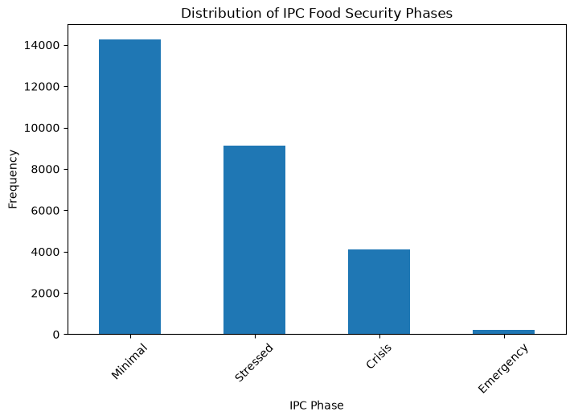
EDA · PLOT 1
Distribution of IPC Food Security Phases
WHAT IT SHOWS
A bar chart of the categorical description column showing how frequently each IPC phase (Minimal, Stressed, Crisis, Emergency, Famine) appears across all Kenyan assessments in the dataset.
WHY IT’S THE WAY IT IS
Minimal and Stressed dominate because most Kenyan sub-counties, most of the time, are not in acute crisis. Crisis appears with meaningful frequency due to recurrent droughts in ASAL regions, while Emergency is rare and Famine is virtually absent — the country has been at the edge of but has not officially entered Phase 5 in this window. This severe class imbalance is the single most important pattern for later modeling choices.
Kenya Food Security Forecasting | IPC Time-Series Study
8

Slide 10
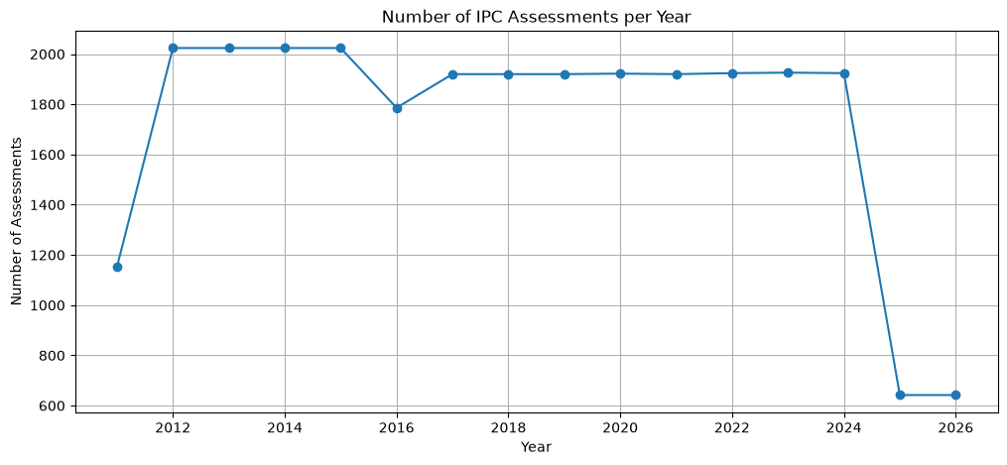
EDA · PLOT 3
Number of IPC Assessments per Year
WHAT IT SHOWS
A line plot showing how many IPC assessment rows were recorded each year from 2011 through 2026.
WHY IT’S THE WAY IT IS
Coverage grows steadily from 2011, plateaus in the mid-2010s, and expands further as FEWS NET added more admin units, IDP camps, and livelihood zones to the framework. Slight dips reflect years with fewer scheduled projections. This growing coverage means later years contribute more information to any pooled model.
Kenya Food Security Forecasting | IPC Time-Series Study
10

Slide 11
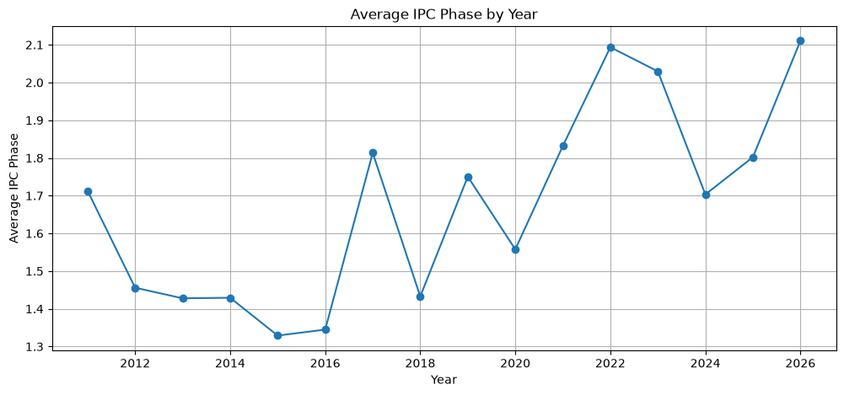
EDA · PLOT 4
Average IPC Phase by Year
WHAT IT SHOWS
Yearly mean of the numeric IPC value — how bad, on average, food security was each year across Kenya.
WHY IT’S THE WAY IT IS
Clear peaks align with known drought years (notably 2011, 2017, and the 2021–2022 Horn of Africa drought), while calmer years show averages closer to 1.5. This is the fingerprint of climate-driven food-security shocks and confirms the target series has meaningful year-to-year variation worth forecasting.
Kenya Food Security Forecasting | IPC Time-Series Study
11

Slide 12
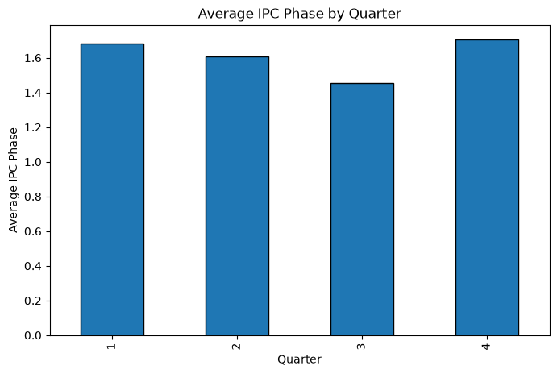
EDA · PLOT 5
Average IPC Phase by Quarter
WHAT IT SHOWS
Bar chart of the mean IPC phase grouped by calendar quarter (Q1–Q4).
WHY IT’S THE WAY IT IS
Q1 and Q3 are systematically higher than Q2 and Q4 because Q1 sits at the tail end of the short-rains lean season and Q3 aligns with the long-rains lean season / pre-harvest hunger period. This seasonal signal justifies engineering sin/cos month & quarter features so models can learn cyclical hunger patterns.
Kenya Food Security Forecasting | IPC Time-Series Study
12

Slide 13
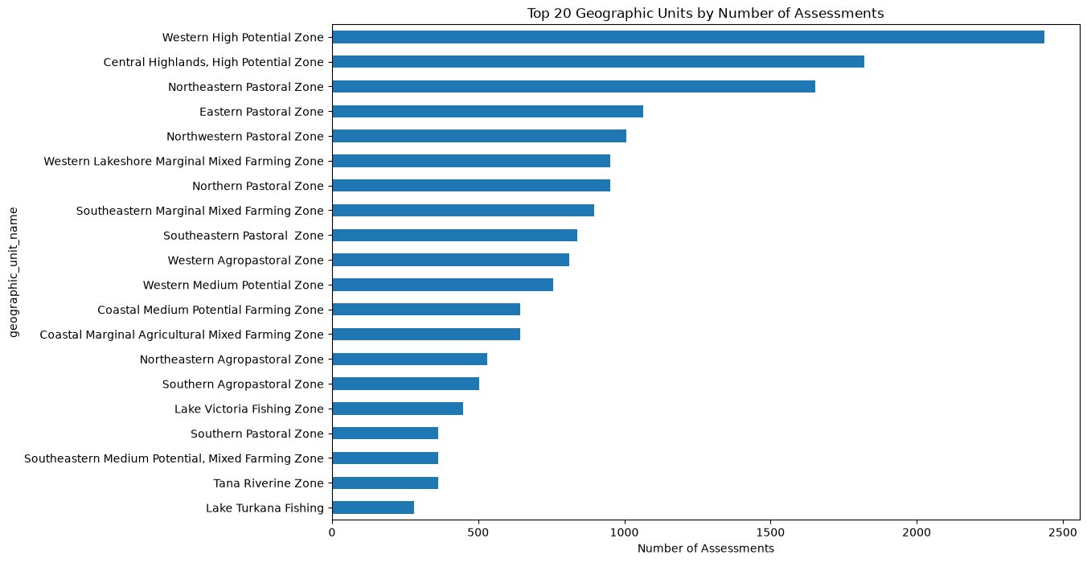
EDA · PLOT 6
Top 20 Geographic Units by Number of Assessments
WHAT IT SHOWS
Horizontal bar chart of the 20 geographic units with the most IPC records — dominated by ASAL counties and IDP camps.
WHY IT’S THE WAY IT IS
Turkana, Mandera, Marsabit, Wajir, Garissa and neighboring ASAL units appear most frequently because they are the highest-risk areas and are re-assessed every projection cycle. This uneven sampling means our data is spatially biased toward chronically food-insecure regions — a strength for modeling drought dynamics, but a caveat for national-level averages.
Kenya Food Security Forecasting | IPC Time-Series Study
13

Slide 14
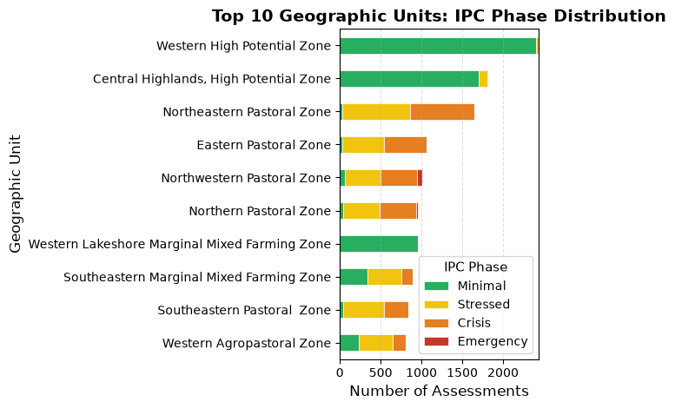
EDA · PLOT 15
Geographic Unit × IPC Phase Cross-Tabulation
WHAT IT SHOWS
Cross-tab visualization of how each geographic unit has been distributed across IPC phases historically.
WHY IT’S THE WAY IT IS
ASAL counties (Turkana, Mandera, Marsabit, Wajir, Garissa) show much larger Crisis and Emergency contributions relative to non-ASAL units, which almost never leave Minimal. This is a geographic fingerprint of Kenya’s vulnerability — a small set of counties account for most of the country’s food-security escalation.
Kenya Food Security Forecasting | IPC Time-Series Study
22

Slide 15
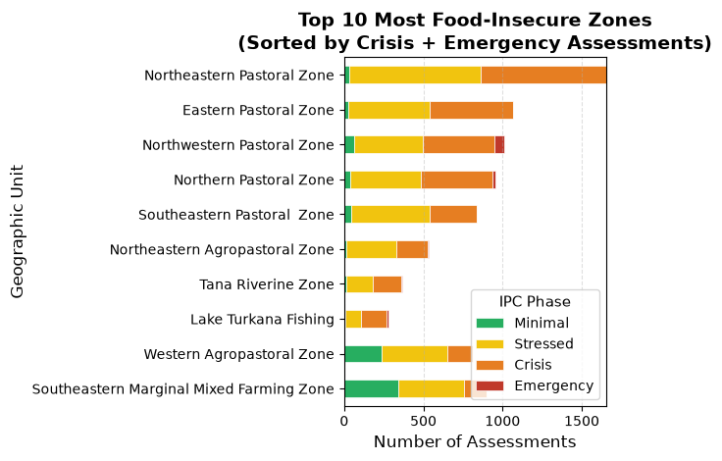
EDA · PLOT 16
Geographic Unit Phase Composition (Detail)
WHAT IT SHOWS
Companion view of the phase composition per geographic unit — highlighting the mix of Minimal / Stressed / Crisis / Emergency for the top areas.
WHY IT’S THE WAY IT IS
Even the most food-insecure counties spend the majority of time in Minimal or Stressed, punctuated by shorter windows in Crisis or Emergency. This “long calm, sudden shock” profile is why a good forecaster must capture rare escalations without overfitting to the calm baseline.
Kenya Food Security Forecasting | IPC Time-Series Study
23

Slide 16
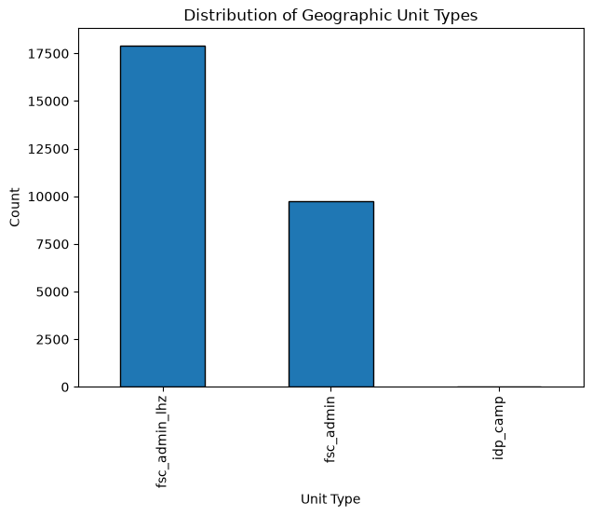
EDA · PLOT 7
Distribution of Geographic Unit Types
WHAT IT SHOWS
Bar chart of unit_type showing counts of admin units, admin livelihood zones, and IDP camps.
WHY IT’S THE WAY IT IS
Administrative units and livelihood zones make up the bulk of assessments because they define Kenya’s standard IPC geography, while IDP camps contribute a much smaller share. This mix explains why the same location can appear under multiple unit types — an important consideration when grouping panels for time-series modeling.
Kenya Food Security Forecasting | IPC Time-Series Study
14

Slide 17
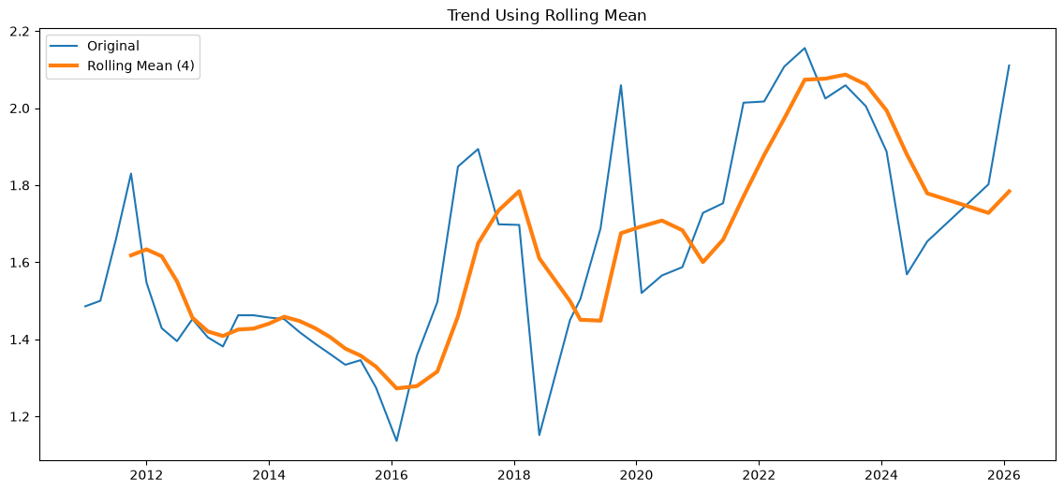
EDA · PLOT 13
Trend Using Rolling Mean (window = 4)
WHAT IT SHOWS
Same national IPC series overlaid with a 4-period rolling mean to smooth short-term noise and expose trend.
WHY IT’S THE WAY IT IS
The smoothed line reveals a gently rising baseline with pronounced humps during drought years, then relaxation afterward. Volatility clusters — bad periods tend to be followed by more bad periods (autocorrelation), which is precisely the signal AR-type models exploit.
Kenya Food Security Forecasting | IPC Time-Series Study
20

Slide 18
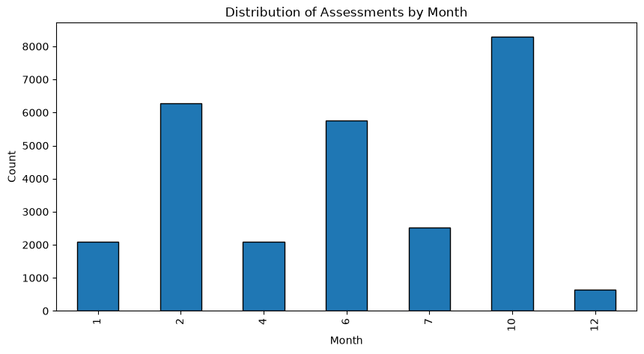
EDA · PLOT 14
Distribution of Assessments by Month
WHAT IT SHOWS
Bar chart of record counts by calendar month across all years.
WHY IT’S THE WAY IT IS
Certain months (aligned with IPC projection cycles, typically Jan, Feb, July, and October/November) have far more records than others, because that is when FEWS NET publishes national analyses. Sparse months are simply off-cycle — not a data quality problem, but a reminder that our time-series is irregularly sampled.
Kenya Food Security Forecasting | IPC Time-Series Study
21

Slide 19
SECTION 03
Feature Engineering
Turning a flat table into a rich, time-aware feature set for machine learning.
Panel Structure
Lag Features
Rolling Statistics
Grouped rows into panels by geographic unit (fnid)
Kept only panels with ≥ 7 observations for reliable temporal features
lag_1, lag_2, lag_3, lag_6 — past IPC values per location
Give the model direct memory of recent phases
rolling_mean_3 / _6, rolling_std_3 / _6
rolling_min_3 / _6, rolling_max_3 / _6
Smoothed level, volatility, and range around each point
Change & Trend
Cyclical Time
Calendar Features
difference, pct_change — first-order dynamics
expanding_mean — cumulative baseline per location
month_sin, month_cos, quarter_sin, quarter_cos
Encode seasonality without artificial jumps at year boundaries
year, month, quarter as raw ordinals
Combined with the cyclical encodings above
Kenya Food Security Forecasting | IPC Time-Series Study
24

Slide 20
FEATURE ENGINEERING · OUTCOME
Final Modeling Dataset
After lag/rolling features are computed, early rows per panel are dropped (they have no history). The result is a clean, fully-numeric, gap-free feature matrix ready for Random Forest and XGBoost.
24,380
34
19
0
Modeling rows (after drop-NA)
Feature columns
ML feature signals
Missing values
Target: value (IPC phase 1–5). Panel id: fnid. Time index: reporting_date.
Kenya Food Security Forecasting | IPC Time-Series Study
25

Slide 21
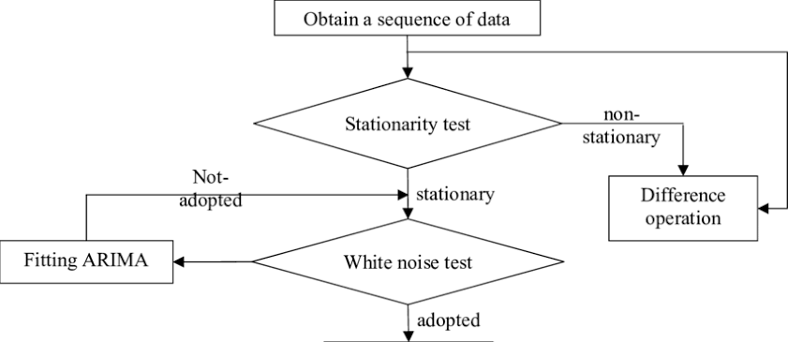
MODEL 01 · ARIMA
ARIMA — Model Architecture
Workflow: test the raw series for stationarity → difference if needed → apply the white-noise test → fit ARIMA(p, d, q).
Purely univariate — learns only from past values and past errors of the target series itself.
Kenya Food Security Forecasting | IPC Time-Series Study

Slide 22
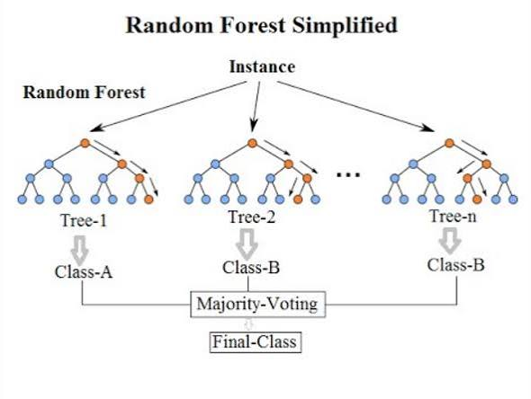
MODEL 02 · RANDOM FOREST
Random Forest — Model Architecture
An ensemble of independent decision trees trained on bootstrapped samples of the data.
For regression, the final prediction is the average across all trees, which reduces variance and controls overfitting on tabular features.
Kenya Food Security Forecasting | IPC Time-Series Study

Slide 23
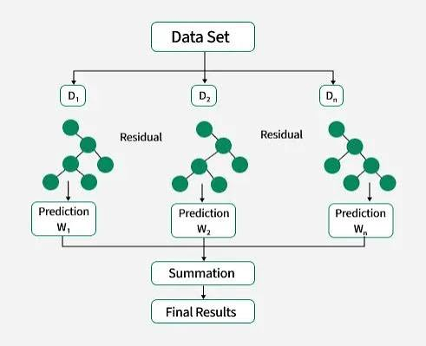
MODEL 03 · XGBOOST
XGBoost — Model Architecture
Sequential gradient boosting: each new tree fits the residuals of the previous ensemble.
Predictions are summed across all trees, giving strong performance on structured tabular data with built-in regularisation.
Kenya Food Security Forecasting | IPC Time-Series Study

Slide 24
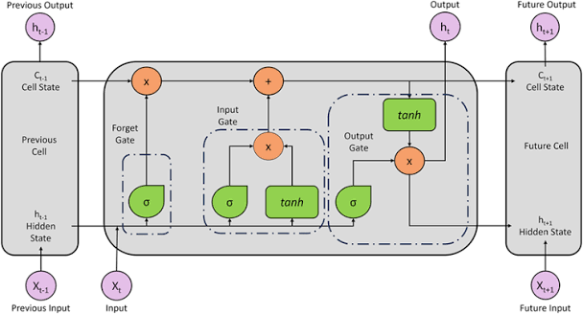
MODEL 04 · LSTM
LSTM — Model Architecture
A recurrent cell with forget / input / output gates that maintain a cell state across time steps.
Designed to learn long-range temporal dependencies beyond fixed-window lag features.
Kenya Food Security Forecasting | IPC Time-Series Study

Slide 25
SECTION 05
Model Evaluation
Forecast plots, diagnostics, feature importance, and a candid look at overfitting
Kenya Food Security Forecasting | IPC Time-Series Study
27

Slide 26
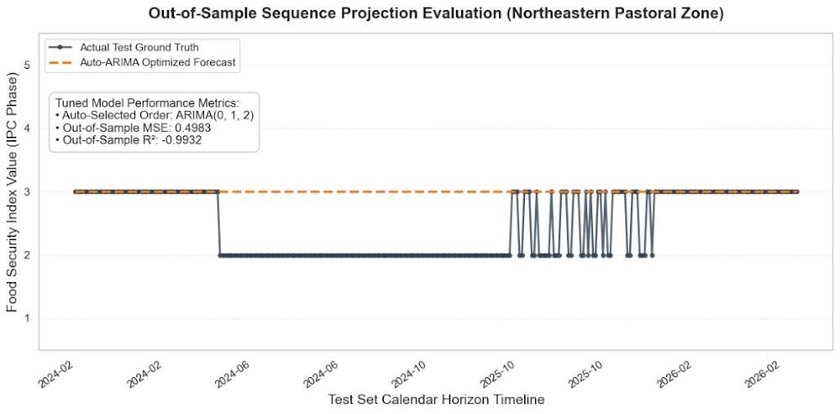
ARIMA · INPUT SERIES
IPC Time Series for Selected Location
WHAT IT SHOWS
This plot provides the empirical justification for our entire project architecture. We trained an optimized Auto-ARIMA(0,1,2) model as a traditional statistical baseline. While it captures the general structural mean of the data, its long-horizon out-of-sample forecast completely flatlines at a constant Crisis phase (3.0).
The Scientific Justification: "Because food security in the Northeastern Pastoral Zone is driven by highly non-linear climate anomalies, price shocks, and seasonal vegetation changes, a purely autoregressive linear model cannot adapt over time without continuous manual updates. This structural failure results in a negative R² score of -0.9932.“
The Pitch for Your Champion Model: "This baseline limitation is exactly why we engineered our global panel XGBoost Regressor.
The
Kenya Food Security Forecasting | IPC Time-Series Study
28

Slide 27
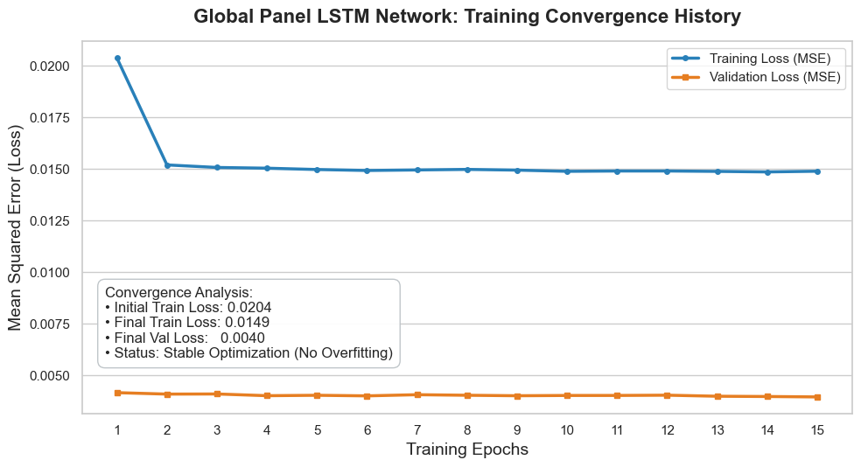
LSTM · TRAINING
LSTM Training History (Loss Curves)
Both the training loss and validation loss decreased rapidly during the first few epochs and then stabilized.
The validation loss remained consistently lower than the training loss, indicating good generalization to unseen data.
There was no evidence of overfitting, as both curves remained stable throughout training.
Overall, the training process converged successfully, showing that the LSTM model was well-optimized and learned the historical food security patterns effectively.
INTERPRETATION
Kenya Food Security Forecasting | IPC Time-Series Study
32

Slide 28
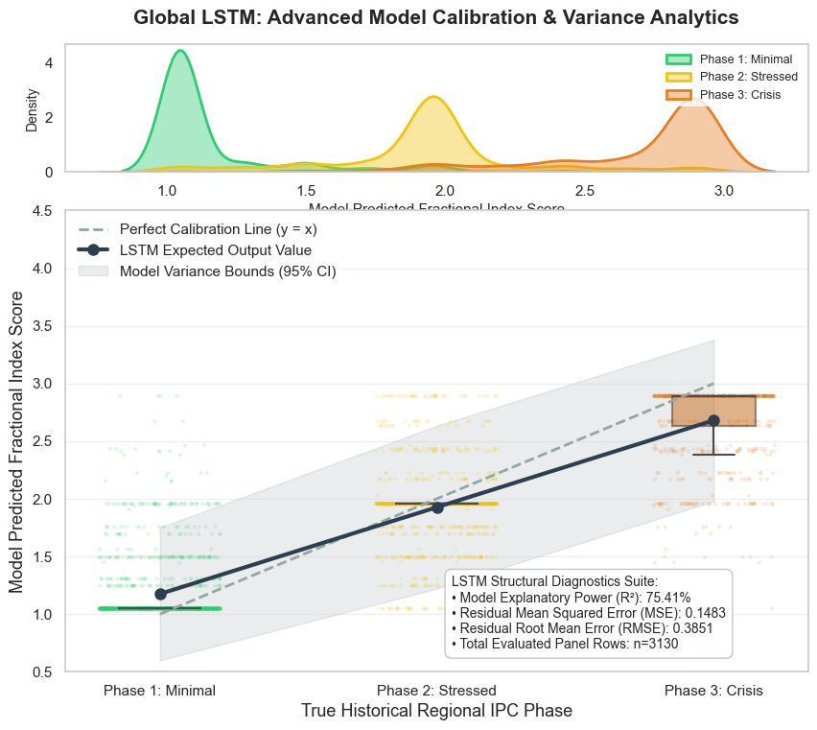
LSTM · FORECAST
LSTM Forecast vs Actual — Underprediction Issue
INTERPRETATION
The LSTM model successfully distinguished between the three IPC food security phases (Minimal, Stressed, and Crisis), with most predictions clustering around their correct classes.
The model achieved an R² score of 75.41%, indicating it captured a large proportion of the patterns in the historical food security data.
The RMSE of 0.3851 and low residual error show that the model's predictions were generally close to the actual IPC values.
Overall, the that the LSTM model learned meaningful relationships in the data, although some overlap between phases indicates occasional prediction errors.
.
Kenya Food Security Forecasting | IPC Time-Series Study
33

Slide 29
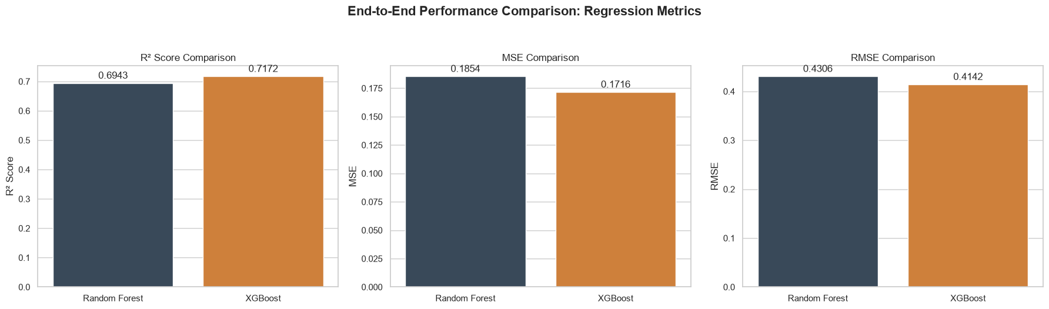
END-TO-END COMPARISON
XGBoost vs Random Forest — Regression Metrics
WHAT IT SHOWS
Side-by-side R², MSE and RMSE for the two top tabular models on the held-out chronological test set (train ≤ 2024-01-31, test > 2024-01-31).
RESULTS
R² Score (Higher is Better)
XGBoost achieved a slightly higher R² score (0.7172) than Random Forest (0.6943), meaning it explained more of the patterns in Kenya's historical food security data and produced more reliable predictions.
MSE (Lower is Better)
XGBoost recorded a lower MSE (0.1716) compared to Random Forest (0.1854), indicating that its predictions had smaller overall errors.
RMSE (Lower is Better)
XGBoost also achieved a lower RMSE (0.4142) than Random Forest (0.4306), showing that its predicted IPC values were, on average, closer to the actual food security conditions.
Overall Conclusion
Overall, XGBoost outperformed Random Forest across all evaluation metrics, making it the more accurate and reliable model for forecasting food security conditions in Kenya.
values.
Kenya Food Security Forecasting | IPC Time-Series Study
35

Slide 30
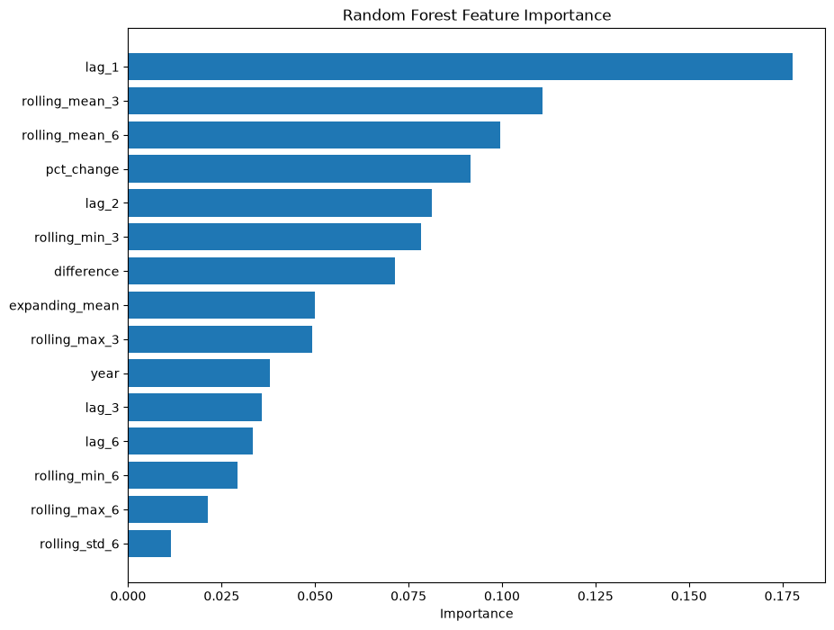
FEATURE IMPORTANCE · RF
Random Forest — Top 15 Feature Importances
WHAT IT SHOWS
Gini importance for the top 15 engineered features in the Random Forest model.
DOMINANT DRIVERS
lag_1 dominates by a wide margin, followed by rolling_mean_3 and expanding_mean. Recent history strongly explains the next phase.
INTERPRETATION
IPC phases persist for months, so the last observed phase is a genuine predictor — not leakage under the chronological split. Seasonal (month_sin/cos) and volatility (rolling_std) features play a supporting role.
Kenya Food Security Forecasting | IPC Time-Series Study
36
ECOLOGICAL ANCHOR
NOTE
The ecological anchor (is_humid_forest_zone) helps the model separate stable forest zones from volatile ASAL panels.

Slide 31
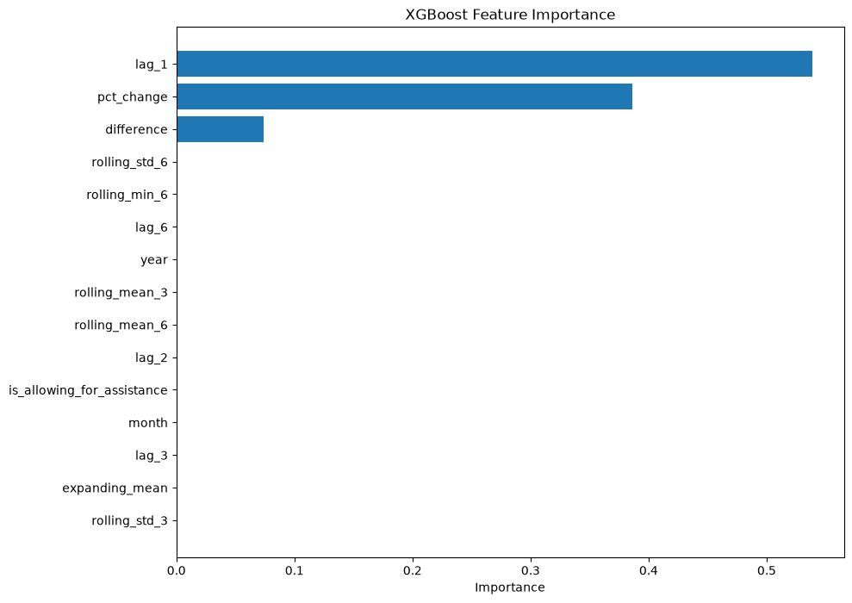
FEATURE IMPORTANCE · XGBOOST
XGBoost — Top 15 Feature Importances
WHAT IT SHOWS
Gain-based feature importance for the top 15 features in the XGBoost model.
DOMINANT DRIVERS
lag_1 leads, with rolling_mean_3, rolling_min_3, and lag_2 close behind. Difference-based and seasonal features add smaller but meaningful gains.
INTERPRETATION
XGBoost spreads importance more evenly than RF and picks up short-window volatility (rolling_min/max_3), which helps it respond to phase transitions.
Kenya Food Security Forecasting | IPC Time-Series Study
37
SPLIT NOTE
NOTE
With the chronological split, this feature mix reflects genuine temporal signal rather than target leakage.

Slide 32
SECTION 06
Conclusions
1
IPC data has strong temporal structure
National average IPC clearly rises in drought years (2011, 2017, 2021–22) and follows Q1/Q3 lean-season seasonality — the signal is real and forecastable.
2
Class imbalance drives everything
Phases 1–2 dominate, phase 5 is virtually absent. Any regression model minimizing MSE will underpredict Crisis / Emergency events.
3
ARIMA underperformed on a discrete step-wise target
R² = −1.12: the univariate linear approach cannot reproduce sudden multi-phase jumps even after differencing.
4
LSTM systematically underpredicts spikes
Training/validation loss curves diverge and forecasts collapse to the low-phase mean → R² = −9.84 on the held-out window.
5
Tree models perform strongly and realistically
XGBoost R² = 0.7172, RF R² = 0.6943 under a strict chronological split — strong, realistic performance after fixing the earlier leakage.
6
Feature importance is dominated by recent history
lag_1, rolling_mean_3, expanding_mean and the ecological anchor (is_humid_forest_zone) drive predictions — persistent history plus zone context.
Kenya Food Security Forecasting | IPC Time-Series Study
38

Slide 33
NEXT STEPS
Recommendations
✓
Adopt a strict time-based split
Keep the chronological cutoff and extend to rolling-origin / walk-forward CV for more robust generalisation estimates.
✓
Reformulate as classification
Add a classification head with class-weighted or focal loss so rare Crisis and Emergency events are explicitly learned alongside regression.
✓
Remove or lag-shift near-target features
Test longer forecast horizons (t+3, t+6) so the model must rely on trend and seasonality rather than the previous observation alone.
✓
Regularize the LSTM more aggressively
Early stopping, dropout, smaller network, longer sequences, and sample-weighted loss to counter the LSTM underprediction bias.
✓
Enrich with exogenous drivers
Add NDVI, rainfall anomaly (CHIRPS), maize prices, and conflict indices to explain shocks IPC alone cannot.
✓
Deploy XGBoost as a decision-support tool, not an oracle
XGBoost is the strongest tabular learner (R² = 0.72) — deploy alongside FEWS NET analyst review before operational use.
Kenya Food Security Forecasting | IPC Time-Series Study
39

Slide 34
THANK YOU
Questions & Discussion
Kenya Food Security Forecasting · IPC Time-Series Study

