Slide 1
WASH Inequality in African Schools
Compiled: Crisis Zones, Whys, Trends & 2030 SDG 6 Outlook
Data: WHO/UNICEF JMP 2024 • 51 African countries • 1,213 observations

Slide 2
Problem Statement
Access to safe water, sanitation, and hygiene (WASH) in schools is a basic right and a foundation for learning, health, and gender equity. Yet across Africa, millions of school-aged children still attend schools without basic water, toilets, or handwashing facilities.
Despite progress under SDG 6, the gap between promise and reality remains wide: progress is uneven across countries and sub-regions, and rural and crisis-affected schools are often left behind. Without clear evidence of where the gaps are, how fast they are closing, and which countries are on track for 2030, resources risk being misallocated.
This compiled presentation uses Python-based analysis of WHO/UNICEF JMP data (2000–2023) to identify crisis zones, measure progress, explain why gaps persist, and inform targeted WASH infrastructure policy.
Source: WHO/UNICEF Joint Monitoring Programme (JMP), 2024.

Slide 3
Target Audience
• Ministries of Education & Health — plan school infrastructure investment and priorities crisis countries.
• UN agencies (UNICEF, WHO, UNESCO) — track SDG 6 progress and target programs to lagging regions.
• NGOs & development partners — identify where to deploy WASH interventions for maximum impact.
• Donors — priorities investments in countries and regions at highest risk of missing 2030 targets.
• Researchers & policy analysts — use reproducible evidence to study WASH inequality across Africa.
Source: WHO/UNICEF JMP, 2024; audience refined from both project presentations.

Slide 4
Data Structure & Source
Source
Structure
WHO/UNICEF Joint Monitoring Programme (JMP) 2024 release — country-level WASH-in-schools data across Africa from 2000–2023.
• Unit of analysis: Country–Year
• Geography: 51 African countries
• Observations: 1,213 country-year records
• Indicators: % schools with Basic, Limited, or No Water, Sanitation, and Hygiene service
• Setting: Schools — national, urban, and rural where available
• Numeric indicators expressed as % of schools
Source: WHO/UNICEF JMP (washdata.org), 2024 update.

Slide 5
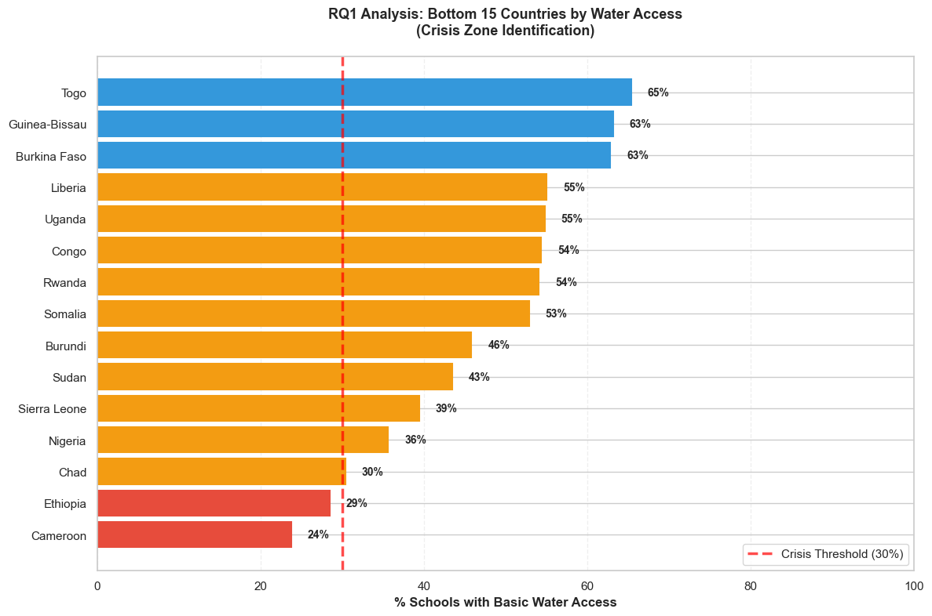
RQ1: Where is the water-access crisis concentrated?
Bottom 15 African countries by % schools with basic water access
Analysis + Why
• Cameroon (24%), Ethiopia (29%), Chad (30%) and Nigeria (36%) define the crisis cluster. And crisis is concentrated in West and Central Africa; North African states do not appear in the bottom group.
• Why: Access to safe drinking water is the foundation of WASH. Without it:
- Students cannot drink safely during school hours
- Teachers cannot prepare food safely
- Disease prevention is impossible
- All other WASH initiatives fail
Source: WHO/UNICEF Joint Monitoring Programme (JMP), 2024.

Slide 6
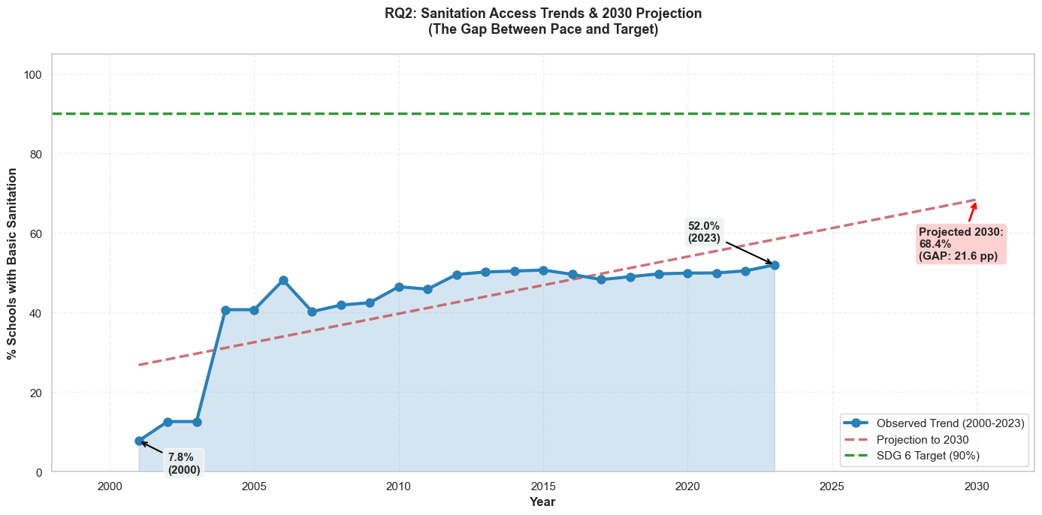
RQ2: Is sanitation progress fast enough?
Africa-wide sanitation access trend with projection to 2030
Analysis + Why
• Sanitation access rose from ~7.8% (2000) to 52% (2023) — real progress, but slowing.
• Gains have plateaued since ~2012, growing less than 1 percentage point per year.
• Projection reaches only 68.4% by 2030 — a 21.6 pp gap below the SDG target.
• Why:
Competing Development Priorities
Donor Fatigue and Fragmentation
Maintenance Failure
Rural –Urban divide
Source: WHO/UNICEF Joint Monitoring Programme (JMP), 2024.

Slide 7
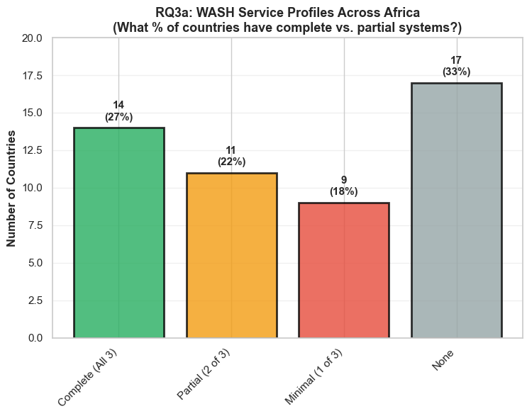
RQ3: How complete are national WASH systems?
WASH service profile distribution, by completeness category
Analysis + Why
• 27% of countries have complete WASH systems; 33% have no complete school WASH system.
• Why:
Infrastructure is built in phases ,not integrated
Each component has different maintenance requirements
The skill gap
Donor preferences

Slide 8
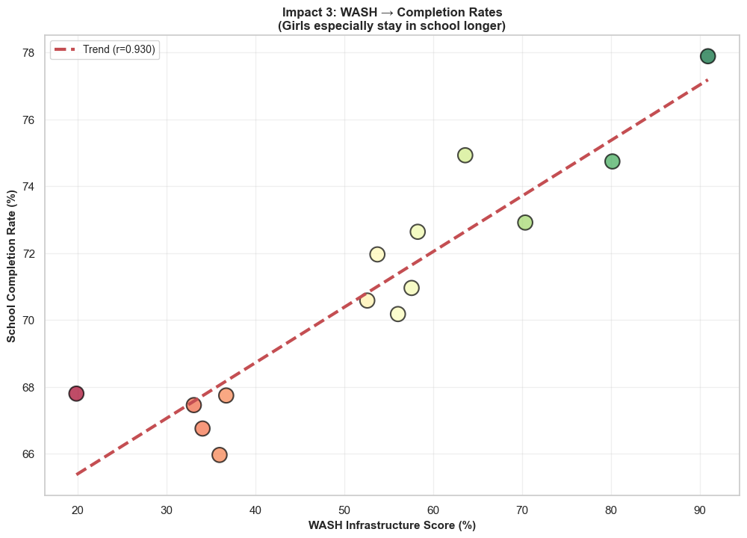
RQ4: WASH Infrastructure & Education Outcomes
Focus on Completion Rates (r = 0.66)
Better Health + Better Grades – Child stays motivated – Completes School
Primary Reason for drop out - repeated school failure
Secondary Reason – Menstruation related stigma for girls + absence
Students who miss 30+ days /year are 40% likely to dropout and students with poor grades lose motivation
How WASH Prevents dropout:
There is improved attendance
Better grades – increased motivation and confidence
Menstruation hygiene facilities – girls stay in school
Cumulative effect : completion rate improves by 15- 20% points
Analysis + Why

Slide 9
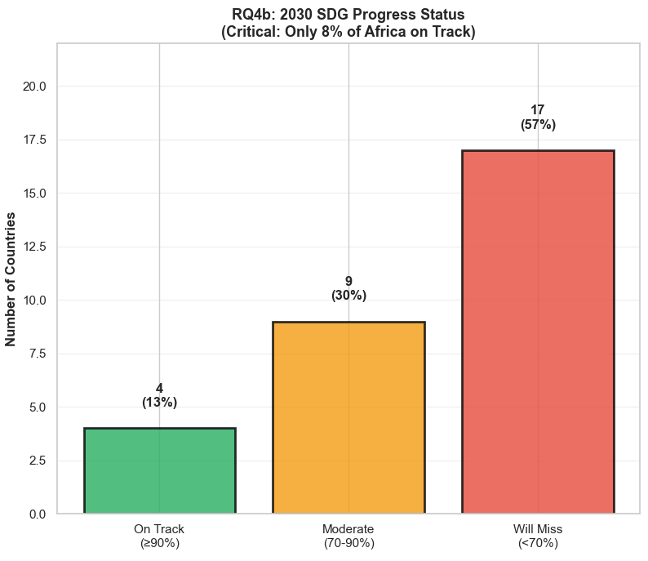
RQ5: Who will meet the 2030 SDG 6 target?
2030 SDG 6 progress status, by country category
Analysis + Why
• 4 countries are on track; 9 are moderate; 17 countries (57%) will miss the 2030 target.
• Why 57 % of the countries will miss the 2030 target:
The commitment – execution gap
The poverty trap dynamic
Donor unpredictability
Implementation capacity constrains

Slide 10
Key Takeaways
Crisis zones
WASH acts as a system
Cameroon, Ethiopia, Chad, Nigeria and Sierra Leone remain below urgent water-access thresholds.
National WASH profiles show incomplete systems, so isolated interventions are not enough.
Progress has plateaued
SDG 6 is at risk
Sanitation gains slowed after 2012; current pace projects only ~68% access by 2030.
Only 13% of countries are on track for 2030 without accelerated investment.
Source: WHO/UNICEF JMP, 2024.

Slide 11
Recommendations
Crisis zones
Priority 2
Break the post-2015 plateau with new delivery models
Sanitation gains collapsed from +32.9 pp (2000–2005) to +1.3 pp (2015–2023). Traditional construction-led approaches have hit diminishing returns; scale community-managed O&M, results-based financing, and school-cluster contracts to reach the harder-to-serve schools
Priority 1
Concentrate investment on the 12 sub-60% countries
12 of 51 countries — including Cameroon (23.7%), Ethiopia, Chad and Nigeria — sit below 60% basic water coverage. Ring-fence donor and national budgets for these states; a uniform per-country allocation will not close a 69-pp gap.
Accountability
Publish a country WASH scorecard every year
17 of 30 analysed countries (57%) are off-track for the 90% SDG target by 2030 — and 4 have negative trends (Cameroon, Uganda, Liberia, Algeria). An annual public scorecard tied to JMP data would create the political pressure currently missing
Source: WHO/UNICEF JMP, 2024.

Slide 12
References
[1] WHO/UNICEF Joint Monitoring Programme for Water Supply, Sanitation and Hygiene (JMP). (2024). Progress on drinking water, sanitation and hygiene in schools 2000–2023. Geneva: WHO & UNICEF. https://washdata.org
[2] United Nations. (2015). Transforming our world: The 2030 Agenda for Sustainable Development (SDG 6: Clean Water and Sanitation). New York: UN General Assembly.
[3] UNICEF. (2023). Water, Sanitation and Hygiene (WASH) in Schools. New York: UNICEF.
[4] UNESCO Institute for Statistics. (2023). Education and WASH indicators database. Montreal: UIS.
[5] WHO. (2022). State of the world's drinking water: An urgent call to action to accelerate progress on ensuring safe drinking water for all. Geneva: World Health Organization.

