Slide 1
square2x2
J
L
longT
T
Z
row2
row3
row4
tonfaT
tonfaT2

Slide 3
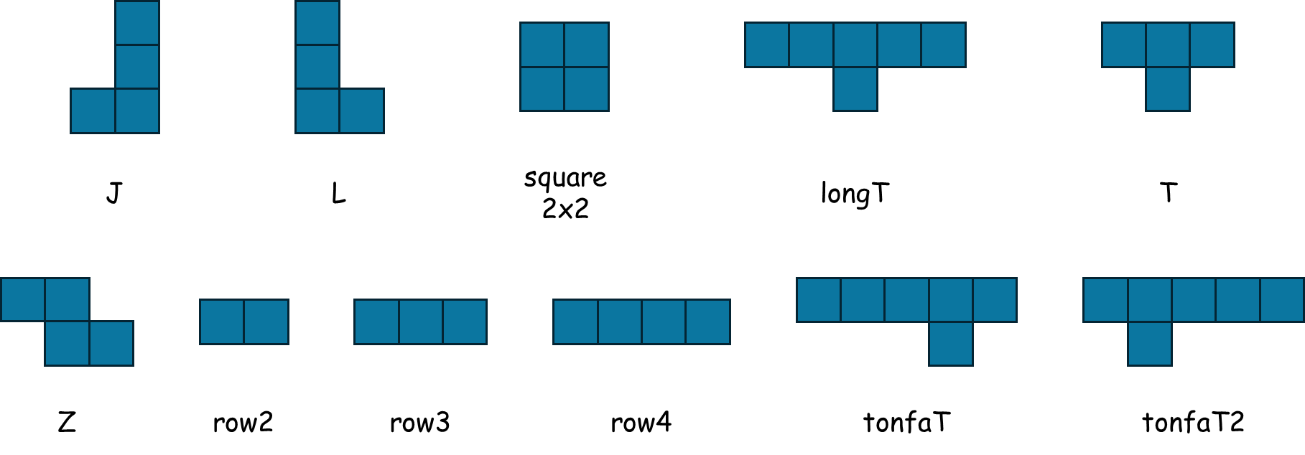
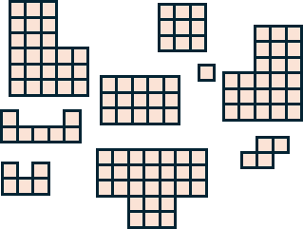
special

Slide 4
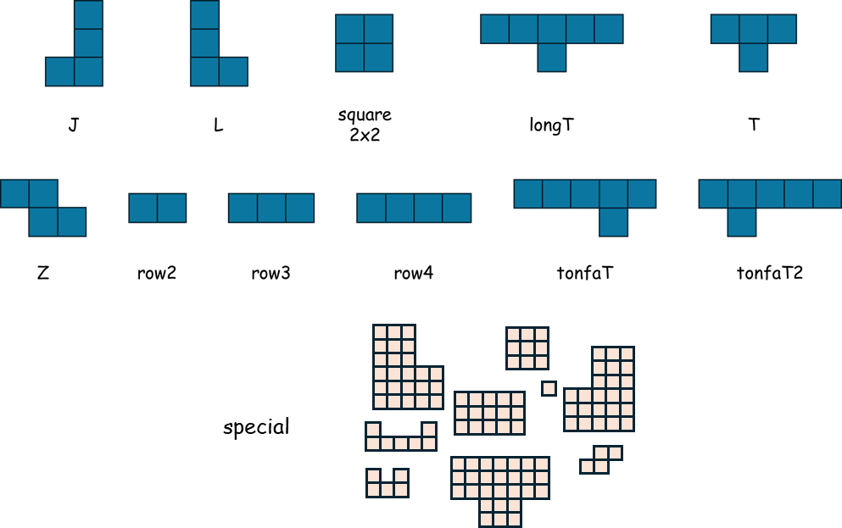

Slide 6


