Slide 1
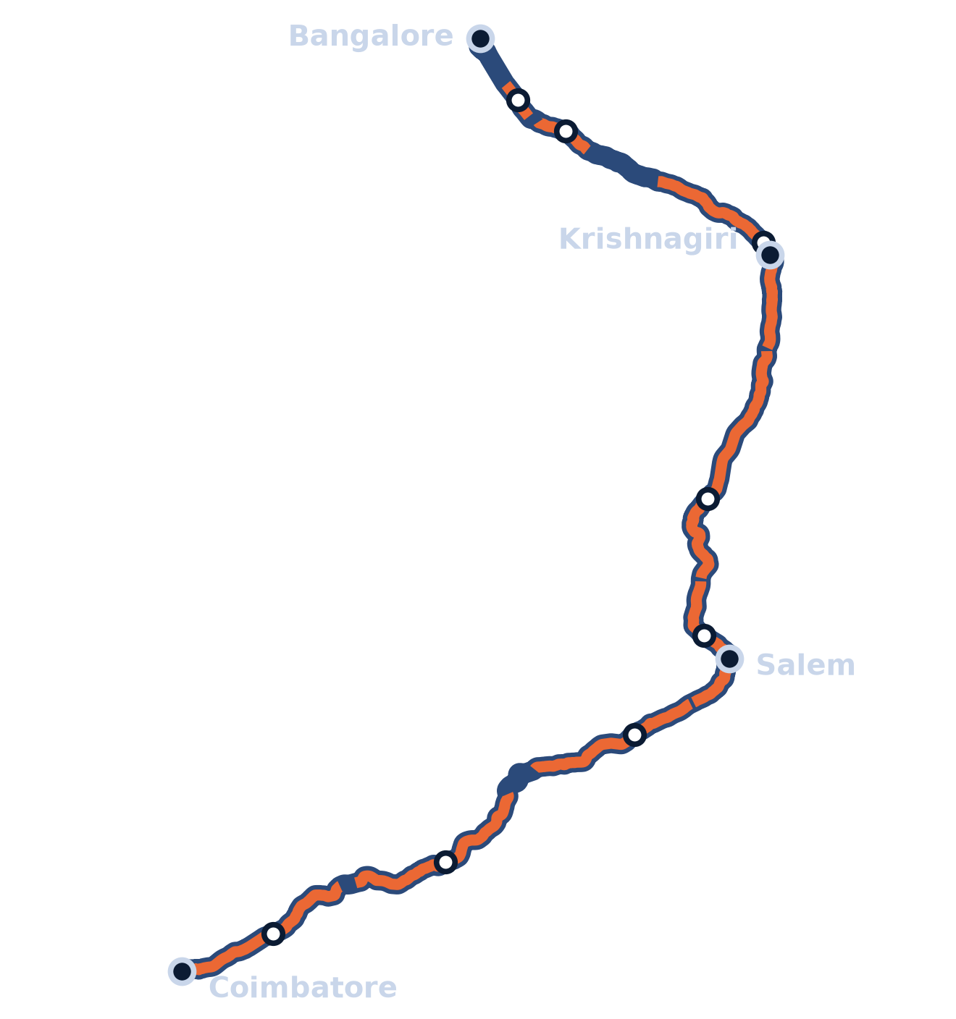

PYTHON · SIMPY · SATELLITE TOLLING
GPS Toll-Based System Simulation
Pay only for the kilometres you drive: distance-based tolling on the Coimbatore → Bangalore highway
362 km
8
−24%
real road route
real toll plazas
toll for a car
github.com/Kes2003/gps-toll-system
Notes:
Good morning. Our project is a GPS toll-based system simulation. Today, highway tolls in India are charged at plazas: you pay a fixed fee at each plaza you pass, however much of the road you use. We simulate the alternative the government is moving towards: satellite-based, distance-based tolling, where your GPS track decides the toll. We built it on the real 362 km Coimbatore to Bangalore highway, with its 8 real toll plazas and their published fees.

Slide 2



THE PROBLEM
Plaza tolls charge the full fee, however far you drive
One fixed fee per plaza
EXAMPLE TRIP
Each plaza charges a single fee for its whole section, 10 to 86 km on this route, even if you drive only part of it.
Krishnagiri → Hosur by car
₹95
Distance isn't measured
What you pay depends on which plazas you pass, not on the kilometres you actually use.
FASTag: the plaza's full fee
₹22
Short trips pay the most per km
A local trip through one plaza pays exactly what a long-distance trip through that section pays.
GNSS: 51 km actually driven
Simulated with NHAI's published fees and the 20 km free rule.
GPS Toll-Based System Simulation
2 / 17
Notes:
Here is the problem. A toll plaza charges one fixed fee for a whole section of highway, between 10 and 86 km on our route. The fee doesn't depend on how much of that section you drive. For example, a car going from Krishnagiri to Hosur, 51 km, pays the full 95 rupee fee at the Krishnagiri plaza. Charged by distance, with the first 20 km free, the same trip costs about 22 rupees.

Slide 3

PROJECT OBJECTIVES
Every requirement in the brief, delivered
01
02
03
04
Define toll zones
Register entry and exit
Calculate distance and toll
Display the path
Each real plaza's tollable length becomes a toll zone on the 362 km route.
GPS fixes are snapped to the road; zone entry and exit are logged with time and km.
Km in each zone × that plaza's rate, with the 20 km free rule and a FASTag comparison.
Route and traffic charts, toll by plaza, and an interactive map of every GPS track.
Delivered
Delivered
Delivered
Delivered
BEYOND THE BRIEF
Multi-vehicle traffic
GPS noise and varying speed
Real NHAI toll fees
SQLite trip history
66 automated tests
GPS Toll-Based System Simulation
3 / 17
Notes:
Our brief had four requirements: define toll zones, register where the vehicle enters and leaves them, calculate the distance and the toll, and display the vehicle's path. All four are delivered, and we went further: many vehicles at once, realistic GPS error and speed, real NHAI fees, a trip history database, and 66 automated tests.

Slide 4




OUR SOLUTION
Satellite-based tolling, simulated end to end
Instead of charging at plazas, the vehicle's GPS track decides the toll.
Track
Detect
Charge
Record
A GPS fix every 10 seconds, with realistic error, snapped back onto the road.
Entry into and exit from each toll zone, registered from the vehicle's position.
Kilometres in each zone × that plaza's own per-km rate. The first 20 km a day are free.
An itemised receipt, the FASTag cost for comparison, and a SQLite trip history.
Modelled on India's National Highways Fee Amendment Rules, 2024, which allow GNSS-based toll collection.
GPS Toll-Based System Simulation
4 / 17
Notes:
Our solution simulates satellite-based tolling from start to finish. First, track: the vehicle reports a GPS fix every 10 seconds. Second, detect: we register when it enters and leaves each toll zone. Third, charge: it pays for the kilometres it drove in each zone, at that plaza's own rate, with the first 20 km free as the 2024 rules allow. Fourth, record: an itemised receipt, the FASTag comparison, and a permanent trip history.

Slide 5



HOW IT WORKS
From GPS fix to toll receipt
STEP 1
STEP 2
STEP 3
STEP 4
STEP 5
STEP 6
Depart
Drive
GPS fix
Map-match
Detect zones
Bill and save
Your vehicle and random traffic leave their towns.
Speed drifts around each vehicle's cruising speed.
Every 10 s, with about 5 m of random error.
Each fix is snapped to the nearest point on the road.
Crossing a zone boundary logs an entry or exit.
Receipt issued and the trip saved to SQLite.
TOLL FORMULA
Toll = Σ (km driven in zone × plaza fee ÷ tollable length) − first 20 km free
GPS Toll-Based System Simulation
5 / 17
Notes:
This is the pipeline for every vehicle, running in a SimPy discrete-event simulation. Vehicles depart from their towns and drive at a speed that drifts naturally. Every 10 seconds we take a GPS fix with a few metres of random error, and snap it back onto the road, which is called map-matching. When the matched position crosses a zone boundary we log an entry or an exit. At the destination the bill is calculated with this formula, a receipt is issued, and the trip is saved.

Slide 6
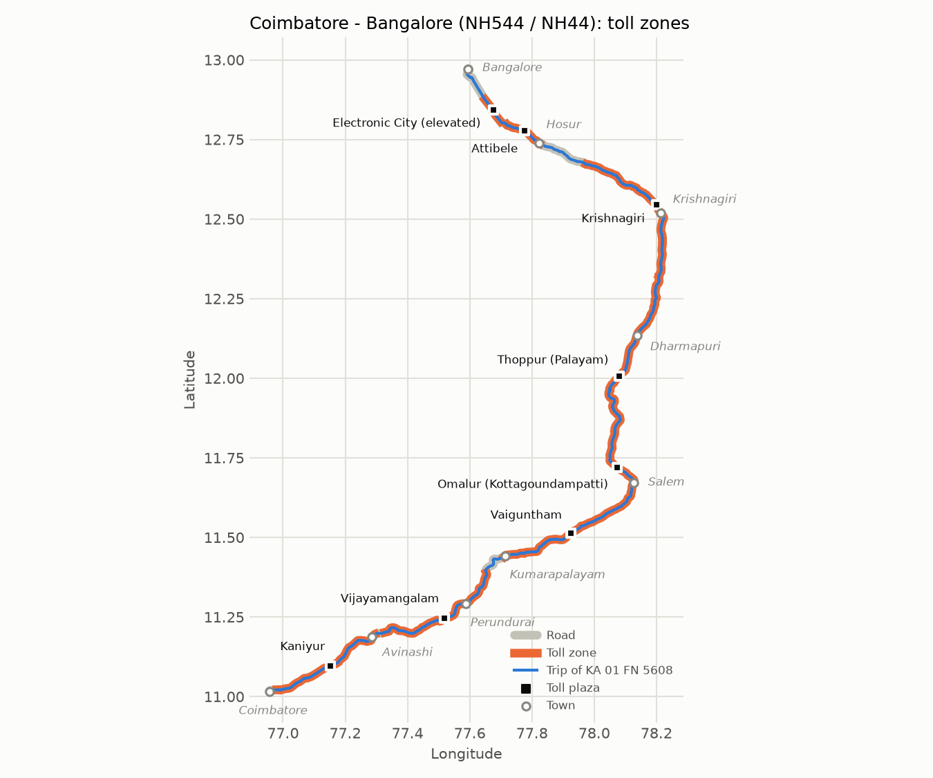
REAL DATA
A real 362 km corridor with 8 toll plazas
Toll plaza | Zone (km) | Car fee | ₹ / km
Kaniyur | 2.6 – 45.3 | ₹125 | 2.93
Vijayamangalam | 48.3 – 96.8 | ₹65 | 1.34
Vaiguntham | 106.3 – 148.6 | ₹75 | 1.40
Omalur | 148.6 – 186.1 | ₹95 | 1.38
Thoppur | 186.1 – 248.5 | ₹160 | 1.86
Krishnagiri | 248.5 – 304.6 | ₹95 | 1.59
Attibele | 322.3 – 336.7 | ₹35 | 2.43
Electronic City | 338.5 – 348.5 | ₹60 | 6.00
Road geometry and plaza positions from OpenStreetMap. Fees and tollable lengths from NHAI's Toll Information System.
GPS Toll-Based System Simulation
6 / 17
Notes:
We didn't use a straight line. The route is the real road from OpenStreetMap: NH544 to Salem, then NH44 through Dharmapuri, Krishnagiri and Hosur, 362 km in total. There are 8 real toll plazas on it, with their published NHAI fees. Each plaza's tollable length becomes an orange toll zone on the map, and its per-km rate is simply its fee divided by that length. Rates range from 1.34 rupees per km to 6 rupees on the Electronic City elevated road.

Slide 7


WORKED EXAMPLE
A car from Coimbatore to Bangalore pays 24% less
₹542.63
GNSS toll: 313.8 km in toll zones
₹710
FASTag: full fee at all 8 plazas
First 20 km a day free
NH Fee Amendment Rules, 2024
No free km for National Permit trucks
3-axle and larger goods vehicles
GPS Toll-Based System Simulation
7 / 17
Notes:
Here is a real example from the simulation: a car driving the whole route. In blue is what it pays with distance-based tolling, in orange what it pays at FASTag plazas today. Where the car drives a plaza's whole section, the two match, as at Attibele and Electronic City. Where zones overlap or the first 20 free kilometres apply, GNSS is cheaper. In total the car pays 542 rupees instead of 710, which is 24% less.

Slide 8
INSIGHT
Short trips see the biggest difference
UP TO
77%
less toll on short trips
Krishnagiri → Hosur by car: ₹22 instead of ₹95. You pay for the 51 km you drive, not for the plaza's whole section.
Salem → Dharmapuri: ₹77 instead of ₹255.
GPS Toll-Based System Simulation
8 / 17
Notes:
The biggest difference is on short trips. Local drivers crossing one plaza pay its full fee today. With distance-based tolling they pay only for what they drive, and the first 20 km are free. Krishnagiri to Hosur drops from 95 rupees to 22, Salem to Dharmapuri from 255 to 77. That is up to 77% less.

Slide 9
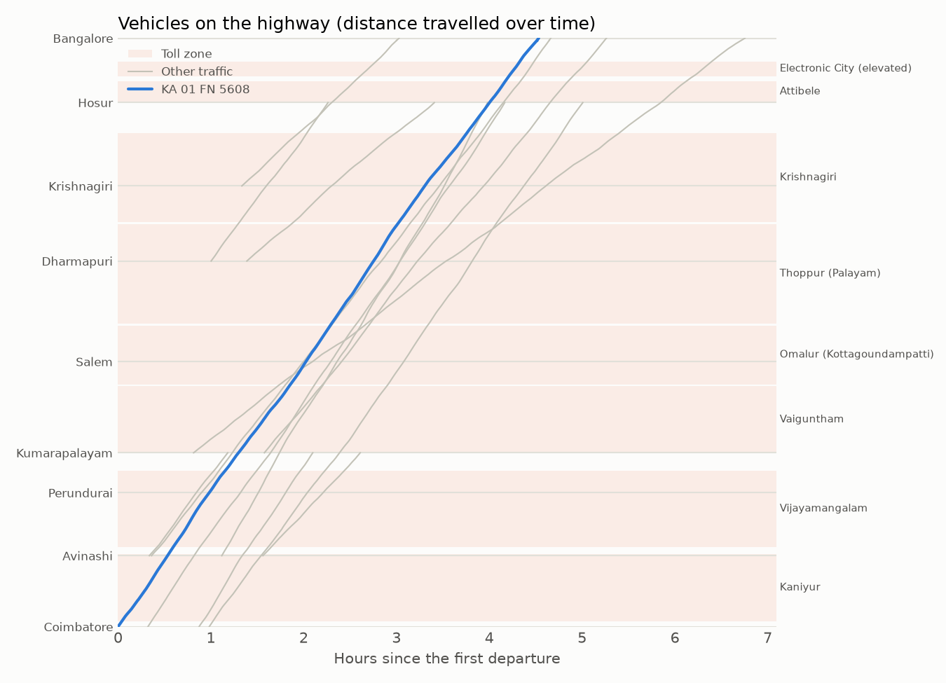

FLEET SIMULATION
Many vehicles on the highway at once
TRAFFIC MIX
Speed drifts ±10% around each vehicle's cruising speed
About 5 m of GPS error, corrected by map-matching
Departures spread over two hours, from 9 towns
GPS Toll-Based System Simulation
9 / 17
Notes:
Real highways carry mixed traffic, so we simulate many vehicles at once. Each line in this time-distance chart is one vehicle: its slope is its speed, and the shaded bands are the toll zones. Traffic follows a realistic mix, 55% cars with LCVs, buses and trucks, joining and leaving at 9 towns. Speeds drift naturally, and GPS fixes carry a few metres of error that map-matching corrects.

Slide 10
RESULTS
200 vehicles, 31,663 km: 23% less toll overall
₹1,18,247
GNSS tolls for all 200 vehicles
₹1,53,525
FASTag plaza fees for the same trips
165 of 200
vehicles pay less with GNSS
Heavy goods vehicles hold National Permits, so they get no free 20 km and save about 15%.
GPS Toll-Based System Simulation
10 / 17
Notes:
We ran 200 vehicles with a fixed random seed: 31,663 km of driving. Distance-based tolls came to 1.18 lakh rupees against 1.54 lakh at FASTag plazas, 23% less, and 165 of the 200 vehicles paid less. On the right, the full route by vehicle class: cars, LCVs and buses save about 24%. Heavy trucks save about 15%, because National Permit vehicles don't get the free 20 km.

Slide 11
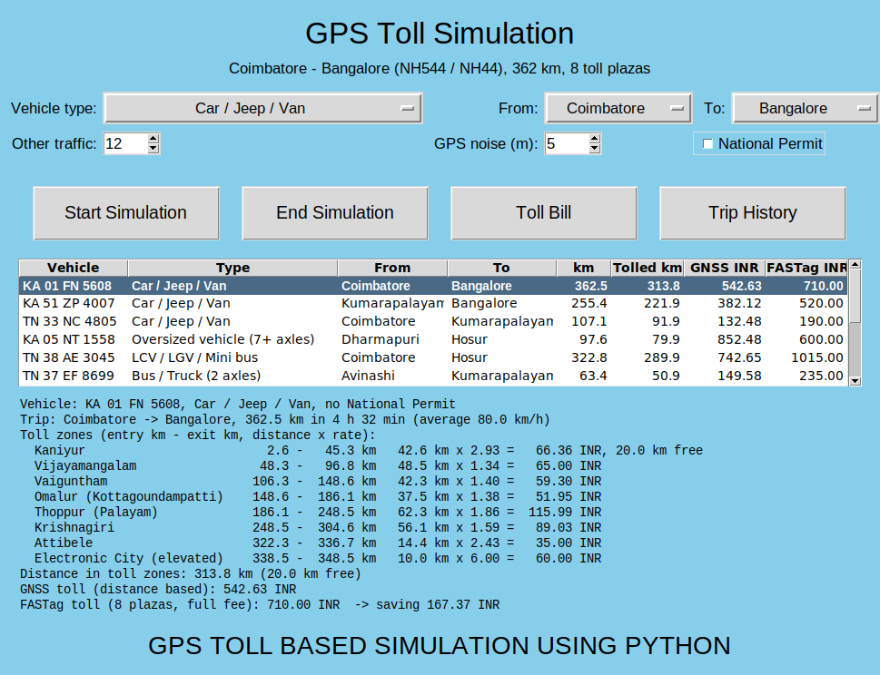





THE APPLICATION
A desktop app and a command-line tool
Tkinter GUI
Choose vehicle, towns, traffic and GPS noise; see every vehicle in one table.
Command line
python main.py --cli --traffic 20 for scripted, repeatable runs.
Charts
Route and toll zones, time-distance traffic, and toll by plaza.
Interactive map
Every GPS track, zone entries and exits, and each plaza's fee table.
Receipts and history
Itemised receipts, with every trip stored in SQLite.
GPS Toll-Based System Simulation
11 / 17
Notes:
The project runs as a desktop app or from the command line. In the app you choose the vehicle type, the towns, how much other traffic to add and the GPS error, then press Start. Every vehicle appears in the results table. Selecting one shows its itemised toll, its charts, the interactive map and its receipt. Every trip is saved to the database automatically.

Slide 12
ARCHITECTURE
Four clear layers, one job per module
main.py
Command line
gui.py
Tkinter desktop app
Interfaces
How users run it
visualization.py
Matplotlib charts, Folium map
billing.py
Itemised receipts
storage.py
SQLite trip history
Output
What users see
simulation.py
SimPy fleet, speed, GPS
tolling.py
Toll zones and bill
models.py
Route, map-matching
rates.py
Vehicle classes
Core
The simulation
route.json
OpenStreetMap road
toll_plazas.json
NHAI fees and lengths
trips.db
Saved trips and charges
Data
Real inputs and records
GPS Toll-Based System Simulation
12 / 17
Notes:
The code is organised in four layers. Interfaces: the command line and the Tkinter app. Output: charts and map, receipts, and the SQLite history. Core: the SimPy simulation, the toll zone and billing logic, the route model with map-matching, and the vehicle classes. Data: the real route and plaza files, plus the trip database. Each module has one job, which kept it easy to test.

Slide 13





TECHNOLOGY
Built with proven open-source tools
Python 3.9+
SimPy
Geopy
Language; tested on 3.11 and 3.12
Discrete-event simulation of every vehicle
Geodesic distances along the road
Matplotlib
Folium
SQLite
Route, traffic and toll charts
Interactive Leaflet map in the browser
Trip and toll charge history
Tkinter
pytest
OpenStreetMap
Desktop user interface
66 automated tests
Real road (via OSRM) and plaza positions
GPS Toll-Based System Simulation
13 / 17
Notes:
Everything is built with open-source Python tools: SimPy for the simulation, Geopy for distances, Matplotlib and Folium for charts and the map, SQLite for the history, Tkinter for the interface and pytest for testing. The road data comes from OpenStreetMap through the OSRM routing engine.

Slide 14

CREDIBILITY
Real data, verified by tests
DATA SOURCES
66
OpenStreetMap + OSRM
Road geometry, towns and toll booth positions (ODbL licence).
automated tests, all passing
NHAI Toll Information System
Map-matching and the real route data
Fees for 6 vehicle classes and the tollable length of all 8 plazas.
Toll zones, 20 km rule and National Permits
NH Fee Rules, 2008
Noisy and noise-free GPS bill the same
Vehicle classes and base per-km rates.
Fleets, partial trips, receipts and SQLite
NH Fee Amendment Rules, 2024
Charts, map and command line
GNSS tolling with the first 20 km a day free.
GPS Toll-Based System Simulation
14 / 17
Notes:
Two things make these results trustworthy. The data is real: OpenStreetMap for the road, NHAI's published fees for every plaza, and the actual fee rules including the 2024 amendment. And the code is tested: 66 automated tests, including a check that noisy GPS produces the same bill as perfect GPS.

Slide 15

TEAM
Team members and contributions
Team Member 1
Team Member 2
Team Member 3
Team Member 4
Project lead · Simulation
GPS · Route data
Database · Billing
Frontend · GUI
SimPy fleet simulation, toll zone logic and integration.
OpenStreetMap route, map-matching and distance calculation.
SQLite trip history, receipts and NHAI fee data.
Tkinter app, charts and the interactive map.
GPS Toll-Based System Simulation
15 / 17
Notes:
Each team member introduces their own part here. Replace 'Team Member 1' to 4 with your names before presenting.

Slide 16

WHAT'S NEXT
Limitations and roadmap
TODAY
NEXT STEP
One direction: Coimbatore → Bangalore
Reverse the route for return trips
Toll zones centred on each plaza
Use official section start and end chainages
20 km free applied per trip
Track the free allowance per vehicle per day
Fees are a 2025–26 snapshot
Refresh fees from NHAI every year
No congestion or GPS signal loss
Add traffic density and GPS outages
GPS Toll-Based System Simulation
16 / 17
Notes:
Like any simulation, ours has limits, and each has a clear next step. Vehicles only drive towards Bangalore; the return direction is the obvious next step. Zones are centred on each plaza because official section boundaries aren't published in the data we used. The free 20 km is applied per trip rather than per day. Fees are a snapshot that NHAI revises yearly. And there is no congestion model yet.

Slide 17
CONCLUSION
Pay for the road you actually use
24%
77%
8
less toll for a car driving the full 362 km route
less on short trips such as Krishnagiri → Hosur
real plazas with real fees, on a real road
Thank you
Questions?
github.com/Kes2003/gps-toll-system
GPS Toll-Based System Simulation
17 / 17
Notes:
To conclude: distance-based tolling charges drivers for the road they actually use. In our simulation of the real Coimbatore to Bangalore highway, a car pays 24% less for the full route, and short local trips pay up to 77% less. Everything is built on real roads, real plazas and real fees, and the code is on GitHub. Thank you, we're happy to take questions.

